Slide 1
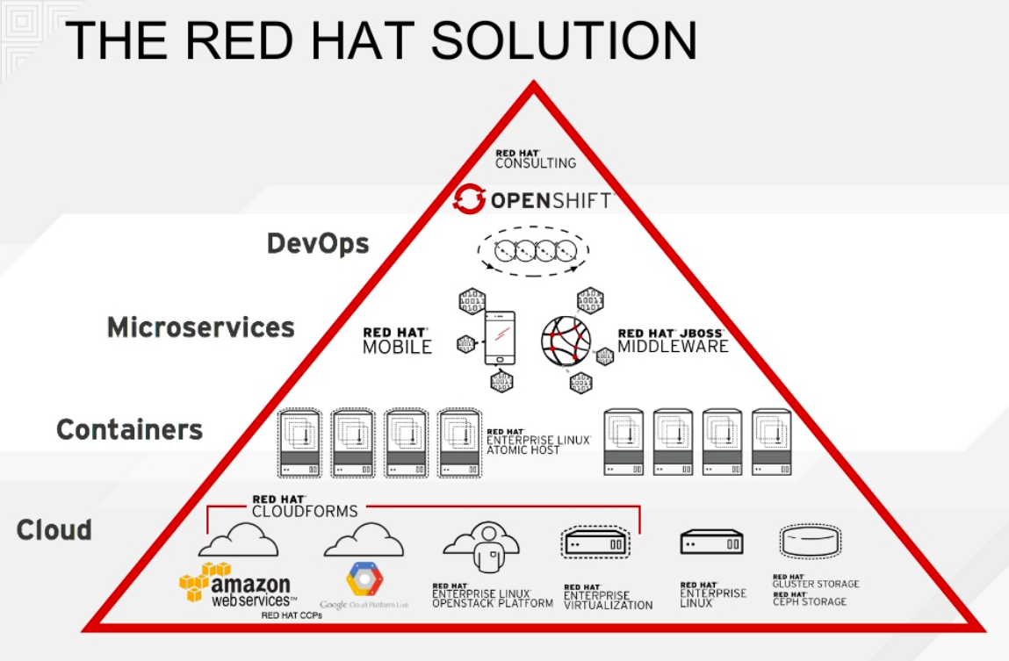

Slide 2
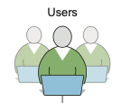


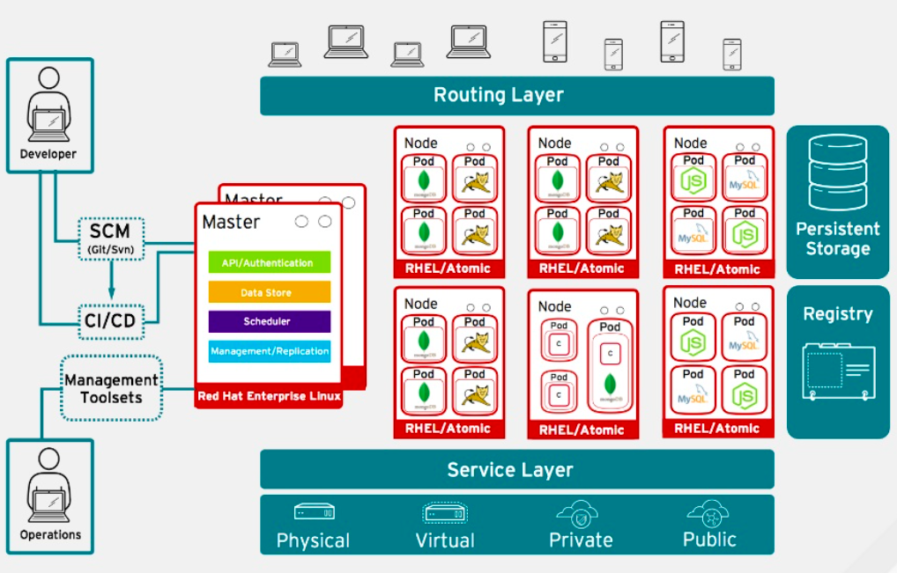





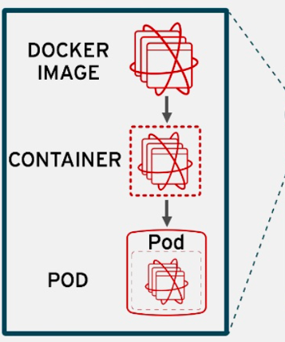
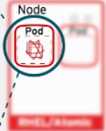



Routing Layer – provides easy DNS access and a consistent endpoint for all application in VPC
Register - provides container images to build and deploy application on the node
Service Layer – encapsulates the application’s business logic and coordinating responses
Eureka Server
Config Server
Single SignOn
ACL
Zuul
Bitbucket
PostgreSQL Database
Image
CONSUL

Slide 3
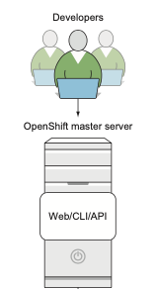
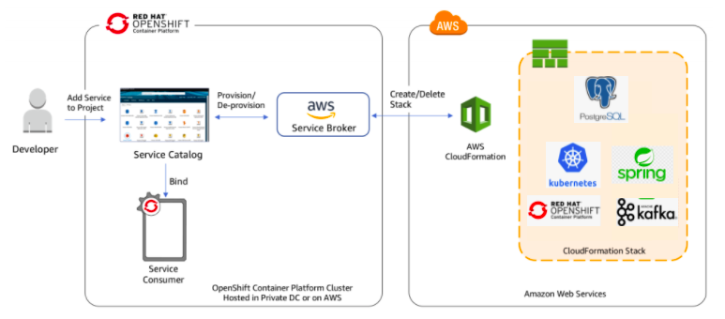
Setting up VPC endpoints for AWS CloudFormation

Slide 4
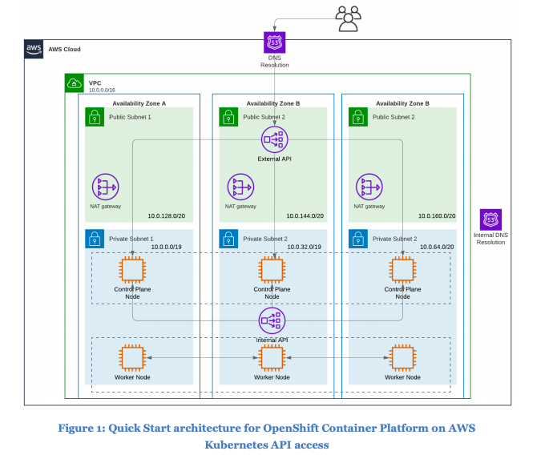
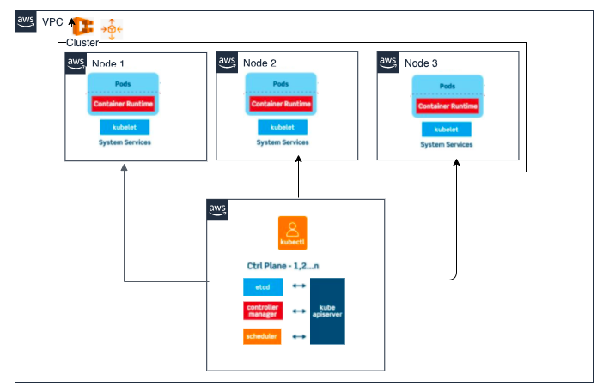
https://aws-quickstart.s3.amazonaws.com/quickstart-redhat-openshift/doc/red-hat-openshift-on-the-aws-cloud.pdf

Slide 5
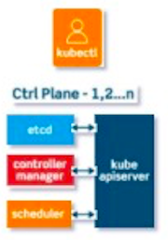
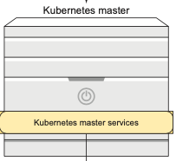
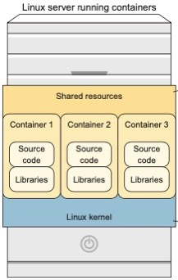
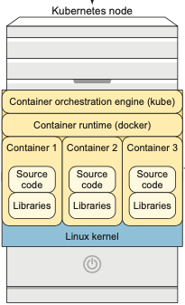
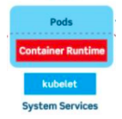
OpenShift uses the Kubernetes master/node architecture as a starting point. From there, it expands to provide additional services that a good application platform needs to include out of the box.

Slide 6
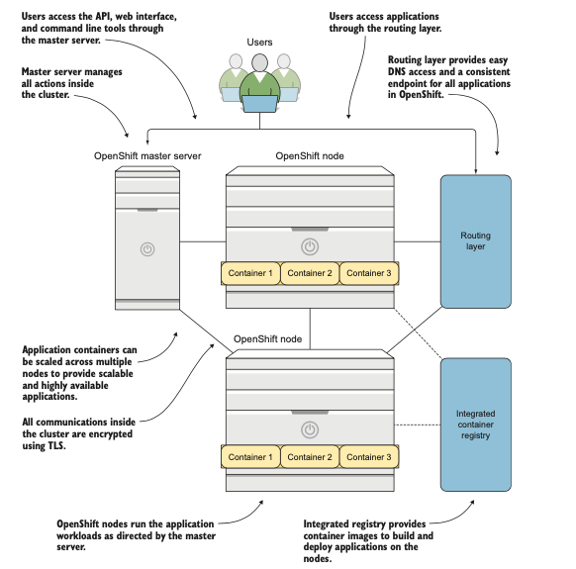

Slide 7
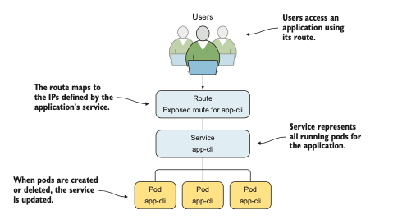

Slide 8
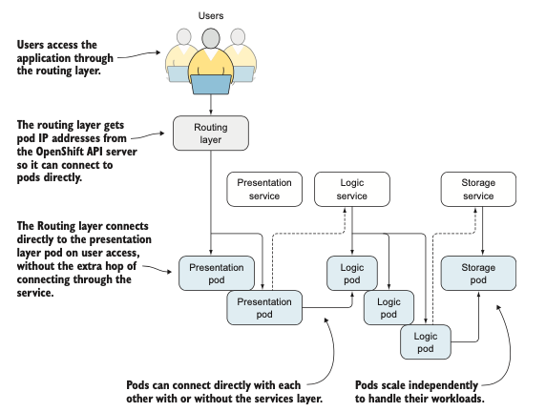

Slide 9
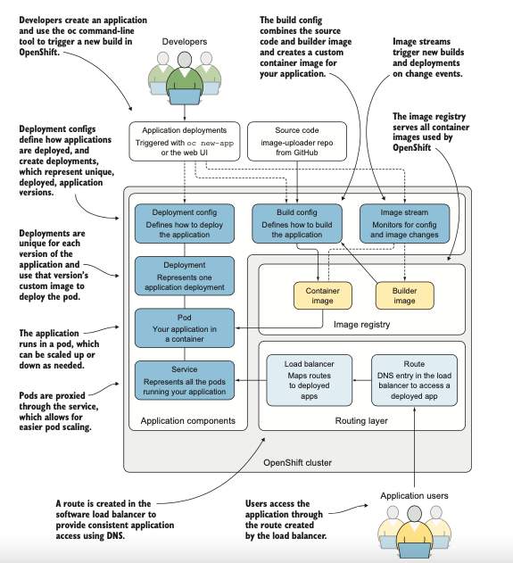

Slide 10
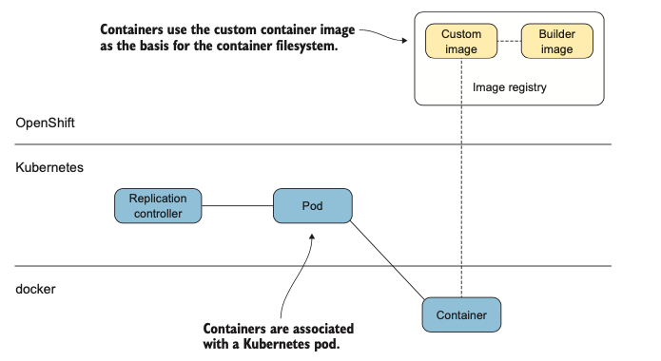
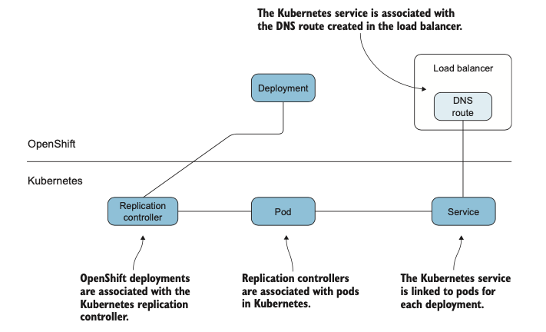

Slide 11
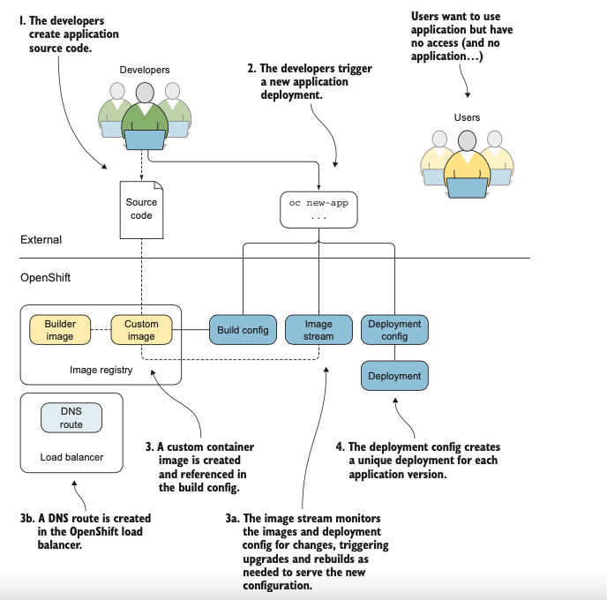

Slide 12
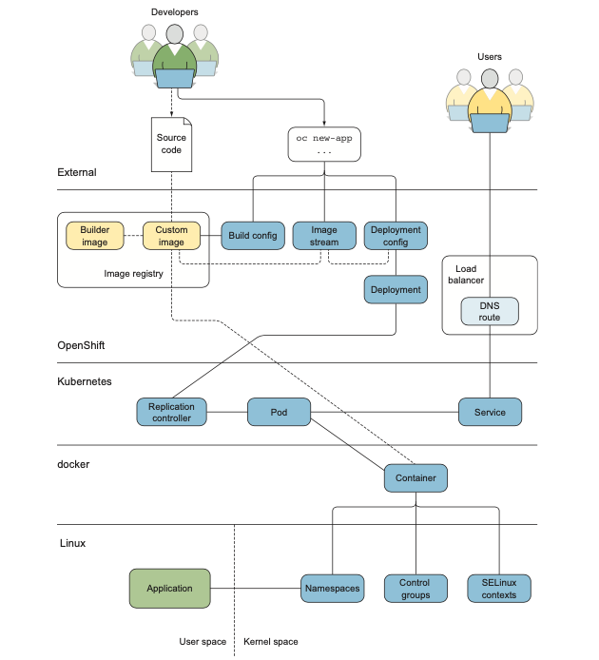

Slide 13
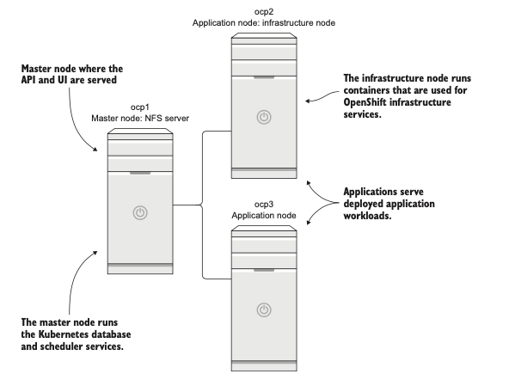

Slide 14
