Slide 1

Future Tech Trends
Daksh Sankhla
December 2022

Slide 2

OUTLINE
Executive Summary
Introduction
Methodology
Results
Visualization – Charts
Dashboard
Discussion
Findings & Implications
Conclusion
Appendix

Slide 3

EXECUTIVE SUMMARY
Trends in Programming Languages
Trends in Databases
Trends in job postings in tech

Slide 4

INTRODUCTION
About: Analyzing the trends in software development
Purpose:
Identify skill requirements for future
What are the top programming languages in demand?
What are the top database skills in demand?
Audience: Human Resource and IT Head

Slide 5

METHODOLOGY
Data Collection Sources
Stack Overflow Developer 2019 Survey
GitHub Job Postings
Programming Languages Annual Salary
Data Exploration
Data Cleaning
Data Visualization
Presentation

Slide 6
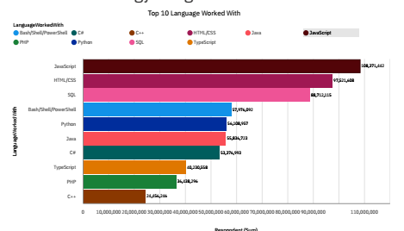
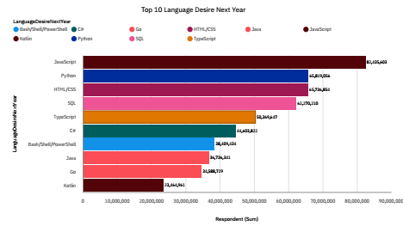
PROGRAMMING LANGUAGE TRENDS
Current Year
Next Year
<Bar chart of top 5 programming languages for the current year goes here.>
< Bar chart of top 5 programming languages for the next year goes here.>

Slide 7
PROGRAMMING LANGUAGE TRENDS - FINDINGS & IMPLICATIONS
Findings
Most people start coding with Web Dev
Low level languages like C are not very popular
SQL is becoming more popular
Implications
Is it important to know Web Dev languages
Python is an important for any developed
SQL and Bid data are growing

Slide 8
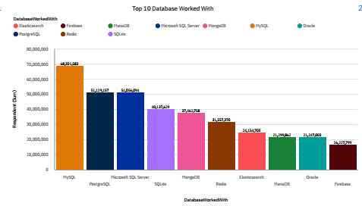
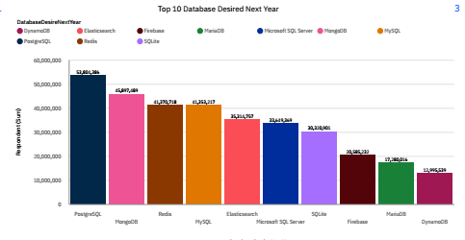
DATABASE TRENDS
Current Year
Next Year

Slide 9
DATABASE TRENDS - FINDINGS & IMPLICATIONS
Findings
MqSql is on top
Postgre and Microsoft sql are competing for second place
MongoDB and redis are fighting for third position
Implications
MqSql is the gateway to SQL
Postgre is still growing and will become more popular
MongoDB and redis will grow more

Slide 10

IBM Cognos DASHBOARD
https://eu1.ca.analytics.ibm.com/bi/?perspective=dashboard&pathRef=.my_folders%2Fcapstone%2Bproject&action=view&mode=dashboard&subView=model000001854e04b305_00000000

Slide 11
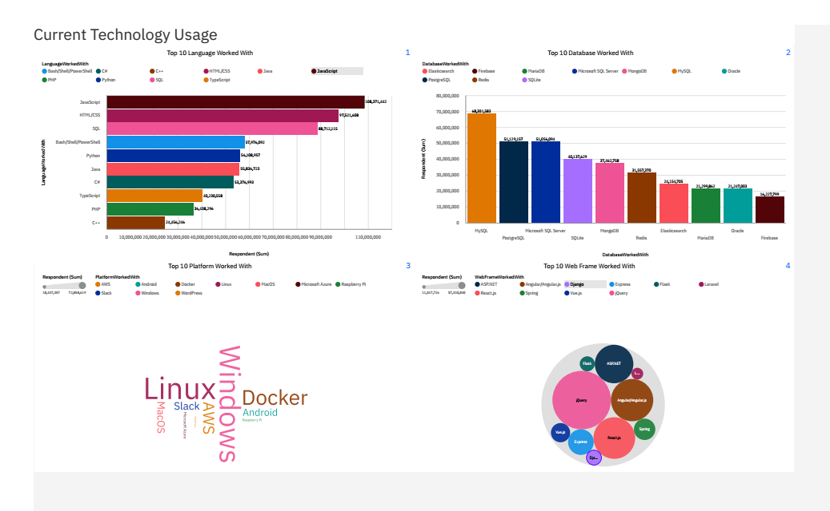
DASHBOARD TAB 1

Slide 12
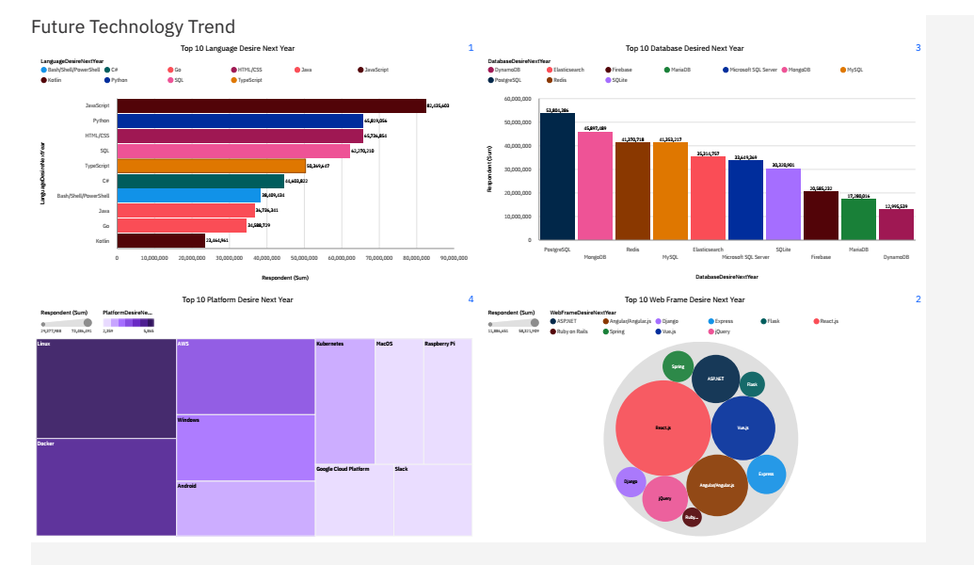
DASHBOARD TAB 2

Slide 13
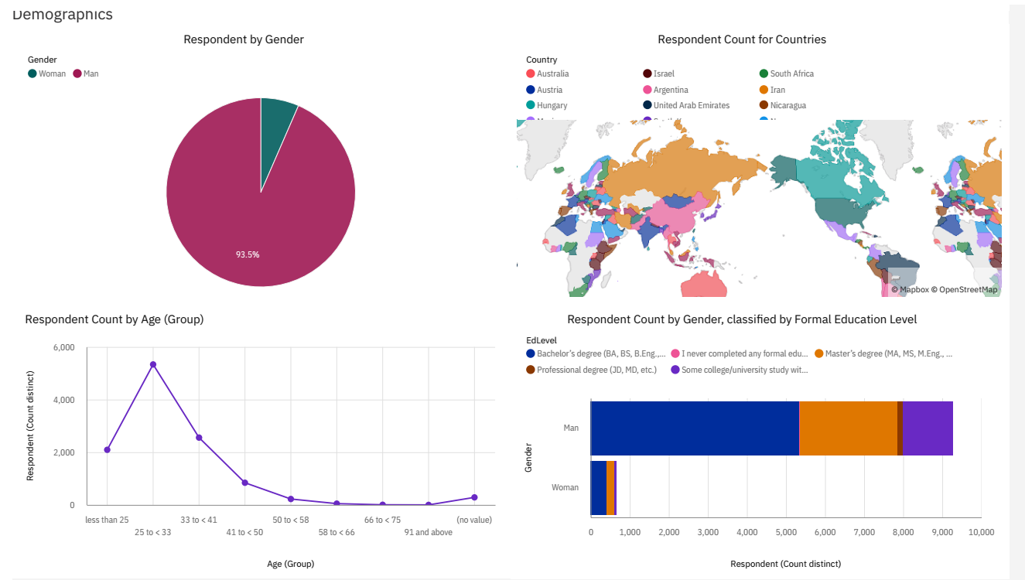
DASHBOARD TAB 3

Slide 14
DISCUSSION
Identify demand for top programming languages
What are the top database skills in demand?
What are the popular IDEs?
Audience: Human Resource and IT Head

Slide 15
OVERALL FINDINGS & IMPLICATIONS
Findings
New alternates to languages/databases are growing
Platforms other than Windows are growing
Large gender gap in tech
Implications
We might see a decline in the number of languages for a specific type
Might see a boom in alternate OS
The gender gap would be hard to over come

Slide 16

CONCLUSION
Web Development is perineal
Need for data analyst is growing
We must equip ourselves with several skills

Slide 17
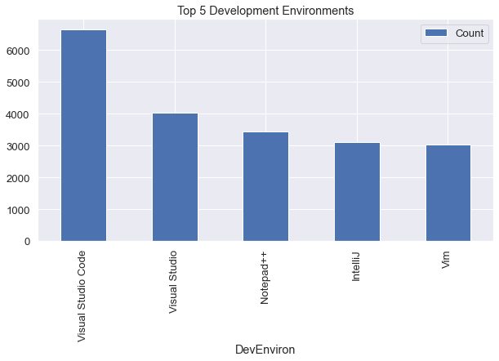

APPENDIX

Slide 18
JOB POSTINGS
In Module 1 you have collected the job posting data using Job API in a file named “job-postings.xlsx”. Present that data using a bar chart here. Order the bar chart in the descending order of the number of job postings.

Slide 19
POPULAR LANGUAGES
In Module 1 you have collected the job postings data using web scraping in a file named “popular-languages.csv”. Present that data using a bar chart here. Order the bar chart in the descending order of salary.

