Slide 1

Digital Diet
Predicting Wellness
Notes:
An analysis into the relationship between digital consumption habits & wellness.

Slide 2
Content
Overview
Data cleaning workflow
High-level demographics
Demographic breakdown
Deeper look (high vs low scorers)
Predictive modelling
Comparative analysis (k-Nearest Neighbors vs Random Forest)
Performance analysis
Insights & Recommendations
Reflections

Slide 3
Overview
Problem Statement
“How do the digital diet habits of participants affect their anxiety levels? What are the best practices of those with positive anxiety scores?”

Slide 4
Overview
Problem Statement
“How do the digital diet habits of participants affect their anxiety levels? What are the best practices of those with positive anxiety scores?”
Setting the scene and Audience
This dataset has been collected as part of an advertising campaign to increase awareness of the impact of digital habits, and encourage positive change.

Slide 5
Overview
Problem Statement
“How do the digital diet habits of participants affect their anxiety levels? What are the best practices of those with positive anxiety scores?”
Setting the scene and Audience
This dataset has been collected as part of an advertising campaign to increase awareness of the impact of digital habits, and encourage positive change.
1998
“internet addiction”
2013
“digital native” (SG 12.2%; 88.4% of total youth)
2020
Distance-based learning, remote/hybrid work
Notes:
In SG (2013), over 12% of the population were digital natives. And over 88% of total youth were digital natives.

Slide 6



Overview
Problem Statement
“How do the digital diet habits of participants affect their anxiety levels? What are the best practices of those with positive anxiety scores?”
Setting the scene and Audience
This dataset has been collected as part of an advertising campaign to increase awareness of the impact of digital habits, and encourage positive change.
Complex needs
Limited resources
Notes:
In this digitized world, we all have complex needs & limited resources. I will address these issues with insights & optimized recommendations.

Slide 7
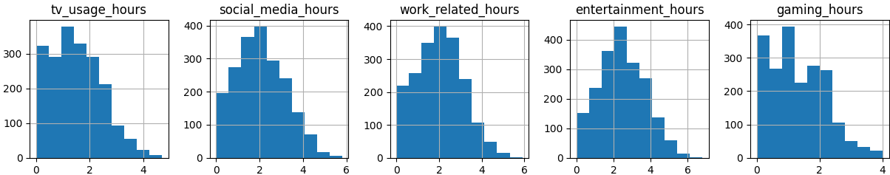
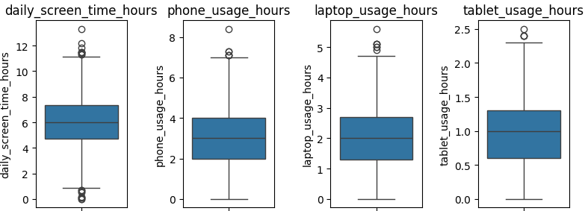
Data cleaning workflow
Dataset was relatively clean (nulls and duplicates).
Several features were skewed by outliers.
After cleaning 1915 rows/unique participants left (of 2000).
Notes:
Decision made to exclude outliers after inspecting histograms, boxplots, quartiles, thresholds.

Slide 8
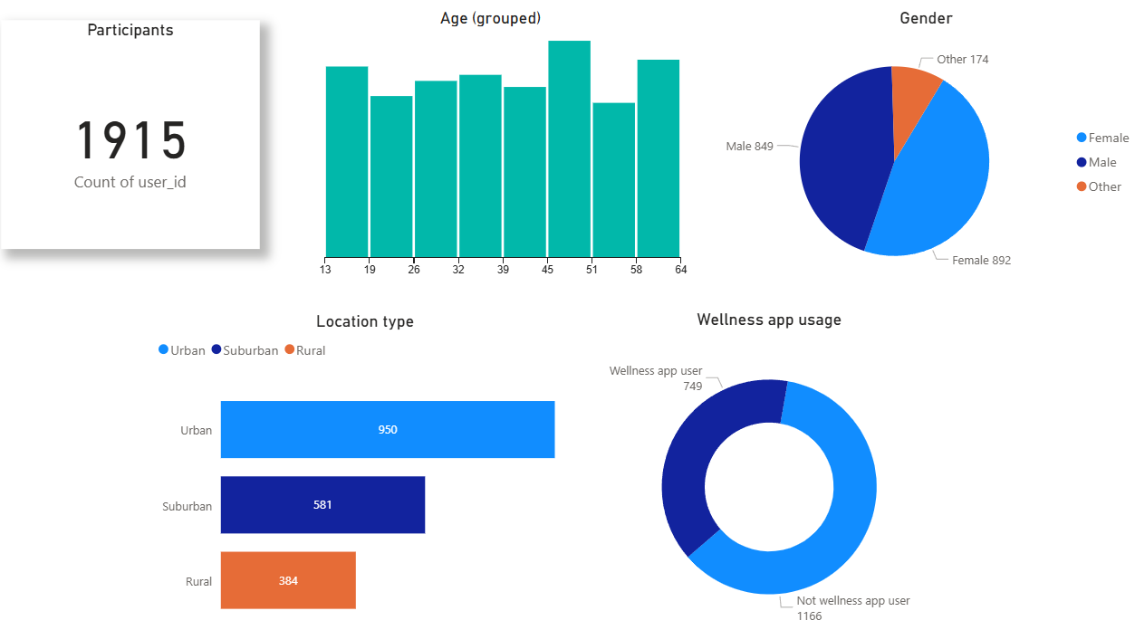
High-level demographics
Power BI Dashboard (page 1 / 4)
Notes:
Demographics-wise, the various categories are quite well-represented. Age is more evenly spread than normally distributed.

Slide 9
Demographic breakdown
Anxiety score is the main metric
It consists of integers from 0-20.
A high score is a good score.
Power BI Dashboard (page 2 / 4)

Slide 10
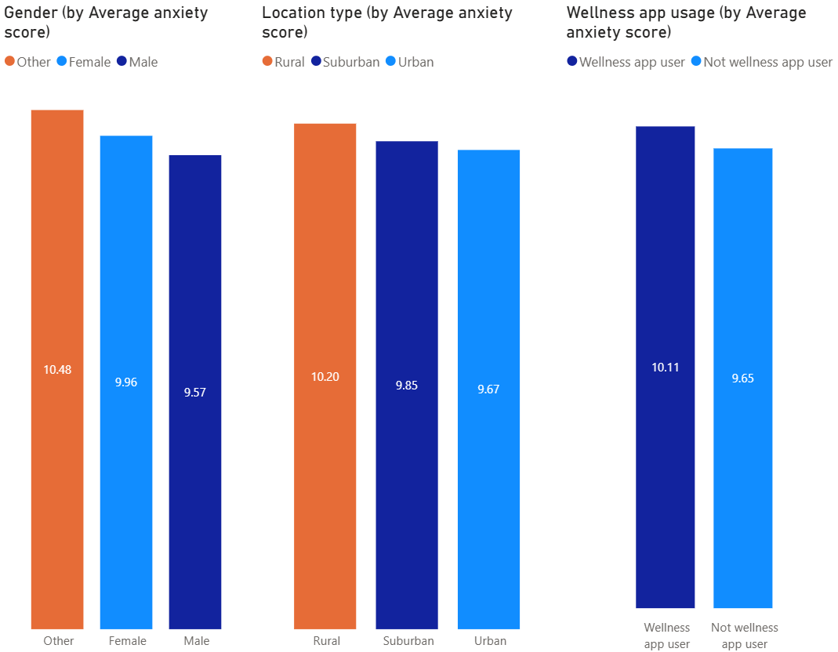
Demographic breakdown
Anxiety score is the main metric
It consists of integers from 0-20.
A high score is a good score.
Power BI Dashboard (page 2 / 4)
Notes:
For gender & locale: Non-binary & rural-located participants scored higher.
Main takeaway: Wellness app users scored higher than non-wellness app users.

Slide 11

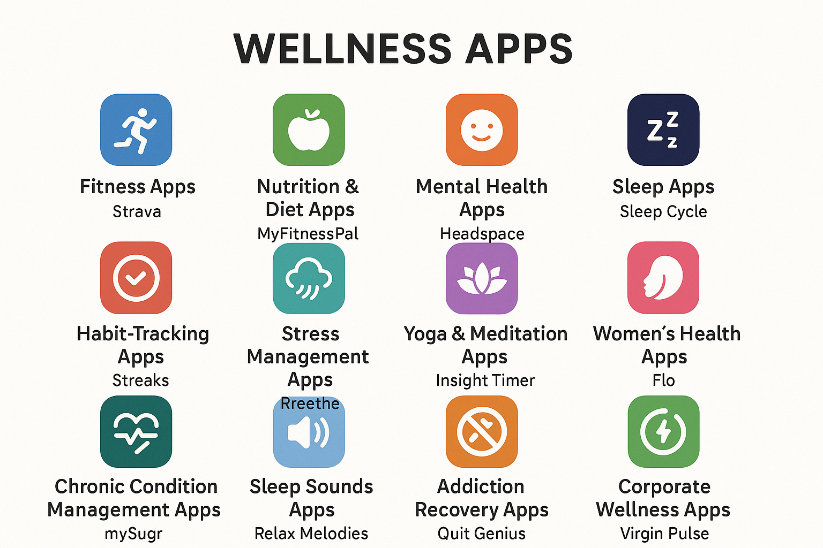
Demographic breakdown
What are Wellness apps?
Notes:
Wellness apps make wellness practices accessible, personalized, & trackable.
Examples include fitness, nutrition, mindfulness, sleep, & wearables.

Slide 12
Deeper look (high vs low scorers)
High scorers: those between 11-20
Comparing the habits of high vs low scorers.
What sets high scorers apart?
Power BI Dashboard (page 3 / 4)

Slide 13
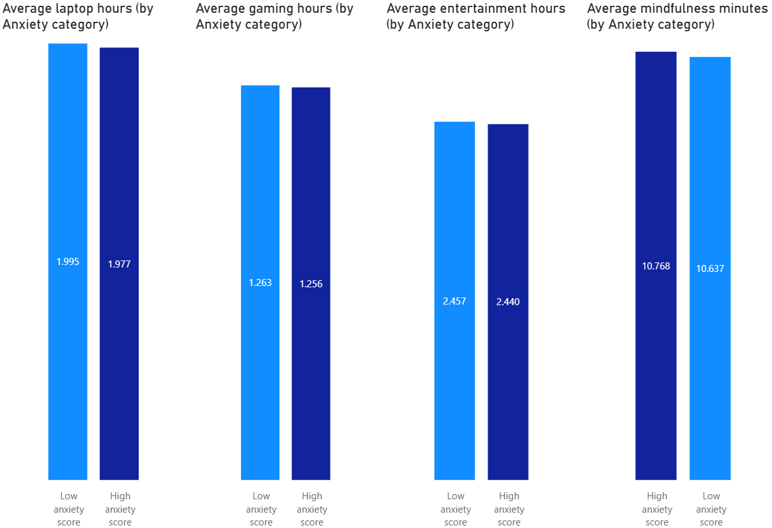
Deeper look (high vs low scorers)
High scorers: those between 11-20
Comparing the habits of high vs low scorers.
What sets high scorers apart?
Power BI Dashboard (page 3 / 4)
Notes:
Main takeaways: High scorers (dark blue) spent less time on their laptops, gaming, & entertainment.
They also clocked more mindfulness minutes.

Slide 14
Deeper look (high vs low scorers)
What is Mindfulness?
Meditation
Breathing
Practicing gratitude
Yoga
Notes:
Mindfulness is a wide-ranging term for meditation, breathing, practicing gratitude, & yoga.
It typically requires small investments of time.

Slide 15
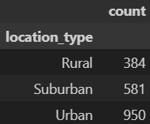
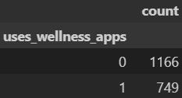
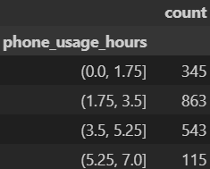
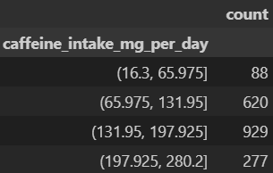
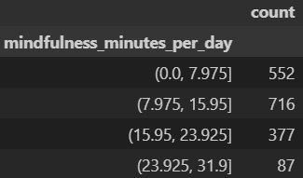
Predictive modelling
Target variable is if participant has a Good anxiety score (11-20), or not.
Goal is binary classification.
Success criteria: Build a model that can accurately predict a participant’s anxiety score.
Target audience: Potential app users. App designers. Digital natives/immigrants interested in positive outcomes.
Feature selection: 2 categorical, 3 numerical.
Notes:
All 5 features are distinctively different.
Categories & bin thresholds also have distinguished counts.

Slide 16
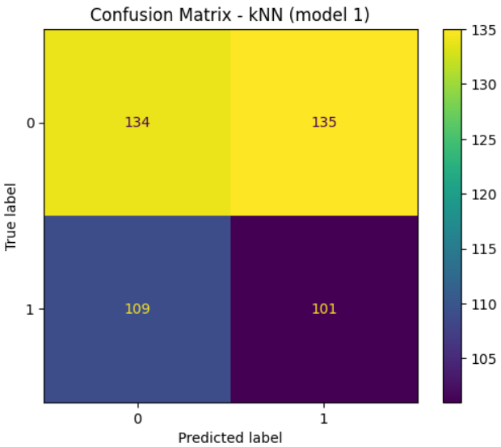
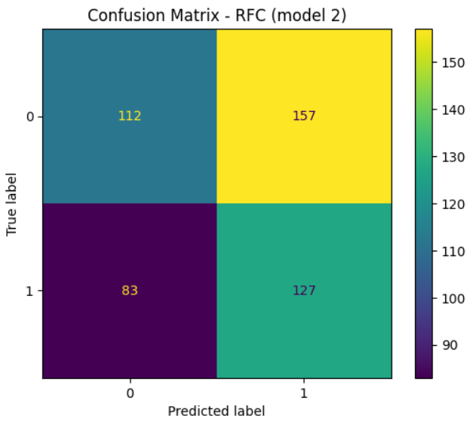
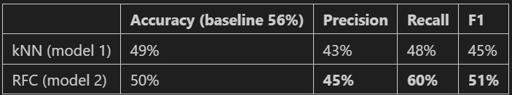
Comparative analysis (k-Nearest Neighbors vs Random Forest)
Context-wise, precision and recall are both important.
We can also rely on F1-score as a performance indicator.
Random Forest outscored k-Nearest Neighbors.
Notes:
RF made more positive predictions than kNN.
Against a baseline accuracy of 56%, both models were slightly behind. Relying only on model accuracy can be misleading. Precision and recall score both focus on true positive prediction. F1-score combines them into a single value, providing a balanced assessment of model performance.

Slide 17
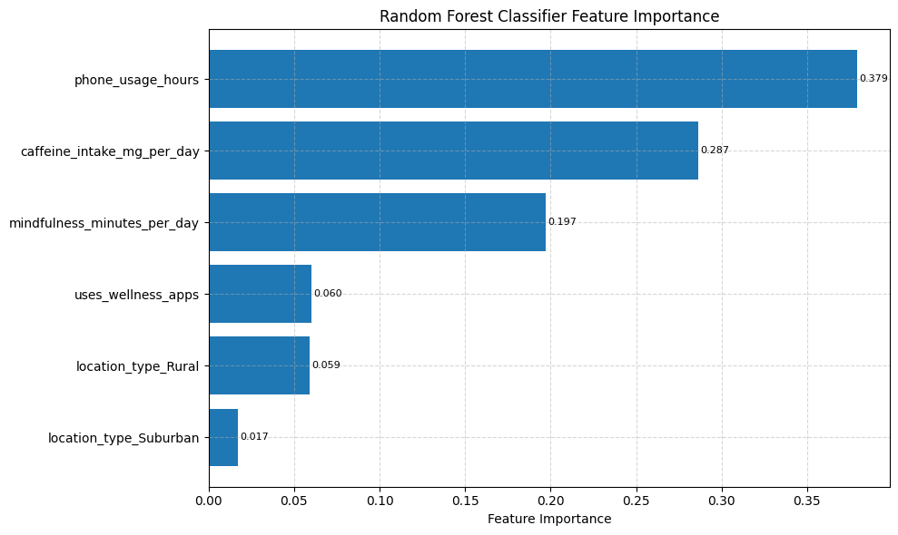
Performance analysis (feature importance)
Notes:
Phone usage, caffeine intake, and mindfulness minutes contributed the most to model performance (by more than 86%). Wellness app usage came in next.

Slide 18

Insights & Recommendations (ordered for optimization)
Take screen-time breaks
Clock mindfulness minutes
Use wellness apps to track these new habits
Watch caffeine intake
Small positive changes can have outsized effects over time.
Notes:
Insights & recommendations ordered for optimization.
The granularity of the data implies that small daily changes can have a big impact on wellness.

Slide 19
Reflections
This complexity of the data reflected the effect of small differences in digital diet habits
02
The dataset was relatively clean. But identifying trends and insights wasn’t straightforward
01
Notes:
1. In terms of visualization & feature selection. Decision to excluding outliers did help the process.
2. Granularity of the data sometimes came down to that of minutes and days.

Slide 20
Thank you

Slide 21
Appendix

Slide 22
Appendix (Q&A)
Overview
Data cleaning workflow
High-level demographics
Demographic breakdown
Deeper look (high vs low scorers)
Predictive modelling
Comparative analysis (k-Nearest Neighbors vs Random Forest)
Performance analysis
Insights & Recommendations
Reflections

Slide 23
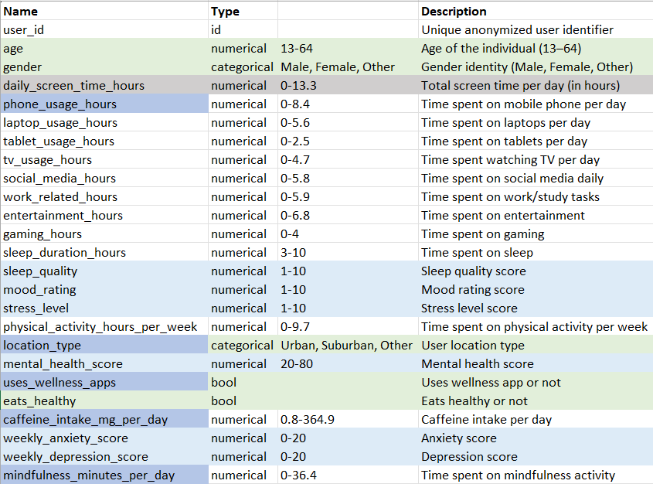
Appendix (Q&A)

Slide 24
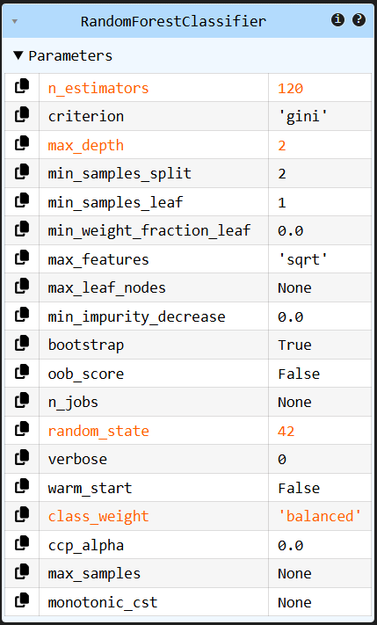
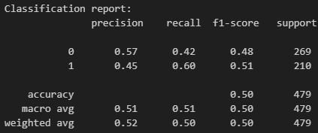
Appendix (Q&A)

