Slide 1
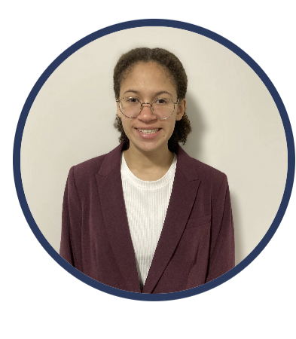
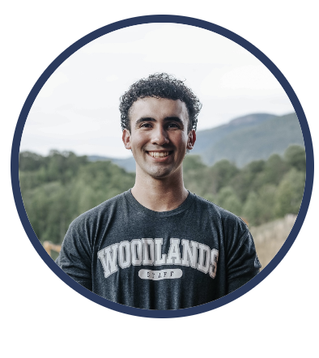
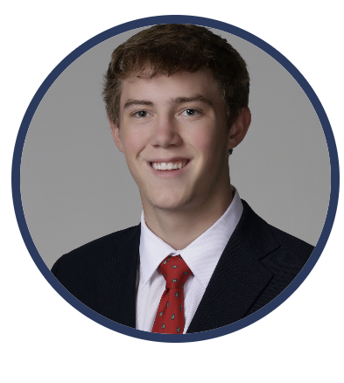
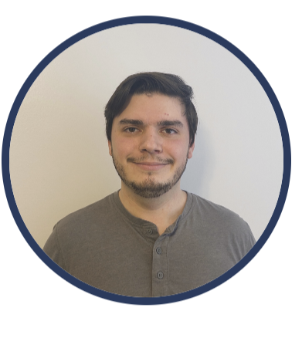
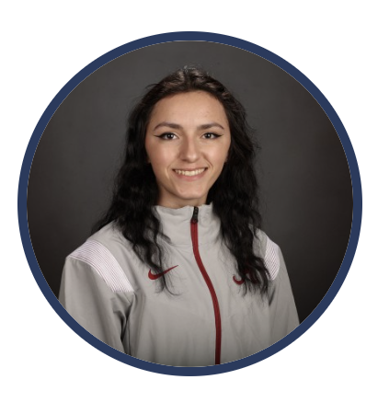
EEG-Based Error Related Potentials
Sophia Kyemba Alexander Steffey Will Mulhern Brody Greene Ali Burkemper
Project Site: https://aliburkemper12.github.io/Capstone-Project-Site/#/
GitHub: https://github.com/wrmulhern/CS495-EEG-Based-Error-Potentials

Slide 2
Project Focus
Create a Low-Cost ErrP Validation Framework
Current applications are not low-cost, require bulky libraries or MATLAB, and are not intuitive for new users
Our application will run natively, rely on few dependencies, and provide a pipeline to process and visualize ErrP's

Slide 3
Sprint Goals
Fix bugs from Sprint 1
UI updates
File validation
Package with PyInstaller
Create log system
Run app using VM
Notes:
Fix bugs from Sprint 1
UI updates
Topomap animated option, loading bar when loading file, darkmode updates, and tabbed view for multiple files
File validation for cyber security
Added file validator to prevent cyber security attacks
Package application with PyInstaller
Create log system
This was done to reduce the large amount of lines printed to theterminal
Get application running in the cloud

Slide 4
Sprint Achievements
Front End: Added tabs, the ability to save graphs​, the capability to select multiple channels, the parsing of CSVs, and an animated topographic map to the GUI
Back End: Added a command line flag to load a dataset directly into the application on start up, set up proper logging and another command line flag to choose log level, created an executable using PyInstaller, and deployed the application on a Cloud VM

Slide 5
Sponsor Feedback
Narrowed scope of the flanker task, will now utilize some existing implementations instead of making a custom one
Accept an epoch CSV file with event file and combine into a single .set file

Slide 6
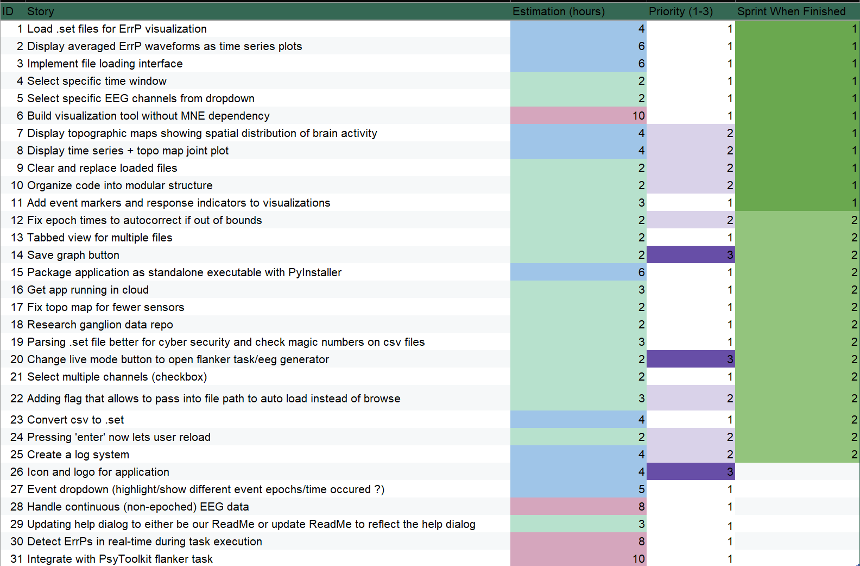
Backlogs
Backlogs
Goals
Continue added visualization functionality
Focus on security through complete file validation
Prepare for ganglion and flanker task connectivity

Slide 7
Cyber Advising
Prioritize data anonymity: De-identify incoming data and avoid storing raw data longer than we must
Implement ganglion device security: Require device authenticity and implement communication encryption

Slide 8
Adjustments
Not completed: Event labels Integrating Ganglion Flanker Task
Lessons learned: New .csv Format Managing Scope Quality of Life Updates

Slide 9
Member Contributions
Sophia: Added ability to convert .csv to .set files, fixed topo map for fewer sensors, worked on log fixes
Alexander: Built file validation for security, added save graph functionality, continued gui improvements
Brody: Added command line arguments for file loading and log level, created executable, deployed application on a cloud VM

Slide 10
Member Contributions
Ali: Created tabbed view for multiple files, help dialogue, record button, and other small UI and project site updates
Will: Added topomap animation feature, added loading bar when loading files, and other UI updates

Slide 11
Technology Used
Core development: PyQt5, Matplotlib, SciPy, UV (GUI & visualization, package manager)
Hardware: OpenBCI ganglion, Muse headband (EEG headsets)
Deployment: PyInstaller, Google Cloud, Git & GitHub (cloud application and version control)
Tech choices were made based off observed standard practices in open-source tutorials.
They have worked well for us, though the EEG hardware has required the most preparation.

Slide 12
Live Demo
Live Demo

