Slide 1
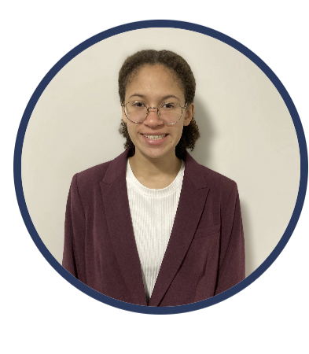
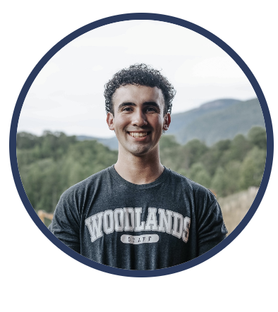
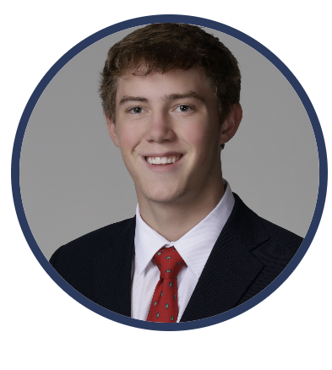
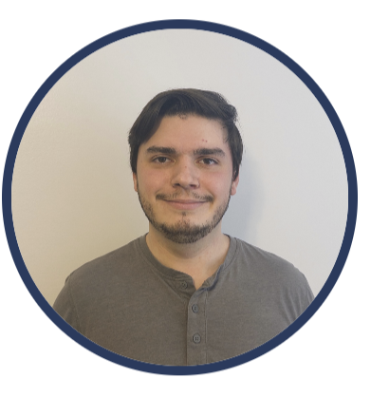
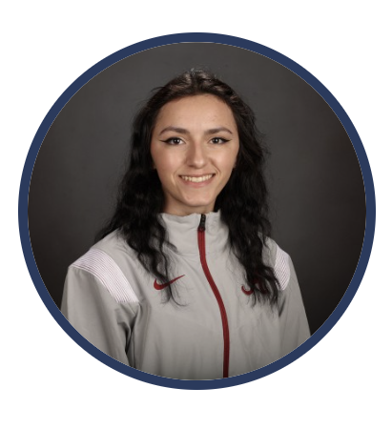
EEG-Based Error Related Potentials
Sophia Kyemba Alexander Steffey Will Mulhern Brody Greene Ali Burkemper
Project Site
GitHub

Slide 2
Project Focus
Creating a Low-Cost ErrP Validation Framework
Current applications are not low-cost
Require MATLAB
Require bulky libraries
Not intuitive for new users
Main Features:
Run as a native application without bulky dependencies
Take in EEG datasets
With ability to run a Flanker task to generate a dataset locally
Process EEG data (averaging, epoching, etc)
Create data visualizations

Slide 3
Goals
The Starting Point
Our main goal for Sprint 1 was to build a program that can define, detect, and visualize ErrPs from .set files
The goal was to build this using open-source MNE-Python code
We first had to understand the MNE code, so a preliminary goal was completing tutorials and watching videos that explained it
Our final goal was to build a GUI that provides a simple interface
We developed visualization implementations for time-series and topographic maps of EEG data

Slide 4


Sprint Achievements
Reverse engineered many of the necessary data parsing and graphing functions from MNE to allow for easier integration with PyInstaller
Designed and implemented a GUI that allows users to load, display, and manipulate graphs of EEG sensor data

Slide 5
Sponsor Feedback
1 - Create a drop down to change event types specified in the given .set file
2 - Create an executable using PyInstaller in Sprint 2
3 - Narrowed scope from a live data plotting tool to a rapid development tool

Slide 6
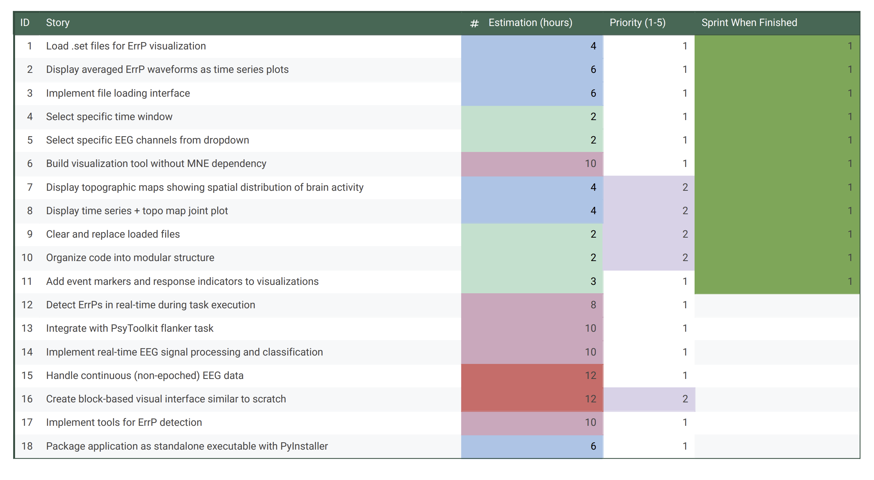
Backlogs
Goals
Complete MNE tutorials on working with continuous data
Build non-MNE interface for defining, detecting, and visualizing ErrPs in .set files
Build GUI

Slide 7
Cyber Planning for New Data
.set file validation
Verify file structure and metadata fields
Validate channel labels and event markers
Reject invalid files
.set file security
Restrict access permissions
Encrypt local directories
Avoid storing raw data longer than we have to

Slide 8
Next Steps & Lessons
Not completed
This Sprint: labeling different event types
Future Sprints: Complete rapid development visualization and advanced data processing
Lessons Learned
.set file structure
MNE functionality
Pyqt5 GUI library

Slide 9
Member Contributions
Sophia: fixed Windows compatibility issues, split code into files that worked with the GUI, communicated with sponsor, organized sprint and product backlogs
Alexander: extended event window functionality to joint maps, fixed when to display event box and sensor dropdowns, debugged epoch selection, organized planning doc and presentation
Brody: Worked on the development environment, the initial GUI implementation, a restructure of the repo, and split the GUI into multiple files for better modularity

Slide 10
Member Contributions
Ali: Focused on first MNE and non-MNE implementations reverse engineering necessary functions, added in "Display Events and Responses" functionality, standardized channel coloring across graph types
Will: added all channels and topographic map functionality, custom input fields for topograph, and robust dark mode theming across layout including graphs, created github repo

Slide 11
AI Assistance
MNE and EEG Tutorials: ChatGPT was helpful to expand upon and walk through provided tutorials, getting a better understanding of how EEG data behaves
Code Analysis & Reverse Engineering: Claude parsed MNE open-source library to extract core functionality for EEG file loading and processing without dependencies
GUI Prototyping & Support: ChatGPT generated initial PyQt5 GUI structure and was helpful for debugging

Slide 12
Live Demo

Slide 13
Thank You

