Slide 1
TEXAS WESLEYAN UNIVERSITY · SCHOOL OF BUSINESS ADMINISTRATION
CIS-4328: Information Security
Threat Modeling, Applied Cryptography, Defense-in-Depth, and Enterprise Incident Response
Instructor: Professor William Nash, Ph.D.
Department of Computer Science & Information Technology | Fall 2026
Notes:
Welcome, students, to CIS-4328: Information Security at Texas Wesleyan University. I am Professor William Nash. In this course, we examine cybersecurity not merely as a set of technical tools, but as an adversarial discipline, a rigorous engineering practice, and an organizational risk management imperative. Our objective is to understand both how modern adversaries compromise systems and how security architects design resilient, defense-in-depth infrastructures capable of surviving sophisticated attacks. Let's begin with our foundational security models.

Slide 2
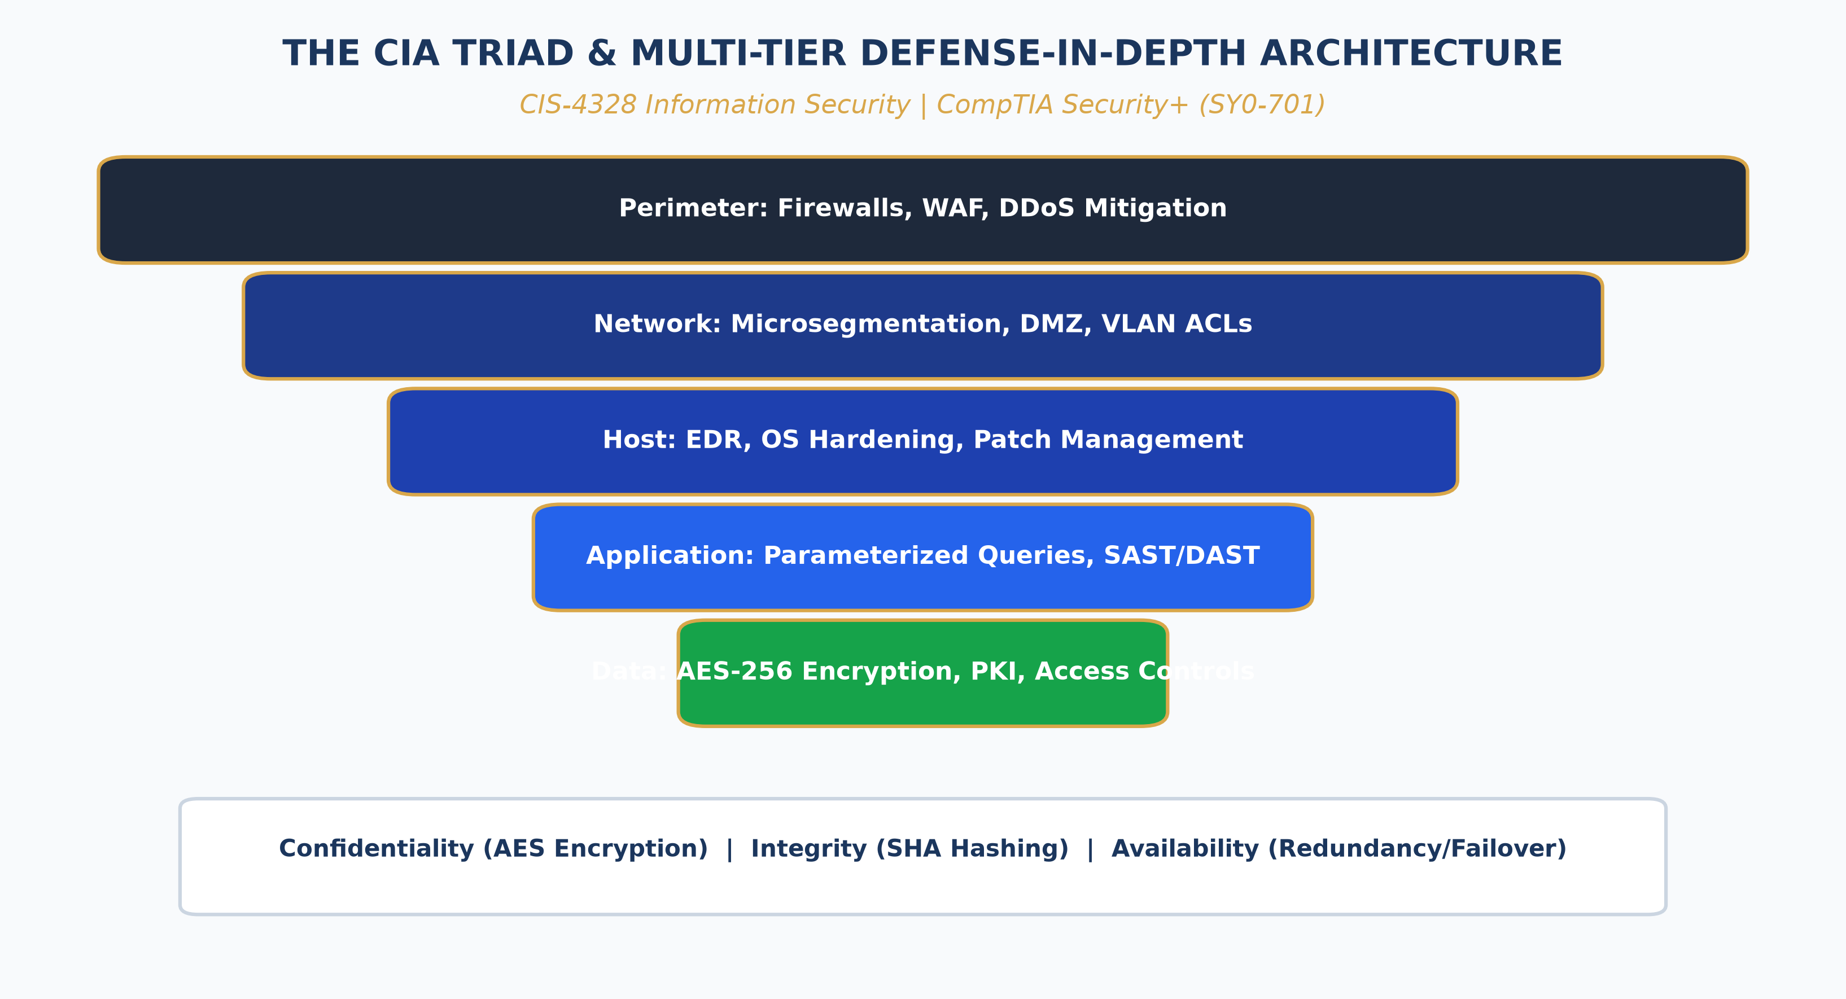
CIS-4328 · MODULE 01: FOUNDATIONS
Security Fundamentals: CIA Triad & Defense-in-Depth
• The CIA Triad: Confidentiality (preventing unauthorized disclosure), Integrity (safeguarding data accuracy and non-repudiation), Availability (guaranteeing timely access).
• The Parkerian Hexad: Expands CIA to include Authenticity (provenance validation), Utility (usefulness of data), and Possession/Control.
• Defense-in-Depth Strategy: Layered defense paradigm: if any single perimeter barrier fails, subsequent interior controls prevent total system compromise.
• Multi-Tier Security Ring: Perimeter Firewalls -> Network Segmentation -> Endpoint Detection & Response (EDR) -> Identity & Access Management (IAM) -> Data-at-Rest Encryption.
• Principle of Least Privilege: Every identity, process, and system must operate using the minimal set of privileges necessary to execute its legitimate function.
Texas Wesleyan University | Department of Computer Science & Information Technology | CIS-4328 | Professor William Nash, Ph.D.
Notes:
In Module 1, we establish our core security philosophy. Everything we do in cybersecurity revolves around the CIA Triad: Confidentiality, Integrity, and Availability. Confidentiality ensures that only authorized entities can view data, enforced through encryption and access control. Integrity ensures data cannot be modified in transit or at rest without detection, enforced through cryptographic hashes and digital signatures. Availability guarantees that systems remain responsive to legitimate users, enforced through fault tolerance, redundancy, and DDoS mitigation. Look at the diagram on the right illustrating Defense-in-Depth. In the past, organizations relied on a castle-and-moat perimeter model: a strong firewall at the edge, but wide-open trust inside. Today, that model is entirely obsolete. A modern security architecture implements concentric rings: perimeter filtering, internal zero-trust microsegmentation, host-based endpoint protection, strict multi-factor authentication, and ubiquitous data encryption.

Slide 3
CIS-4328 · MODULE 02: THREAT LANDSCAPES
Adversarial Modeling & MITRE ATT&CK
Threat Actor Taxonomies & Motives
• Nation-State APTs: Advanced Persistent Threats with vast resources, custom zero-day exploits, and long-term espionage objectives.
• Cybercrime Syndicates: Financially motivated threat actors specializing in Ransomware-as-a-Service (RaaS), double extortion, and credential theft.
• Insider Threats: Malicious or negligent employees possessing legitimate credentials; the most challenging threat to detect with external perimeter controls.
• Hacktivists & Script Kiddies: Politically driven disruptions or opportunistic actors using automated vulnerability scanners and public exploit scripts.
MITRE ATT&CK & Cyber Kill Chain
• Cyber Kill Chain (Lockheed Martin): Linear progression: Reconnaissance -> Weaponization -> Delivery -> Exploitation -> Installation -> C2 -> Actions on Objectives.
• MITRE ATT&CK Matrix: Dynamic, empirical taxonomy of real-world adversary Tactics, Techniques, and Common Knowledge (TTPs).
• Tactics vs Techniques: Tactics represent the adversary's goal (e.g., Initial Access, Persistence, Privilege Escalation). Techniques represent how they accomplish it.
• Threat Hunting & Purple Teaming: Using ATT&CK matrices to identify visibility gaps in enterprise SIEM/EDR detection rules and emulate adversarial behavior.
Texas Wesleyan University | Department of Computer Science & Information Technology | CIS-4328 | Professor William Nash, Ph.D.
Notes:
Module 2 focuses on threat modeling and adversarial methodologies. To defend a network, you must understand your adversary. We categorize threat actors along a spectrum of capability and motive—from unsophisticated script kiddies to well-funded nation-state Advanced Persistent Threats. To structure our defense, we utilize industry standard frameworks. Lockheed Martin's Cyber Kill Chain presents the linear steps of an intrusion. However, the modern gold standard for SOC analysts and incident responders is the MITRE ATT&CK framework, shown on the right. ATT&CK organizes adversary behavior into Tactics—such as Initial Access, Persistence, and Lateral Movement—and breaks each down into specific, observable Techniques. When analyzing an intrusion, mapping logs to ATT&CK techniques enables defenders to anticipate the adversary's next move and deploy targeted countermeasures.

Slide 4
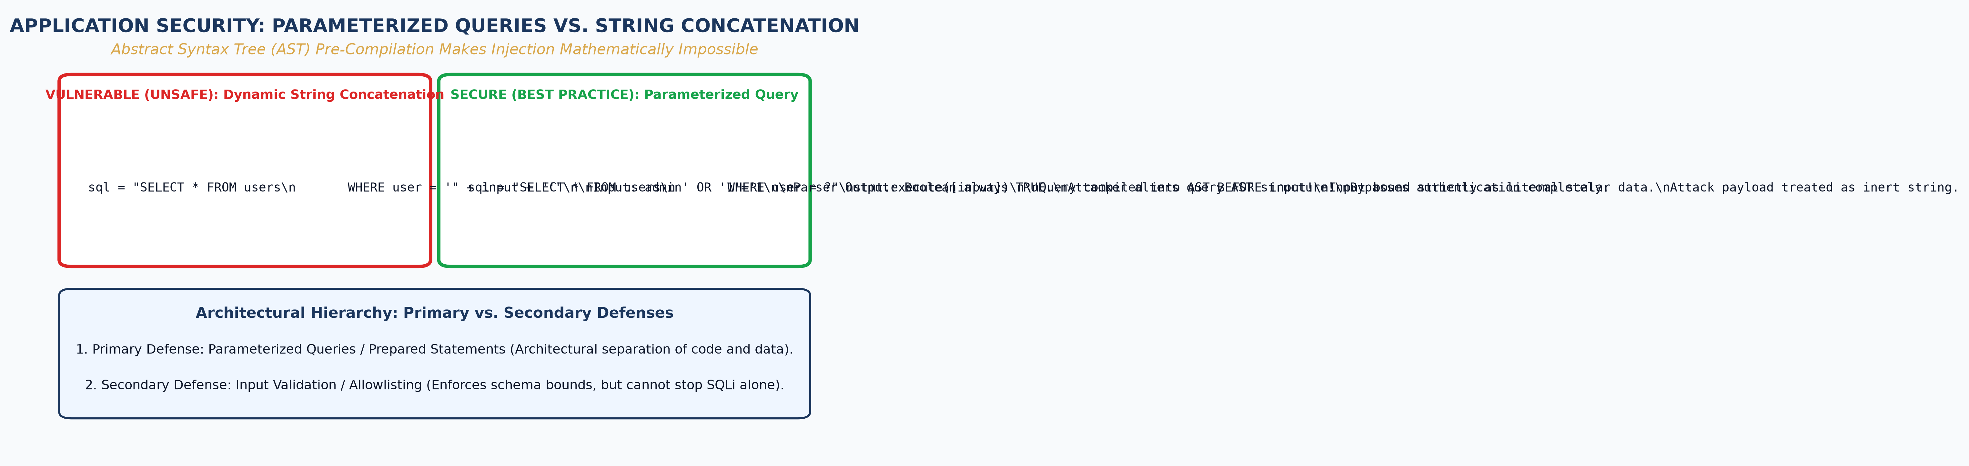
CIS-4328 · MODULE 03: APPLICATION SECURITY
Web Application Vulnerabilities: SQLi Mechanics
• OWASP Top 10 Context: A03:2021-Injection remains one of the most critical enterprise application vulnerabilities worldwide.
• Root Cause of SQLi: Flawed application architecture that treats untrusted user input as executable code instead of raw data.
• Tautological Exploit Vector: Inputting `' OR '1'='1` forces the underlying database SQL parser to evaluate the WHERE clause as unconditionally TRUE.
• Attacker Exploitation Impact: Bypasses authentication mechanisms, dumps entire customer databases (UNION-based), or executes OS commands (xp_cmdshell).
• Defensive Architecture: Parameterized Queries (Prepared Statements) separate SQL code logic from data literals via AST precompilation.
Texas Wesleyan University | Department of Computer Science & Information Technology | CIS-4328 | Professor William Nash, Ph.D.
Notes:
In Module 3, we dive into application-layer security, focusing on SQL Injection—consistently ranked among the top web threats by OWASP. SQL injection occurs because of a fundamental architectural failure: concatenating unsanitized user input directly into dynamic database strings. Observe the diagram on the right. In the vulnerable model, an attacker submits an apostrophe followed by OR '1'='1'. The database SQL parser treats that input as executable syntax, turning the WHERE clause into a tautology that is always true, immediately granting administrative access without a valid password! Now look at the secure model below it. To eliminate SQL injection, we must implement Parameterized Queries, or Prepared Statements. The database engine precompiles the Abstract Syntax Tree of the SQL query with placeholders. When user input arrives, the engine treats it strictly as raw string literals—never as executable code. Even if an attacker enters SQL syntax, it is evaluated simply as harmless data.

Slide 5
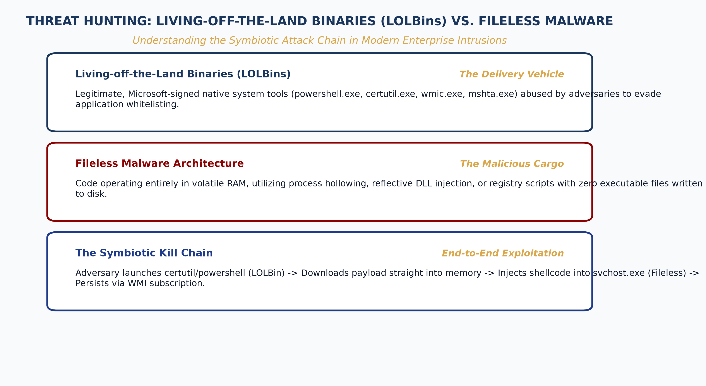
CIS-4328 · MODULE 04: THREAT ANALYSIS
Modern Malware: Living-off-the-Land (LOLBins)
• Traditional vs Modern Malware: Legacy compiled PE binaries dropped on disk are rapidly detected by signature-based AV and hash lookups.
• Living-off-the-Land Binaries (LOLBins): Adversaries abuse legitimate, trusted, digitally signed OS utilities (powershell.exe, certutil.exe, mshta.exe, wmic.exe).
• Fileless In-Memory Execution: Malicious shellcode is injected directly into volatile RAM (e.g., via process hollowing), leaving zero artifacts on physical disk storage.
• Bypassing Defenses: Because the executing process is signed by Microsoft or Apple, legacy antivirus engines assume the behavior is benign.
• Detection & Mitigation: Requires behavioral Endpoint Detection & Response (EDR), script block logging (EID 4104), and strict Application Whitelisting (WDAC/AppLocker).
Texas Wesleyan University | Department of Computer Science & Information Technology | CIS-4328 | Professor William Nash, Ph.D.
Notes:
Module 4 examines the evolution of modern malware. The days when attackers dropped an obvious 'virus.exe' file onto a hard drive are largely gone. Modern threat actors use Living-off-the-Land techniques, weaponizing built-in operating system binaries—known as LOLBins. Look at the comparison diagram on the right. In a fileless attack, the adversary uses PowerShell or Certutil—legitimate tools signed by Microsoft—to download payloads directly into volatile memory (RAM). The malware executes inside the address space of a legitimate Windows process through techniques like process hollowing. Traditional antivirus software looks for malicious file signatures on disk; because nothing touches the disk, the antivirus reports clean! To defend against this, modern SOCs deploy behavioral Endpoint Detection and Response (EDR) solutions that monitor process creation trees, parent-child relationships, command-line arguments, and enforce strict PowerShell Script Block Logging.

Slide 6
CIS-4328 · MODULE 05: CRYPTOGRAPHY
Applied Cryptography: Ciphers, Hashes & MACs
Symmetric vs. Asymmetric Encryption
• Symmetric Cryptography: Single shared secret key for encryption and decryption. Highly efficient for bulk data transport. Industry standard: AES-256 (GCM mode).
• Symmetric Modes of Operation: ECB (vulnerable, preserves plaintext patterns) vs CBC (requires IV) vs GCM (Galois/Counter Mode provides authenticated encryption).
• Asymmetric Cryptography: KeyPair: Public key encrypts / verifies; Private key decrypts / signs. Solves key distribution. Standards: RSA (3072+ bit), ECC (ECDSA, Ed25519).
• Hybrid Cryptosystems: Combines both: Asymmetric exchange negotiates an ephemeral symmetric session key (e.g., via ECDHE), then bulk data encrypts via AES.
Cryptographic Hashing & Integrity
• One-Way Hash Properties: Pre-image resistance (irreversible), Second pre-image resistance, Collision resistance (no two inputs yield same output), Avalanche effect.
• Secure Hashing Standards: SHA-256 and SHA-3 (Keccak). Deprecated standards: MD5 and SHA-1 (both proven broken via practical collision attacks).
• Hashed Message Authentication (HMAC): Combines a cryptographic hash function with a secret key to guarantee both data integrity and data authenticity simultaneously.
• Password Hashing Functions: Requires slow, memory-hard key derivation functions with unique cryptographic salts: Argon2id, bcrypt, PBKDF2 (prevents Rainbow Table attacks).
Texas Wesleyan University | Department of Computer Science & Information Technology | CIS-4328 | Professor William Nash, Ph.D.
Notes:
In Module 5, we explore applied cryptography, the mathematical foundation of digital security. We categorize cryptographic primitives into symmetric and asymmetric algorithms. Symmetric encryption, like AES-256, uses one shared key; it is exceptionally fast and ideal for encrypting large databases and hard drives. However, how do two parties who have never met safely share that key across the Internet? That is where asymmetric cryptography comes in. Using mathematical one-way functions like elliptic curves or prime factorization, asymmetric systems allow public key sharing. In TLS 1.3, we use hybrid cryptography: ephemeral elliptic curve Diffie-Hellman negotiates a session key, and AES-GCM handles the high-speed data stream. On the right column, notice cryptographic hashes. A hash is a one-way mathematical fingerprint. For password storage, never use fast algorithms like SHA-256; always use salted, memory-hard algorithms like Argon2id or bcrypt to defend against GPU-accelerated cracking.

Slide 7
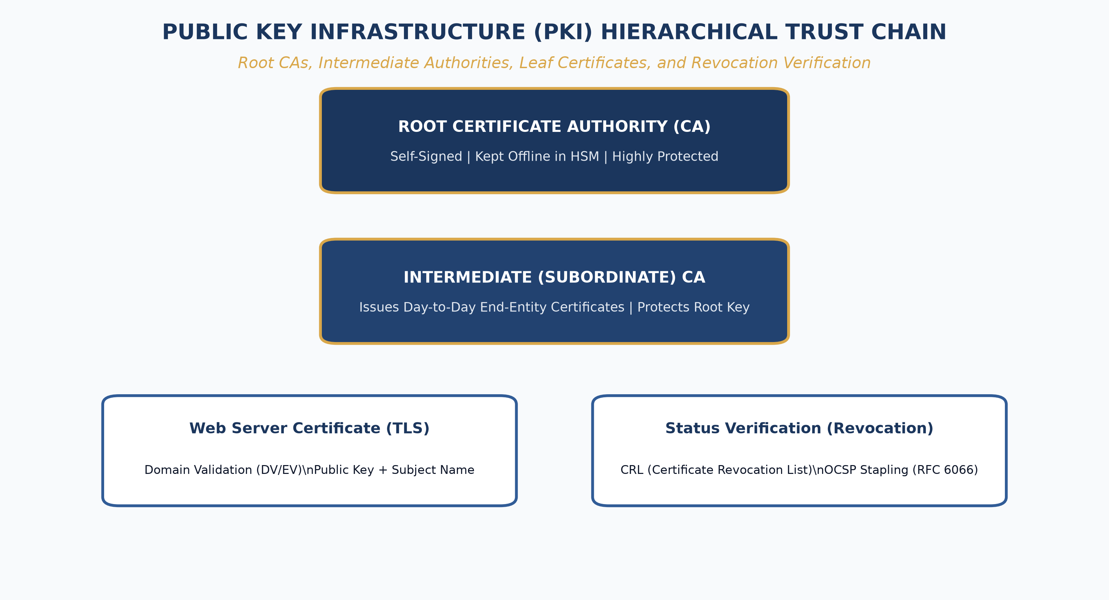
CIS-4328 · MODULE 06: IDENTITY & PKI
Public Key Infrastructure (PKI) & Trust Chains
• PKI Architectural Purpose: Binds human identities and server hostnames to verified public keys using digitally signed X.509 certificates.
• The Hierarchy of Trust: Root Certificate Authority (CA) -> Intermediate CA -> End-Entity (Server/Client) Leaf Certificate.
• Root CA Offline Isolation: Root CAs are kept powered off in air-gapped secure vaults; intermediate CAs handle daily issuance to contain compromise risk.
• Cryptographic Verification: Browser walks the chain: validates each certificate's digital signature using the public key of the issuing parent CA up to a trusted Root.
• Revocation Protocols: Online Certificate Status Protocol (OCSP) and Certificate Revocation Lists (CRLs) invalidate compromised private keys before expiry.
Texas Wesleyan University | Department of Computer Science & Information Technology | CIS-4328 | Professor William Nash, Ph.D.
Notes:
Module 6 addresses Public Key Infrastructure, or PKI. When you connect to your bank's website, your browser displays a padlock. How does it know it's really the bank? Look at the diagram on the right illustrating the PKI Chain of Trust. At the top is the Root CA, whose self-signed certificate is pre-installed in your browser's trust store. To safeguard that root, the Root CA delegates authority to an Intermediate CA. The Intermediate CA then signs the end-entity certificate for the web server. When your browser connects, it receives the server's certificate. It mathematically verifies the signature using the Intermediate CA's public key, and verifies the Intermediate's signature using the Root CA's public key. If every signature in the chain is mathematically valid, not expired, and not listed on an OCSP revocation list, the connection is trusted. PKI is the bedrock of secure communications across the global economy.

Slide 8
CIS-4328 · MODULE 07: SECURITY ARCHITECTURE
Enterprise Network Security & Zero Trust Architecture
Next-Generation Network Defense
• Next-Gen Firewalls (NGFW): Deep Packet Inspection (DPI) operating at Layer 7; inspects application payloads, performs SSL/TLS decryption, and blocks threat signatures.
• Intrusion Detection & Prevention (IDS/IPS): Signature-based detection (Snort/Suricata rules) and behavioral anomaly detection to alert (IDS) or actively drop malicious flows (IPS).
• Demilitarized Zones (DMZ): Isolated perimeter subnet hosting internet-facing servers (web, mail, DNS), preventing direct inbound connections to the internal LAN.
• Microsegmentation: Granular security zoning inside the data center to prevent lateral movement by compromised workloads.
Zero Trust Architecture (ZTA / NIST SP 800-207)
• Core Paradigm: 'Never Trust, Always Verify.' Eliminates implicit trust based solely on network location or IP subnet.
• Policy Engine & Policy Enforcement Point: Every single transaction is explicitly authenticated, authorized, and encrypted before access is granted to an enterprise resource.
• Context-Aware Access Evaluation: Evaluates user identity, device health posture, geolocation, behavioral anomalies, and time of access dynamically.
• Data-Centric Security: Focuses protection directly on enterprise data assets rather than relying on brittle network perimeter boundaries.
Texas Wesleyan University | Department of Computer Science & Information Technology | CIS-4328 | Professor William Nash, Ph.D.
Notes:
Module 7 explores network security architectures and the paradigm shift toward Zero Trust. Historically, corporate networks were designed like castles: high walls on the outside, but once someone was on the internal Wi-Fi or VPN, they had access to everything. Adversaries exploited this by compromising a single low-level workstation and moving laterally across the entire organization. Under NIST SP 800-207 Zero Trust Architecture, shown on the right, network location implies zero trust. Whether a request originates from an office cubicle in Fort Worth or a coffee shop in Tokyo, it must pass through a Policy Enforcement Point. The system evaluates: Who is the user? Is their multi-factor authentication valid? Is their laptop fully patched? Does their behavior match normal patterns? Only then is access granted to that specific application. This is the gold standard of modern enterprise defense.

Slide 9
CIS-4328 · MODULE 08: IDENTITY GOVERNANCE
Identity & Access Management (IAM) & Authentication
Authentication Factors & Modern MFA
• The Three Classic Factors: Something you know (passwords, PINs), Something you have (smartcards, hardware tokens), Something you are (biometrics: fingerprint, facial scan).
• MFA Vulnerability Vectors: SMS OTP is vulnerable to SIM-swapping and SS7 interception. Push notifications are vulnerable to MFA Fatigue / Prompt Bombing attacks.
• Phishing-Resistant MFA (FIDO2 / WebAuthn): Hardware security keys (YubiKeys) using public key cryptography bound to the origin URL, rendering credential harvesting attacks impossible.
• Passwordless Authentication: Leverages device biometrics (Windows Hello, Touch ID) to unlock local private keys for token exchange.
Enterprise Federated Identity Protocols
• Kerberos Protocol: Ticket-based symmetric authentication protocol used within on-prem Active Directory (KDC, AS, TGS, TGT).
• SAML 2.0 (Security Assertion Markup): XML-based federation protocol used for enterprise web Single Sign-On (SSO) between Identity Providers (IdP) and Service Providers (SP).
• OAuth 2.0 Authorization: Token-based delegation framework issuing scoped Access Tokens and Refresh Tokens (JSON Web Tokens - JWT).
• OpenID Connect (OIDC): Identity layer built on top of OAuth 2.0 that provides verifiable ID Tokens containing user identity claims.
Texas Wesleyan University | Department of Computer Science & Information Technology | CIS-4328 | Professor William Nash, Ph.D.
Notes:
In Module 8, we examine Identity and Access Management. Identity is the new security perimeter. Passwords alone are no longer acceptable protection. We require Multi-Factor Authentication. However, not all MFA is created equal. Attackers routinely bypass SMS codes through SIM-swapping, and bypass mobile app push notifications through prompt fatigue attacks—bombarding an employee with notifications at 3:00 AM until they click approve. To achieve true resistance, enterprise security mandates FIDO2 WebAuthn hardware security keys, which cryptographically bind the login challenge to the browser's exact domain URL. On the right, we also examine enterprise federation protocols: SAML and OpenID Connect allow single sign-on across thousands of cloud applications, while OAuth 2.0 issues cryptographically signed JSON Web Tokens for delegated API access.

Slide 10
CIS-4328 · MODULE 09: SECURITY OPERATIONS
Incident Response & Digital Forensics Lifecycle
NIST SP 800-61 Rev 2 IR Lifecycle
• Phase 1: Preparation: Developing IR plans, establishing communication out-of-band channels, configuring EDR/SIEM log retention, training CSIRT personnel.
• Phase 2: Detection & Analysis: Correlating indicators of compromise (IOCs), triage alerts, determining attack scope, establishing baseline timeline.
• Phase 3: Containment, Eradication & Recovery: Short-term containment (network isolation), long-term containment, purging malware/backdoors, rebuilding from clean gold images.
• Phase 4: Post-Incident Activity: Conducting 'Lessons Learned' reviews, updating firewall/EDR rules, and calculating total organizational financial/operational impact.
Digital Forensics & Evidence Integrity
• Order of Volatility (RFC 3227): Capture evidence from most volatile to least: CPU registers/cache -> RAM -> Network state -> Disk storage -> Backup media.
• Cryptographic Chain of Custody: Bit-stream forensic disk images must be hashed immediately (SHA-256) upon acquisition to prove evidence has not been tampered with in court.
• Memory Analysis (Volatility Framework): Extracting running processes, active network sockets, injected DLLs, and decrypted encryption keys from volatile RAM dumps.
• Timeline Reconstruction: Parsing Master File Table ($MFT), shimcache, amcache, and Windows Event Logs to establish exact adversary intrusion sequence.
Texas Wesleyan University | Department of Computer Science & Information Technology | CIS-4328 | Professor William Nash, Ph.D.
Notes:
Module 9 covers Incident Response and Digital Forensics. In cybersecurity, the saying goes: 'It's not if you will be breached, but when.' When an incident occurs, the response team follows the NIST SP 800-61 lifecycle: Preparation, Detection and Analysis, Containment and Eradication, and Post-Incident Review. In containment, hasty actions like pulling the power plug can destroy critical volatile evidence. As digital investigators, we follow RFC 3227's Order of Volatility: capture volatile RAM first, because RAM contains active network connections, in-memory malware payloads, and plaintext encryption keys. Every forensic image must be cryptographically hashed with SHA-256 to establish a legally defensible Chain of Custody. Rigorous methodology separates professional incident response from chaotic disaster.

Slide 11
CIS-4328 · MODULE 10: STRATEGIC GOVERNANCE
Security Governance, Risk & Compliance (GRC)
Risk Assessment & Quantitative Modeling
• Risk Formula: Risk = Threat x Vulnerability x Asset Impact (or Likelihood x Impact).
• Quantitative Risk Calculations: Asset Value (AV), Exposure Factor (EF), Single Loss Expectancy (SLE = AV x EF), Annualized Rate of Occurrence (ARO), Annualized Loss Expectancy (ALE = SLE x ARO).
• Risk Treatment Strategies: Risk Mitigation (implement controls), Risk Transference (cyber insurance), Risk Acceptance (documented leadership sign-off), Risk Avoidance (cease high-risk activity).
• Business Impact Analysis (BIA): Establishing Recovery Time Objective (RTO) and Recovery Point Objective (RPO) for disaster recovery planning.
Regulatory & Security Frameworks
• NIST Cybersecurity Framework (CSF 2.0): Six Core Functions: Govern, Identify, Protect, Detect, Respond, and Recover.
• ISO/IEC 27001:2022: International standard for designing, implementing, and certifying an Information Security Management System (ISMS).
• Regulatory Mandates: HIPAA (healthcare data privacy & security), PCI-DSS (payment card protection), Sarbanes-Oxley (financial reporting integrity), GDPR (data privacy rights).
• Continuous Auditing & Assurance: Third-party SOC 2 Type II attestation evaluating Trust Services Criteria (Security, Availability, Confidentiality).
Texas Wesleyan University | Department of Computer Science & Information Technology | CIS-4328 | Professor William Nash, Ph.D.
Notes:
In Module 10, we address Security Governance, Risk Management, and Compliance—the strategic domain that connects technical controls to executive leadership. Security professionals must communicate risk in the language of business: financial impact. Using quantitative risk modeling, we calculate Single Loss Expectancy and Annualized Loss Expectancy. If a control costs fifty thousand dollars a year but only prevents a ten-thousand-dollar annual loss, it is economically unjustified! We also evaluate comprehensive frameworks like the newly updated NIST Cybersecurity Framework 2.0, which added the foundational 'Govern' function, and mandatory regulatory standards like PCI-DSS and HIPAA. True security requires aligning technical defenses with legal obligations and enterprise risk tolerance.

Slide 12
CIS-4328 · COURSE CAPSTONE
Course Synthesis & Professional Career Pathways
CIS-4328 Core Competencies
• Threat-Informed Defense: Proficiency in evaluating cyber threat intelligence, mapping adversary behaviors to MITRE ATT&CK, and identifying vulnerability vectors.
• Applied Engineering & Hardening: Deep understanding of cryptographic algorithms, PKI chain of trust, network segmentation, and zero trust architectures.
• Operational Incident Readiness: Ability to execute the NIST IR lifecycle, preserve digital evidence, and conduct triage analysis.
• Governance & Strategic Alignment: Quantitative risk assessment, regulatory compliance posture, and security policy architecture.
Professional Certification Roadmap
• CompTIA Security+ (SY0-701): Industry baseline credential verifying foundational technical security skills across all domains.
• CompTIA CySA+ / PenTest+: Intermediate credentials focusing on SOC analytical defense or practical ethical hacking and assessment.
• Certified Information Systems Security Professional (CISSP): The premier senior management and architecture credential, aligned with our 8 course domains.
• Final Exam & Practical Defense: Review your Canvas study guides, master the hands-on analysis rubrics, and prepare for our final comprehensive assessment.
Texas Wesleyan University | Department of Computer Science & Information Technology | CIS-4328 | Professor William Nash, Ph.D.
Notes:
To wrap up CIS-4328: congratulations on navigating one of the most rigorous and vital courses in our curriculum. You now possess the foundational knowledge that security engineers, SOC analysts, and cybersecurity consultants use daily. The domains we covered align directly with industry benchmarks, including the CompTIA Security+ and the gold-standard CISSP credential. As you prepare for your final capstone evaluation, focus on explaining the architectural 'why' behind each control—why parameterized queries stop SQL injection, why EUI-64 flips the seventh bit, why Zero Trust evaluates context rather than IP addresses. Thank you for your dedication to defending our digital world. Best of luck on the final exam!

