Slide 1
TEXAS WESLEYAN UNIVERSITY · SCHOOL OF BUSINESS ADMINISTRATION
CSC-6361: Advanced Computer Networks
Graduate Foundations: Multi-Area Link-State Routing, BGP-4 Path Vector Dynamics, and Data Center Fabrics
Instructor: Professor William Nash, Ph.D.
Department of Computer Science & Information Technology | Fall 2026
Notes:
Welcome, graduate scholars, to CSC-6361: Advanced Computer Networks at Texas Wesleyan University. I am Professor William Nash. In this graduate-level course, we transition from elementary networking concepts to rigorous architectural analysis, mathematical queuing theory, dynamic inter-domain routing protocols, and software-defined data center fabrics. Our focus is both analytical and empirical: dissecting the protocol mechanics that allow the global Internet and modern hyperscale cloud infrastructures to scale robustly. Let's begin our exploration.

Slide 2
CSC-6361 · MODULE 01: GRADUATE FOUNDATIONS
Network Performance Modeling & Queuing Theory
Queueing Systems & Little's Law
• Little's Law Fundamental Formula: L = λW, where L is the average number of packets in the system, λ is the average packet arrival rate, and W is the average time a packet spends in the system.
• M/M/1 Queueing Model: Poisson packet arrivals (Markovian), exponential service times, single transmission channel. Utilization factor ρ = λ / μ.
• Average System Delay (W): W = 1 / (μ - λ). As link utilization ρ approaches 1.0 (100%), queue buffering and latency escalate asymptotically toward infinity.
• Packet Loss & Buffer Sizing: Buffer sizing rule-of-thumb: B = RTT x C (Bandwidth-Delay Product). Modern research demonstrates B = (RTT x C) / sqrt(N) for N desynchronized TCP flows.
Latency Components & Measurement
• End-to-End Latency Decomposition: D_total = D_proc (processing) + D_queue (queuing) + D_trans (transmission = L/R) + D_prop (propagation = d/s).
• Transmission vs Propagation: Transmission delay depends strictly on packet size and link bandwidth. Propagation delay depends strictly on physical distance and signal speed (approx. 2 x 10^8 m/s in fiber).
• Bufferbloat & Active Queue Management: Excessive router buffering induces high latency without preventing packet loss. Solved via AQM algorithms like CoDel and PIE.
• Jitter & Statistical Multiplexing: Variance in packet arrival times affecting real-time streaming and high-frequency financial trading networks.
Texas Wesleyan University | Department of Computer Science & Information Technology | CSC-6361 | Professor William Nash, Ph.D.
Notes:
Welcome to our theoretical opening module in CSC-6361. At the graduate level, we analyze networks through mathematical modeling. Consider Little's Law: L equals lambda times W. When we apply this to an M/M/1 queuing model, link utilization rho equals arrival rate lambda divided by service rate mu. Notice the mathematical consequence in our formula for average delay: W equals 1 over mu minus lambda. When traffic is light, delay is negligible. But as utilization approaches 100 percent, the denominator approaches zero, and packet delay shoots toward infinity! This mathematical reality governs all router queue management. Furthermore, we must distinguish transmission delay—the time required to push bits onto the wire—from propagation delay—the physical travel time of light through fiber optic glass. Understanding these dynamics is essential when designing hyperscale cloud fabrics.

Slide 3
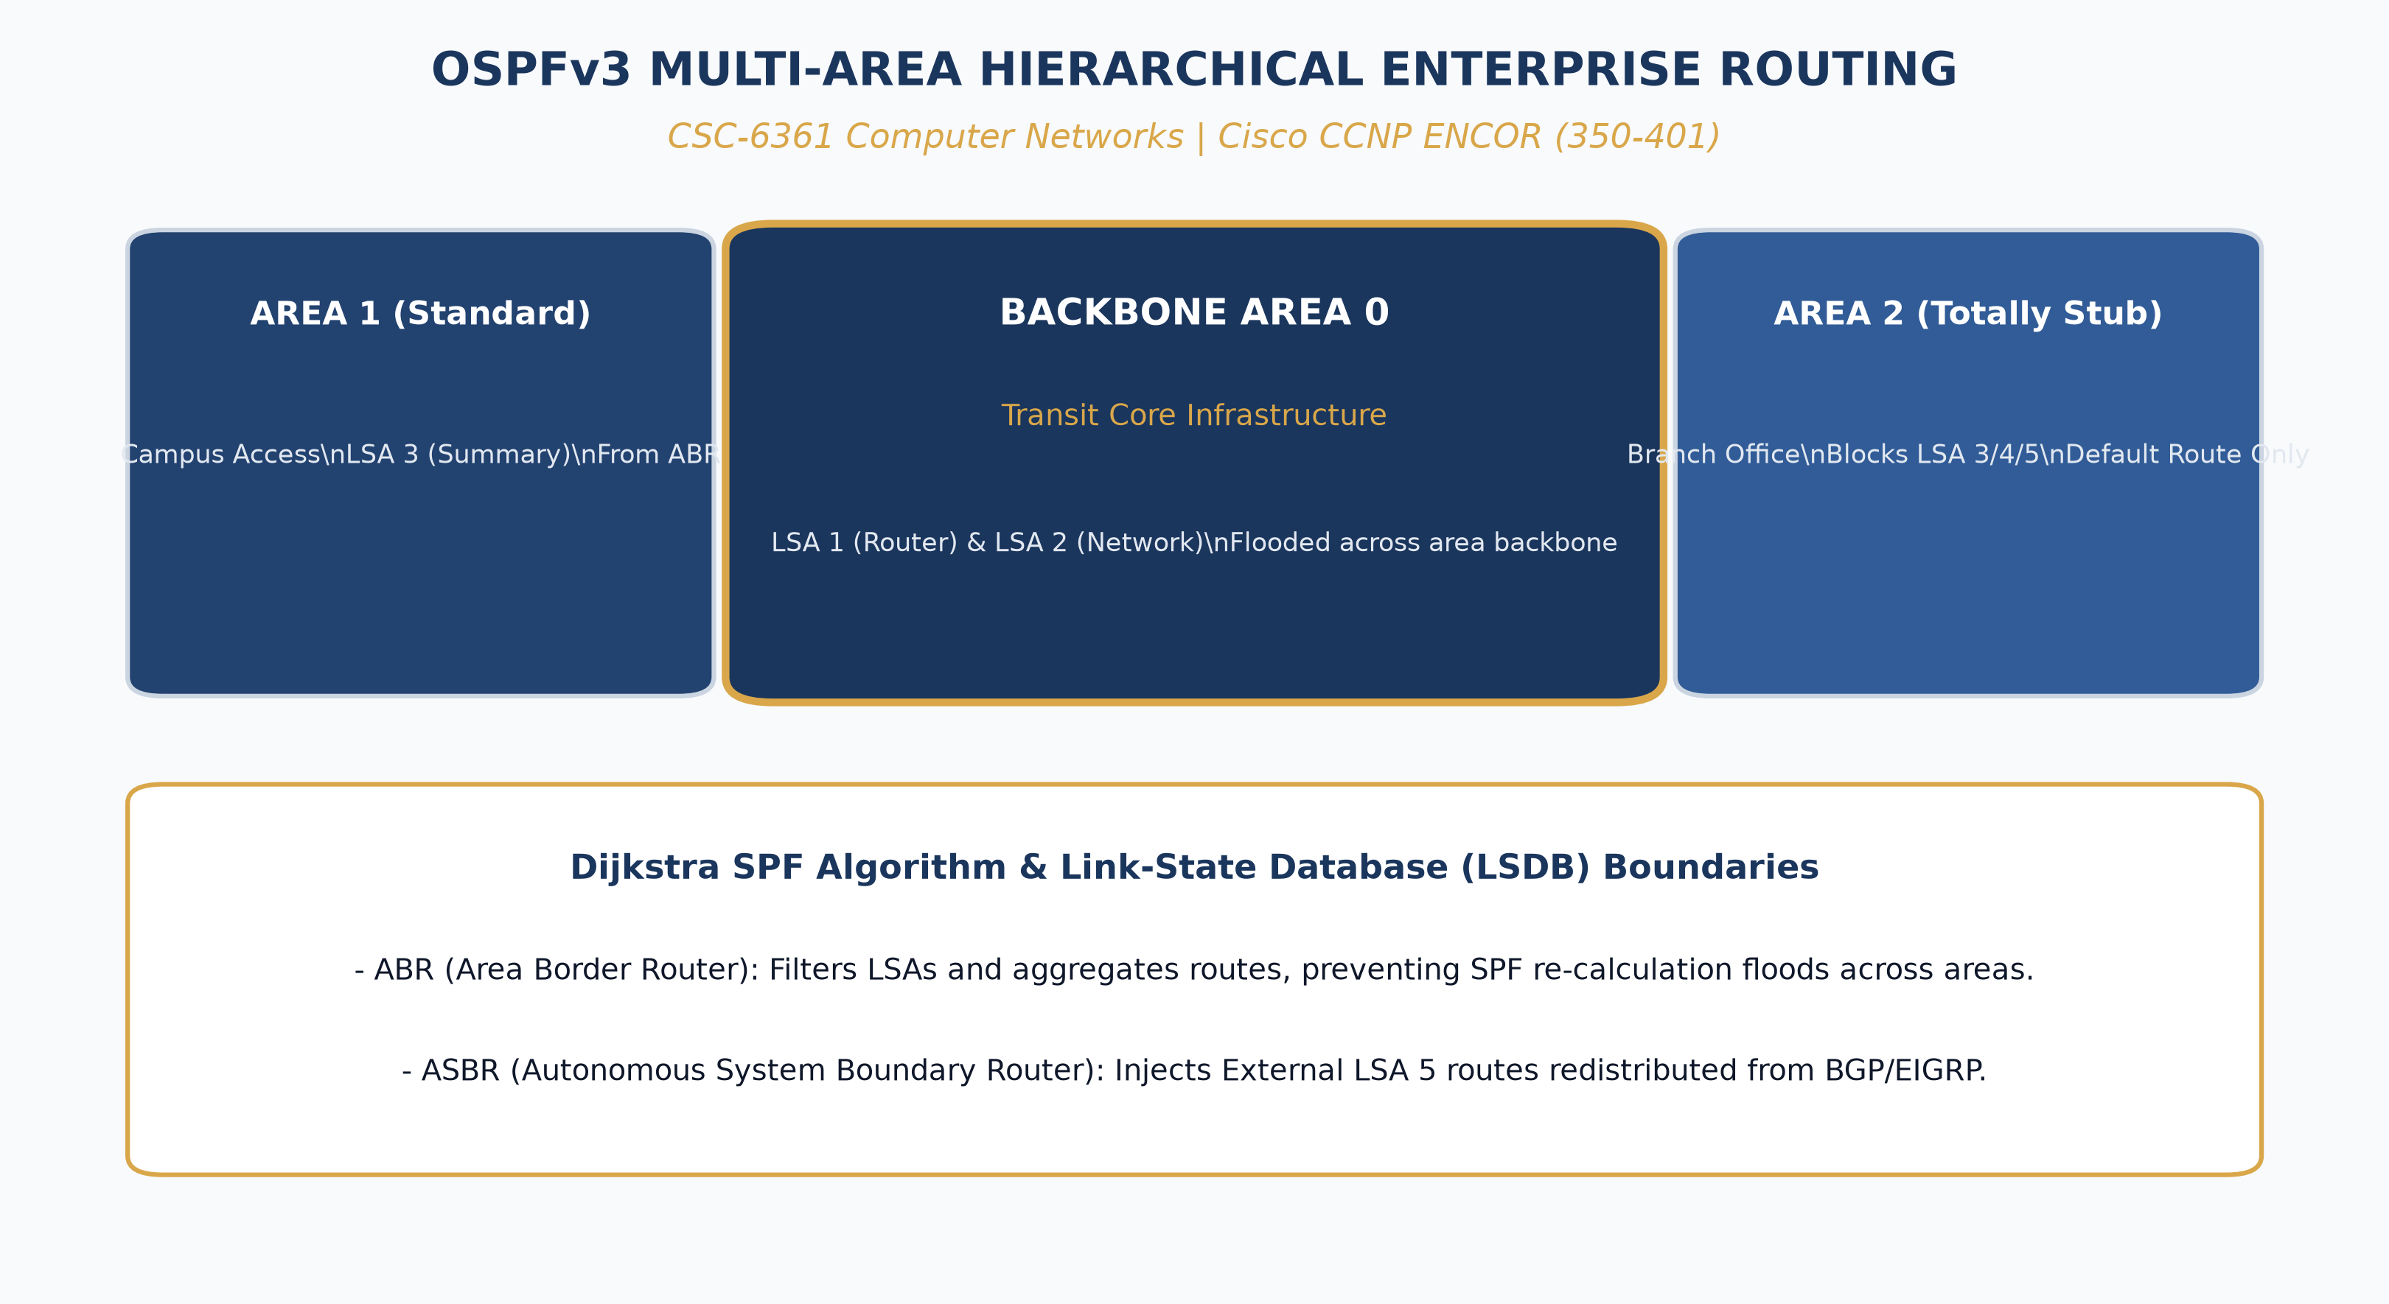
CSC-6361 · MODULE 02: LINK-STATE ROUTING
Multi-Area OSPFv2/OSPFv3 Interior Routing
• Hierarchical Area Segmentation: All non-backbone areas (Area 1, Area 2...) must connect directly to Area 0 (Backbone Area) to prevent inter-area routing loops.
• Link State Database (LSDB): Every router in an area maintains an identical map of the network topology, calculated independently via Dijkstra's Shortest Path First (SPF) algorithm.
• Router Classifications: Internal Routers, Area Border Routers (ABRs - link Area 0 to standard areas), Autonomous System Boundary Routers (ASBRs - redistribute external routes).
• LSA Types & Information Flooding: LSA 1 (Router LSA), LSA 2 (Network LSA via DR), LSA 3 (Summary LSA via ABR), LSA 4 (ASBR Summary), LSA 5 (AS External LSA).
• Inter-Area Route Summarization: Configured on ABRs to condense dozens of internal subnets into a single prefix, shrinking routing table sizes and isolating SPF recalculations.
Texas Wesleyan University | Department of Computer Science & Information Technology | CSC-6361 | Professor William Nash, Ph.D.
Notes:
In Module 2, we explore interior gateway protocols, specifically Multi-Area OSPF. In a small network, single-area OSPF works well. But in an enterprise with thousands of routers, running Dijkstra's algorithm across the entire network whenever a single interface flaps exhausts router CPU cycles and causes instability. Look at the topology on the right. OSPF solves this through two-level hierarchy. Area 0 is the contiguous backbone. Surrounding areas, like Area 10 for Campus West and Area 20 for Campus East, connect to Area 0 through Area Border Routers (ABRs). When a link flaps inside Area 10, the full SPF recalculation is confined strictly to Area 10! The ABR simply generates an LSA Type 3 Summary LSA into Area 0. By configuring manual route summarization on the ABR, dozens of subnets are advertised as a single aggregate prefix, conserving routing memory across the entire enterprise.

Slide 4
CSC-6361 · MODULE 03: ALGORITHMIC ROUTING
Dijkstra's SPF Algorithm & Metric Mechanics
Dijkstra's Shortest Path First (SPF)
• Graph Theoretical Representation: Network modeled as a directed graph G = (V, E), where V represents routers/switches and E represents directional links with positive weights.
• Computational Complexity: Standard Dijkstra implementation yields O(|V|^2) or O(|E| + |V| log |V|) with a Fibonacci min-heap priority queue.
• SPF Convergence Lifecycle: 1. Topology changes -> 2. Flooding of LSA packet -> 3. LSDB updated -> 4. Dijkstra executes -> 5. RIB (Routing Table) updated -> 6. Hardware FIB reprogrammed.
• Partial Route Calculation (PRC): In modern implementations (OSPF/IS-IS), prefix changes trigger fast PRC without executing a full node-tree SPF recalculation.
OSPF Metric Engineering & Tuning
• Reference Bandwidth Formula: Cost = Reference Bandwidth / Interface Bandwidth (bps). Default reference bandwidth in legacy Cisco IOS is 10^8 (100 Mbps).
• The 100 Mbps Metric Anomaly: At default 100 Mbps reference bandwidth, FastEthernet (100M), GigabitEthernet (1G), and 10-GigabitEthernet (10G) all receive cost = 1!
• Corrective Configuration: Must configure 'auto-cost reference-bandwidth 100000' (or 1000000) across all routers to differentiate gigabit and 100G fiber links.
• Interface Cost Tuning: Directly altering cost via 'ip ospf cost <value>' to engineer asymmetric traffic flows and backup link utilization.
Texas Wesleyan University | Department of Computer Science & Information Technology | CSC-6361 | Professor William Nash, Ph.D.
Notes:
Module 3 covers the algorithmic engine powering link-state routing: Dijkstra's algorithm. Dijkstra builds a shortest-path tree rooted at the local router. The metric OSPF uses is Cost, inversely proportional to bandwidth: Cost equals reference bandwidth divided by interface bandwidth. Here is an important real-world engineering caveat: Cisco's default reference bandwidth was set decades ago to 100 Megabits per second. Under that default, a 100 Mbps link has a cost of 1. But a 1 Gbps link and a 10 Gbps link also round down to a cost of 1! The router would treat a slow 100 Megabit link as identical to a 10 Gigabit fiber pipe. Therefore, in any modern enterprise or graduate lab, the very first command we issue is 'auto-cost reference-bandwidth 100000' to accurately reflect high-speed infrastructure.

Slide 5
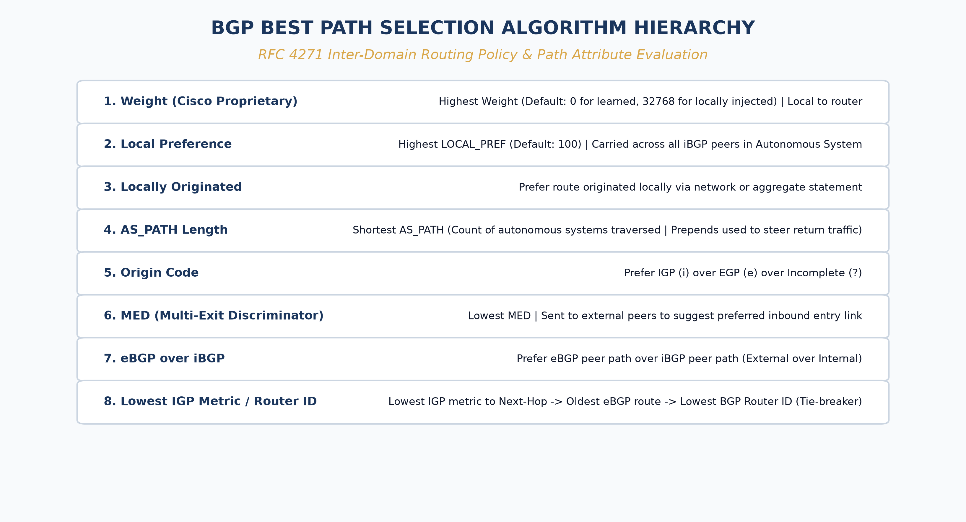
CSC-6361 · MODULE 04: BGP FUNDAMENTALS
Inter-Domain Routing: BGP-4 Path Selection
• Path-Vector Paradigm: BGP does not calculate link metrics; it exchanges Autonomous System paths (AS-Path), preventing routing loops across the global Internet.
• Autonomous System (AS) Numbers: 2-byte legacy (1-65535) and 4-byte modern ASNs (RFC 4893). Public ASNs allocated by IANA/RIRs; Private ASNs (64512-65534).
• iBGP vs eBGP Mechanics: eBGP runs between different ASNs (TTL=1, updates AS-Path). iBGP runs within the same AS (requires full mesh or Route Reflectors; does not update AS-Path).
• Deterministic Decision Algorithm: Evaluates attributes in strict order: Weight (Cisco) -> Local Preference -> Originate -> AS-Path Length -> Origin -> MED -> eBGP over iBGP -> IGP Metric -> Router ID.
• Policy-Driven Routing Engine: Enables network operators to enforce business contracts, transit agreements, and peering policies over simple shortest-distance metrics.
Texas Wesleyan University | Department of Computer Science & Information Technology | CSC-6361 | Professor William Nash, Ph.D.
Notes:
In Module 4, we step out of internal enterprise networks and examine the routing protocol that glues the global Internet together: the Border Gateway Protocol, or BGP-4. BGP is not a distance-vector or link-state protocol; it is a Path-Vector protocol. It does not care about ping times or link costs; it cares about policy and business agreements between Autonomous Systems. Look at the BGP decision hierarchy on the right. When multiple paths exist to the same destination prefix, BGP evaluates them in an exact, deterministic order. First, Cisco-proprietary Weight (highest wins, local to router). Second, Local Preference (highest wins, shared across the AS to choose outbound exit points). Third, locally originated routes. Fourth, the shortest AS-Path. Fifth, Origin code (IGP over EGP over Incomplete). Sixth, Multi-Exit Discriminator or MED (suggesting inbound paths to neighbors). Memorizing this decision sequence is fundamental for any senior network architect.

Slide 6
CSC-6361 · MODULE 05: BGP ENGINEERING
BGP Policy Engineering & Route Manipulation
Inbound & Outbound Traffic Engineering
• Controlling Outbound Traffic: Manipulate Local Preference (default 100). Higher values dictate which internal edge router carries enterprise traffic out to the Internet.
• Controlling Inbound Traffic: AS-Path Prepending: artificially appending our own ASN multiple times (e.g., '65001 65001 65001') to make a backup transit link appear longer and less attractive to external peers.
• Multi-Exit Discriminator (MED): Non-transitive metric passed to an external neighbor to express a preference between multiple ingress points into our AS (lower MED wins).
• BGP Communities: Numerical tags (e.g., ASN:Value) attached to prefixes to trigger upstream ISP traffic engineering actions (blackholing, local-pref manipulation).
Route Filtering & Peering Architectures
• Prefix Lists & Route Maps: Granular filtering of routes received from or advertised to peers, preventing catastrophic route leak accidents.
• RPKI Route Origin Validation: Resource Public Key Infrastructure uses cryptographic signatures (ROAs) to validate that an advertising ASN is authorized to originate a prefix, defeating BGP hijacking.
• Internet Exchange Points (IXPs): Physical switching fabrics where hundreds of ISPs, CDNs (Netflix, Google, Cloudflare), and enterprises peer directly to exchange traffic settlement-free.
• Transit vs Peering Economics: Paid IP Transit (metered Gbps) vs Settlement-Free Peering (mutual exchange of customer routes at IXP switches).
Texas Wesleyan University | Department of Computer Science & Information Technology | CSC-6361 | Professor William Nash, Ph.D.
Notes:
Module 5 explores BGP traffic engineering in practice. How do we influence which path traffic takes across the Internet? For outbound traffic leaving our network, we manipulate Local Preference—higher local preference wins. For inbound traffic entering our network from external providers, the challenge is harder because upstream providers make their own routing decisions. To discourage incoming traffic on a backup link, we employ AS-Path Prepending: we artificially duplicate our own AS number three or four times. When the rest of the world sees that path, it evaluates it as longer and prefers our primary link. We also explore RPKI—Resource Public Key Infrastructure. Historically, BGP had no authentication; any router could announce any IP block, leading to catastrophic BGP route hijacking. With RPKI cryptographic validation, routers drop unauthorized route announcements automatically.

Slide 7
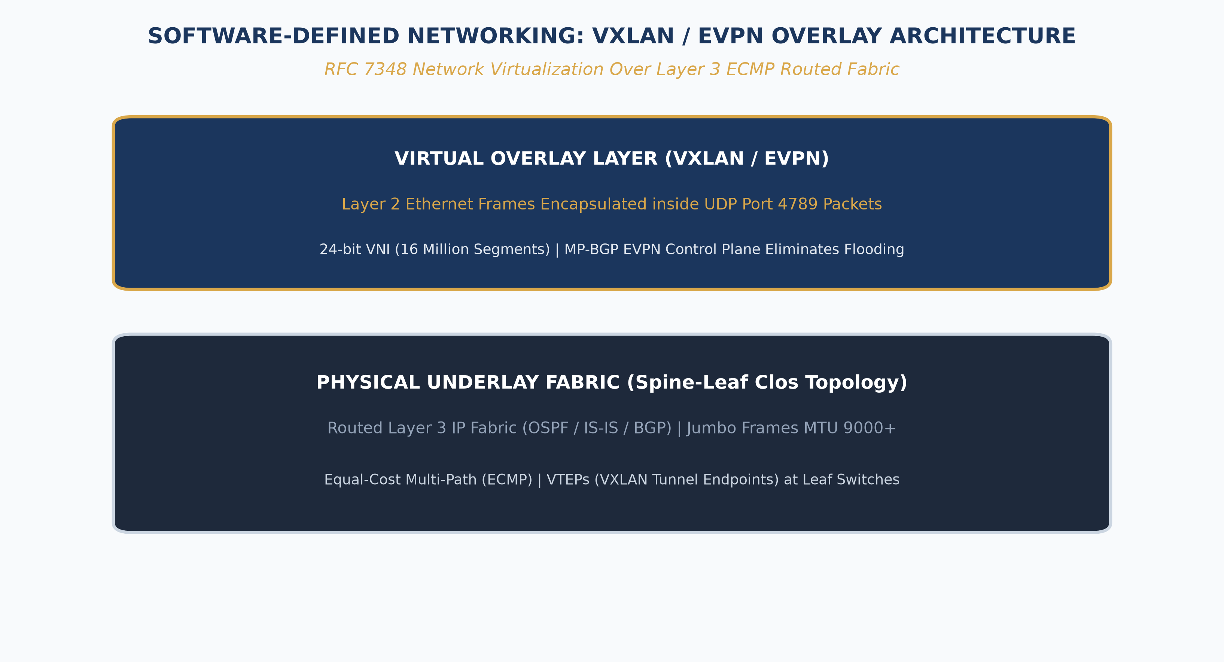
CSC-6361 · MODULE 06: DATA CENTER FABRICS
Data Center Fabrics & VXLAN / EVPN Overlays
• Spine-and-Leaf Architecture: Replaces legacy spanning-tree access-aggregation-core tiers; every leaf connects to every spine, ensuring consistent 1-hop latency and ECMP load balancing.
• The Underlay vs. Overlay Paradigm: Underlay Network: robust, high-speed Layer 3 routed fabric (BGP/OSPF). Overlay Network: virtualized Layer 2/3 topologies running over the underlay.
• VXLAN Protocol (RFC 7348): Encapsulates Layer 2 Ethernet frames inside Layer 4 UDP datagrams (port 4789), expanding VLAN scale from 4,096 to 16.7 million Virtual Network Identifiers (VNIs).
• VTEP Tunnel Endpoints: VXLAN Tunnel Endpoints on leaf switches encapsulate and de-encapsulate virtual machine traffic transparently.
• BGP EVPN Control Plane: Replaces inefficient flood-and-learn multicast with MP-BGP (Type 2 MAC/IP advertisement routes, Type 5 IP prefix routes) for scalable host reachability.
Texas Wesleyan University | Department of Computer Science & Information Technology | CSC-6361 | Professor William Nash, Ph.D.
Notes:
In Module 6, we analyze modern hyperscale data center architecture. Look at the diagram on the right. In cloud data centers hosting thousands of virtual machines, traditional spanning tree architectures are dead. If spanning tree blocks half your links, you waste 50% of your multi-million dollar fiber investment! Instead, modern data centers use a 2-tier Spine-Leaf Clos topology. Every leaf switch connects to every spine switch. The physical fabric—the Underlay—is a pure Layer 3 routed network running BGP or OSPF with Equal-Cost Multi-Pathing (ECMP). To allow virtual machines in the same subnet to migrate anywhere in the data center across Layer 3 boundaries, we create an Overlay network using VXLAN. VXLAN encapsulates the VM's Layer 2 Ethernet frame inside a standard Layer 4 UDP packet. Leaf switches act as VXLAN Tunnel Endpoints (VTEPs). To manage these tunnels without flooding, we use Ethernet VPN (EVPN) via Multi-Protocol BGP to distribute MAC and IP reachability like routing updates. This is the architecture powering modern cloud providers like AWS, Google Cloud, and Azure.

Slide 8
CSC-6361 · MODULE 07: TRANSPORT PROTOCOLS
Transport Layer Evolution: TCP Dynamics to QUIC
TCP Congestion Control Evolution
• Loss-Based Congestion (Tahoe/Reno): AIMD (Additive Increase, Multiplicative Decrease). Interprets packet loss as congestion, halving cwnd (congestion window). Induces bufferbloat on high-speed links.
• CUBIC Congestion Control: Standard Linux TCP algorithm. Uses a cubic window growth function independent of RTT, scaling aggressively on long-fat networks (high BDP).
• BBR (Bottleneck Bandwidth and RTT): Google's model-based algorithm. Measures delivery rate and minimum RTT directly; does not treat packet loss as congestion, maximizing throughput without filling buffers.
• Explicit Congestion Notification (ECN): Routers mark CE bits in IP header during incipient queue buildup; receiver echoes ECE to sender to reduce rate before drops occur.
The QUIC Protocol & HTTP/3
• Transport Over UDP: QUIC runs in user-space on top of UDP (port 443), bypassing slow OS kernel TCP stack upgrade cycles across billions of devices.
• Zero-RTT Connection Setup (0-RTT): Combines transport handshake and TLS 1.3 cryptographic key negotiation into a single round-trip (or 0-RTT for resumed sessions).
• Elimination of Head-of-Line Blocking: Unlike TCP, where a single dropped packet stalls all multiplexed streams in the connection, QUIC streams are independent at Layer 4.
• Connection Migration: Uses 64-bit Connection IDs rather than 4-tuple IP/ports, allowing seamless handoff as mobile devices switch between Wi-Fi and 5G cellular.
Texas Wesleyan University | Department of Computer Science & Information Technology | CSC-6361 | Professor William Nash, Ph.D.
Notes:
Module 7 explores the transport layer, where theoretical computer science meets practical software engineering. For decades, TCP congestion control relied on loss: send packets faster until one drops, then slash the transmission rate in half. On gigabit fiber links with large buffers, this causes severe bufferbloat. Google introduced BBR, which models bottleneck bandwidth and minimum RTT to maximize throughput without causing queue buildup. Even more revolutionary is QUIC, the transport protocol underpinning HTTP/3. TCP suffers from Head-of-Line blocking: if one packet in a stream drops, the entire connection freezes until it retransmits. QUIC runs on top of UDP and embeds TLS 1.3 encryption directly into the transport header. Multiplexed streams are completely independent, and connection migration allows your smartphone to switch from campus Wi-Fi to cellular data without dropping your video call!

Slide 9
CSC-6361 · MODULE 08: MODERN PARADIGMS
Software-Defined Networking & Programmable Data Planes
Software-Defined Networking (SDN)
• Decoupling Planes: Separates the distributed Control Plane (routing decision logic) from the hardware Data Plane (forwarding engines).
• Centralized Controller Architecture: Logically centralized controllers (ONOS, OpenDaylight) maintain a global network view and program flow tables via Southbound APIs (OpenFlow, P4Runtime).
• Northbound APIs & Automation: RESTful / gRPC interfaces allowing cloud orchestration software (Kubernetes, OpenStack) to instantiate networks dynamically via code.
• Intent-Based Networking (IBN): Operators declare high-level operational policies; the controller automatically translates, verifies, and deploys configuration down to the infrastructure.
Programmable Data Planes (P4 Language)
• P4 Programming Paradigm: 'Programming Protocol-Independent Packet Processors' allows compiling custom packet parsing algorithms directly into network switch silicon.
• Reconfigurable Match-Action Tables (RMT): Replaces fixed-function ASICs with programmable pipelines capable of parsing arbitrary protocol headers (custom telemetry, IoT, AI tensors).
• In-Band Network Telemetry (INT): Packets collect telemetry data (ingress timestamp, queue latency, switch ID) directly in-flight through headers without CPU polling.
• Hardware Acceleration: SmartNICs and Data Processing Units (DPUs) offloading network virtualization, encryption, and storage logic from host CPUs.
Texas Wesleyan University | Department of Computer Science & Information Technology | CSC-6361 | Professor William Nash, Ph.D.
Notes:
In Module 8, we study Software-Defined Networking and programmable data planes. Traditional networking bundled the control plane and data plane into proprietary vendor hardware boxes. SDN decoupled them: the forwarding switches become fast, dumb flow-tables, while a centralized software controller calculates routes with a global view of the network. Taking this one step further is P4—Programming Protocol-Independent Packet Processors. Historically, switch ASICs had fixed silicon: if a new protocol came out, you had to wait years for new hardware chips. With P4, engineers write code that compiles directly onto programmable switch chips, allowing custom packet parsing, in-band telemetry, and microsecond-level traffic engineering. Networking has truly become software.

Slide 10
CSC-6361 · MODULE 09: GRADUATE METHODOLOGY
Empirical Emulation, Measurement & Research
Network Research Environments
• Cisco Packet Tracer: High-fidelity protocol visualization, discrete event simulation, and rapid campus topology prototyping for our course lab deliverables.
• Mininet & SDN Emulation: Creates realistic virtual networks using Linux network namespaces and virtual Ethernet pairs running real Linux kernel network stacks.
• GNS3 / EVE-NG Network Emulators: Executes real vendor operating system binaries (Cisco IOL, Arista vEOS, Juniper vSRX) inside virtualized QEMU/KVM hypervisors.
• Discrete-Event Simulators (ns-3 / OMNeT++): Packet-level mathematical simulation enabling precise peer-reviewed evaluation of novel transport and queuing algorithms.
Experimental Design & Statistical Rigor
• Hypothesis Formulation: Defining measurable dependent variables (P99 tail latency, goodput, packet loss ratio) under variable independent loads.
• Tail Latency & Percentiles: Evaluating performance at 99th and 99.9th percentiles (P99/P99.9) rather than arithmetic means, capturing outlier degradation in hyperscale systems.
• Reproducibility & Artifact Sharing: Providing automated topology scripts, traffic generation profiles (iperf3, TRex), and raw PCAP trace datasets.
• Academic Publication Alignment: Structuring research papers according to IEEE/ACM networking standards (SIGCOMM, INFOCOM, CoNEXT).
Texas Wesleyan University | Department of Computer Science & Information Technology | CSC-6361 | Professor William Nash, Ph.D.
Notes:
Module 9 bridges our technical analysis with graduate research methodology. When conducting network research or evaluating architecture for an enterprise, an engineer cannot simply rely on averages. In large-scale systems, the average latency is meaningless; what matters is the P99 or P99.9 tail latency—the slowest requests that degrade user experience. In our course, you have hands-on lab projects in Packet Tracer. For your graduate capstone research, you will evaluate experimental designs using tools like Mininet, ns-3, or live hardware emulators. Focus on statistical rigor: define your hypothesis, isolate your variables, measure baseline performance, and capture packet traces using Wireshark to validate every theoretical claim.

Slide 11
CSC-6361 · MODULE 10: FUTURE HORIZONS
Emerging Frontiers: Ultra-Ethernet, AI Fabrics & Quantum
AI / ML Hyperscale Fabrics & Ultra Ethernet
• AI Workload Characteristics: Distributed training of Large Language Models requires massive, synchronized All-Reduce collective communication operations between tens of thousands of GPUs.
• The Problem with Standard Ethernet: Elephant flows cause hash collisions in traditional ECMP, resulting in network congestion and GPU idle time ('bubble time').
• RoCEv2 & RDMA: Remote Direct Memory Access over Converged Ethernet bypasses host OS kernel and CPU, writing directly between remote GPU memories at 400G/800G.
• Ultra Ethernet Consortium (UEC): Developing an open, optimized transport layer replacing TCP with packet spraying, selective retransmission, and in-network aggregation.
Quantum Communications & Post-Quantum Crypto
• Quantum Key Distribution (QKD): Exploits quantum entanglement and the No-Cloning Theorem to establish cryptographically unbreakable symmetric keys (e.g., BB84 protocol).
• Quantum Internet Architecture: Quantum repeaters using entanglement swapping to transmit quantum qubits across long-distance fiber networks.
• NIST Post-Quantum Cryptography (PQC): Standardized quantum-resistant algorithms: ML-KEM (Kyber) for key encapsulation and ML-DSA (Dilithium) for digital signatures.
• Migration Urgency ('Harvest Now, Decrypt Later'): Adversaries intercepting encrypted enterprise traffic today to decrypt once cryptanalytically relevant quantum computers emerge.
Texas Wesleyan University | Department of Computer Science & Information Technology | CSC-6361 | Professor William Nash, Ph.D.
Notes:
In Module 10, we examine the bleeding edge of networking: AI fabrics and Quantum networks. Training modern artificial intelligence models with hundreds of billions of parameters requires clustering tens of thousands of GPUs. These GPUs must synchronize gradients across the network. If the network experiences microsecond latency spikes, thousands of GPUs sit idle, burning millions of dollars in power! To solve this, the industry is transitioning to RoCEv2—RDMA over Converged Ethernet—and the Ultra Ethernet Consortium is redesigning transport protocols specifically for AI. Simultaneously, the threat of quantum computing breaking RSA and ECC has prompted NIST to standardize Post-Quantum Cryptography like ML-KEM and ML-DSA. As graduate engineers, you will be designing the networks that navigate these massive paradigm shifts.

Slide 12
CSC-6361 · COURSE CAPSTONE
Graduate Capstone Synthesis & Research Defense
CSC-6361 Graduate Synthesis
• Theoretical Depth: Rigorous understanding of queuing models, Dijkstra computational complexity, and transport layer congestion dynamics.
• Enterprise & Cloud Architecture: Mastery of multi-area OSPF, BGP-4 inter-domain routing policies, and VXLAN/EVPN data center Clos fabrics.
• Empirical Experimentation: Hands-on topology emulation, protocol verification, and Wireshark packet dissection.
• Research Readiness: Ability to formulate hypotheses, design reproducible network experiments, and evaluate empirical performance metrics.
Master's Defense Expectations
• Final Lab Practicum Submission: Submission of fully configured enterprise campus topologies in Packet Tracer with comprehensive routing validation.
• Research Paper / Project Defense: Formal defense of your semester research project examining advanced protocol dynamics or architecture modeling.
• Academic Rigor: Clear, precise scholarly writing adhering to IEEE citation and technical documentation standards.
• Final Office Hours & Consultations: Available via Canvas or scheduled Teams meetings for individual research guidance.
Texas Wesleyan University | Department of Computer Science & Information Technology | CSC-6361 | Professor William Nash, Ph.D.
Notes:
Scholars, this concludes our graduate lecture series in CSC-6361: Advanced Computer Networks. Throughout this semester, we have traversed the networking landscape from the foundational queuing mathematics of Little's Law, through multi-area OSPF and global BGP path vector dynamics, all the way to modern VXLAN data center fabrics and AI hyperscale infrastructure. You have demonstrated exceptional dedication to mastering both the theoretical elegance and the practical complexity of computer networks. As you finalize your semester research projects and lab deliverables, approach your work with scientific rigor, verify every claim with empirical packet traces, and prepare to defend your architectural designs. It has been a privilege guiding you through this material. I look forward to reading your final research papers. Thank you, and best of luck!

