Slide 1
TEXAS WESLEYAN UNIVERSITY · SCHOOL OF BUSINESS ADMINISTRATION
CIS-3321: Network Administration
Foundations of Enterprise Routing, Switching, IPv4/IPv6 Addressing, and Network Operations
Instructor: Professor William Nash, Ph.D.
Department of Computer Science & Information Technology | Fall 2026
Notes:
Welcome, students, to CIS-3321: Network Administration at Texas Wesleyan University. I am Professor William Nash. In this comprehensive lecture series, we bridge the theoretical foundations of network engineering with hands-on enterprise infrastructure design. Over the course of our modules, you will develop the skills required to design, configure, manage, and troubleshoot modern local area networks, switched architectures, and routed internetworks using Cisco Packet Tracer as our dedicated simulation laboratory. Let's dive into our foundational network models.

Slide 2
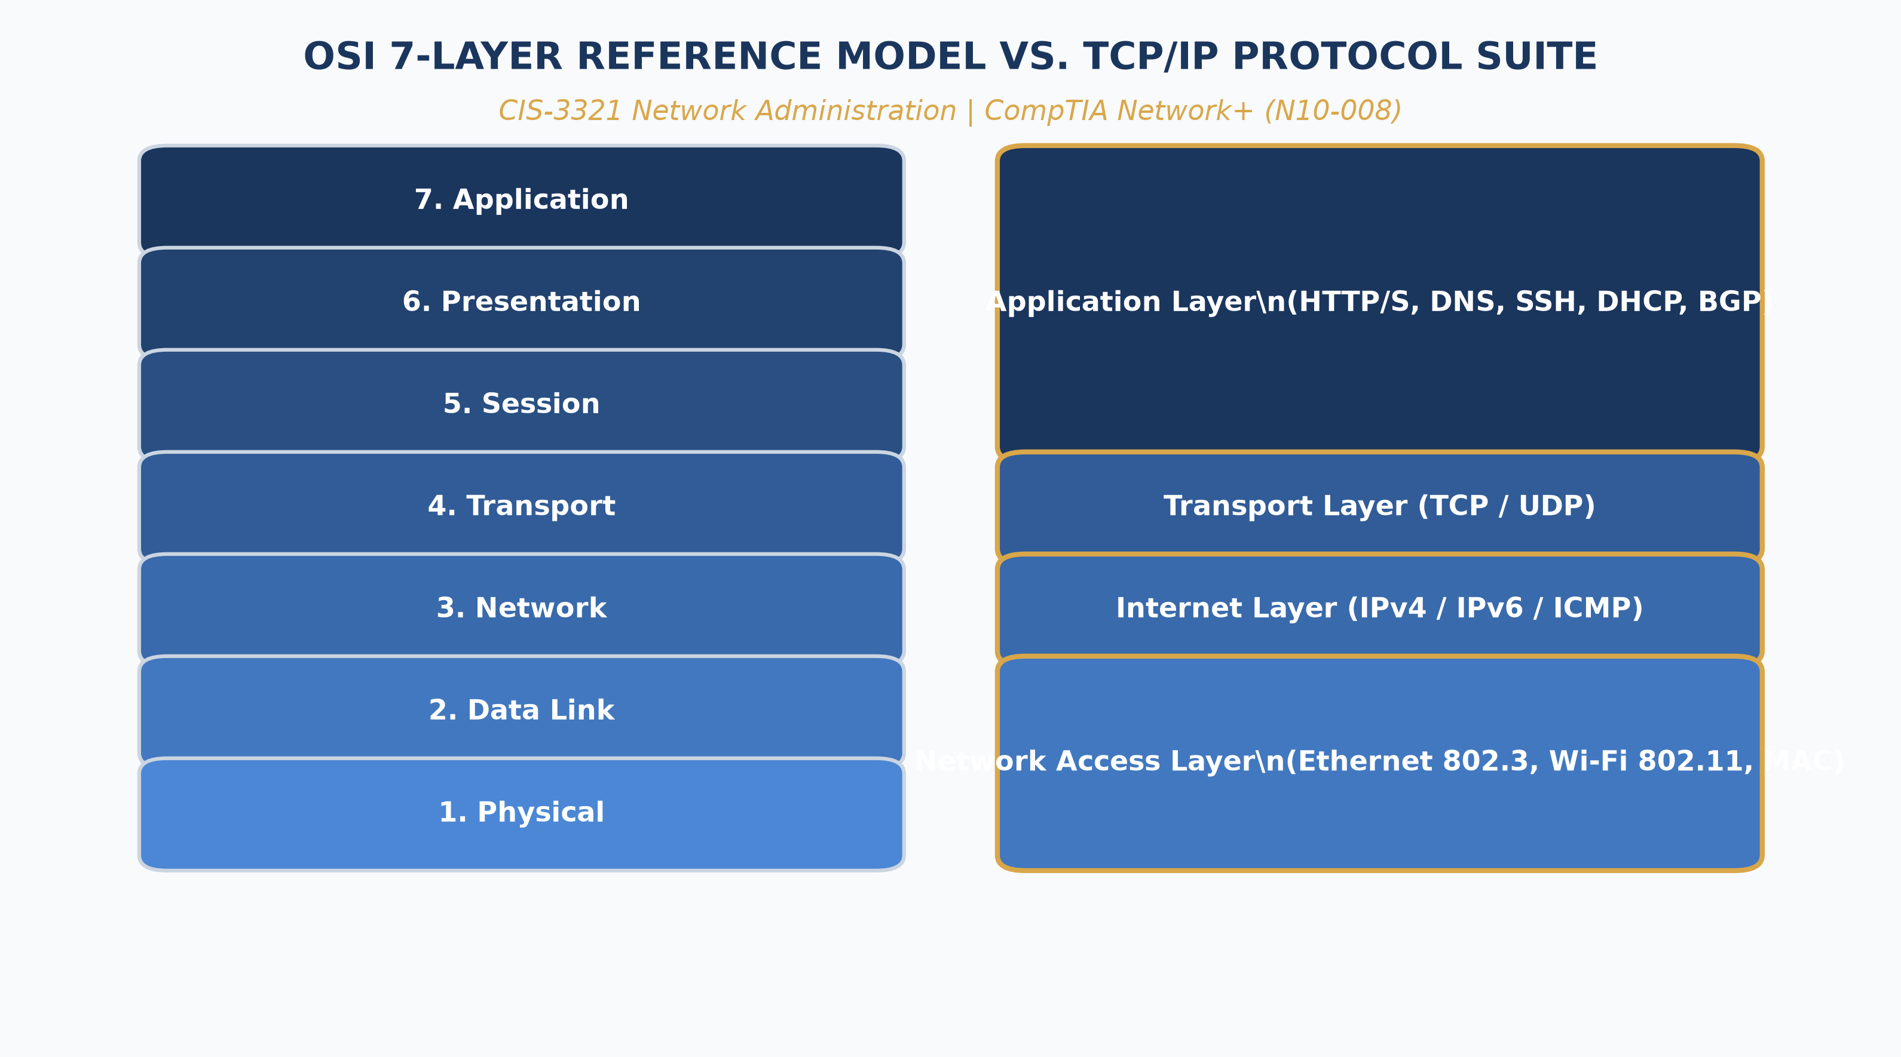
CIS-3321 · MODULE 01: FOUNDATIONS
Architectural Reference Models: OSI vs. TCP/IP
• Layered Abstraction: Decouples network applications from physical transmission media, enabling modular protocol development.
• OSI 7-Layer Hierarchy: Standardized by ISO: Application, Presentation, Session, Transport, Network, Data Link, Physical.
• TCP/IP 4-Layer Suite: The operational protocol architecture of the global Internet: Application, Transport, Internet, and Link / Network Access.
• PDU Encapsulation: Data descends the stack: Data -> Segment (TCP/UDP) -> Packet (IP) -> Frame (Ethernet) -> Bits (Physical medium).
• De-encapsulation at Receiver: Each receiving layer strips its corresponding header, parses control metadata, and passes the payload upward.
Texas Wesleyan University | Department of Computer Science & Information Technology | CIS-3321 | Professor William Nash, Ph.D.
Notes:
On this slide, we examine the structural backbone of all modern communications: the 7-Layer OSI Reference Model and its real-world implementation, the TCP/IP Protocol Suite. Take a close look at the diagram on the right. Notice how the top three layers of the OSI model—Application, Presentation, and Session—are consolidated directly into the TCP/IP Application layer. As an enterprise network administrator, you will live primarily in Layers 1 through 4. At Layer 4, Transport, data is segmented into TCP segments or UDP datagrams. At Layer 3, Network, we encapsulate these into IP packets containing logical source and destination IP addresses. At Layer 2, Data Link, we wrap the packet into an Ethernet frame containing physical MAC addresses and a Frame Check Sequence for error detection. Finally, at Layer 1, physical transceivers convert those frames into electrical pulses, fiber-optic light, or RF radio waves. Understanding this encapsulation sequence is crucial for diagnosing network faults.

Slide 3
CIS-3321 · MODULE 02: LAYER 2 INFRASTRUCTURE
Ethernet Switching & Data Link Operations
Ethernet Framing & Switching Mechanics
• Standard 802.3 Frame: Preamble (7 bytes), SFD (1 byte), Dest MAC (6 bytes), Source MAC (6 bytes), Type/Length (2 bytes), Payload (46-1500 bytes), FCS/CRC (4 bytes).
• MAC Address Learning: Switches examine incoming source MAC addresses, recording the ingress interface in the CAM (Content Addressable Memory) table with a 300s aging timer.
• Frame Forwarding Logic: Known Unicast: forward out designated port. Unknown Unicast: flood out all ports in the VLAN except the ingress port.
• Broadcast & Multicast: Broadcasts (FF:FF:FF:FF:FF:FF) flooded across entire broadcast domain; Multicast selectively forwarded via IGMP snooping.
Switch Architectures & Collision Domains
• Microsegmentation: Each dedicated full-duplex switch port forms its own isolated collision domain, effectively eliminating CSMA/CD collisions.
• Switching Methods: Store-and-Forward (validates entire FCS before forwarding, highest integrity) vs Cut-Through (forwards immediately after reading 6-byte dest MAC).
• Duplex & Speed Mismatch: Auto-negotiation failure results in half-duplex fallback, producing late collisions, FCS alignment errors, and severe packet degradation.
• Buffer Architectures: Port-based queuing vs Shared Memory buffering to handle high-bandwidth bursts and prevent packet drops.
Texas Wesleyan University | Department of Computer Science & Information Technology | CIS-3321 | Professor William Nash, Ph.D.
Notes:
Here in Module 2, we analyze how Layer 2 switches govern local traffic. A modern Ethernet switch is fundamentally a high-speed multi-port bridge operating in hardware via ASICs. When an Ethernet frame enters an interface, the switch reads its Source MAC address. If that MAC isn't in its Content Addressable Memory (or CAM table), the switch learns it and binds it to that port. Next, the switch inspects the Destination MAC address. If the destination is already known, it forwards the frame strictly out that single port. If the destination is unknown, it floods the frame out every port belonging to that VLAN except the receiving port. Notice how full-duplex switching establishes dedicated 100 Mbps or 10 Gbps paths per port, eliminating physical collisions. However, broadcast domains remain intact—and managing broadcast domains leads directly to our study of VLANs and subnetting.

Slide 4
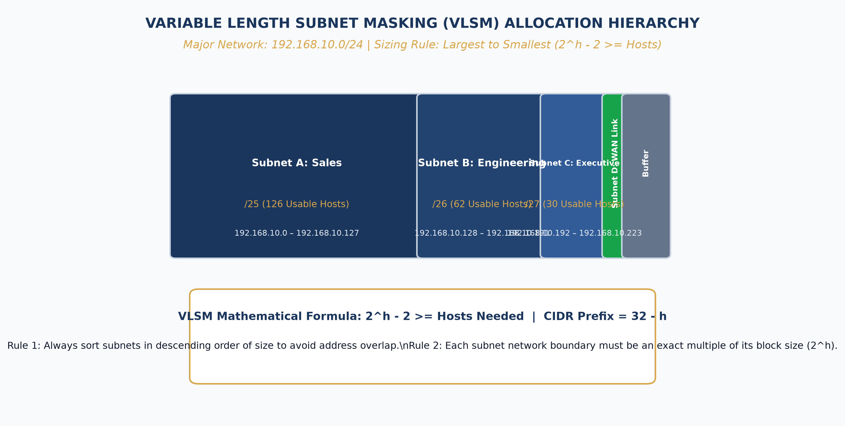
CIS-3321 · MODULE 03: IP ADDRESSING
Enterprise IPv4 Subnetting & VLSM Architecture
• Hierarchical IP Structure: 32-bit logical address partitioned into Network Prefix, Subnet bits, and Host identifier fields.
• Classless Inter-Domain Routing (CIDR): Deprecates rigid classful boundaries (Class A, B, C); uses slash notation (e.g., /24, /27) to maximize address conservation.
• Variable Length Subnet Masking (VLSM): Subnets a subnet: allows different subnet mask lengths across an enterprise hierarchy based on actual host density.
• Subnet Mathematical Derivation: Total hosts = 2^(host bits); Usable hosts = 2^(host bits) - 2 (reserving Network ID and Broadcast IP).
• Point-to-Point WAN Optimization: Deploying /30 (2 usable hosts) or /31 (RFC 3021 point-to-point links) prevents catastrophic IP address waste.
Texas Wesleyan University | Department of Computer Science & Information Technology | CIS-3321 | Professor William Nash, Ph.D.
Notes:
Moving to Module 3, let's examine IPv4 addressing and Variable Length Subnet Masking, or VLSM. In industry, network administrators who cannot subnet with precision waste costly public IP space and create unmanageable routing tables. Look at the diagram on the right. We start with a /24 block, 192.168.1.0/24, providing 256 raw addresses. Rather than assigning identical /26 subnets everywhere regardless of size, VLSM allows us to allocate a /26 with 62 usable hosts to Engineering, a /27 with 30 usable hosts to Sales, and /30 subnets with exactly 2 usable hosts to our router-to-router point-to-point WAN links. Always remember the fundamental formula: Usable hosts equals 2 to the power of host bits minus 2. That minus 2 accounts for the all-zeros host portion, which defines the subnet wire identifier, and the all-ones host portion, which serves as the local broadcast address. Master this binary arithmetic, as it is the core foundation of all IP routing.

Slide 5
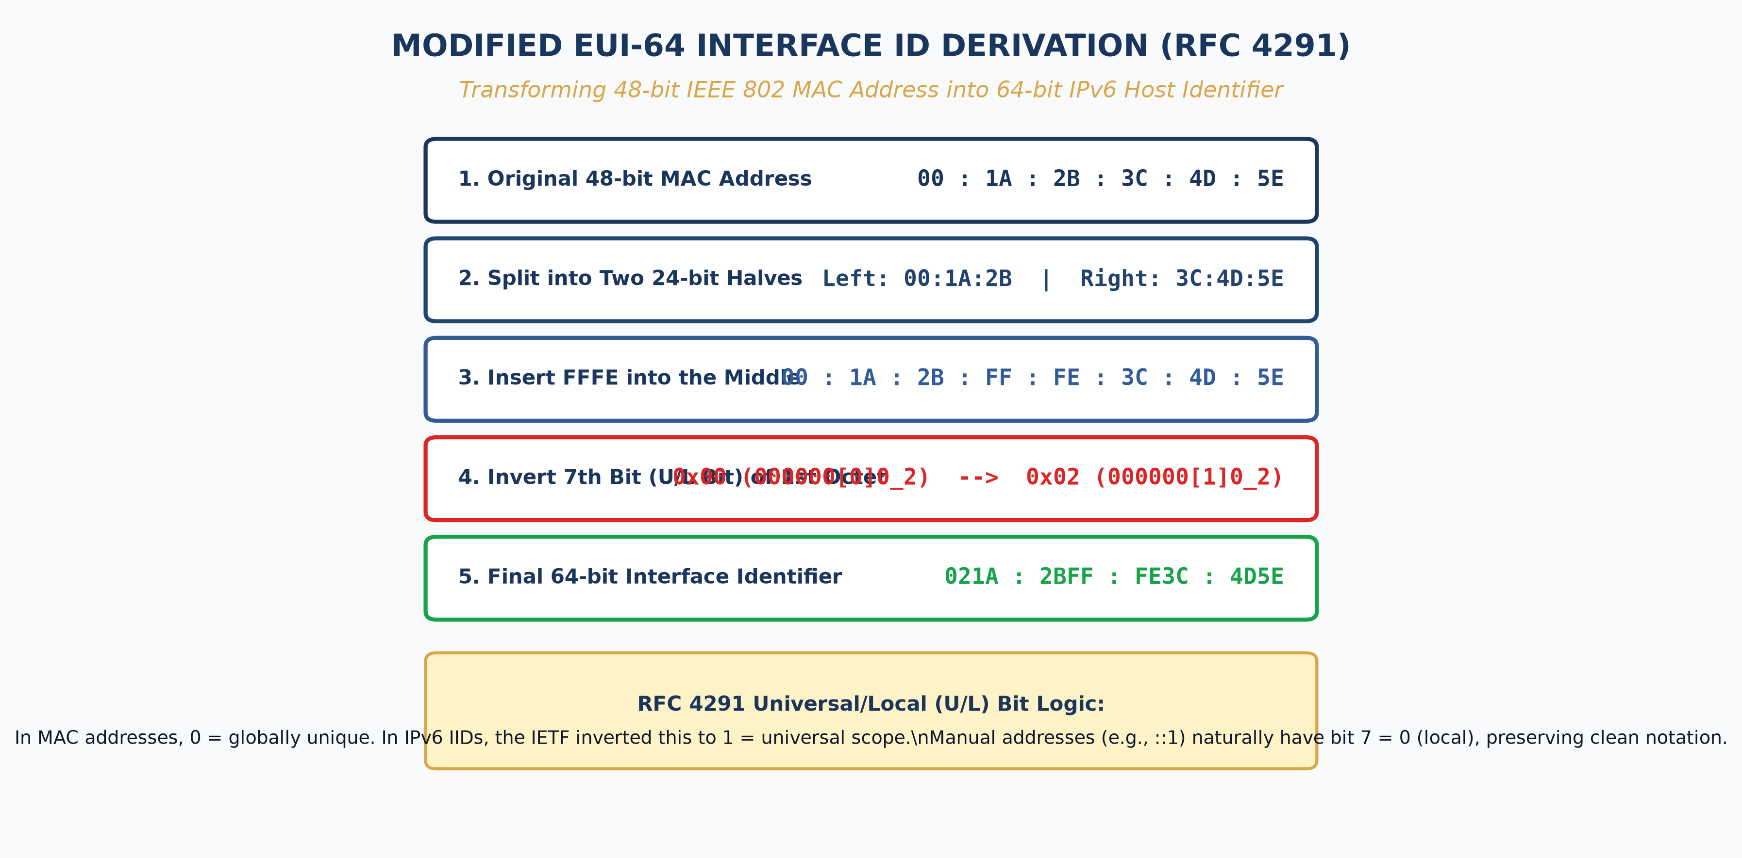
CIS-3321 · MODULE 04: IPV6 FOUNDATIONS
Next-Gen IP: IPv6 & Modified EUI-64 Interface IDs
• 128-Bit Hexadecimal Space: 3.4 x 10^38 addresses; eliminates NAT dependency and restores true end-to-end transport transparency.
• Standard Subnet Partition: /48 Global Routing Prefix assigned by ISP; /64 Subnet Prefix used uniformly on enterprise LANs (providing 18.4 quintillion hosts/subnet).
• Modified EUI-64 Generation: Automatically synthesizes a 64-bit Interface ID from a client's 48-bit physical MAC address.
• The 7th-Bit Universal/Local Inversion: Inverts bit 7 (Universal/Local bit) to 1, indicating locally managed EUI-64 compliance.
• Hexadecimal FFFE Insertion: Splits the 24-bit OUI and 24-bit NIC identifier, inserting 0xFFFE into the exact center.
Texas Wesleyan University | Department of Computer Science & Information Technology | CIS-3321 | Professor William Nash, Ph.D.
Notes:
In Module 4, we transition from IPv4 to the massive 128-bit address space of IPv6. In IPv6, subnets are standardized at /64. One of the most elegant mechanisms in IPv6 is Stateless Address Autoconfiguration, or SLAAC, combined with Modified EUI-64. Look closely at the diagram on the right. When an IPv6 host configures its interface ID automatically, it takes its 48-bit physical MAC address, splits it right between the 24-bit Vendor OUI and the 24-bit device NIC serial number, and inserts the hexadecimal string 0xFFFE right into the middle. Then—and this is a favorite certification exam question and critical networking concept—it inverts the 7th bit of the very first byte, the Universal/Local bit. As shown in our breakdown: 00 in hex is 0000 0000 in binary. Flipping the 7th bit produces 0000 0010, which converts to 02! Therefore, MAC 00:1A:2B:3C:4D:5E becomes Interface ID 021A:2BFF:FE3C:4D5E. This mathematical certainty guarantees unique, stateless link-local addresses.

Slide 6
CIS-3321 · MODULE 05: ROUTING FOUNDATIONS
Router Architecture & Cisco IOS CLI Operations
Hardware Architecture & Boot Sequence
• Control Plane vs Data Plane: Control Plane (Route Processor/CPU) manages routing protocols and RIB; Data Plane (ASICs/CEF) forwards packets at wire-speed.
• Memory Subsystems: ROM (POST, Bootstrap, ROMMON fallback), Flash (compressed Cisco IOS image), NVRAM (startup-config, config-register), RAM (running-config, routing table, ARP cache).
• Boot Sequence: 1. POST diagnostic -> 2. Bootstrap executes -> 3. IOS located in Flash & loaded into RAM -> 4. Startup-config parsed from NVRAM.
• Cisco Express Forwarding (CEF): Builds FIB (Forwarding Information Base) and Adjacency Table directly in hardware memory to bypass CPU route lookups.
Cisco IOS Command Hierarchy & Best Practices
• EXEC Modes: User EXEC (Router>) -> Privileged EXEC (Router#) via 'enable' -> Global Config (Router(config)#) via 'configure terminal'.
• Subconfiguration Modes: Interface (config-if)#, Line (config-line)#, Routing (config-router)#.
• Essential Security Baseline: 'service password-encryption', 'enable secret', 'banner motd', 'transport input ssh', and line vty console passwords.
• State Preservation: Always issue 'copy running-config startup-config' or 'write memory' to persist volatile RAM changes to non-volatile NVRAM.
Texas Wesleyan University | Department of Computer Science & Information Technology | CIS-3321 | Professor William Nash, Ph.D.
Notes:
Module 5 brings us into the core operational environment of Cisco IOS. A router is a specialized computer with distinct memory components. ROM contains the POST self-test and basic bootstrap instructions. Flash holds the operating system image itself. NVRAM contains your saved configuration file, startup-config, while dynamic RAM holds the running-config, the routing table, and the ARP cache. When you power on a router, the bootstrap loader pulls IOS into RAM, and if a configuration exists in NVRAM, it applies it. In our CLI operations, remember the hierarchy: User EXEC has limited monitoring rights; Privileged EXEC, unlocked by 'enable', allows deep inspection and debugging; and Global Configuration mode allows system-wide changes. When configuring routers in Packet Tracer, remember that changes in RAM disappear during a reboot unless you explicitly write them to NVRAM using 'copy running-config startup-config'.

Slide 7
CIS-3321 · MODULE 06: SWITCHED NETWORKS
VLAN Segmentation & Inter-VLAN Routing
Virtual LANs (VLANs) & 802.1Q Trunking
• Broadcast Domain Isolation: VLANs segment a single physical switch into multiple logical Layer 2 broadcast domains, enhancing security and bandwidth efficiency.
• Access vs Trunk Links: Access ports carry untagged traffic for a single VLAN (end devices). Trunk ports carry multiplexed traffic across switches for multiple VLANs.
• IEEE 802.1Q Tagging: Inserts a 4-byte VLAN tag into the Ethernet header, including a 12-bit VID (supporting VLANs 1 to 4094) and 3-bit 802.1p Priority field.
• Native VLAN Protocol: Untagged frames arriving on a trunk are assigned to the Native VLAN (default VLAN 1). Security standard dictates changing Native VLAN to an unused ID.
Inter-VLAN Routing Paradigms
• Legacy Routing: Required a dedicated physical router interface for every individual VLAN—economically unfeasible in enterprise scale.
• Router-on-a-Stick (ROAS): A single physical router interface connected to a trunk port is divided into logical subinterfaces (e.g., g0/0.10, g0/0.20) with 'encapsulation dot1Q'.
• Multilayer Switching (Layer 3): High-performance enterprise standard. Switches route between VLANs internally via Switched Virtual Interfaces (SVIs) at backplane speeds.
• Default Gateway Alignment: Each host's configured default gateway must match the exact IP address assigned to its local subnet's router subinterface or SVI.
Texas Wesleyan University | Department of Computer Science & Information Technology | CIS-3321 | Professor William Nash, Ph.D.
Notes:
In Module 6, we address the challenge of scale: Virtual LANs. By default, every port on a switch belongs to VLAN 1, forming one large broadcast domain. If a workstation broadcasts an ARP request, every machine on that switch must process it. By defining VLAN 10 for Faculty and VLAN 20 for Students, we physically isolate their traffic at Layer 2. To transport multiple VLANs between switches over a single physical cable, we use 802.1Q trunking, which injects a 4-byte tag into the Ethernet frame containing a 12-bit VLAN identifier. Now, how do hosts in VLAN 10 talk to hosts in VLAN 20? Since they reside in different IP subnets, they cannot communicate at Layer 2; they require a Layer 3 router. We achieve this either through Router-on-a-Stick—where subinterfaces like GigabitEthernet 0/0.10 act as default gateways—or via Layer 3 Multilayer Switches using Switched Virtual Interfaces, or SVIs. This architecture is central to our Packet Tracer laboratory assignments.

Slide 8
CIS-3321 · MODULE 07: HIGH AVAILABILITY
Redundancy & Loop Prevention: STP & EtherChannel
Spanning Tree Protocol (STP / RSTP)
• The Layer 2 Loop Hazard: Redundant switch links create catastrophic broadcast storms, multiple frame transmission, and CAM table instability within milliseconds.
• Root Bridge Election: Switches exchange BPDUs. The switch with the lowest Bridge Priority (default 32768) + MAC address becomes the Root Bridge for the topology.
• Port Roles & States: Root Ports (lowest path cost to root), Designated Ports (forwarding per segment), Alternate/Blocking Ports (logically disabled to break loops).
• Rapid STP (802.1w / 802.1s): Replaces legacy 50-second convergence (Listening/Learning/Forwarding) with sub-second synchronization via edge-port PortFast and handshake proposals.
Link Aggregation via EtherChannel
• Bandwidth Aggregation: Bundles 2 to 8 physical Ethernet interfaces into a single logical channel (Port-Channel), multiplying available throughput.
• STP Loop Mitigation: STP treats the entire aggregated bundle as one single logical interface, preventing redundant parallel links from being blocked.
• Protocol Standards: LACP (IEEE 802.3ad open standard - 'active' / 'passive') vs PAgP (Cisco proprietary - 'desirable' / 'auto').
• Load Distribution: Hashes Layer 2 MACs or Layer 3 IP addresses to balance flows across active physical member links.
Texas Wesleyan University | Department of Computer Science & Information Technology | CIS-3321 | Professor William Nash, Ph.D.
Notes:
Module 7 explores high availability and loop mitigation. In an enterprise network, we want physical redundancy so that if a cable or switch fails, the network stays alive. However, because Ethernet frames lack a Time-To-Live (TTL) counter, any Layer 2 loop causes broadcast frames to circulate endlessly, generating a broadcast storm that can saturate gigabit links and crash switch CPUs within seconds. The Spanning Tree Protocol, or STP, solves this by electing a Root Bridge and calculating the shortest tree path. Redundant links are placed into an Alternate Blocking state. If the primary link fails, STP unblocks the redundant link. In modern networks, we use Rapid STP (802.1w) for sub-second failover. Furthermore, to utilize all available physical links simultaneously without triggering STP blocking, we configure EtherChannel, bundling multiple physical interfaces into one logical channel using the open-standard Link Aggregation Control Protocol, or LACP.

Slide 9
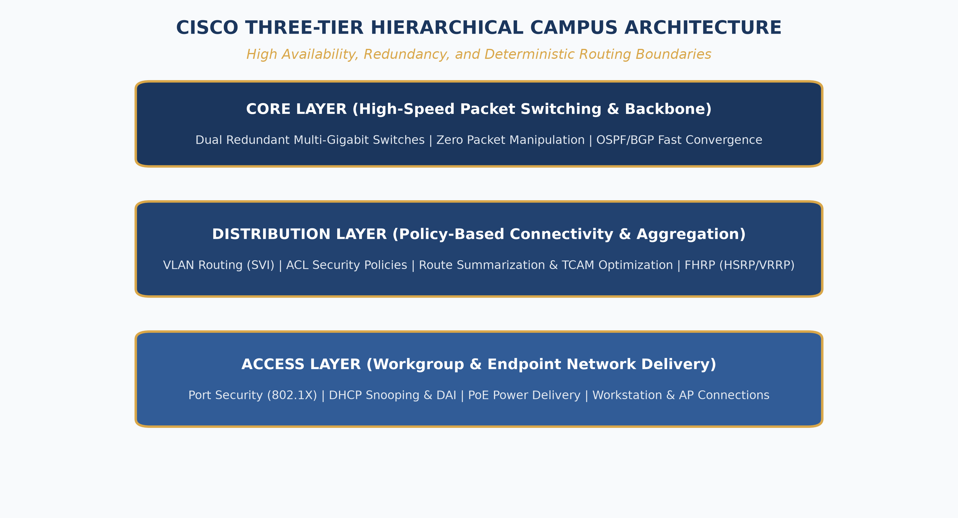
CIS-3321 · MODULE 08: ROUTING INFRASTRUCTURE
Enterprise Campus Architecture & Dynamic Routing
• Cisco Three-Tier Hierarchical Design: Core Layer (ultra-fast packet switching), Distribution Layer (policy, routing, ACLs, VLAN aggregation), Access Layer (workstation connectivity).
• Dynamic Routing Mechanics: Routers discover remote networks, maintain routing tables, and dynamically compute optimal paths without manual intervention.
• Distance-Vector vs Link-State: Distance-vector (RIP) evaluates hop counts blindly. Link-state (OSPF) builds a complete topological database (LSDB) using Dijkstra's algorithm.
• Single-Area OSPFv2 Deployment: Operates over IPv4; establishes neighbor adjacencies via Hello packets, calculates metrics based on cumulative interface bandwidth (Cost = 10^8 / bps).
• Designated Router (DR/BDR) Election: On multiaccess broadcast networks, routers elect a DR and BDR to reduce the O(N^2) flood of Link State Advertisements (LSAs).
Texas Wesleyan University | Department of Computer Science & Information Technology | CIS-3321 | Professor William Nash, Ph.D.
Notes:
On this slide, we synthesize these technologies into the classical Cisco Three-Tier Hierarchical Campus Model. Examine the topology diagram on the right. At the bottom is the Access Layer, where user workstations, IP phones, and wireless access points connect to switches. These access switches connect via redundant 802.1Q trunks to our Distribution Layer switches. The Distribution layer is the boundary between Layer 2 and Layer 3: it runs First Hop Redundancy Protocols, enforces Access Control Lists, and routes traffic between departments. Finally, the Core Layer acts as the enterprise backbone, transporting packets between distribution blocks and the data center or WAN edge at maximum wire speed. Within this campus backbone, we run Open Shortest Path First, or OSPF. Unlike distance vector protocols, OSPF routers flood Link State Advertisements, construct an identical map of the entire topology, and run Dijkstra's algorithm to compute the shortest cost path to every destination.

Slide 10
CIS-3321 · MODULE 09: APPLIED LABORATORIES
Packet Tracer Practical Protocol & Assessment
Packet Tracer Simulation Protocol
• Complete In-Platform Mastery: All practical assignments, packet flows, and topology configurations are completed directly within Cisco Packet Tracer—no NetAcad required.
• Real-Time vs Simulation Mode: Toggle to Simulation Mode to inspect individual PDU headers layer-by-layer as packets traverse switches, routers, and firewalls.
• CLI Troubleshooting Methodology: Master verification commands: 'show ip interface brief', 'show ip route', 'show mac address-table', 'show vlan brief', and 'show spanning-tree'.
• Automated Assessment Compliance: Ensure all host IPs, subnet masks, default gateways, and router hostnames match grading rubrics precisely for 100% lab completion.
Course Deliverables & Lab Schedule
• Lab M01: Cabling & Device Initial Config: Console access, banner configuration, SSH hardening, and IP address assignment on Cisco 2960 switches and 4321 routers.
• Lab M02: Subnetting & Addressing Plan: Implementation of VLSM subnets across multi-department enterprise campus topologies.
• Lab M03: VLANs, Trunks & ROAS: Configuring 802.1Q encapsulation, native VLANs, and subinterface routing on router gateways.
• Lab M04: OSPFv2 Dynamic Routing: Activating OSPF Area 0, verifying neighbor adjacencies, passive interfaces, and route convergence.
• Final Practical Practicum: Comprehensive multi-site enterprise build-out integrating all course routing, switching, and security elements.
Texas Wesleyan University | Department of Computer Science & Information Technology | CIS-3321 | Professor William Nash, Ph.D.
Notes:
In Module 9, let's discuss our lab methodology. Remember, as announced at the start of the semester, you do NOT need to log into any third-party NetAcad portal. All lab activities are hosted directly within Cisco Packet Tracer. When completing your labs, take full advantage of Simulation Mode. In simulation mode, you can freeze time, click on any packet as it sits on a wire, and inspect the Layer 2 Ethernet frame, the Layer 3 IP packet, and the Layer 4 segment. When troubleshooting, do not guess: use your verification commands. Issue 'show ip interface brief' to verify physical status and IP configuration. Issue 'show ip route' to confirm that routing paths exist. Check your VLAN assignments with 'show vlan brief'. Precision in syntax and attention to detail will ensure full points on every deliverable.

Slide 11
CIS-3321 · COURSE CAPSTONE
Course Synthesis & Industry Certification Alignment
Core Competencies Achieved
• Layer 2 Switching Mastery: VLAN segmentation, 802.1Q trunking, STP loop prevention, and EtherChannel port aggregation.
• Layer 3 Routing Engineering: Static routing, floating static routes, OSPF link-state routing, and inter-VLAN routing architectures.
• IP Address Engineering: Comprehensive mastery of IPv4 VLSM calculations and IPv6 EUI-64 SLAAC configurations.
• Operational Troubleshooting: Systematic OSI-model troubleshooting from physical layer cabling up to transport layer services.
Cisco CCNA (200-301) Roadmap
• Network Fundamentals (20%): Components, topology architectures, physical cabling, IPv4/IPv6 addressing schemes.
• Network Access (20%): VLANs, trunking, EtherChannel, Rapid PVST+, and wireless network architectures.
• IP Connectivity (25%): Routing tables, route determination, static routing, and single-area OSPFv2 operations.
• IP Services & Security (25%): DHCP, DNS, NAT/PAT, NTP, ACLs, Layer 2 security (port security, DHCP snooping, DAI).
• Next Steps: Complete the comprehensive Final Lab Practicum and review our Canvas practice exam sets.
Texas Wesleyan University | Department of Computer Science & Information Technology | CIS-3321 | Professor William Nash, Ph.D.
Notes:
To conclude our CIS-3321 lecture series: you have now acquired the foundational engineering skills that power modern digital enterprises. The topics we have mastered—from the binary mechanics of subnetting and EUI-64, to the intricacies of Spanning Tree and OSPF—directly map to the official Cisco CCNA 200-301 curriculum. As you prepare for the upcoming final lab exam, make sure you practice configuring these topologies from scratch on a blank Packet Tracer canvas. Thank you for your hard work and intellectual dedication this semester. I look forward to seeing your final lab submissions in Canvas. Have a great day!

