Slide 1
The Technology Value Stream
By Jordan Wrobel

Slide 2
Lead time vs. Processing time
Lead time
Is calculated from the time the ticket is created to the time it is received by the user.
The idea is to keep this as short as possible.
Processing time
This is calculated by the amount of time a developer is actually working on the project
It does not count the time the project is sitting in idle.
Often a ratio is calculated between Lead time and Processing time.

Slide 3
The Value Stream Efficiency Gap
< 5%
Usual process time as a share of total lead time
This means that usually over 95% of total lead time is spent waiting or spent on approval queues, handoffs, and batch delays.

Slide 4
The common scenario: Multi month deployments
Phase 1
Batch Requirements
Specs spend weeks waiting for sign-offs
Phase 2
Siloed Coding
Long lived feature branches accumulate severe merge debt.
Phase 3
Manual QA Cycles
Handed off to seperate testing teams for multi week regression.
Phase 4
CAB Approval
Change advisory board review schedules stall release windows.

Slide 5
The Cost of Multi Month Lead Times
Delayed Feedback
Defects discovered months after original coding need painful context switches.
Massive Batch Risk
Shipping thousands of changes at once makes root to cause diagnosis nearly impossible
Sunk Capital Waste
Completed engineering effort generates zero business return while trapped in queues.

Slide 6
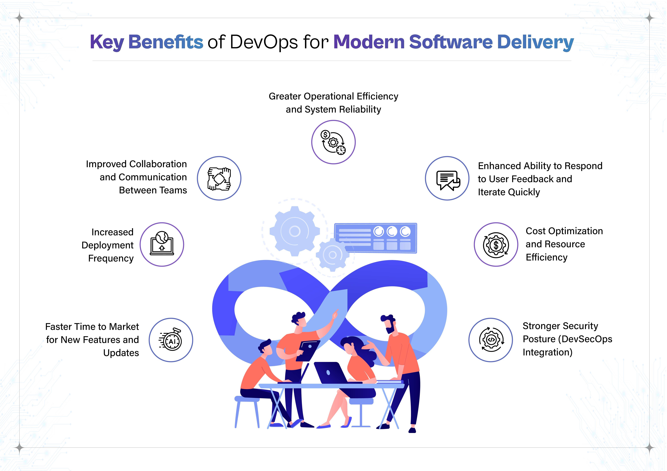
The DevOps Ideal: Deployment in Minutes
Single Piece Continuous Flow
Deployment lead time shifts from commit to production in less than 60 minutes. Work goes through automated test gates without having to push it through manually.
Fast Verification: CI suites execute in parallel.
Zero downtime Releases
Immediate Feedback

Slide 7
Pillars of Sub Hour Delivery
Trunk Based Flow
Many small merges eliminate multi day branch conflict resolution.
Automated Testing
Shift left pipelines manual testing gate bottlenecks.
Decoupled Deployments
Feature flags separate deployment to infrastructure from customer release.

Slide 8
Shortening Lead Time Unlocks Innovation Velocity
Focusing on deployment lead time shortens feedback loops, lowers operational risk, and changes software delivery from an event to a continuous capability.

Slide 9
Works Cited
https://cdn.prod.website-files.com/69e21b4f9f476c322983da68/6a9db185c9cceed5dc71ef59_68189d4ea78f0a32c26b564b_The%2520Evolution%2520from%2520DevOps%2520to%2520DevSecOps-03.jpeg Source: www.cogentuniversity.com
“Can you help me write a 7-10 slide presentation about the techonology value stream?” prompt. Gemini, Google, 10/24/2026, https://gemini.google.com/app.

