Slide 1
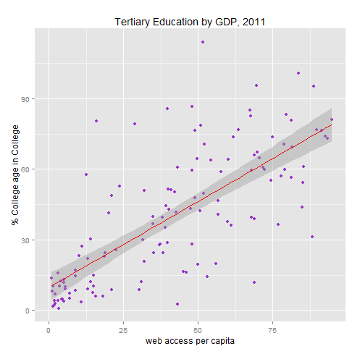
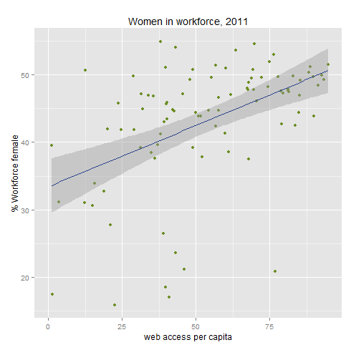
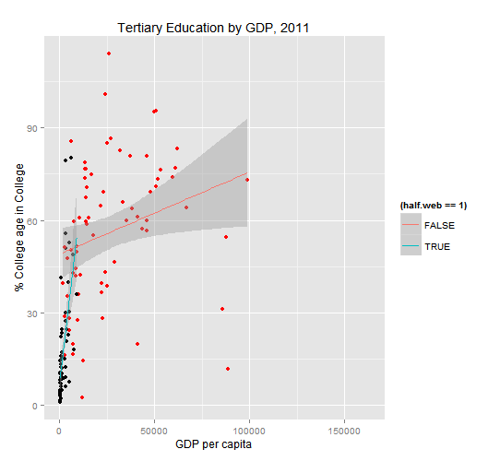
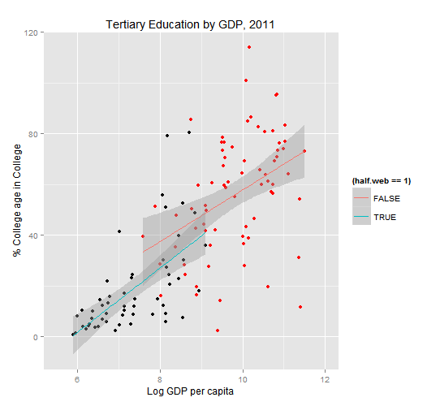
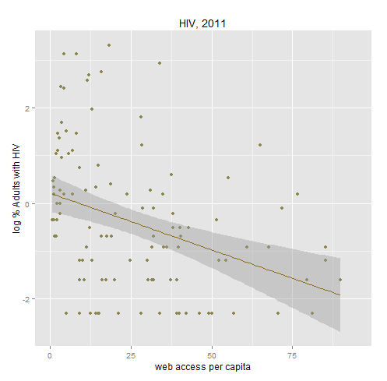
Investigating the Relationship Between Internet Access and Social Progress
Rob Smith
Introduction
Results
Discussion:
An explosion in access to the internet has brought about great societal change worldwide. A common attitude is that enhanced communication means enhanced democracy, and that people with a clear window to the world strive to better themselves and their societies.
However, confounding variables abound. One might see a spike in education in a country around the advent of the internet, but wealth might be an underlying factor which increases both internet access and education availability.
Using the model: Y=β₀+β₁(Web) + β₂X₂ ... + β_{k}X_{k} ,
Where Y is a measure of progress and each X is a possible confounding predictor (or interaction), the β₁ term in the models with and without the confounding variables was tested against
H₀: β₁= 0
H_{a}: β₁≠ 0
It's a bit surprising how web access remains a significant predictor so often even when controlled for. It would imply that there is something about countries with internet access vs those that don't, besides wealth and infrastructure, which contributes to positive social indicators. In this case, an increase in those who pursue education, a rise in jobs for women, and possibly a reduction in the transmission of HIV.
That difference well may be the internet it self, and an introduction into the global village. It may be a culture of openness and progress which accompanies the introduction of the internet. These results raise as many questions as they answer.
CAVEAT:
These data were collected for one year, 2011, because that was the year with the fewest holes in the World Bank data. It does not weight for population, which in hindsight could be an important step. As always, there is more research to be done on the topic, but only so much to reasonably include in one report.
Education
Regressed against web access only: p< .000
Proposal
Adding the variables:
-log GDP per capita
-% Expended on education
-log GDP x Education Expenditure
p= .0195, still the most significant, too!
Using the World Bank's World Development indicators, identify areas of societal progress (Pursuit of higher education, gender equality in the workforce, HIV infection rates) and investigate their statistical relationship to internet access in comparison to other, more intuitively related factors (spending on education, spending on health).
Women in workforce
Regressed against web access only: p< .000
Methods
Data was gathered from the World Bank via the WDI package in R.
Relationship of countries' web access to indicators of progress were investigated with and without possible confounding variables, and the differences in significance were noted.
Special attention is given to variable transformation, as an inappropriate model can be especially hazardous in the case of multiple predictors, for example:
Adding variables from education:
p<.000
Adding variable for contraceptive use:
p=.713
References
R Core Team. 2014. R: A Language and Environment for Statistical Computing. Vienna, Austria: R Foundation for Statistical Computing. http://www.R-project.org/.
Arel-Bundock, Vincent. 2013. WDI: World Development Indicators (World Bank). http://CRAN.R-project.org/package=WDI.
Wickham, Hadley. 2009. ggplot2: elegant Graphics for Data Analysis. Springer New York. http://had.co.nz/ggplot2/book.
HIV
Regressed against web access only: p< .000
Adding:
-log GDP
-Contraceptive use
p=.6
Apparent Change
Less Change

