Slide 1
Java Vars
Sebastian Rabiej

Slide 2

About me
Java Developer
4 years professionally, 12 as a hobby
Looking for the meaning of words „being professional”
Mail: SebastianRabiej[AT]o2.pl
Twitter: @sebastianrabiej
Blog: pomiedzyliniamikodu.blogspot.com
@sebastianrabiej

Slide 3

It’s your turn!
@sebastianrabiej

Slide 4
Order order = new Order();
var order = new Order();
@sebastianrabiej

Slide 5
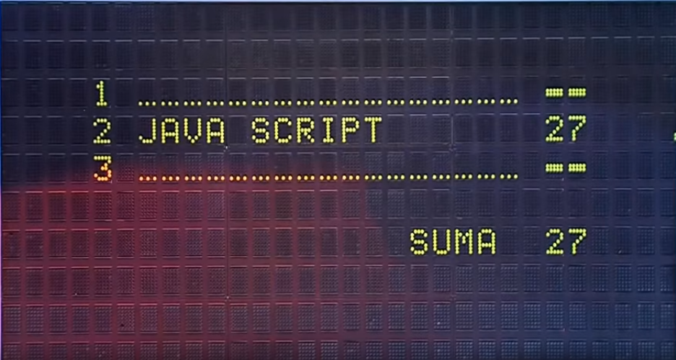
@sebastianrabiej

Slide 6
Type inference
Type inference is the ability to automatically deduce, the type of an expression at compile time. The compiler is often able to infer the type of a variable or the type signature of a function, without explicit type annotations having been given.
wikipedia
@sebastianrabiej

Slide 7
Java 11
(x, y) -> x.process(y);
(var x, var y) -> x.process(y);
(@Nonnull var x, @Nullable var y) -> x.process(y);
@sebastianrabiej

Slide 8
Why?
@sebastianrabiej

Slide 9
Why?
- boilerplate code
@sebastianrabiej

Slide 10
Why?
- boilerplate code
Dog dog = new Dog();
@sebastianrabiej

Slide 11
Why?
Other popular languages
have this feature
- boilerplate code
Dog dog = new Dog();
C#
C++
Scala
Kotlin
Go
@sebastianrabiej

Slide 12
The identifier var is not a keyword
@sebastianrabiej

Slide 13
When you can’t use that?
- lambdas
- Method signature
- Method references
- Null assign
- var exampleArray = {1,2,3}
@sebastianrabiej

Slide 14

@sebastianrabiej

Slide 15

DRY is ok
@sebastianrabiej

Slide 16

But not too DRY
@sebastianrabiej

Slide 17
public void doFancyBusinessStuff(){
Order order = new Order();
businessMethod1();
businessMethod2();
businessMethod3();
businessMethod4();
}
@sebastianrabiej

Slide 18
public void doFancyBusinessStuff(){
var order = new Order();
businessMethod1();
businessMethod2();
businessMethod3();
businessMethod4();
}
@sebastianrabiej

Slide 19
public void doFancyBusinessStuff(){
var order = orderBuilder.emptyOrder().build();
businessMethod1();
businessMethod2();
businessMethod3();
businessMethod4();
}
@sebastianrabiej

Slide 20
public void doFancyBusinessStuff(){
var order = createNewEmptyOrder();
businessMethod1();
businessMethod2();
businessMethod3();
businessMethod4();
}
private Order createNewEmptyOrder()
@sebastianrabiej

Slide 21
public void doFancyBusinessStuff(){
var order = createNewEmptyOrder();
businessMethod1();
businessMethod2();
businessMethod3();
businessMethod4();
}
private OrderId createNewEmptyOrder()
@sebastianrabiej

Slide 22

@sebastianrabiej

Slide 23
Dziękuję
Mail: SebastianRabiej[AT]o2.pl
Twitter: @sebastianrabiej
Blog: pomiedzyliniamikodu.blogspot.com
@sebastianrabiej

