Slide 1
Lambda.NET
AWS Lambda + .NET Core + Serverless Framework
Michał Baryliński · Cloud Engineer

Slide 2
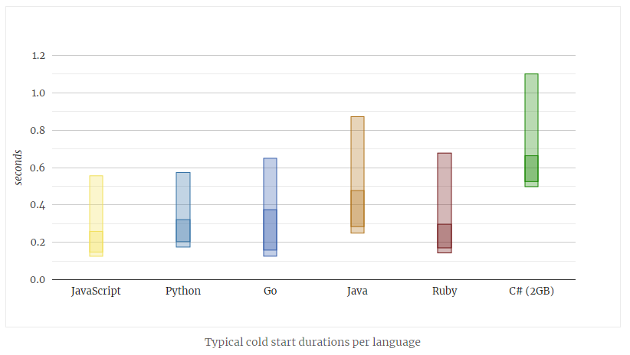
Zimne starty, czyli gorący temat
Źródło: https://mikhail.io/serverless/coldstarts/aws/

Slide 3








Architektura
Amazon API Gateway
AWS Lambda
AWS Identity and Access Management
AWSSDK.*
Amazon.Lambda.*
Amazon CloudWatch
Amazon DynamoDB
Amazon Simple Storage Service
AWS CloudFormation

Slide 4
Hands-on
a.k.a. „show me the code”

Slide 5
Podsumowanie
sls create
λ
REST API
DynamoDB
S3

Slide 6
Słowo o kosztach
Lambda
$0.0000166667
per GB-second
$0.20 per 1 milion requests
API Gateway
$3.70 per 1 milion API calls
(first 333 milion)
DynamoDB
$0.000793 per WCU/h
$0.0001586 per RCU/h
or
$1.525 per milion WRU
$0.305 per million RRU
+
$0.306 per GB-month
S3
$0.0245 per GB-month
free tier
400 000 GB-sec / month
1 milion requests
1 milion API calls per month
(for 12 months)
25 WCU
25 RCU
25GB
5 GB / month

Slide 7
LINKS
Serverless Framework
https://serverless.com/
npm i –g serverless
YAML for AWS reference: https://serverless.com/framework/docs/providers/aws/guide/serverless.yml/
.NET Core on AWS Lambda:
https://docs.aws.amazon.com/lambda/latest/dg/dotnet-programming-model.html
https://github.com/aws/aws-lambda-dotnet
https://github.com/aws/aws-sdk-net/
https://mikhail.io/serverless/coldstarts/aws/

Slide 8
Thank you!
Go visit pgs-soft.com

