Slide 1

BURN
FRAMEWORKS

Slide 2
BURN
FRAMEWORKS
DON’T

Slide 3
YOU AIN’T GONNA
NEED IT

Slide 4
YOU AIN’T GONNA
NEED IT

Slide 5
HARD TO UNDERSTAND

Slide 6
HARD TO UNDERSTAND
TRY

Slide 7
NO CONTROL

Slide 8
NO CONTROL
TAKE

Slide 9
LOCK-IN

Slide 10
LOCK-IN
EMBRACE

Slide 11
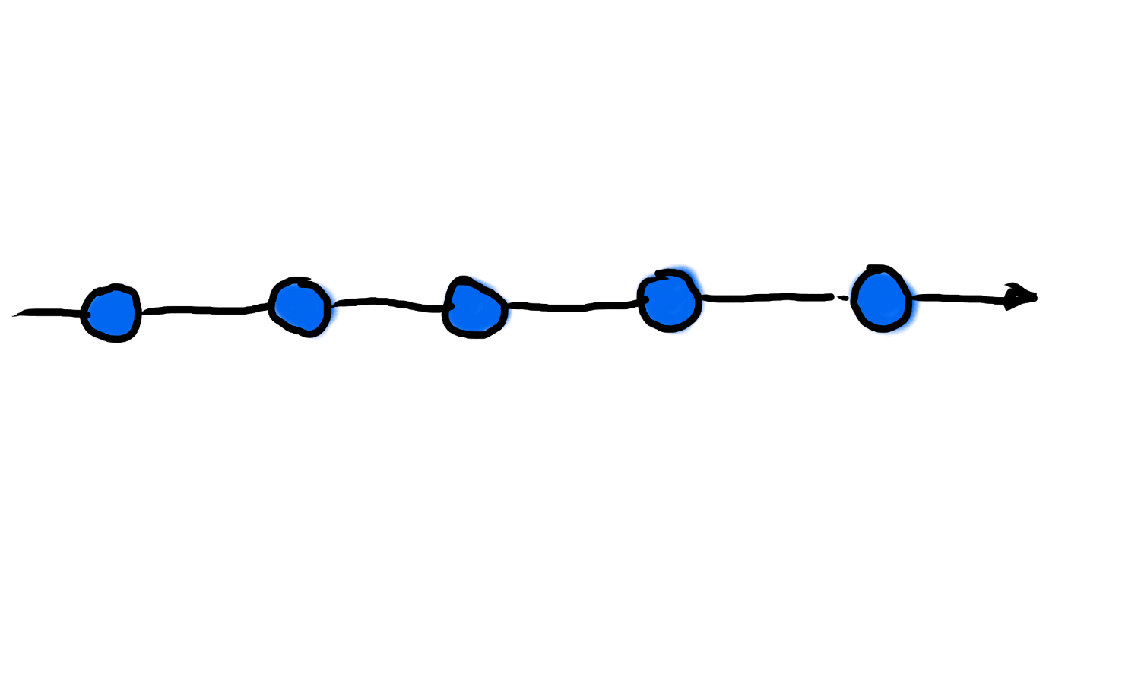

Slide 12
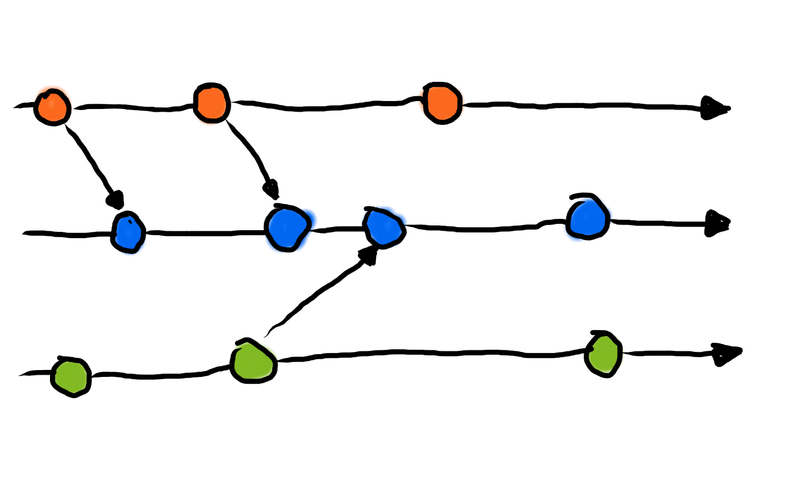

Slide 13
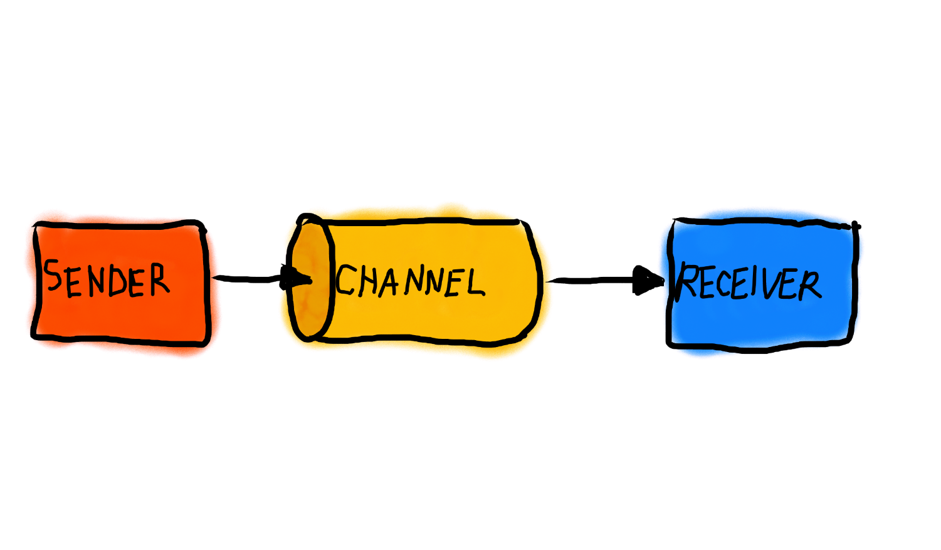

Slide 14
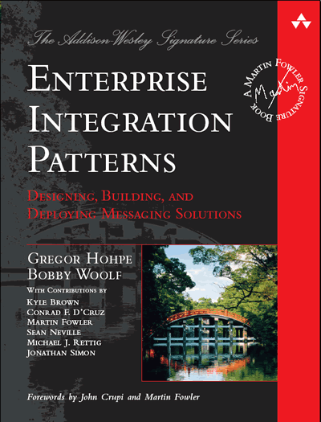

Slide 15
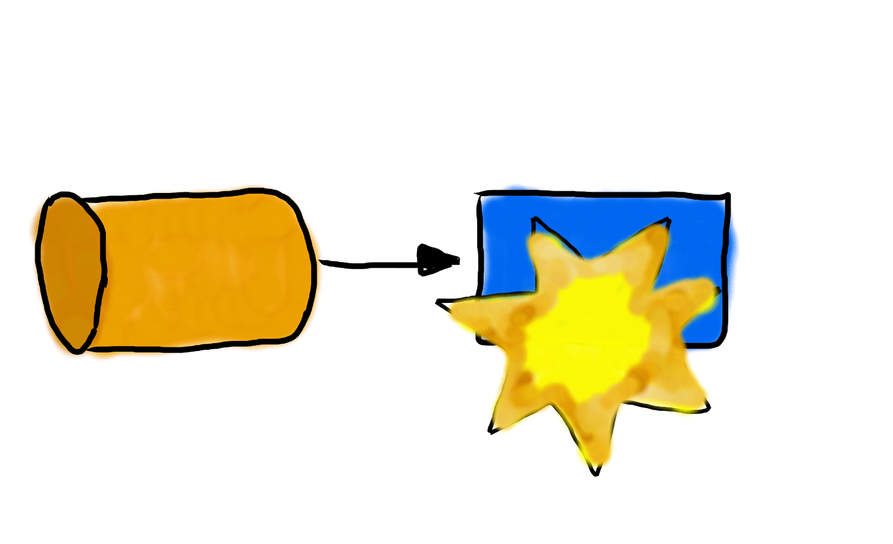

Slide 16


Slide 17
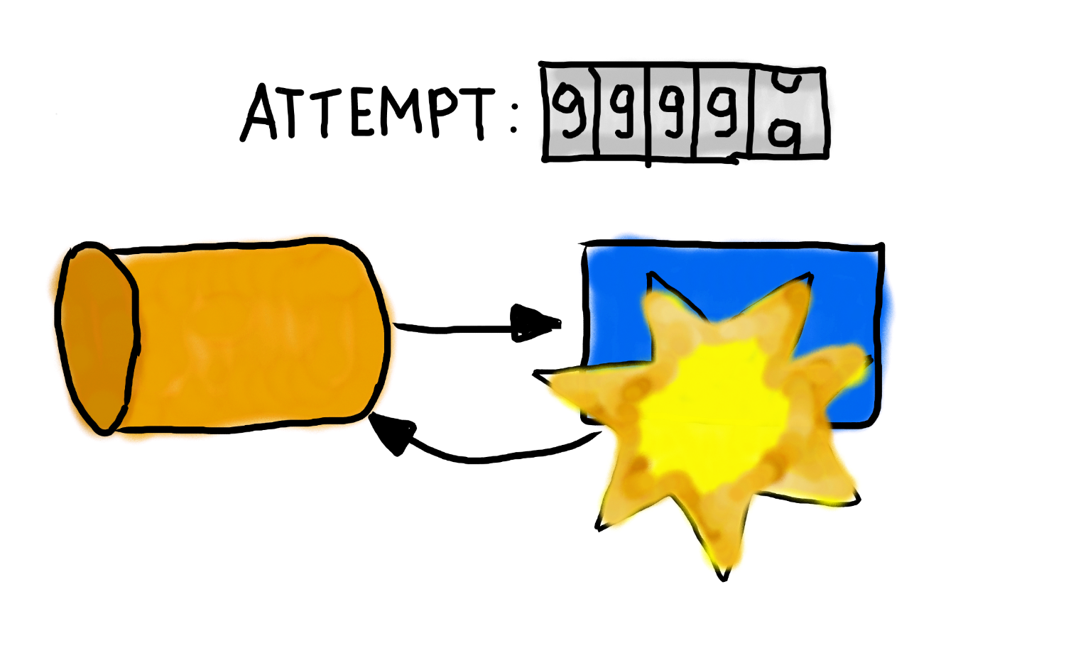

Slide 18
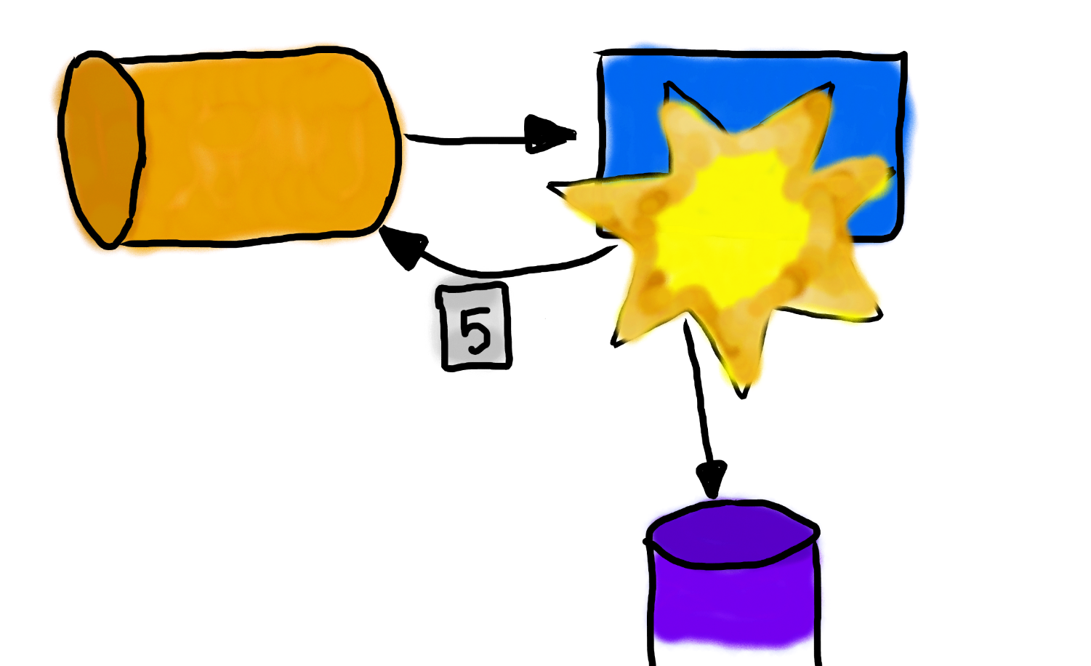

Slide 19
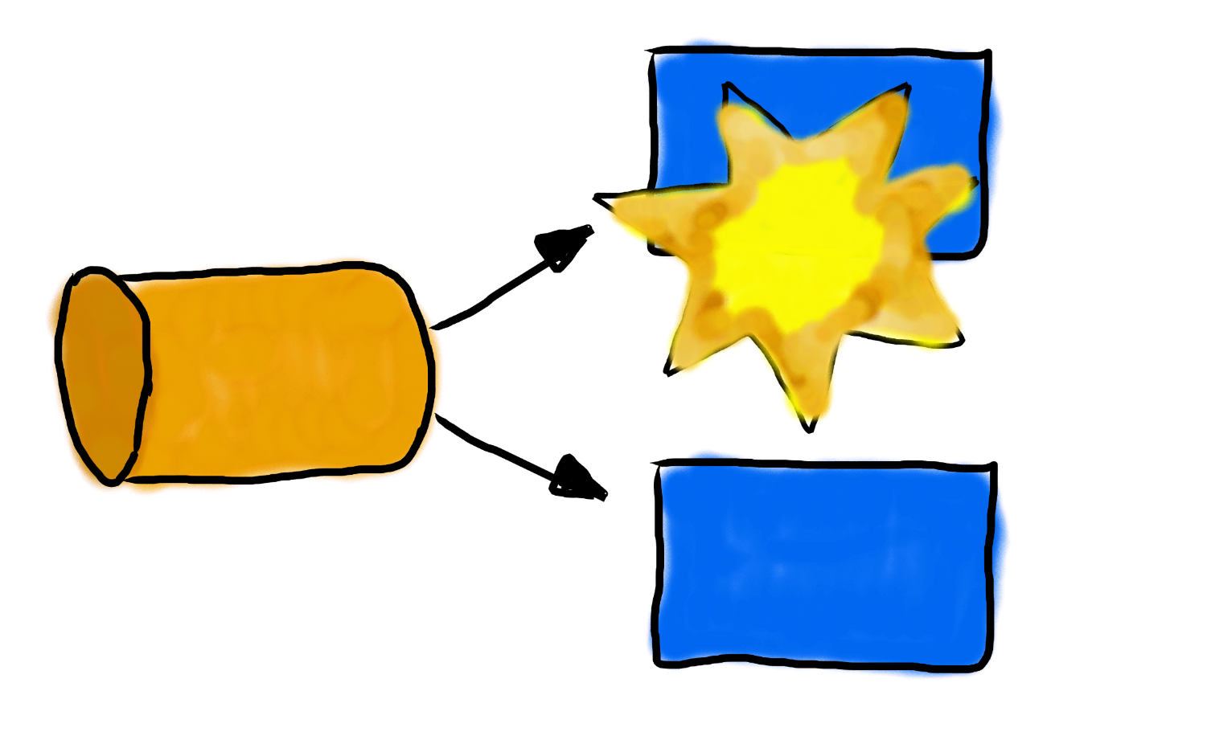

Slide 20
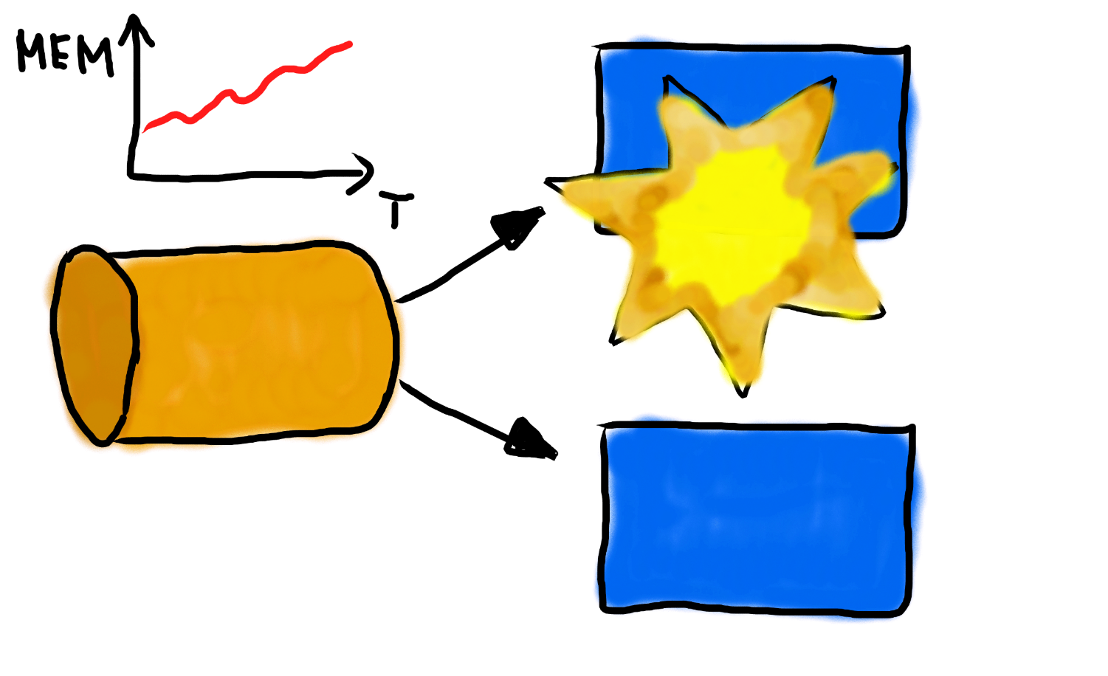

Slide 21
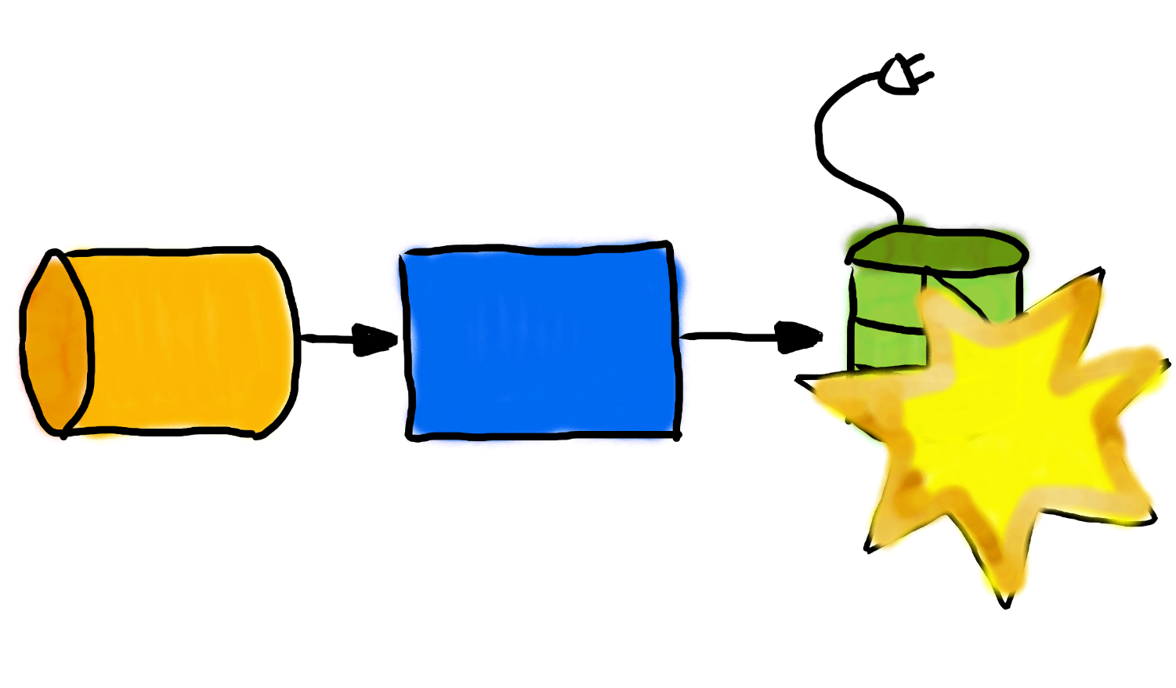

Slide 22
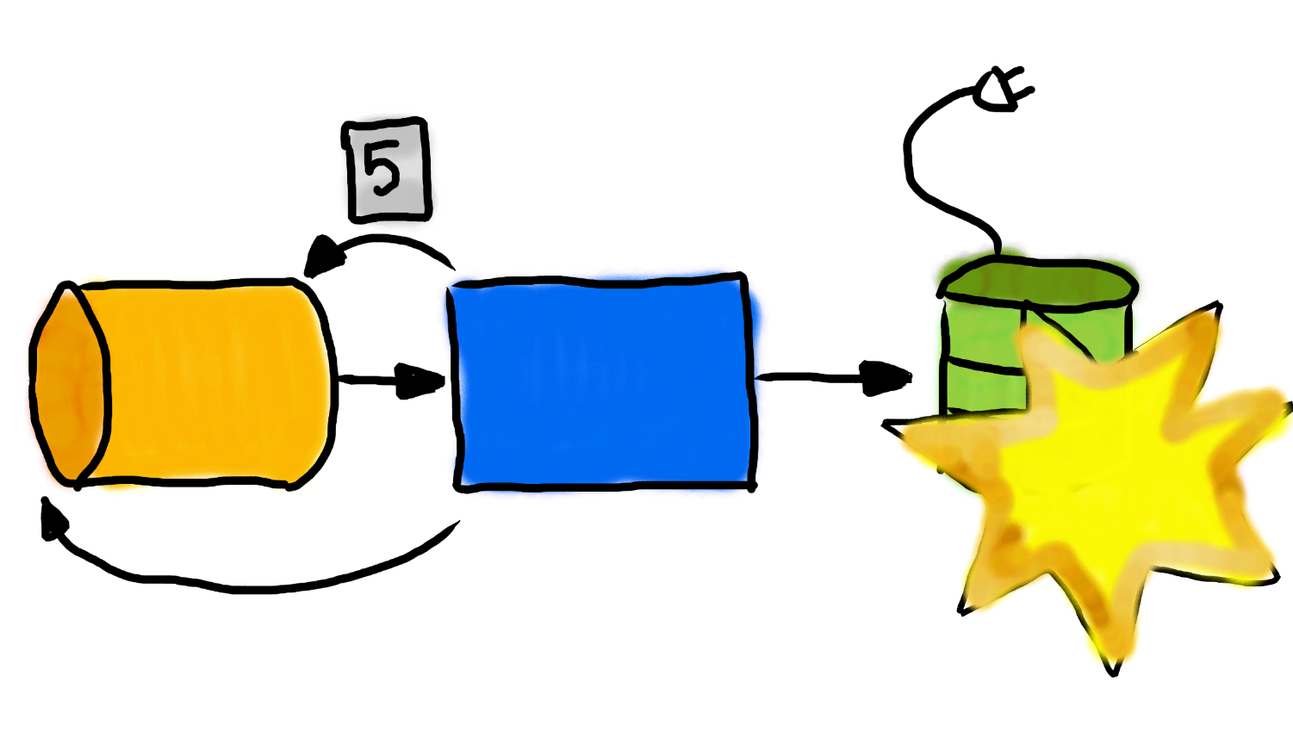

Slide 23
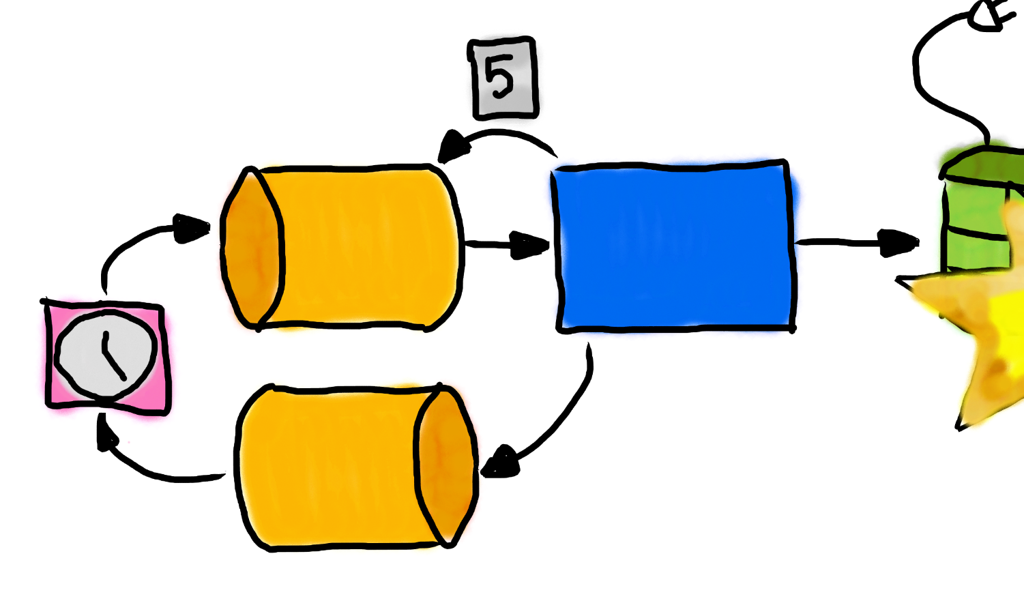

Slide 24
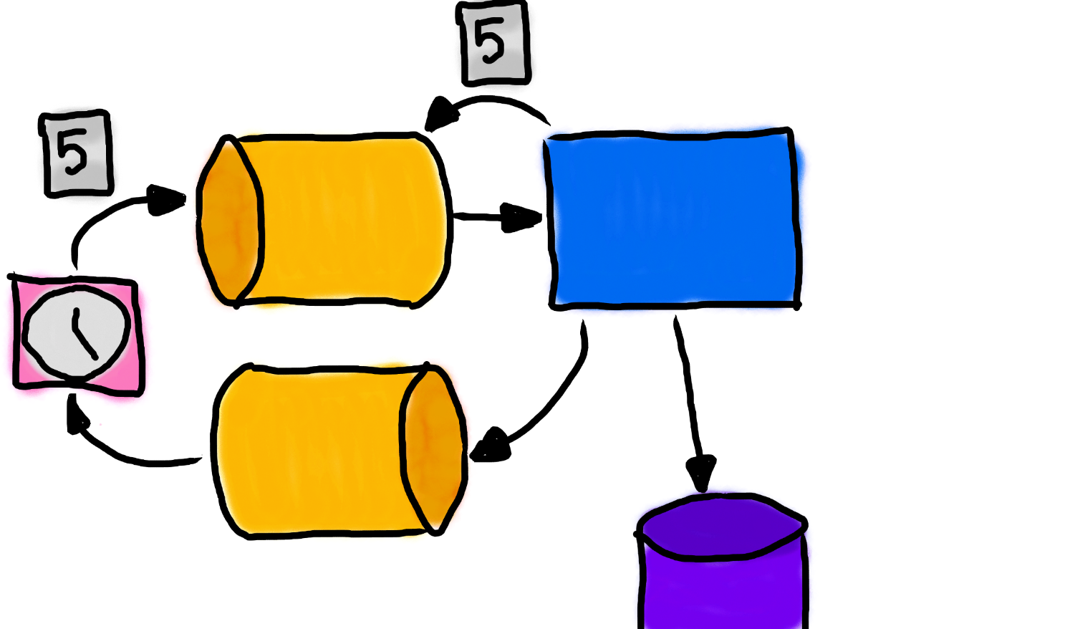

Slide 25
ABSTRACT!

Slide 26
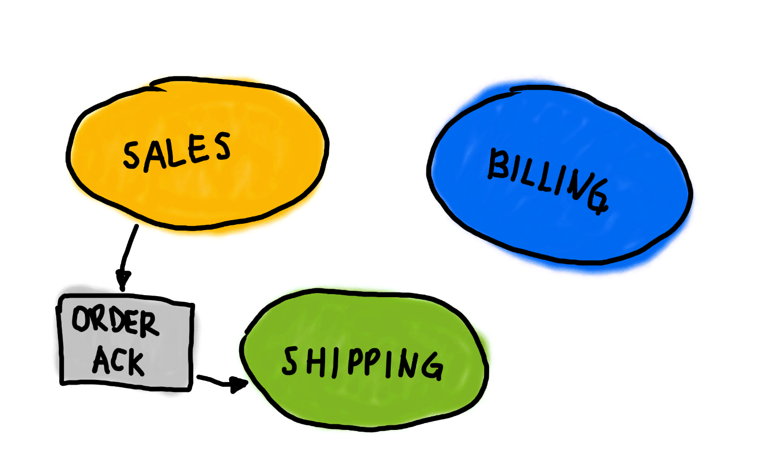

Slide 27
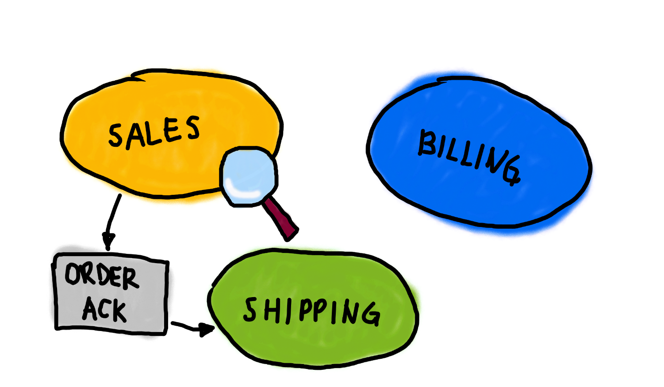

Slide 28
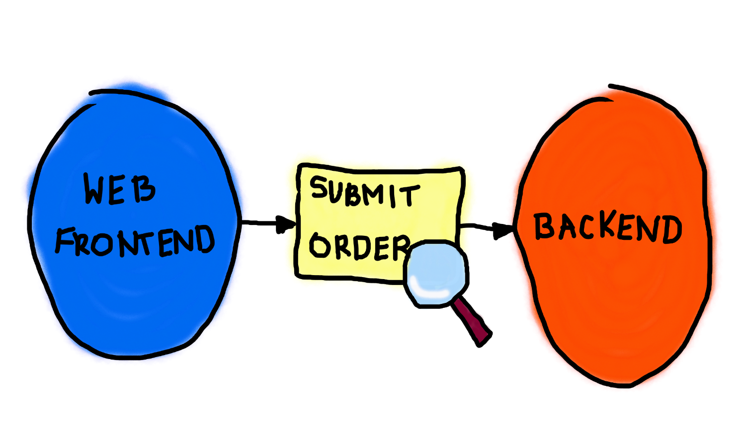

Slide 29
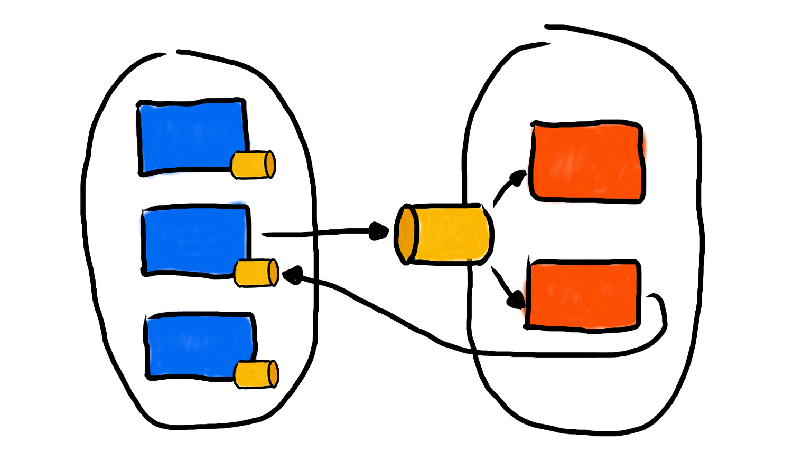

Slide 30
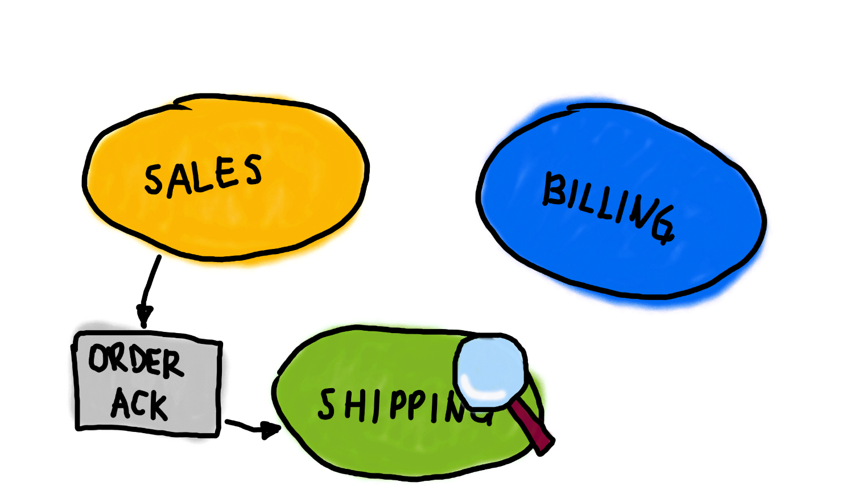

Slide 31
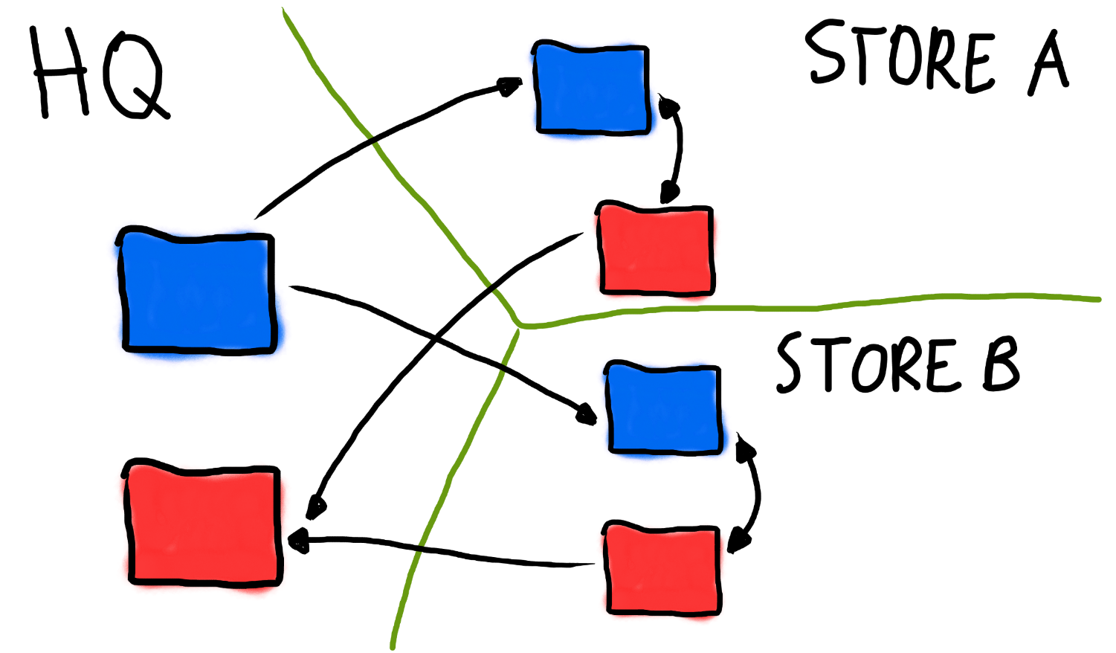

Slide 32
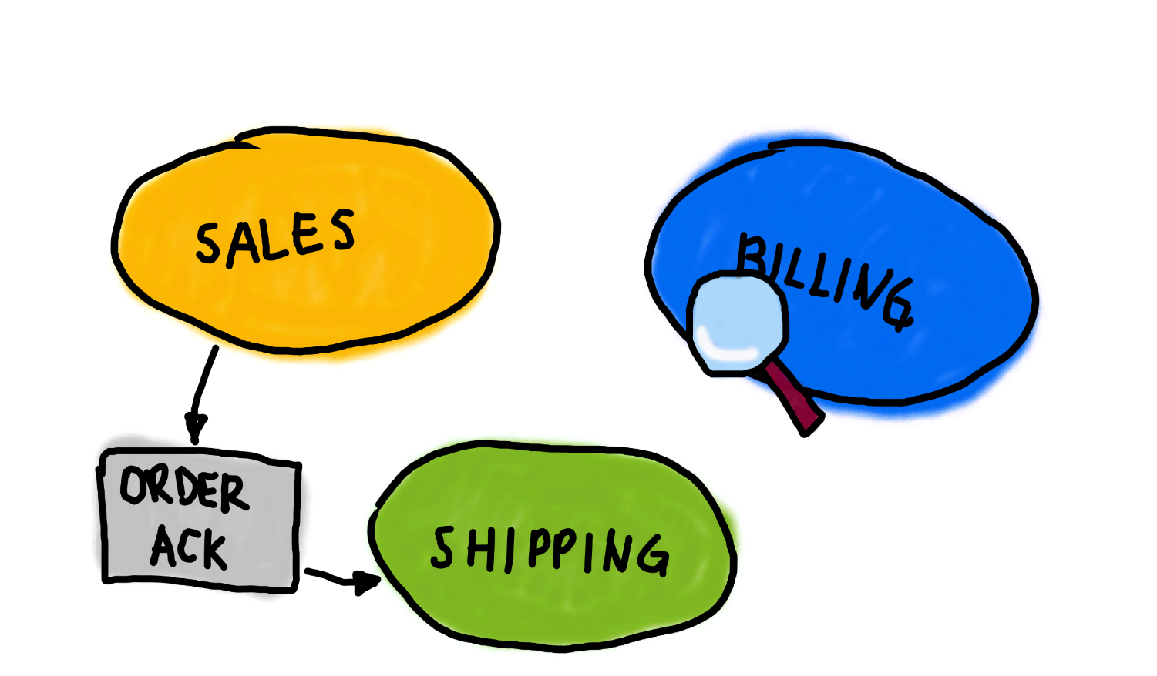

Slide 33
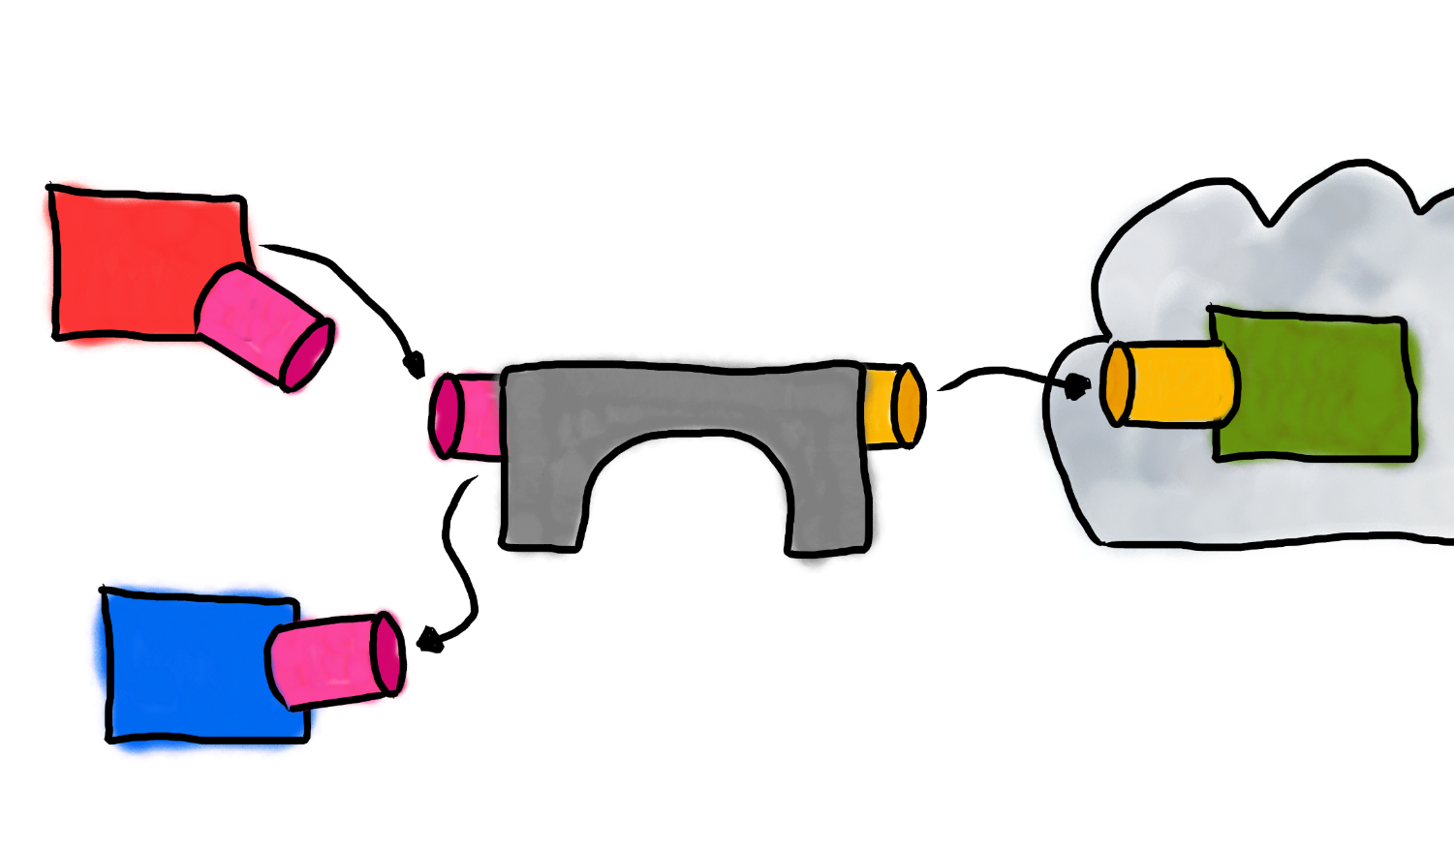

Slide 34
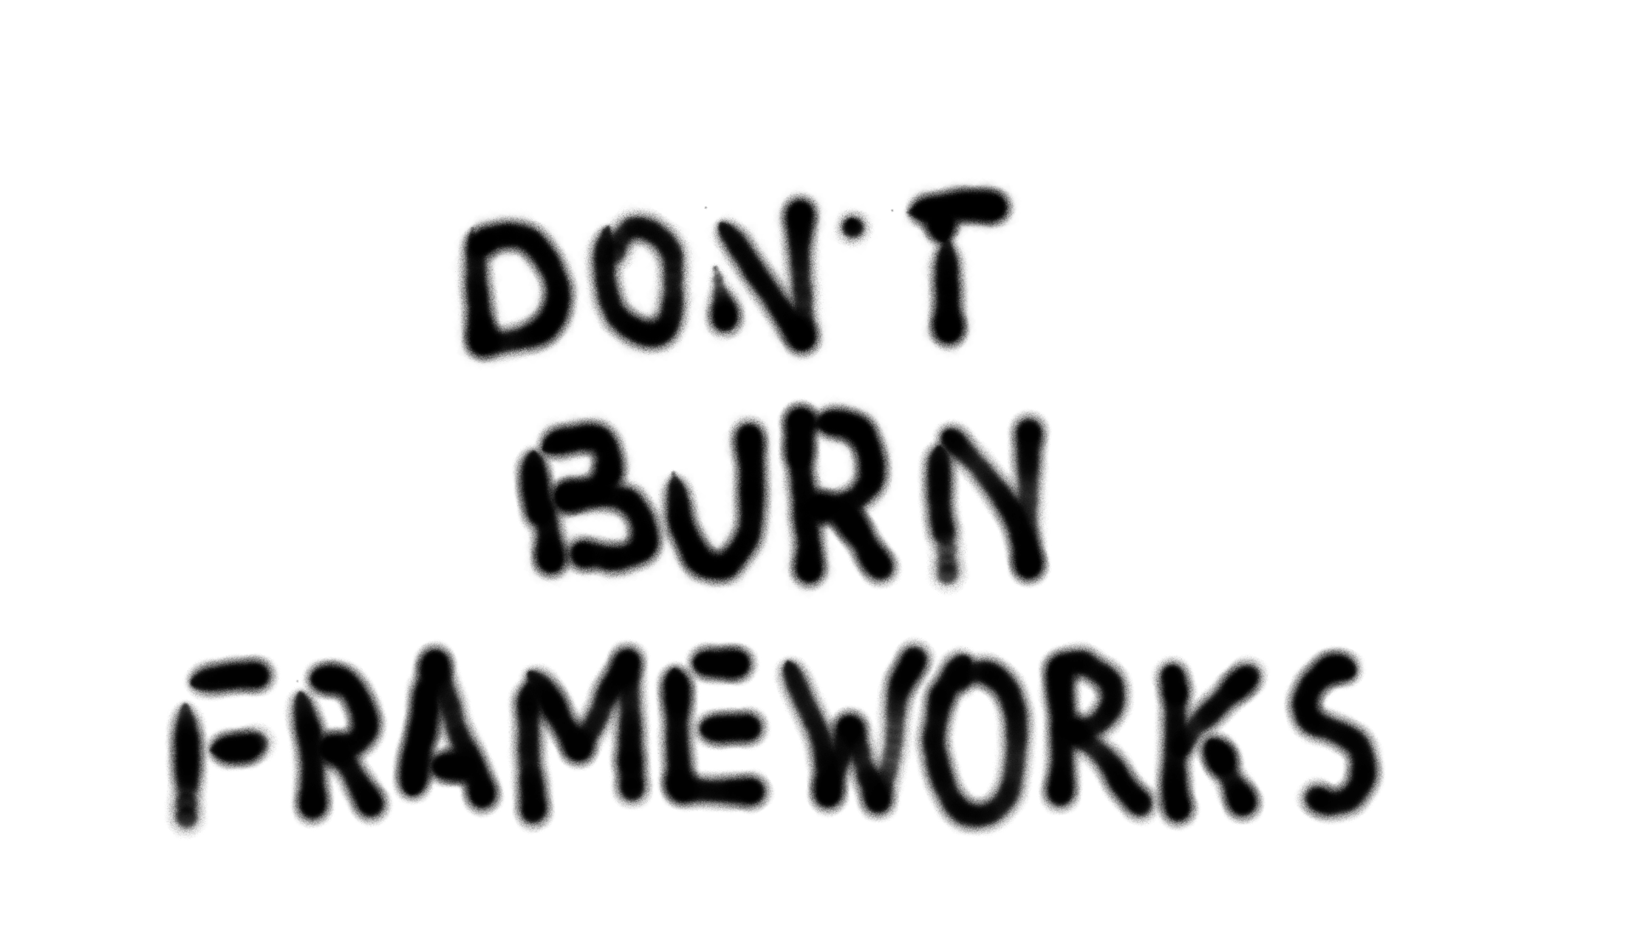

Slide 35
THANK
YOU
:-)

