Slide 1

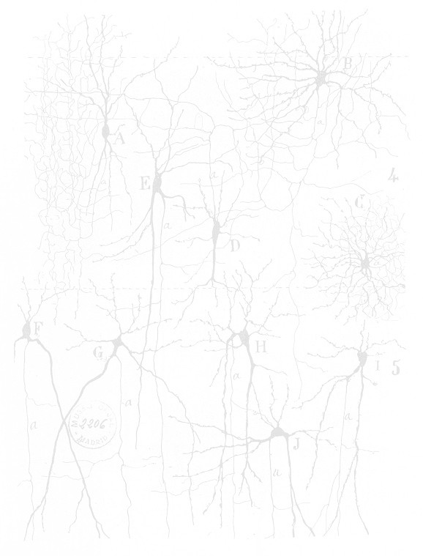
Organizational principles of the mouse connectome
Rich Pang, University of Washington rpang@uw.edu
Sid Henriksen, Newcastle University; NIH s.henriksen@ncl.ac.uk
Mark Wronkiewicz, University of Washington wronk@uw.edu

Slide 2
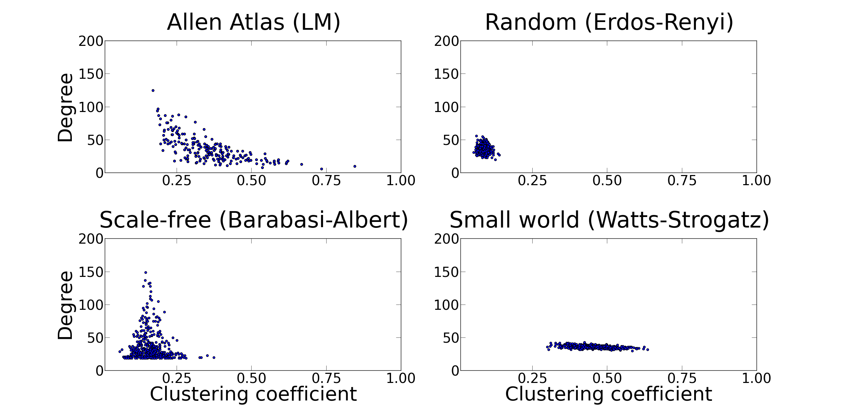
Where we left off last time...

Slide 3
Topological symmetry

Slide 4
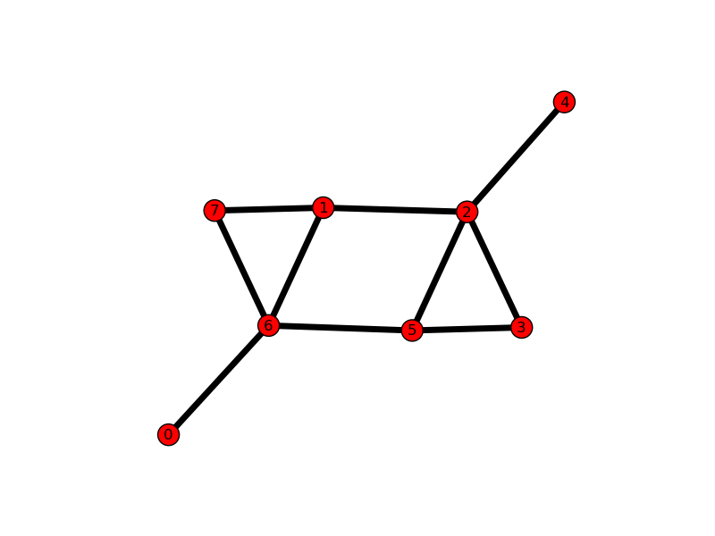
Topological symmetry

Slide 5
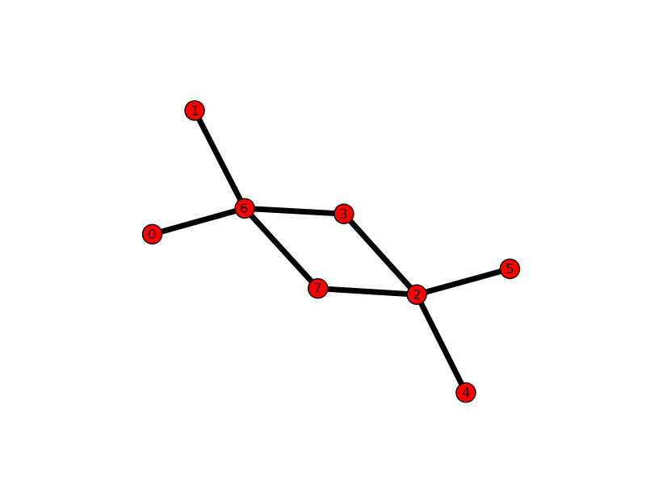
Topological symmetry

Slide 6
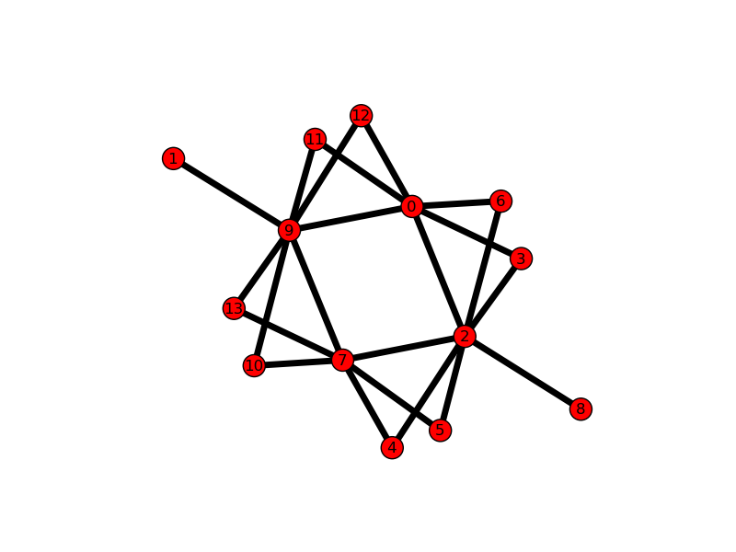
Topological symmetry

Slide 7
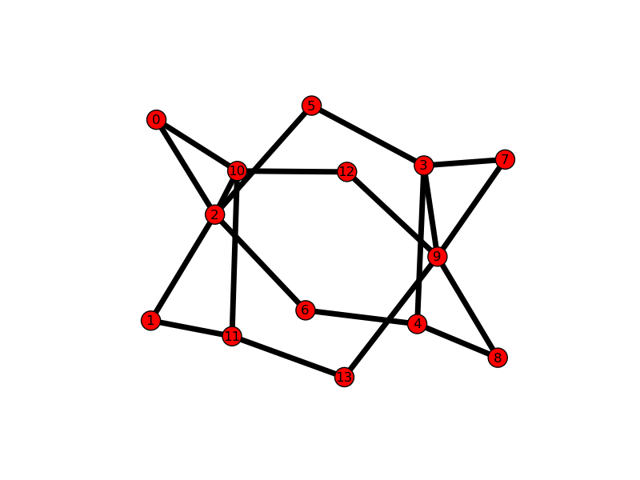
Topological symmetry

Slide 8
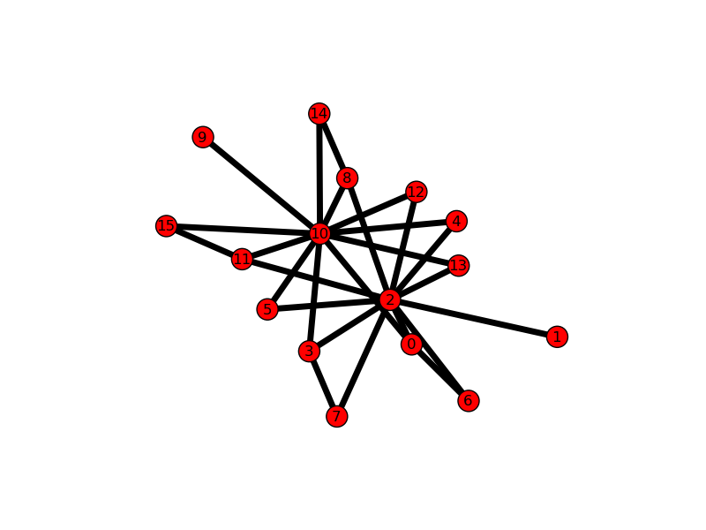
Topological symmetry

Slide 9
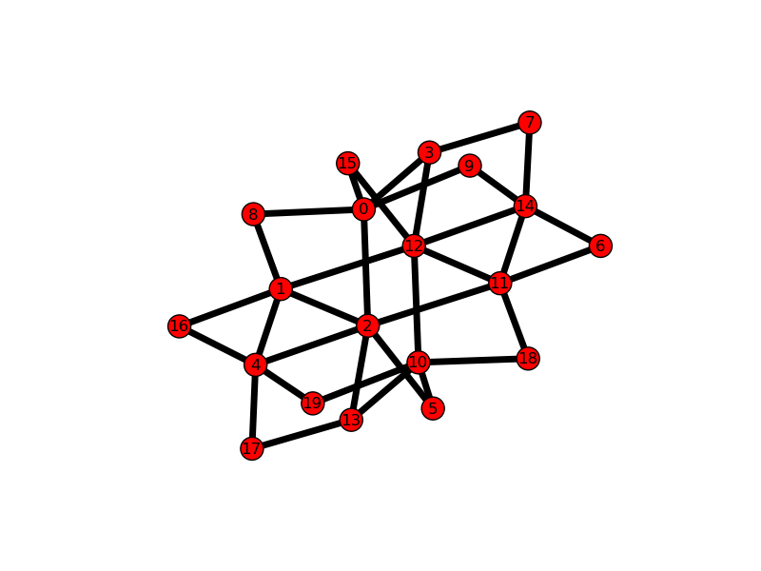
Topological symmetry

Slide 10
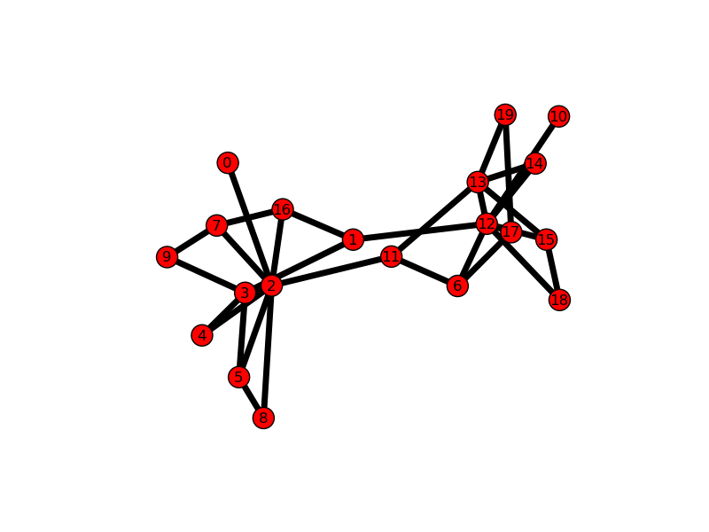
Topological symmetry

Slide 11
Effects of symmetry

Slide 12
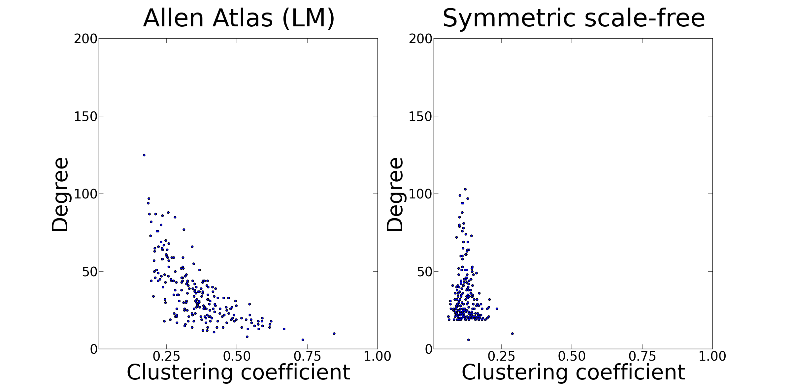
Effects of symmetry

Slide 13
New graph: power law clustered

Slide 14
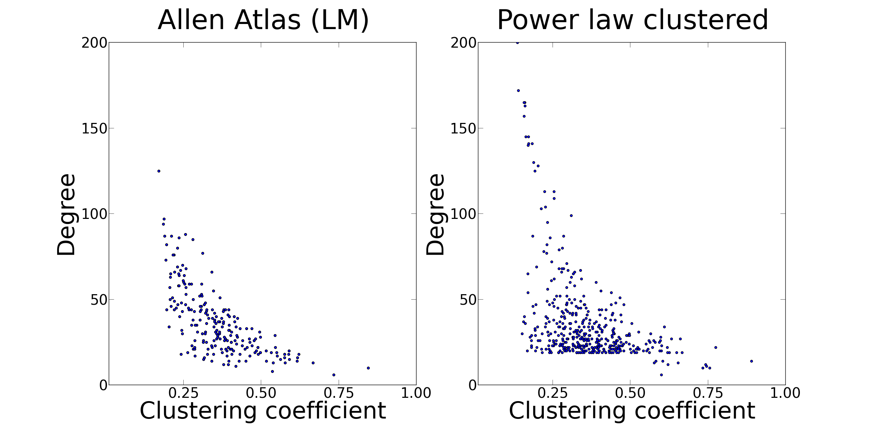
New graph: power law clustered

Slide 15
Data-driven model

Slide 16
Data-driven model
Physical distance not captured by graph theoretic approaches

Slide 17
Data-driven model
Physical distance not captured by graph theoretic approaches
Model:

Slide 18
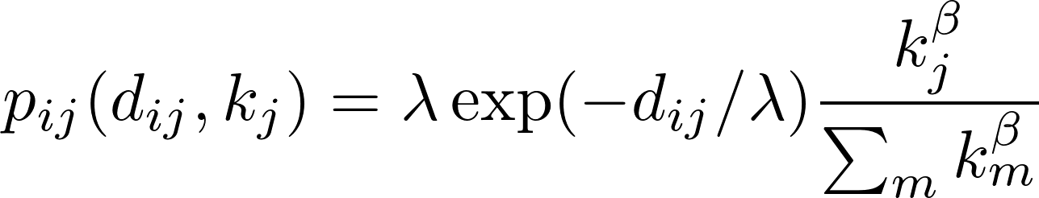
Data-driven model
Physical distance not captured by graph theoretic approaches
Model:

Slide 19
Data-driven model
Physical distance not captured by graph theoretic approaches
Model:
Probability of node i to connect to node j

Slide 20
Data-driven model
Physical distance not captured by graph theoretic approaches
Model:
Probability of node i to connect to node j
Dependence on distance

Slide 21
Data-driven model
Physical distance not captured by graph theoretic approaches
Model:
Probability of node i to connect to node j
Dependence on distance
Preferential attachment

