Slide 1
FE-582 Stock analysis for 30 Dow Jones Stocks
Junzhe Wang
Ashish Negi
Rohnit Shetty

Slide 2
What are we all about?
Enormous availability of data in today’s world can help investors take better decisions
1
To get a better understanding of the market and to make wise choices we need to explore the data closely
2
Our goal is to use the historical price of 30 Dow Jones stocks to analyze the stock market and predict its performance
3

Slide 3

Can we use the content of stock data analysis to successfully predict stock price performance and other key information?

Slide 4
Dataset Description
Dataset provides end of day data for all stocks currently in the Dow Jones Industrial Average, from 2015-01-02 to 2019-06-11
30 different CSV files with the names of 30 different stocks
List of stocks and symbols as per: https://en.wikipedia.org/wiki/Dow_Jones_Industrial_A verage

Slide 5
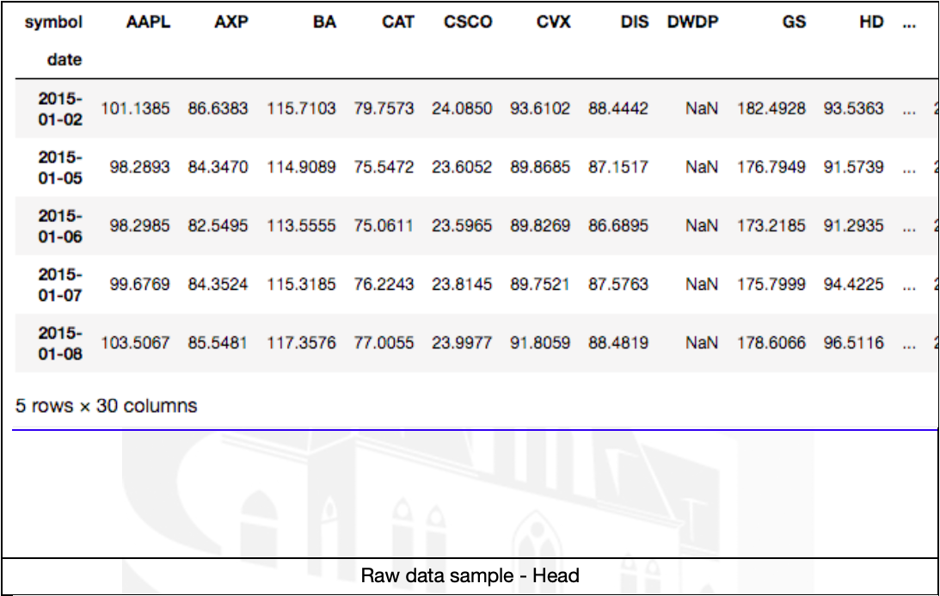
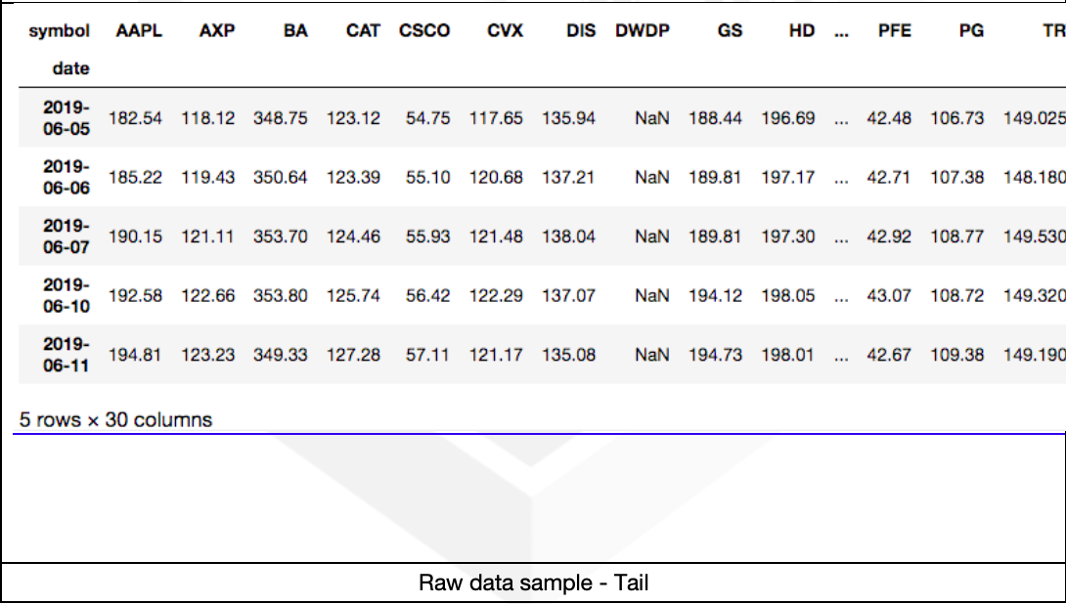

Slide 6
Goals of Exploratory Data Analysis
Distribution of the dataset
Missing numerical values, outliers or anomalies
Underlying assumptions
Patterns and relationships between variables
Most suitable algorithm

Slide 7
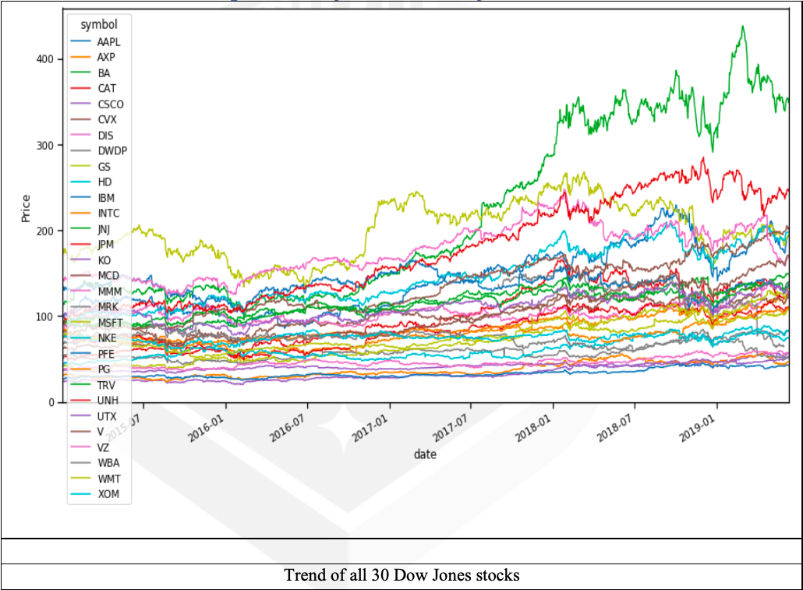

Slide 8
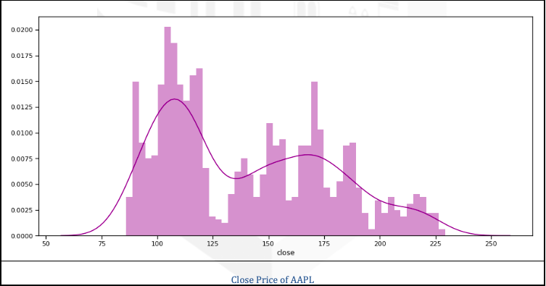
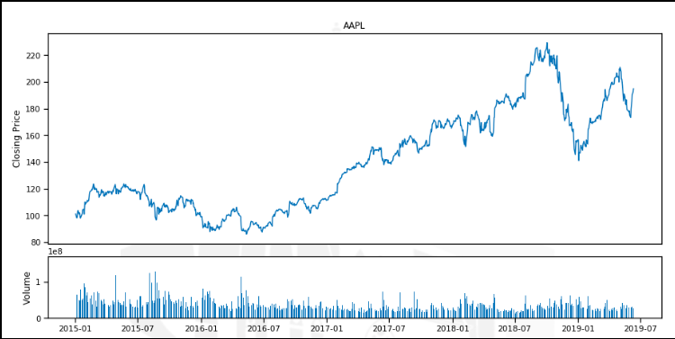

Slide 9
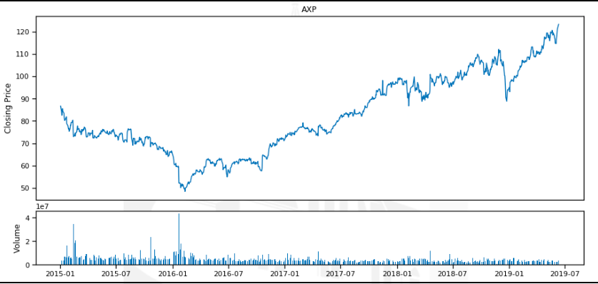
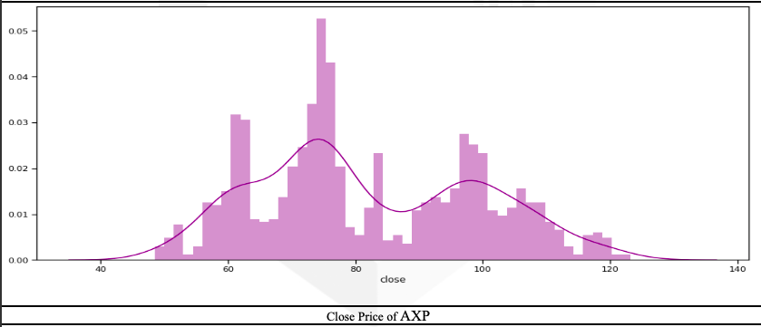

Slide 10
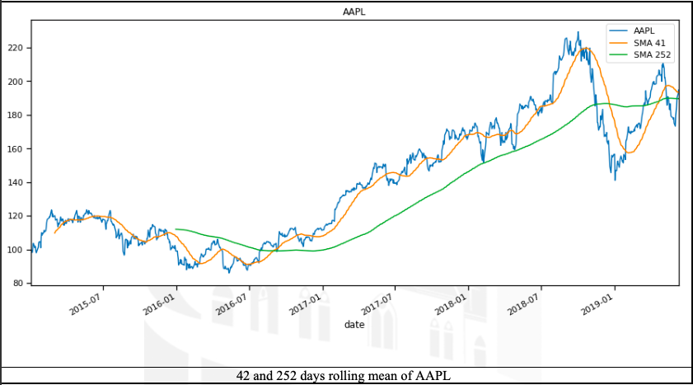

Slide 11
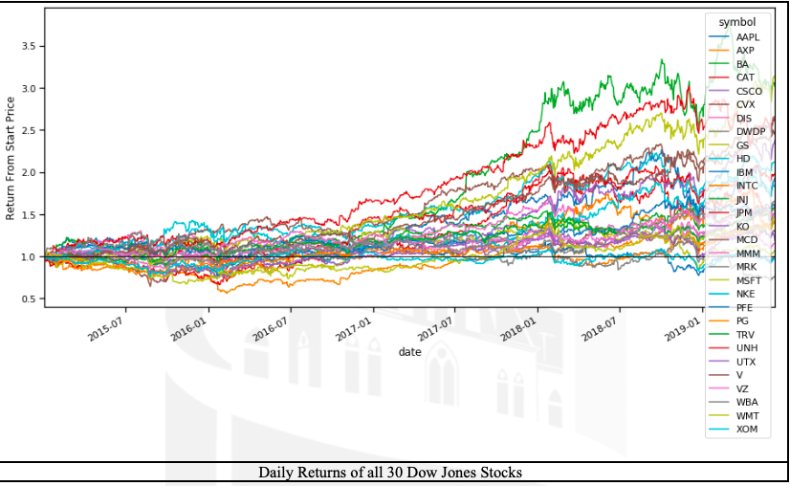

Slide 12
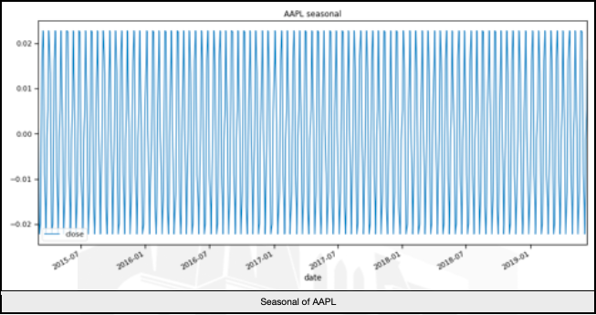

Slide 13
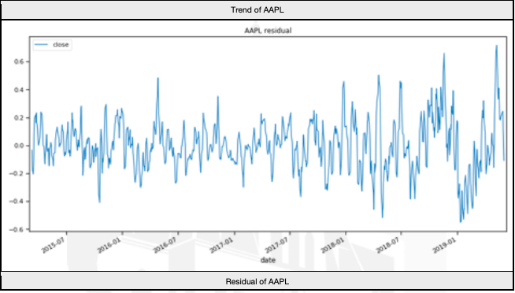
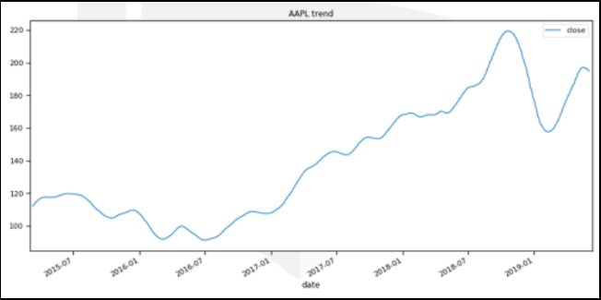
Seasonal Decomposition

Slide 14
Linear Regression Model
Linear regression is a linear approach to modeling the relationship between a scalar response and one or more explanatory variables
Split the dataset into 66% training and 34% test dataset

Slide 15
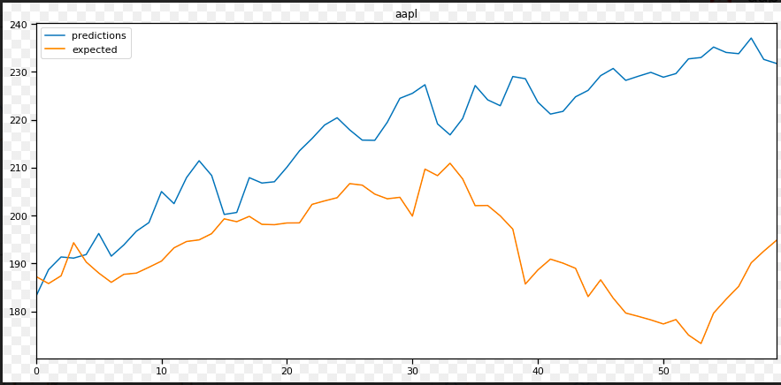
Linear Regression Model Demonstration for Apple

Slide 16
Arima Model
Using ARIMA model, you can forecast a time series using the series past values
Dataset is initialized as 66% and increases sequentially

Slide 17
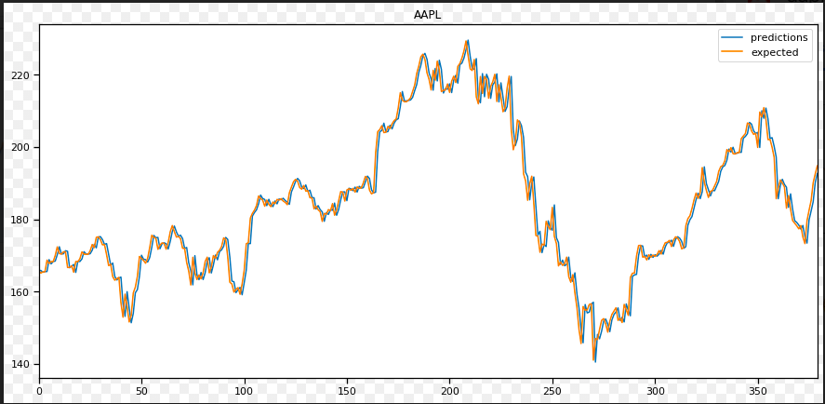
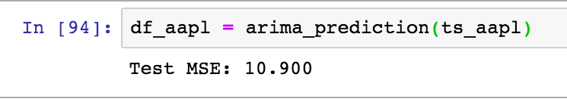
Arima Model Demonstration for Apple Inc.

Slide 18
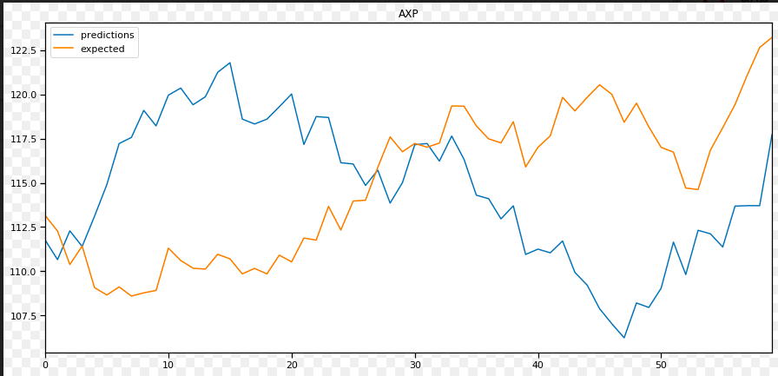
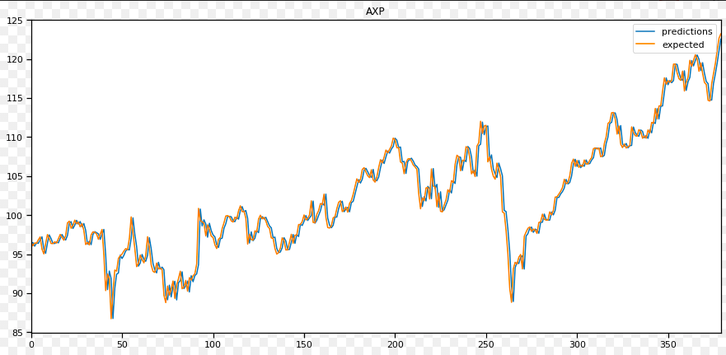
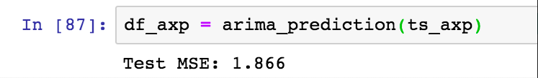
Comparing Predictions for American Express Company
Linear Regression
Arima

Slide 19
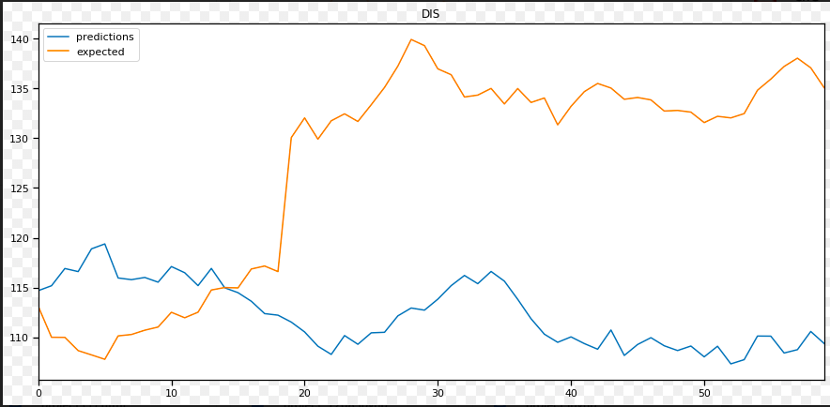
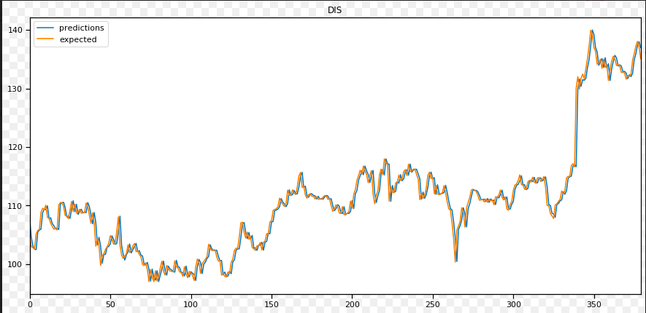
Comparing for Walt Disney Company
Linear Regression
Arima

Slide 20

Future Goals
A change in the variance or volatility over time can cause problems when modeling time series with classical methods like ARIMA. We can extend the prediction rate by further researching more models
ARCH or Autoregressive Conditional Heteroskedasticity method provides a way to model a change in variance in a time series that is time dependent, such as increasing or decreasing volatility.
GARCH or Generalized Autoregressive Conditional Heteroskedasticity allows the method to support changes in the time dependent volatility, such as increasing and decreasing volatility in the same series

Slide 21
THANK YOU

Slide 22
References
Dow Jones Industrial Average (https://en.wikipedia.org/wiki/Dow_Jones_Industrial_Average)
Dow Jones Stock dataset (https://www.kaggle.com/timoboz/stock-data-dow-jones)
Seasonal Adjustment (https://en.wikipedia.org/wiki/Seasonal_adjustment)
Linear Regression Example (https://scikit-learn.org/stable/auto_examples/linear_model/plot_ols.html)

