Slide 1
CS-513-A
UFC Winner Prediction
Professor:
Kasha Dehnad

Slide 2
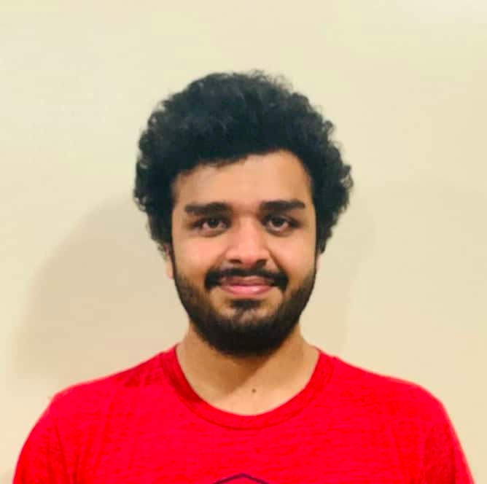
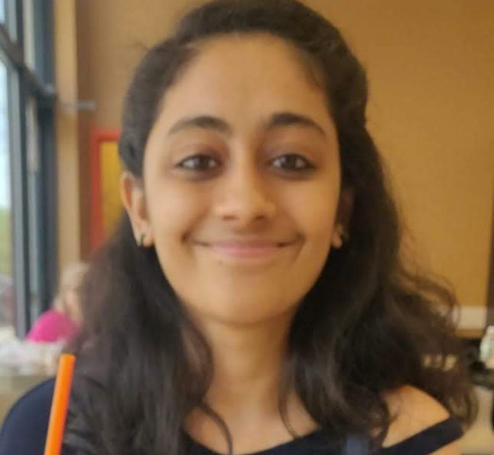

Team Members
Rohnit Shetty
Tanvi Kinkhabwala
Shrey Vaity

Slide 3
Table of contents:
Introduction
Data Cleaning and Data Preprocessing
Random Forest Analysis
CART
Gradient Boosting Machines
KNN
Conclusion

Slide 4
Introduction:
UFC (Ultimate Fighting Championship) is an American mixed martial arts company. It is the largest company and has the highest level fighters
The data has been scraped originally from the UFC website
UFC data set consists of 145 variables with 5144 rows (Kaggle)
It contains variables such as the height, weight, reach, age, wins streak, losing streak, number of strikes, number of punches etc. of all the players
Using these top influencing variables, we will predict the winner of a particular fight
Implemented various models and tuned them for prediction to obtain a good accuracy

Slide 5
Data Cleaning and Preprocessing
We chose the variables that will be available before the fight such as the physical attributes and the winning/losing streaks of the player
Replaced the missing values with the median of the column on the whole data set
Converted the data to numeric values for all the columns with factor values (Except for the predictive variable)
Transformed the data into training (75%) and test (25%)

Slide 6
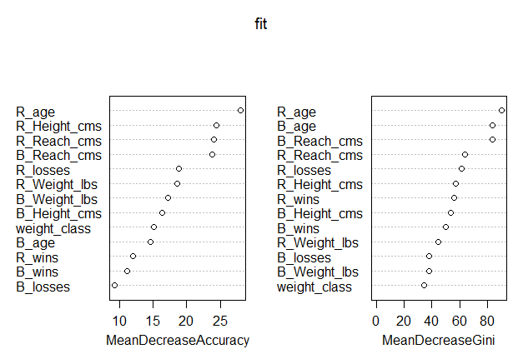

Random Forest Analysis
Number of trees = 500
Tuned the parameters, to get a better accuracy
Nodesize = 20
mtry = 5
Accuracy: 68.27%
Confusion matrix
Importance plot

Slide 7
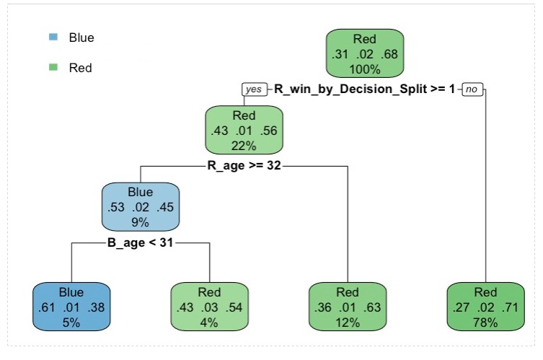
Classification & Regression Trees (CART)
Split with respect to Red and Blue winners to increase accuracy
Data split at R’s win by decision split, R’s and B’s age
Accuracy Achieved: 67.89%

Slide 8
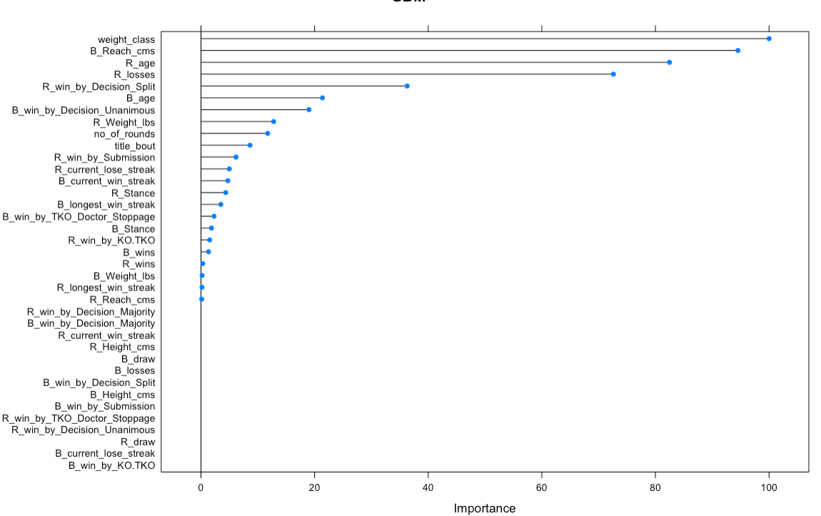
Gradient Boosting Machines (GBM)
Caret package used to define a fit control which uses the “repeatedcv” method with 5 resampling iterations and 5 complete sets of folds
Important features: weight_class,
Blue_reach, Red and
blue ages, etc
Accuracy: 68.82%
Ended up Predicting
71.1% of accurate
Red Victories

Slide 9
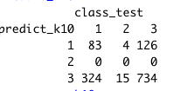

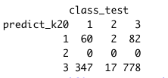
K-Nearest Neighbor Algorithm(KNN)
Normalized the data
Implemented K = 10, 15, 20
ACCURACY
For
K = 10 : 63.7 %
K = 15 : 64.31 %
K = 20 : 65.3 %
Best Accuracy from KNN is 65.3 which obtained by considering K=20

Slide 10
Conclusion
In general the outcomes of any sport is quite unpredictable, hence, even the fights are quite unpredictable. With respect to that, the accuracy achieved is quite favorable
The highest accuracy we achieved was from GBM which is ‘68.82%’
The size of the dataset (even though contains data worth 26 years) is not enough to predict the draw instances due to its less presence
Similarly, since we have more instances of Red Fighter Victories throughout the dataset, the models end up predicting Red Victories more accurately than it does with Blue ones
Method | Accuracy
Random Forest | 68.27%
CART | 67.89%
GBM | 68.82%
KNN | 65.3%

Slide 11


Slide 12
References
UFC-Fight historical data from 1993 to 2019 (https://www.kaggle.com/rajeevw/ufcdata)
Package Caret (https://cran.r-project.org/web/packages/caret/caret.pdf)
UFC Athlete Details (https://www.ufc.com/athletes)

