Slide 1
Baby’s First
Knowledge-Based App
intelligent solutions with OpenCyc

Slide 2
opencyc.org
The OpenCyc Platform is your gateway to the full power of Cyc, the world’s largest and most complete general knowledge base and commonsense reasoning engine. OpenCyc contains hundreds of thousands of Cyc terms organized in a carefully designed ontology (?). Cycorp offers this ontology at no cost and encourages you to make use of, and extend, this ontology rather than starting your own from scratch.

Slide 3
OpenCyc can be used as the basis of a wide variety of intelligent applications such as:
rich domain modeling (?)
semantic data integration (?)
text understanding
domain-specific expert systems (?, sounds neat)
game AIs
to name just a few.

Slide 4
Release 4.0 of OpenCyc includes:
The core Cyc ontology whose domain is all of human consensus reality. (neat)
A java-based Cyc Inference Engine and the Cyc Knowledge Base Browser
Documentation and self-paced learning materials to help users achieve a basic- to intermediate-level understanding of the issues of knowledge representation and application development using Cyc.
A specification of CycL, the language in which Cyc (and hence OpenCyc) is written.
A specification of the Cyc API for application development.

Slide 5
OpenCyc is available for download from SourceForge under an OpenCyc License.
Visit the Cyc Developer Center at dev.cyc.com for developer resources such as
Java APIs
unfamiliar language
most popular language, should be plenty of support, easy to pick up
API, so may only need limited understanding of Java to operate

Slide 6
example code
sandbox of basic functionality from which sophisticated, powerful implementation can be constructed
clear and immediate feedback to help answer:
what can be done with OpenCyc?
**what can I do with OpenCyc?**

Slide 7
javadocs
docs there for when things get hairy
required reading, need thorough understanding for basic implementation?
Cyc XML Schemas (XSDs)
unfamiliar
hopefully won’t have to worry about these

Slide 8
forums
comfort that others have “done this” before
feedback for scope and scale of issues when things go wrong
silly mistake?
wrong approach?
need to download this or patch that?
exercise in futility?
peer support for my first baby steps
aid in min/maxing time spent troubleshooting/developing
issue trackers
and more.

Slide 9
Some Perspective
“developing” web applications for ~7 months
work mostly with high-level languages and frameworks with active and industry-oriented communities
the extent of my role in “development” as a hobby:
finding and making use of existing tools (frameworks, APIs, plugins) to make some new tool (website, command-line app, new plugin) that does something valuable

Slide 10
What is a Tool?
Ruby on Rails Tech Demo (2005)
0 to functioning blog app in 15 mins
"Woops! It worked."
"Look at all the things I'm not doing, look at all the configuration I'm not writing!”
write less, do more
RubyGems package manager
supplementing your project with open source, industry-tested ruby libraries is as simple as adding a line of code to your “gemfile”

Slide 11
How to Teach a Rails App Japanese
make a gmail account (fill out forms, click buttons)
request a free trial for Google Cloud Platform (go to link, click button)
enable google translate api (click button)
generate api key (click button) => “xxxxx”
add line to gemfile
gem ‘easy_translate’
install gem (command line)
bundle
open up the developer console (command line)
rails c

Slide 12
EasyTranslate.api_key = ‘xxxxx’
true
EasyTranslate.translate('Hello', to: :ja)
“もしもし”
EasyTranslate.translations_available.length
91

Slide 13
“There’s a gem for that…”
With the “easy_translate” gem, I was able to bolt on a canned “translate” feature to my chatroom bot in my very first website without:
formatting and handling http requests to and from the google API
processing natural language
learning 90 other languages

Slide 14
Typical Time Allocation
~5% brainstorming and planning (UMLs, diagrams, misc chicken scratch)
thinking up and calculating new solutions
~15% tinkering (writing small blocks of independent code)
~5% integrating new chunks of code into project
~25% debugging and testing existing code
~10% tweaking (scrapping, revising, and rewriting)
remainder spent reading (docs, stack-traces, similar code, wiki, forum threads, textbook references, etc…)
looking for and looking up existing solutions

Slide 15
That being said…
Some problems cannot be solved without becoming familiar with, or worse, becoming a competent user of foreign tools and domains.

Slide 16
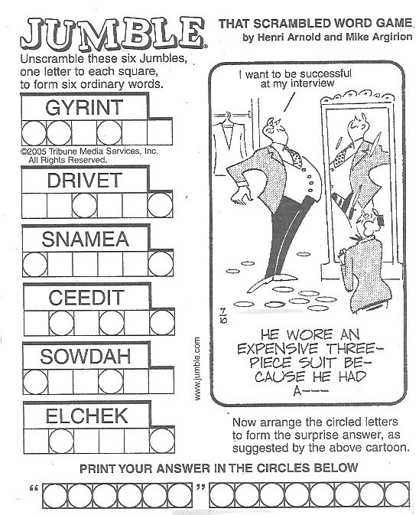
Enter the Jumble
1. extract all English words from each jumble
2. for all combinations of solved jumbles, select letters at the marked indices to form solution letter pools
3. rearrange unique letter pools according to:
b. correct lengths
a. valid English
c. syntactically correct order
d. adheres to "context" provided by "hints"
./jumble "he wore an expensive three-piece suit because he had a. I want to be successful at my interview"/6/8 gyrint/1/2/4 drivet/3/6 snamea/1/6 ceedit/2/4/6 sowdah/1/4 elchek/2/6

Slide 17
Shortcomings
for some jumbles, table of valid solutions remained unmanageably large after exhausting my familiar “toolbox”
restricting dictionary by frequency and dialect broke other solutions
a jumble solver driven solely by pattern matching and probabilistic paradigms is neither robust nor extensible

Slide 18
Another Look at that Clue
how to select ‘“vested” interest’ from 22 valid solutions?
what an English speaking human might extract from the clue:
picture of man in suit
first word is quoted
probably pun, other is “filler”
“…because he had a __ __.”
probably [adjective] [noun]
“expensive”, “three-piece suit”, “interview”

Slide 19
After a Little Googling
several routes ranging from “nontrivial and time consuming” at best to completely foreign scholarly concepts
no magic (or free) plugin to bridge the gap
can and has been done before by other hobbyists
cannot avoid having to learn something new
lots and lots of blood, sweat, tears, and reading ahead

Slide 20
New to Cyc? We recommend these tutorials to get started on ontology development.
First round of reading material:
KB Browser Interface (1 pdf)
Foundations of Knowledge Representation in Cyc (4 pdfs)
Predicates and Denotational Functions (5 pdfs)
Errors in Representing Knowledge (3 pdfs)
Survey of Knowledge Base Content (8 pdfs)
OE Example: Events and Roles (4 pdfs)
Writing Efficient CycL: Some Concrete Suggestions (2 pdfs)
Inference in Cyc (5 pdfs)

Slide 21
…OpenCyc is available for download from.…
download from source forge link
read the README
very clear instructions
get OpenCyc server along with KB Browser running without “some assembly required”

Slide 22
Off to a Railsy Start
copy-paste SubL expressions into the server command line:
CYC(1): (+ (- 2 1) (* 2 3))
[Time: 0.007 secs]
7
CYC(2): (isa #$BillClinton)
[Time: 0.009 secs]
(#$Agent-Generic #$Individual)
NIL
enter CycL expressions into the browser text box (painstakingly, indenting manually):
(genls Person ?X)
Status : Suspended, Exhaust Total
Hide Answers (49 new) Actions : [All Answers] [Save Answers] [Save Answers as Queries] [Timeline]
Answer ?X
*[Explain #48] Thing
*[Explain #47] PartiallyIntangible
*[Explain #46] (CollectionUnionFn
…

Slide 23
Neat
While reading:
exposed to lots and lots of high-level Cyc concepts
digested what I could with the help of wikipedia:
…if #$negationInverse is applied to two predicates and the first predicate holds for two arguments, then it's not the case that the second predicate will hold for the same two arguments in reverse argument order.
…all good heuristics are mutually contradictory, otherwise you could set up a decision tree, right?
got a taste of how vast and comprehensive the KB has to be
attempted to follow along with my KB browser…

Slide 24
Attempting to “Assert”
Please Login Now
Sorry, the Cyc KB editing facilities cannot be used by people logged in as Guest. Failure to login using your unique name might cause your actions to interfere with those of other users. Please login using your real name now.
no big deal, **don’t plan on having to extend the KB to solve my problem anyway**

Slide 25
Attempting to Query
While reading:
referencing some example CycL expressions
few and far between
even fewer that didn’t implement features not available in OpenCyc (inferencing from “rules”, missing assertions/predicates/misc constants)
very rarely managed to return a result other than:
=> No answers
=> Query was not proven
=> invalid constant

Slide 26
I could have sworn…
(#$and
(#$isa ?X #$Cat)
(#$isa ?X ?Y))
=> Status : Suspended, Exhaust Total
No answers
(#$and
(#$isa ?X #$Cat)
(#$isa ?X #$Mammal))
=> Status : Suspended, Exhaust Total
No answers
(#$isa #$Cat #$Mammal)
=> Status : Suspended, Exhaust Total
Query was not proven

Slide 27
Maybe I missed a step in the setup?
direct copy-paste:
(#$forAll ?WHAT
(#$implies
(#$isa ?WHAT #$CanadianProvince)
(#$geopoliticalSubdivision #$Canada ?WHAT)))
=> Status : Suspended, Exhaust Total
Query was not proven
run query again in the #$WorldGeographyMt microtheory:
=> Status : Suspended, Exhaust Total
Query was not proven
Are the examples from the tutorial exclusive to Research/EnterpriseCyc? Are they out of date?
Is my baby macbook the problem here?
Is OpenCyc RAM or CPU intensive (contemporarily speaking)?
Would I hear my fans whirring or see a dialog box pop up if there was a hardware issue?

Slide 28
Some Nagging, Unanswered Questions
Will I have to extend the KB and/or point it toward new resources, or will my main mode of interaction consist of queries?
Does the structure of the data I’ll be retrieving resemble what I see in the browser?
If so, how can this data (some kind of graph?) be processed? (iterated over?, map/reduced?, parsed with RegExps?)
What can and what should I extract from this data?
What is the format of the data I’ll be retrieving? (one of several RDF formats?, JSON object?, Java object?, chunks of strings?)
Provided I can retrieve and process this data, how do I make use of it?
How have others figured out this “Ontological Development” thing?
no closer to understanding how I will be integrating OpenCyc into my project

Slide 29
By now
read entirety of Ontology tutorials
little confidence in performing basic KB browser tasks
uncertain as to what does and doesn’t apply to OpenCyc
glanced at a link or two from the Ontologist’s Handbook (my next batch of reading material), did not feel more at ease
haven’t attempted to boot up Java environment

Slide 30
What am I doing wrong?
ctrl + f + “foru”
=> 0 results
ctrl + f + “discus”
=> 0 comments
google + “opencyc forums”
=> sourceforge.net/p/opencyc/discussion/
=> 155 “help” threads
=> 611 “open discussion” threads

Slide 31
OpenCyc Use Cases

