Slide 1
A study on descriptive patterns based on similarity classes of individual constants 個体の類似クラスに基づく記述的類似性
Knowledge Base Lab.
M2
Ruipeng Wang

Slide 2
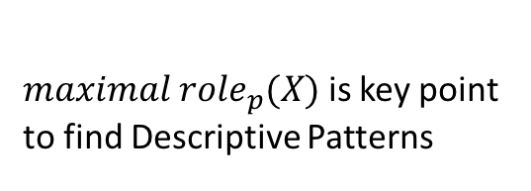
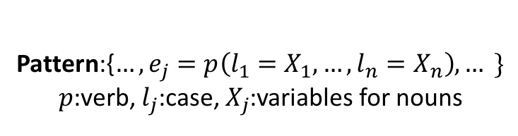

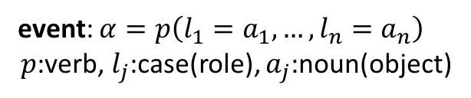

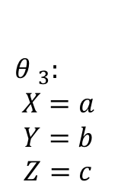

Over $N_{τ}$ documents(min Support)
Descriptive Similarity
Patterns
建設する
D2
建設する
$${θ }_{2}$$
p (l1 = X, l2 = Y)
q (l1 = Y, l2 = Z)
に
が
p (l1 = m, l2 = n, …)
q (l1 = n, l2 = o, …)
が
会社
原告
が
$${θ }_{3}:$$
$$X=a$$
$$Y=b$$
$$Z=c$$
X: p(l1 = X), r(l2 = X)
Y: p(l2 = Y), q(l1 = Y)
Z: q(l2 = Z), r(l1 = Z)
が
破壊する
D3
specific
に
破壊する
p (l1 = a, l2 = b, …)
q (l1 = b, l2 = c, …)
event：建設する:が/原告
some main cases we will concern in our research:
ガ','ヲ','ニ','ト','デ',
p (l1 = X, l2 = Y)
q (l1 = Y, l2 = Z)
r (l1 = Z, l2 = X)
event: $α=p\left(l_{1}=a_{1},…,l_{n}{=a_{n}}\right)$
$p$:verb, $l_{j}$:case(role), $a_{j}$:noun(object)
Dn
$${θ }_{n}$$
$maximal {role}_{p}(X)$ is key point to find Descriptive Patterns
Pattern:{$…,e_{j}=p\left(l_{1}=X_{1},…,l_{n}{=X_{n}}\right),… \}$
$p$:verb, $l_{j}$:case, $X_{j}$:variables for nouns
p (l1 = x, l2 = y, …)
q (l1 = y, l2 = z, …)
r (l1 = z, l2 = x, …)
* Requirement: importance of nouns(object), a pattern contain at least one keyword(KeyGraph)

Slide 3


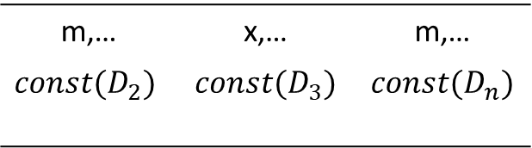

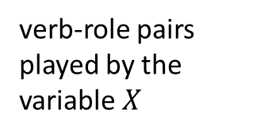
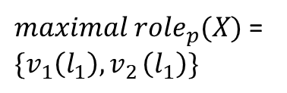

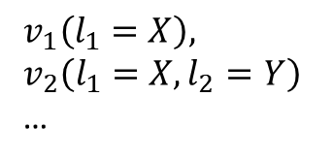




Combination of enlargement is changeable
Maximal closure meeting min support requirement
primitive pattern for closures
$maximal {role}_{p}(X)$ =
$${\{v}_{1}\left(l_{1}\right){,v}_{2}\left(l_{1}\right)\}$$
pp(X) = v1(l1 = X), v2(l1 = X)
v2(l2 = Y), v3(l1 = Y)
v3(l2 = Z)
v4(l1 = A)
v4(l2 = B), v5(l1 = B)
…
$$v_{1}(l_{1}=m,…)∈D_{n}$$
m,… | x,… | m,…
$$const(D_{2})$$ | $$const(D_{3})$$ | $$const(D_{n})$$
…
…
By enlargement of role set to get maximal closures, the argument in pp(X) is extended. It means more specific patterns can be extracted.
* Every possible specific pattern can be extracted from closures.
$$D_{2}$$
$$D_{3}$$
…
$$D_{n}$$
$maximal {role}_{p}(Y)$ ,…
$$v_{1}\left(l_{1}=X\right),v_{2}(l_{1}=X)$$
complex situations:
verb-role pairs played by the variable $X$
Goal:
Design a workable idea to expand patterns within one month before graduation.
$$v_{2}\left(l_{2}=Y\right),v_{3}(l_{1}=Y)$$
similarity text structure
…
$$v_{1}\left(l_{1}=X\right),$$
$$v_{2}\left(l_{1}=X,l_{2}=Y\right)$$
…
Get descriptive pattern from maximal closure
Descriptive pattern
$$P$$

Slide 4
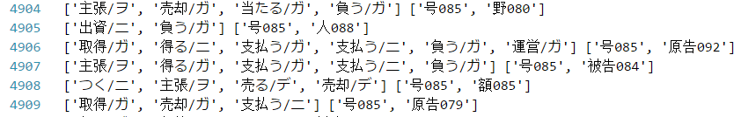
Works
We use KNP tool to parse our texts of precedent set and build a whole event set contains 84550 events from 101 documents.
Using adjusted clique finding program, 5030 maximal closures have been extracted under KeyGraph requirement.(8209 results without KeyGraph)
Goal of next month(until graduation)
Design some workable idea and make some experiments to expand patterns base on the closure data we have.
A part of result

