Slide 1
TEMPO: ground pixel, FOR center
N–S: 2.00 km E–W: 4.75 km
Area = 2.00 km × 4.75 km = 9.50 km² = 9.50×10⁶ m²
2.00 km = 2.00×10³ m 4.75 km = 4.75×10³ m
2.00×10³ m × 4.75×10³ m = 9.50×10⁶ m²
1 m² = 10⁴ cm² → 9.50×10¹⁰ cm²
tempo.si.edu/instrument · 33.5°N, 89.2°W

Slide 2
Reprojected study grid (this project)
GeoTIFF: …/tempo_mass_no2_kg_per_pixel.tif · EPSG:32611 · (easting × northing from affine)
E–W (pixel, x): 3,218.37 m = 3.2184 km
N–S (pixel, y): 3,218.19 m = 3.2182 km
Area = E–W × N–S = 3218.37 m × 3218.19 m = 10,357,338.56 m²
= 10.3573 km² = 1.04×10⁷ m²
1 m² = 10⁴ cm² → 1.0357×10¹¹ cm²

Slide 3
Column → mass
Symbols (TEMPO grid + plume product)
σ — plume column (fₚ·ΔVCD); same kind of field as TEMPO VCD (molec·cm⁻²)
fₚ — mean Planet plume mask in that TEMPO cell (0…1) (step 04)
ΔVCD — VCD − VCD_bg (excess column after local background; step 07)
A — ground footprint of one raster cell (m² → cm²; reprojected GeoTIFF)
Nₐ — Avogadro. MNO₂ — molar mass of NO₂ (kg·mol⁻¹)
σ = fₚ·ΔVCD (molec·cm⁻²)
m (kg) = σ · (A in cm²) / (Nₐ · MNO₂)
Nₐ = 6.02214076×10²³ mol⁻¹ MNO₂ = 0.0460055 kg·mol⁻¹
e.g. max-mass cell: σ ≈ 9.1×10¹⁶ molec·cm⁻²

Slide 4
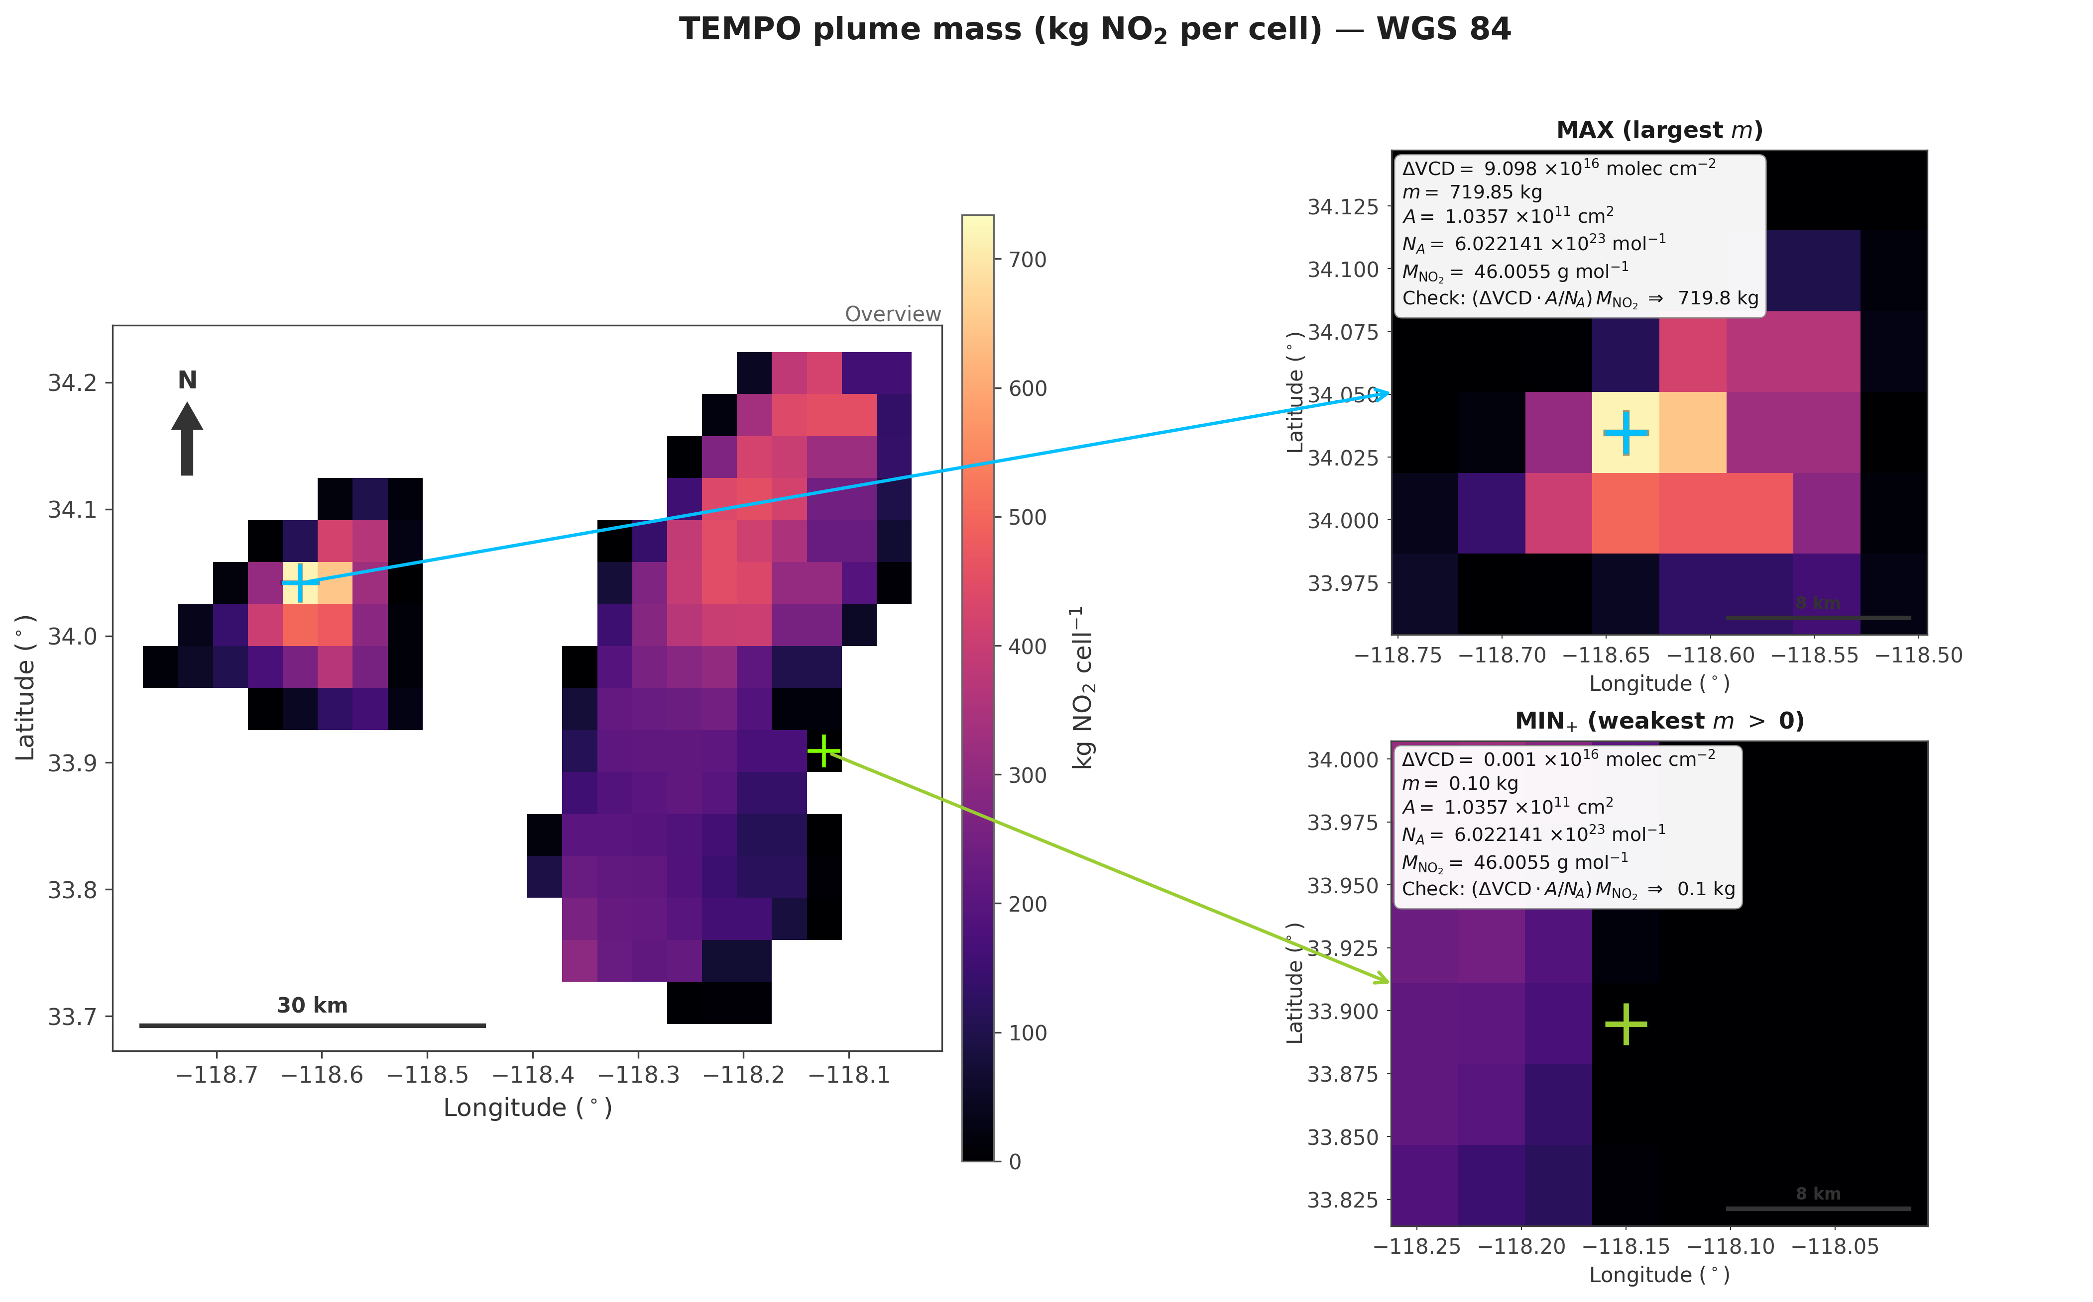
Reprojected grid: where are the max and weakest positive cells?
Overview (WGS 84, kg NO₂ per cell) + zooms: same pixel area A; colors scale with σ = f_p·ΔVCD. Arrows: overview markers → insets.

Slide 5
Plume mask (Planet fraction on TEMPO grid)
fₚ from …/tempo_fp_plume_utm11_clipped.tif (step 04). Range over pixels with 0 < fₚ ≤ 1 (screened nodata removed).
min fₚ = 0.0007463 max fₚ = 1
max / min = 1340 → about 3.1 orders of magnitude (log₁₀ of the ratio).

