Slide 1
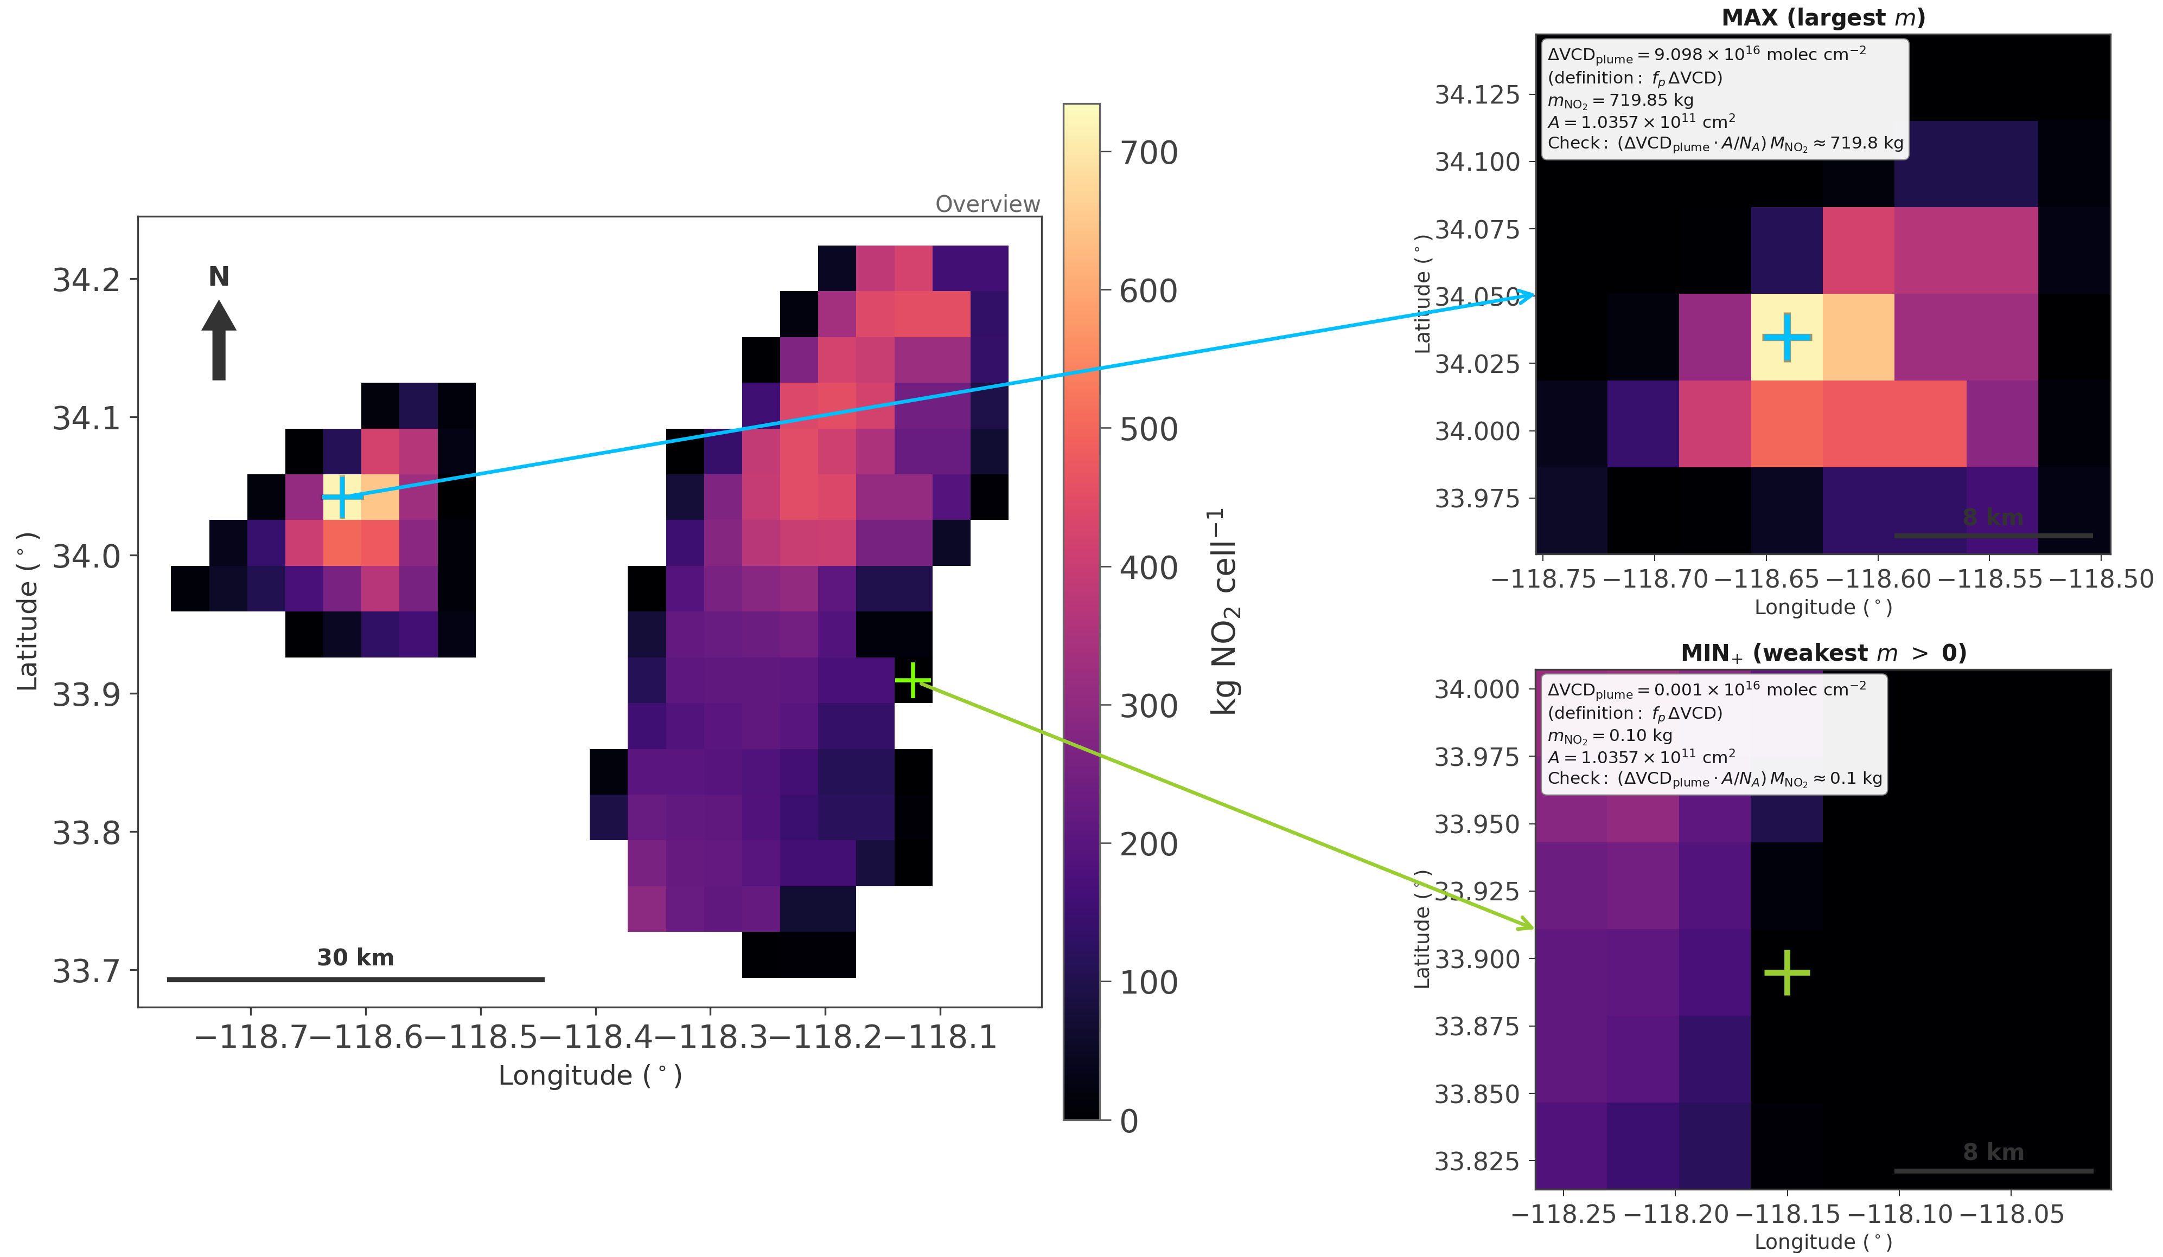
Where are the max and weakest positive cells?

Slide 2
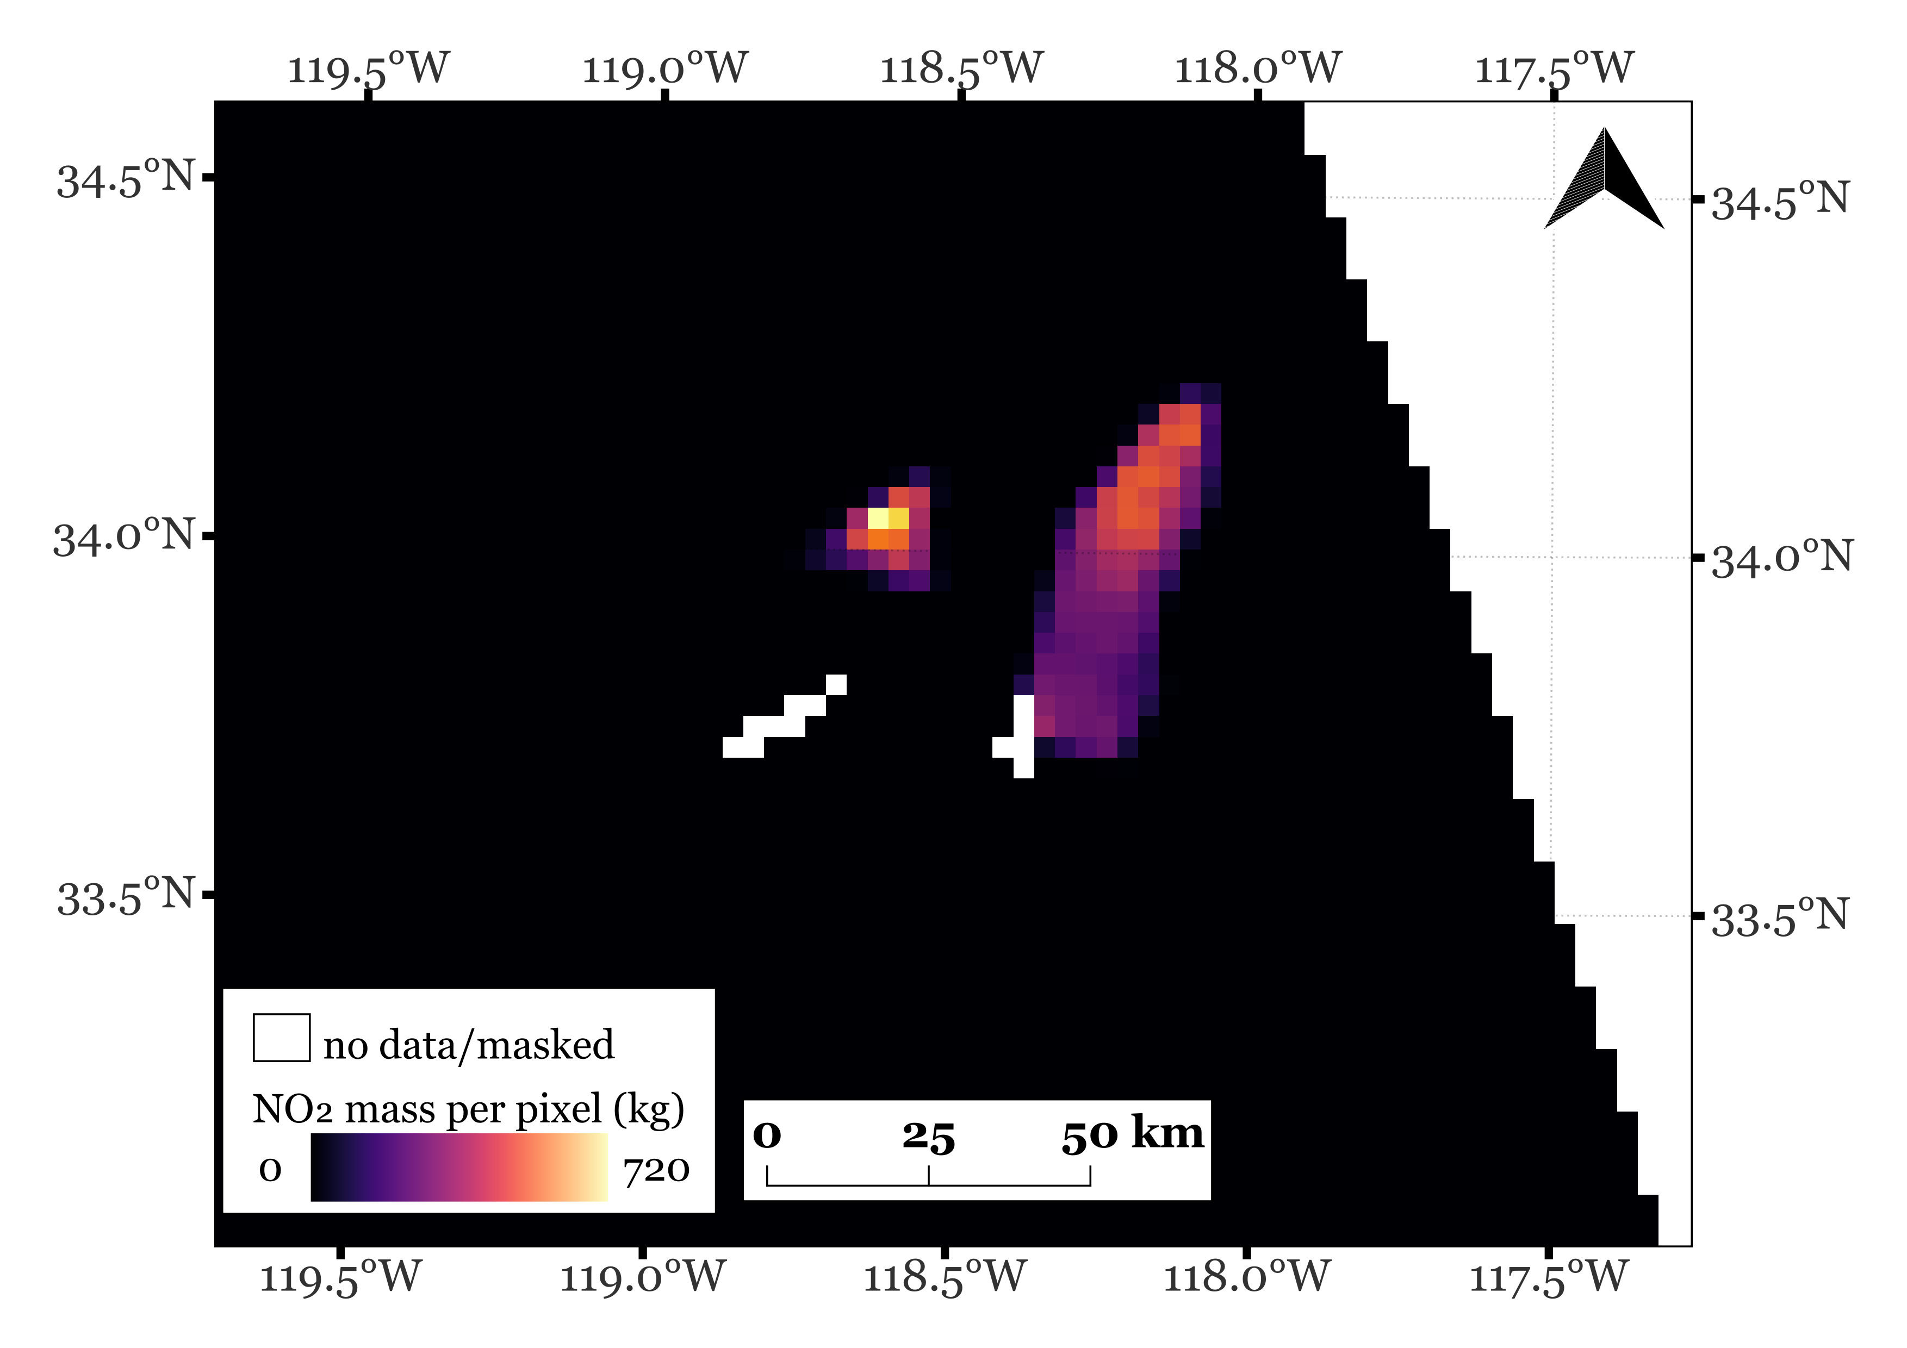
Final Map

Slide 3
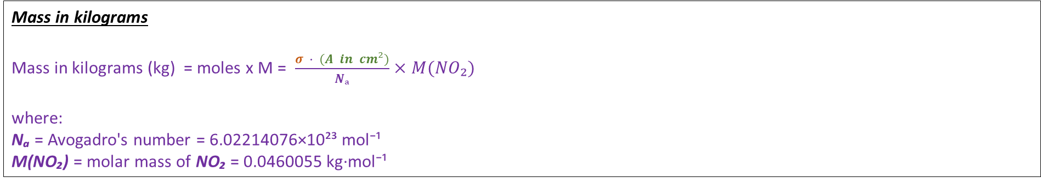
Column to Mass conversion
Pixel Area
Tempo ground pixel at the center measures 2.0 km (north-south) and 4.75 km (east-west)
Approx. pixel area at the center A = 2.00 km × 4.75 km = 9.50 km² = 9.50×10⁶ m² = 9.50×10¹⁰ cm²
Tempo ground pixel after reprojecting to study area EPSG:32611 measures 3.2184 km (north-south) and 3.2182 km (east-west)
Approx. pixel area after reprojection A (reprojected) = 3218.37 m × 3218.19 m = 10,357,338.56 m² = 1.04×10⁷ m² = 1.0357×10¹¹ cm²
Plume Column
σ = fₚ · ΔVCD (molecules/cm²)
where:
σ is plume column (same kind of field as TEMPO VCD) fₚ is Planet plume mask in that TEMPO cell (0…1) ΔVCD is VCD − VCD_{bg} (excess column after local background)
Mass in kilograms
Mass in kilograms (kg) = moles x M = $\frac{σ · (A in cm²)}{Nₐ}$ $×M(NO₂)$
where:
Nₐ = Avogadro's number = 6.02214076×10²³ mol⁻¹ M(NO₂) = molar mass of NO₂ = 0.0460055 kg·mol⁻¹

