Slide 1
Function Calling Harness
Function Calling From 6.75% to 100%
Qwen Meetup Korea
Samchon, Wrtn Technologies
Notes:
Hello, I am Samchon, an open-source developer at Wrtn Technologies.
Today's topic is Function Calling Harness: the story of raising the success rate from 6.75% to 100%. Let's begin the presentation now.

Slide 2

Tr;dr
AutoBE
Typia
Function Calling
Qwen Series
Notes:
First, let me briefly summarize this presentation.

Slide 3

AutoBe
AI backend generator
Do not write text codes
Instead, make AST structured data
Function Calling All-in
Types are extremely complicated
Recursive union types
Notes:
AutoBe is an agent that automatically builds backends.
Rather than text-based coding with AI, it assembles our custom compiler AST structures through function calling.
As a result, the types used in function calling are extremely complex, with infinite recursive and union structures.

Slide 4
Typia
TypeScript import typia, { tags } from "typia"; interface IMember { id: string & tags.Format<"uuid">; email: string & tags.Format<"email">; age: number & tags.Type<"uint32"> & tags.ExclusiveMinimum<19> & tags.Maximum<100>; } const check: boolean = typia.is<IMember>(input);
TypeScript Compiler Plugin
Analyze TypeScript Source Code
Lenient JSON Parsing
Type Coercion
Validation Feedback
Function Calling Success Rate
6.75% -> 100%
transform
JavaScript (compiled) ((input) => { return ( typeof input === "object" && null !== input && typeof input.id === "string" && /^[0-9a-f]{8}-.../.test(input.id) && typeof input.email === "string" && /^[a-z0-9._%+]+@.../.test(input.email) && Number.isInteger(input.age) && input.age >= 0 && 19 < input.age && 100 >= input.age ) })
Notes:
And Typia, a compiler library.
It analyzes TypeScript types and optimally employs various techniques to improve function calling success rates.
This is the secret to raising the function calling success rate from 6.75% to 100%.

Slide 5

Function Calling
No ambiguity
Model neutral
Mechanically Verifiable
Deterministically Convergent
Essential for AI in Engineering Design
Notes:
And Function Calling.
It has no ambiguity, is AI model-neutral, is mechanically verifiable, and therefore converges deterministically.
Thus, it is essential when introducing AI into the field of engineering design.

Slide 6

Qwen Series
The best performance for tool calling
In small/middle sized models
Smaller models are the Best for QA
Take more mistakes
Expose system vulnerabilities
Suitable for debugging
Notes:
Lastly, the Qwen series.
They demonstrate the best function calling performance in small/medium sizes.
And because these smaller models make mistakes more frequently, they actually expose system and logic vulnerabilities better, making them the best choice for debugging and QA.

Slide 7

Preface
Industrial Consensus
No Alternative Solution
Harness Engineering
Notes:
Now let's begin the main story.

Slide 8

1. Industrial Consensus
NESTFUL (EMNLP 2025)
GPT-4o: 28% accuracy on nested tool call sequences
https://arxiv.org/abs/2409.03797
JSONSchemaBench (ICLR 2025)
3~41% converage on 10,000 real-world schemas (hardest tier)
https://arxiv.org/abs/2501.10868
BoundaryML (Blog)
Structured outputs actively degrade model reasoning
https://boundaryml.com/blog/structured-outputs-create-false-confidence
Notes:
The industry consensus is quite skeptical about function calling, especially function calling with complex types.
Simple types work, but complex types don't.
Strict mode, designed to improve function calling success rates, actually degrades the quality of the output.
Research and criticism of this kind are dominant.

Slide 9

2. No Alternative Solution
In Engineering Field,
Free-form text cannot be mechanically verified
Without structure, there can't be mechanical feedback
Without mechanical feedback, no guarantee
So we have to make function calling work
There's no other path for engineering purpose
Notes:
But in the engineering/design field, there is no alternative.
- Free-form text cannot be mechanically verified.
- Without a structured format, logic feedback is also difficult.
Without logic feedback, its stability cannot be guaranteed.
So when introducing AI into the engineering/design field, we ultimately have to make function calling work, even though it doesn't.

Slide 10

3. Harness Engineering
Success Rate for extremely complicate type
Qwen3-coder-next for DTO schema design: 6.75%
GPT 5.4 for API specification reviewing: 9.91%
The answer was not a better model or a smarter prompt
It was on the harness engineering
Combined with Compiler Skills
Notes:
Our measurements were no different from the papers. The success rates for complex structures were similar across models: 6.75% for qwen3-coder-next and 9.91% for GPT 5.4.
Therefore, the answer was not to use bigger and more expensive models or write elegant prompts,
but rather powerful harness engineering combined with a compiler.

Slide 11
3. Harness Engineering
100% success — all four Qwen models
The answer was not a better model or a smarter prompt.
It was a harness.
Type schemas that constrain
+ compilers that verify
+ feedback that corrects
Notes:
And once we realized harness engineering through the compiler,
based on Qwen 3.5, the function calling success rate reached 100% across all models.
Type-based constraints, compiler-based validation, and detailed feedback through them. This is what made it possible.

Slide 12

AutoBe
AI Backend Auto-Generation Agent
Not text code, but AST data
Notes:
Now let's learn about this harness engineering in action,
the first project that achieved the goal of engineering design:
AutoBe.

Slide 13
2.1. What AutoBe Does
Build an e-commerce backend with products, carts, orders, and payments
Requirements Analysis (SRS)
Database Schema (ERD)
API Specification (OpenAPI v3.2)
E2E test code
Implementation code
Type-safe SDK for clients
Notes:
If you ask AutoBe to build a shopping mall, yes, it actually builds one.
From the standard requirements specification, to DB/API design documents and test code, to SDK integration libraries that clients can use.
It creates everything related to backend design and logic.

Slide 14
2.2. LLMs Don’t Write Code
Phase | AST Type | Description
Analyze | AutoBeAnalyze | Structured SRS (Software Requirements Specification)
Database | AutoBeDatabase | Database Compiler ensuring Integrity
Interface | AutoBeOpenApi | OpenAPI Compiler for API & DTO Generation
Test | AutoBeTest | Test Compiler for API E2E Testing
Realize | Modular Code | TypeScript Compiler
The LLM fills structures. Compilers write code.
Notes:
And in this process, AutoBe does not have the LLM write text-based code.
Instead, it has the LLM assemble through function calling against the AST structures of our custom compiler.

Slide 15
The Forms Are Not Simple
IJsonSchema: 10 variants, infinitely recursive nesting
export type IJsonSchema =
| IJsonSchema.IConstant
| IJsonSchema.IBoolean
| IJsonSchema.IInteger
| IJsonSchema.INumber
| IJsonSchema.IString
| IJsonSchema.IArray // items: IJsonSchema ← recursive
| IJsonSchema.IObject // properties: Record<string, IJsonSchema> ← recursive
| IJsonSchema.IReference
| IJsonSchema.IOneOf // oneOf: IJsonSchema[] ← recursive
| IJsonSchema.INull;
First-try success rate: 6.75% — 10 variants × recursive nesting = combinatorial explosion
Notes:
And the compiler's AST structures are complex.
As you can see, the structure is a union type, and each individual type references others recursively in a chain.
It has infinite combinations and depth.

Slide 16
IExpression — 30+ Variants, Recursive
Test expression type — programming-language-level complexity in a single function call
export type IExpression =
| IBooleanLiteral | INumericLiteral | IStringLiteral // literals
| IArrayLiteralExpression | IObjectLiteralExpression // compound literals
| INullLiteral | IUndefinedKeyword // null/undefined
| IIdentifier | IPropertyAccessExpression // accessors
| IElementAccessExpression | ITypeOfExpression // access/operations
| IPrefixUnaryExpression | IPostfixUnaryExpression // unary operations
| IBinaryExpression // binary operations
| IArrowFunction | ICallExpression | INewExpression // functions
| IArrayFilterExpression | IArrayForEachExpression // array operations
| IArrayMapExpression | IArrayRepeatExpression // array operations
| IPickRandom | ISampleRandom | IBooleanRandom // random generation
| IIntegerRandom | INumberRandom | IStringRandom // random generation
| IPatternRandom | IFormatRandom | IKeywordRandom // random generation
| IEqualPredicate | INotEqualPredicate // assertions
| IConditionalPredicate | IErrorPredicate; // assertions
30+ variants with recursive nesting programming-language complexity in one function call
Notes:
It gets even more complex when you get to the compiler for the test program.
Over 30 union types are chained together, and they internally contain those union types again recursively.
Infinite combinations, infinite breadth and depth.
This is the nature of compiler ASTs, and in fact, the nature of all engineering design fields.

Slide 17
2.3. Self-Healing Loops
Write
Validate
Diagnose
Correct
Generate
↻ repeat until success
Write — LLM fills AST-typed data via function calling
Validate — Typia checks if value conforms to the AST type
Diagnose — Compiler verifies the AST data (DB, OpenAPI, TS)
Correct — On failure, feed precise diagnostics back to the LLM
Generate — Once all checks pass, compiler emits final code
Notes:
And even after succeeding in composing AST data through function calling after much trial and error, there is one more step.
Validate: verifying whether the AST structure matches the actual type.
Diagnose: checking whether the data is compilably valid.
Corrector: correcting it when it is not valid.
Through these self-healing loops, the data generated by AI is progressively improved and repeated until it succeeds.

Slide 18
2.4. AST Specs Are Better
Constraint by Absence, Not Prohibition
Prompts say “don’t do X” — model must recall X to avoid it
AST specs define only what’s allowed — everything else doesn’t exist
Output space shrinks to valid-only → higher accuracy per attempt
Custom Compilers = Custom Diagnosers
Generic validators: “invalid JSON” — no actionable information
AST-aware compilers: exact path, expected type, actual value
Precise diagnostics → targeted correction → faster convergence
Notes:
And building a coding agent with AST specs has many advantages over text-based coding agents.
Instead of flooding with prohibition rules, you can constrain through specifications,
and the compile error messages issued by the Diagnoser can be made more AI-friendly to improve precision.

Slide 19
2.5. Four Qwen Models, All 99.8%
Compilation success rate across all tested Qwen models
qwen3.5-397b-a17b (17B / 397B) — Largest MoE → 100%
qwen3.5-122b-a10b (10B / 122B) — Medium MoE → 100%
qwen3.5-27b (27B Dense) — Medium Dense → 100%
qwen3.5-35b-a3b (3B / 35B) — Small MoE → 99.8%
qwen3-coder-next (3B / 80B) — Coding-specialized → 99.8%
From 397B to 35B. Same schema, same pipeline, same result.
Notes:
So when generating backends with AutoBe, all five Qwen models achieve 100% or near-100% compilation success.
From 397B down to 35B. Even a 3B active parameter model can complete an Amazon or Coupang-level shopping mall backend.
Same schema, same pipeline, same results.
Even when using frontier models, the distribution of code quality is uniform.

Slide 20
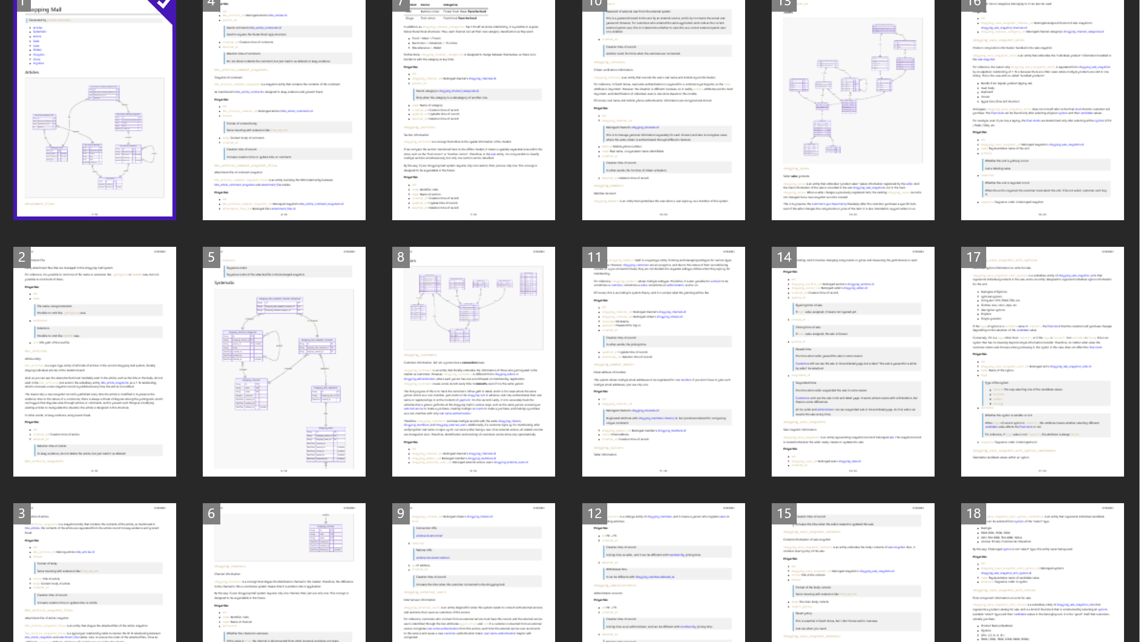
Notes:
This is the DB design document and guide created by AutoBe through function calling.

Slide 21
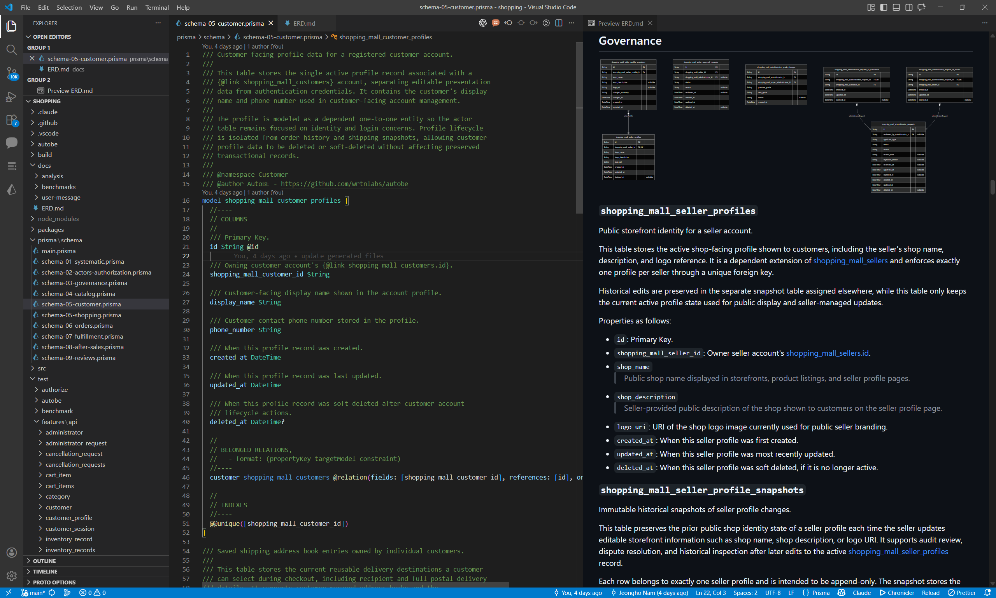
Notes:
And its ORM schema definition.

Slide 22
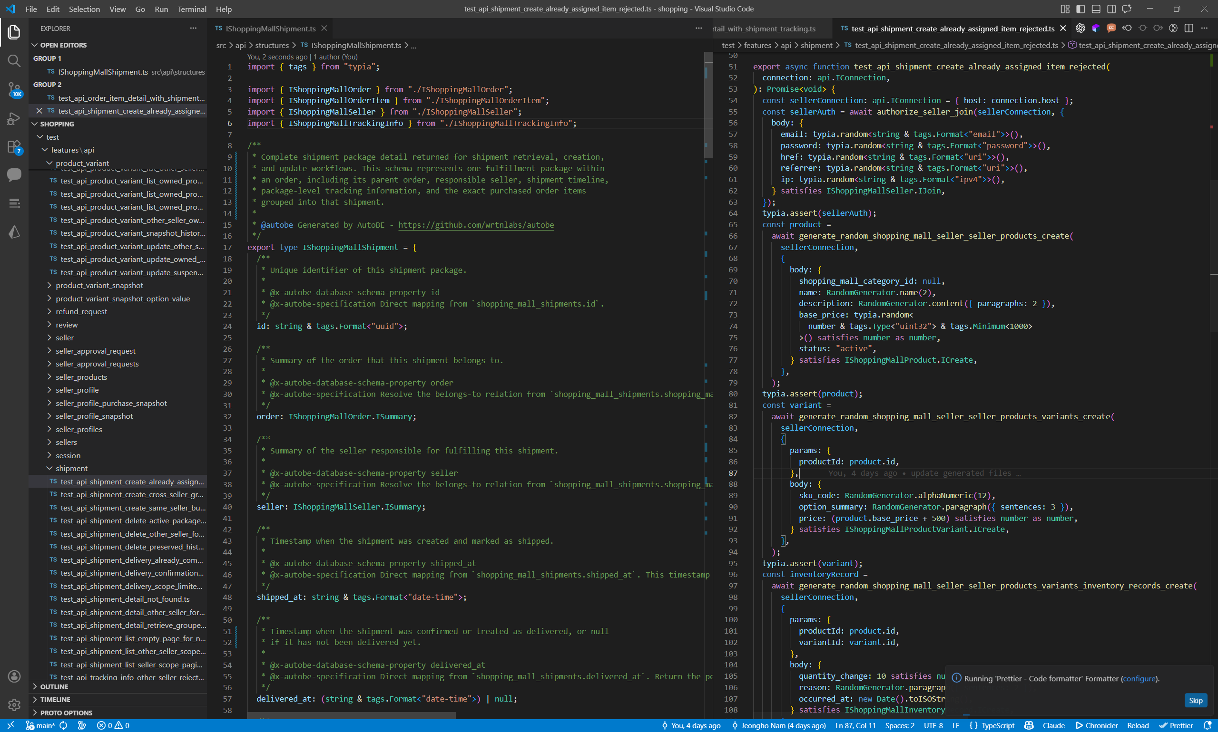
Notes:
This is the DTO spec definition and test code.

Slide 23
AutoBe
AI Backend Auto-Generation Agent
🌐 https://autobe.dev
📦 https://github.com/wrtnlabs/autobe
📋 https://github.com/wrtnlabs/autobe-examples

Slide 24

Typia
The Infrastructure for LLM Function Calling
Turns 6.75% into 100% by Compiler Skills
Notes:
Now, let's talk about Typia,
the story of raising the function calling success rate from 6.75% to 100%.

Slide 25
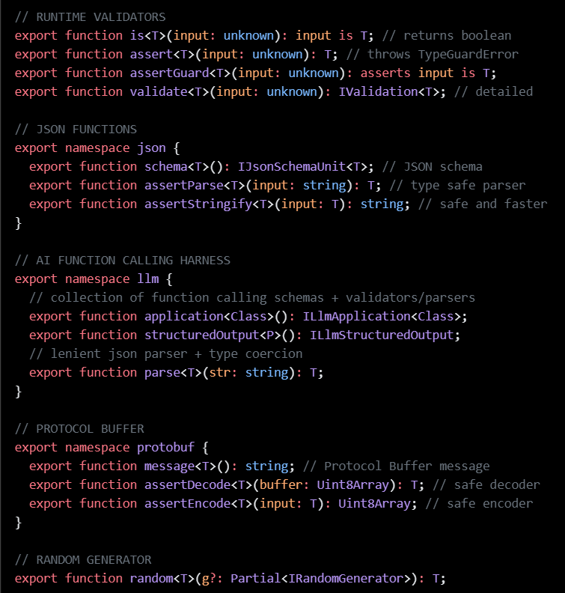
3.1. What Is Typia
A TypeScript compiler plugin
analyzes source code at compile time
Overcomes TypeScript's runtime type erasure
Generates optimal validation code (AOT — Ahead of Time)
20,000× faster than class-validator
One line of code — no extra schema definitions needed
typia.validate<T>(input) — that's it
Notes:
Typia is a plugin library for the TypeScript compiler.
It analyzes TypeScript source code at the compiler level and automatically generates optimal logic code for each type.
It was once famous under the title of a validator that is 20,000 times faster.

Slide 26
Typia's Core: TS → JS Transform
Before Compilation: TypeScript
After Compilation: JavaScript
import typia, { tags } from "typia";
interface IMember {
id: string & tags.Format<"uuid">;
email: string & tags.Format<"email">;
age: number &
tags.Type<"uint32"> &
tags.ExclusiveMinimum<19> &
tags.Maximum<100>;
}
const check: boolean = typia.is<IMember>(input);
((input) => {
return (
"object" === typeof input &&
null !== input &&
"string" === typeof input.id &&
/^[0-9a-f]{8}-.../.test(input.id) &&
"string" === typeof input.email &&
/^[a-z0-9._%+-]+@.../.test(input.email) &&
"number" === typeof input.age &&
Number.isInteger(input.age) &&
input.age >= 0 &&
19 < input.age &&
100 >= input.age
);
})
→
A single line — typia.is<IMember>(input) transforms into UUID regex, email regex, integer + range checks
Notes:
And this is what the optimal code generated by Typia looks like.
When you use Typia's is function, it automatically transforms into optimal type-checking code at compile time.
This is called a transformer.

Slide 27
Type → Schema: Automatic Generation
TypeScript Type (input)
Generated JSON Schema (output)
import typia, { tags } from "typia";
interface IMember {
/**
* Member's age.
*
* Only adults aged 19 or older
* can register.
*/
age: number
& tags.Type<"uint32">
& tags.ExclusiveMinimum<18>;
email: string & tags.Format<"email">;
name: string
& tags.MinLength<1>
& tags.MaxLength<100>;
}
const schema = typia.llm.parameters<IMember>();
{
"type": "object",
"properties": {
"age": {
"type": "integer",
"description": "Member's age.\n...
"exclusiveMinimum": 18
},
"email": {
"type": "string", "format": "email"
},
"name": {
"type": "string",
"minLength": 1, "maxLength": 100
}
},
"required": ["age","email","name"]
}
→
JSDoc comments → description fields | Type constraints → validation rules
One type = LLM guidance + validation rules
Notes:
And when you use the typia.llm.parameters function, as you can see, TS types are automatically converted into structured output schemas.
Comments also become the description in the structured output.

Slide 28
3.2. typia.llm.application<Class>()
Scales schema generation to entire classes — every method becomes a function calling schema
Each ILlmFunction automatically provides:
parameters — JSON Schema for the LLM to fill
parse() — lenient JSON parsing + type coercion
coerce() — schema-based type conversion
validate() — precise error detection with exact paths
Define one class → get the full function calling pipeline
Compile
TS Class → Schema
parse()
Lenient parsing
coerce()
Type conversion
Correction Loop
validate()
Error feedback
execute()
Function call
Feedback Loop
Result
Notes:
And when you apply this to a class, all functions in that class are automatically converted into function calling schemas.
And for each function, in addition to the structured output schema, three more features are added:
parse(): a lenient JSON parser
coerce(): automatically corrects types
validate(): finds incorrect types and issues detailed feedback messages

Slide 29
Type Coercion
LLM Output
Type Definition
// Expected
{
"type": "card",
"cardNumber": "1234-5678“
}
// Actual LLM output
"{
\"type\":\"card\",
\"cardNumber\":\"1234-5678\“
}"
// Union type occurs double JSON stringified
type IPayment = ICardPayment | IBankPayment;
interface ICardPayment {
type: "card";
cardNumber: string;
}
interface IBankPayment {
type: "bank";
accountNumber: string;
}
→
• LLM returns a string containing JSON — not the object itself
• Valid JSON — jsonrepair, dirty-json, LangChain all pass it through
• Qwen 3.5: 100% of anyOf fields. Claude: same on oneOf
• Only type-aware parsing can detect and unwrap it
Notes:
And this is what type coercion means.
On the right side, the payment type IPayment is a union type of card payment and bank payment. That is, a customer can pay by card or by bank transfer.
However, Qwen 3.5 and Anthropic Claude, with 100% probability, apply double JSON.stringify on this union type, producing incorrect types.
Typia identifies the correct type information at the compiler level and forcefully corrects it. This is coerce.

Slide 30
Seven Sins in One Output
Markdown wrapper, prefix text, wrong types, incomplete keywords, unclosed brackets
const llmOutput = `
I'd be happy to help! ← 1. prefix text
```json ← 1. markdown block
{
"order": {
"payment": "{\"type\":\"card\“, cardNumber: “\1234" ← 2. double-stringify, but broken
"product": {
name: "Laptop", ← 3. unquoted key
price: “1299.99”, ← 3. not number
quantity: 2, ← 3. trailing comma
},
"customer": {
vip: tru ← 4. incomplete keyword
← 4. unclosed brackets
← 4. unclosed markdown block
`;
const result = func.parse(llmOutput); // ✓ all 7 fixed
One call to func.parse() — all 7 problems fixed, zero model changes
Notes:
And this is what lenient JSON parsing means.
As you can see, there are many things wrong here. This is one of the most common issues with small/medium models like Qwen.
First, it returned markdown instead of JSON.
Second, looking at order.payment, yes, the double JSON.stringify issue from earlier occurred. And that inline JSON string itself is also malformed.
Third, looking at the member properties of product, keys are not wrapped in quotes, strings are used instead of numbers, and there is a trailing comma after quantity.
Lastly, customer.vip was left incomplete, and after that, brackets were not closed and the markdown JSON block was not closed either.
Typia restores this by recursively alternating between parse and coerce. This is lenient JSON parsing.

Slide 31
Validation Feedback
The LLM sees exactly where it went wrong — on its own JSON
{
"order": {
"payment": {
"type": "card",
"cardNumber": 12345678 // ❌ [{"path":"$input.order.payment.cardNumber","expected":"string"}]
},
"product": {
"name": "Laptop",
"price": -100, // ❌ [{"path":"$input.order.product.price","expected":"number & Minimum<0>"}]
"quantity": 2.5 // ❌ [{"path":"$input.order.product.quantity","expected":"number & Type<\"uint32\">"}]
},
"customer": {
"name": "John Doe",
"email": "invalid-email", // ❌ [{"path":"$input.order.customer.email","expected":"string & Format<\"email\">"}]
"vip": "yes" // ❌ [{"path":"$input.order.customer.vip","expected":"boolean"}]
}
}
}
5 errors, 5 exact paths — fix only what’s broken, keep everything else
Notes:
However, even after parsing and coercion, incorrectly typed values may still remain.
This happens when properties were never filled in from the start, or when values are created that are impossible to correct.
In this case, Typia reports exactly where and how each one is wrong, as shown above, providing feedback to the AI.
This is Typia's validation feedback.

Slide 32
The Only Compiler-Level Solution
Typia is the only framework that operates at the compiler level
and supports all four in a single integrated pipeline:
Schema Generation — from TypeScript types at compile time
Lenient Parsing — broken JSON recovery + type coercion
Validation — exact path + expected type for every error
Feedback Generation — LLM-readable structured error report
Notes:
And let me take a moment to brag here.
Typia is the only one that provides integrated support and stabilization for all four features we've covered at the compiler level.
And for each individual feature as well, Typia is the only one that supports union types.

Slide 33
Harness Engineering: AutoBe + Typia
Typia Layer (Function Calling level)
Type → auto schema generation
Broken JSON recovery (lenient parsing)
Schema-based type coercion
Precise error feedback (validation feedback)
AutoBe Layer (system level)
4 AST types + 4-tier compiler validation
Self-healing loops (diagnostics → correction)
40+ agent collaboration + batch + prompt caching
Typia makes FC I/O robust. AutoBe ensures system-wide consistency. Together = the harness.
Notes:
Now, let me summarize the function calling harness.
Typia layer: type-to-schema, parsing, coercion, validation feedback
AutoBe layer: 4 ASTs + 4-stage compiler verification, self-healing loop
Typia makes function call I/O robust; AutoBe guarantees system consistency.
A deterministic loop wrapping a probabilistic model -- that is the harness.
A climbing harness does not make you stronger. It makes your strength safe.
A test harness does not make code correct. It makes bugs visible.
A function calling harness does not make the LLM smarter. It makes the LLM's mistakes correctable.

Slide 34
"The type is the schema,
the validator,
and the prompt."
The harness is everything around it.
Notes:
The type is the schema, the validator, and the prompt.
The harness is everything around it.
This is the philosophy of Typia.

Slide 35

Function calling
Advantages of Function Calling
Applications in Engineering Designs
Notes:
So far, we have seen how AutoBe automated backend coding through the function calling harness,
and learned how Typia underpins the function calling harness.
In this section, we will explore the strengths of function calling and its applications in industry.

Slide 36
4.1. Natural Language vs Types
Types eliminate ambiguity
ExclusiveMinimum<18> vs "greater than 18"
Schemas constrain by absence, not prohibition
No "any" in schema → can't generate it
Model-neutral: same schema, any model
Deterministically convergent: 6.75% → 100%
Notes:
Natural language evolved to be ambiguous. Metaphor, nuance, humor -- they all operate on top of ambiguity.
Conversely, programming languages were designed to eliminate ambiguity.
That is why types are model-neutral, can be verified through constraints, and converge deterministically.

Slide 37
4.1. Natural Language vs Types
Via Prompt:
"The age field must be a positive integer greater than 18. Don't use string types for numeric fields. All required fields must be present..."
Problems:
Is ">18" or "≥18"? No way to verify
Rules multiply endlessly as schemas grow
Via Type:
interface IMember {
age: number
& Type<"uint32">
& ExclusiveMinimum<18>;
}
// ✓ Mechanically verifiable
// ExclusiveMinimum<18> is >18.
// It's an integer. It's required.
// No ambiguity.
Notes:
It becomes even clearer when you look at the code.
Expressing the same condition of being 18 years or older, natural language and types are this different.
In domains that require precision, type constraints provide the certainty that natural language instructions cannot.

Slide 38

4.2. Pink Elephant Problem
"Don't think of a pink elephant“
"Don't do X" places X at the center of attention
Paradoxically increases generation probability
With schemas, this problem disappears
No "any" in schema → LLM cannot generate it
Field types limited to 7 choices → no "varchar“
Not prohibition, but absence
Prompts prohibit what you don't want
Schemas allow only what you do want
Notes:
The pink elephant problem -- very famous, right?
The moment you say "Don't think of a pink elephant," you end up thinking of a pink elephant.
And for those who have built agents, this might be a word that triggers trauma.
When writing prompts, can you really avoid using prohibition rules? You write prompts diligently, but the AI behaves unexpectedly, and as you try to block it, you inevitably end up creating prohibition rules. But then, through vector search, the pink elephant appears at the forefront of patterns, and paradoxically, the AI ends up doing more of the very thing you prohibited.

Slide 39
4.2. Pink Elephant Problem
Prompt:
"Don't use the any type"
Schema:
IJsonSchema = 10 variants
No "any" in the union
→ Can't generate it
export type IJsonSchema =
| IJsonSchema.IConstant
| IJsonSchema.IBoolean
| IJsonSchema.IInteger
| IJsonSchema.INumber
| IJsonSchema.IString
| IJsonSchema.IArray
| IJsonSchema.IObject
| IJsonSchema.IReference
| IJsonSchema.IOneOf
| IJsonSchema.INull;
// 10 variants. No "any".
// Can't generate what doesn't exist.
Notes:
For example, in a coding agent, you might instruct via prompt: "Don't use the 'any' type." And then the AI uses the any type even more aggressively.
But with schemas, you simply don't create the any type spec in the first place. Then the any type is fundamentally blocked. Because that is the spec.

Slide 40
4.2. Pink Elephant Problem
Prompt:
"Don't make inline object type
(describing what inline object type is)
{something:{nothing:{x: number}}}
Schema:
Exclude<IJsonSchema, IObject>
Inline object excluded by type
→ Can't generate it
export namespace IJsonSchema {
export interface IObject {
type: "object";
properties?: Record<
string,
Exclude<IJsonSchema, IJsonSchema.IObject>
>;
additionalProperties?:
| boolean
| Exclude<IJsonSchema, IJsonSchema.IObject>;
required?: string[];
description?: string | undefined;
}
}
Notes:
If you write a prompt saying "Don't define inline object types," it creates inline object types even more aggressively.
But if you define it as a schema using the Exclude type, the AI will never create inline object types. Why? Because that is the spec.

Slide 41
4.3. Model Neutrality
Prompt engineering is inherently model-dependent
Optimized for GPT ≠ works on Claude ≠ works on Qwen
Function calling is model-neutral
JSON Schema means the same regardless of model
Strong models: 1–2 attempts, weaker: 3–4, both → 100%
Same schema, same pipeline → 100% on all models
Qwen, GLM, DeepSeek, OpenAI — no model-specific tuning
"Can this model do it?" → "Which is most cost-effective?"
Cost = avg retries × tokens/attempt × cost/token
Notes:
Prompt engineering is inherently model-dependent. A prompt optimized for GPT behaves differently on Claude, and differently again on Qwen. Rewriting prompts every time you switch models -- that's everyday life.
However, the function calling-based approach is model-neutral. JSON Schema means the same thing regardless of which model reads it.
The validation feedback loop absorbs performance differences between models.
Strong models take 1-2 iterations, weak models take 3-4 -- both converge to 100%.

Slide 42
4.3. Model Neutrality
Prompt Fragility — OpenAI Cases
GPT-4 → GPT-4o: same prompts suddenly fail
github.com/chapman4444/gpt4o-regression-report
GPT-4 → GPT-5: prompt rewrite required
OpenAI had to ship a Prompt Optimizer tool
cookbook.openai.com/examples/gpt-5
GPT-4o retirement (2026.03.31): API endpoints shut down
echostash.app/blog/gpt-4o-retirement
Notes:
The fact that AutoBe achieved 100% compilation across Qwen, GLM, DeepSeek, and OpenAI -- with the same schema, same pipeline -- is proof of this neutrality. Model-specific prompt tuning was never done, not even once.
The nature of model selection changes.
"Can this model do this task?" -- from a capability question
"Which model is the most cost-efficient?" -- to a cost optimization problem.
Average retry count x tokens per attempt x cost per token.

Slide 43
4.3. Model Neutrality
Prompt Fragility — Anthropic + Conclusion
Claude 3.x → 4.x: breaking changes every major version
Prefill removed, tool versions changed, style shifted
docs.anthropic.com/en/docs/about-claude/models/migrating-to-claude-4
Every vendor, every version: prompts must be rewritten
Model-specific tricks = vendor lock-in + technical debt
Type schemas don't break across versions.
JSON Schema is an industry standard — zero rewrite.
Notes:
This is an actual results comparison table.
Qwen, DeepSeek, OpenAI -- even with different models, all achieve 100% in the same pipeline.
Zero model-specific prompt tuning. The schema and feedback loop absorb the differences.

Slide 44
4.4. The Core: Verifiability
Function calling brings LLM output into software engineering
Structured output → engineering problem
Validation is deterministic — pass/fail
Feedback is precise — "Field X should be Y but got Z"
Correction converges — fix only that part
Type schema + deterministic validator + structured feedback
= harness
6.75% → 100%
Notes:
The key: verifiability.
The fundamental advantage of function calling is that it brings LLM output into the domain of software engineering.
Free-form text output makes accuracy an AI problem. Parsing is fuzzy, validation is fuzzy, correction is fuzzy.
In contrast, structured output makes accuracy an engineering problem.
Validation is deterministic -- JSON Schema validation gives a clear pass/fail.
Feedback is precise -- "Field X should be type Y, but you gave Z."
Correction converges -- precise feedback makes the model fix only that part.

Slide 45
4.4. The Core: Verifiability
Type Schema
+ Deterministic Validator
+ Structured Feedback
Prompt engineering tries to make the probabilistic part reliable.
The harness makes the deterministic part airtight.
In domains that demand precision: 6.75% → 100%
Notes:
The model is still probabilistic. It still makes mistakes.
But because the structure wrapping the model is deterministic, the process converges to 100%.
Type schema + deterministic validator + structured feedback = harness.
Prompt engineering tries to make the probabilistic part reliable.
Function calling makes the deterministic part perfect.
In domains that require precision, the latter wins. 6.75% becomes 100%.

Slide 46
4.5. This Pattern Is Universal
Every domain where output is mechanically verifiable
Applicable Domains
Software: type check → compilation → test execution
Semiconductor: DRC → LVS → SPICE simulation
Chemical Process: mass balance → energy balance → simulation
Control Systems: transfer function → stability → time-domain
Inapplicable: creative writing, strategic decisions
No validator → no feedback loop → no convergence
Notes:
This pattern is universal.
Semiconductors: DRC(ms) > LVS(sec) > SPICE simulation(min+). All deterministic.
Chemical processes: mass conservation > energy balance > process simulation. Laws of physics are the validator.
Architecture/BIM: dimensional clash > building codes > lighting/HVAC simulation.
Control systems: transfer function validity > stability analysis > time-domain simulation.
The same structure is possible in every engineering field that has had verification tools for over 40 years.
Let's look at the specific types.

Slide 47
Semiconductors — Chip Layout Hierarchy
DRC (fast) → LVS (med) → SPICE simulation (deep) — all deterministic
type IBlock =
| ILogicBlock // children: IBlock[] ← recursive
| IMemoryBlock // children: IBlock[] ← SRAM, DRAM, ROM, Flash, MRAM
| IAnalogBlock // children: IBlock[] ← PLL, ADC, DAC, SerDes, LDO
| IIOBlock | IClockTree | IInterconnect | IPowerGrid | ICPU | IGPU
| INPU | IDSP | ISecurityBlock | IDebugBlock | IPhyBlock;
type IStandardCell = // hundreds per PDK
| IAND | IOR | INAND | INOR | IXOR | IXNOR | INOT | IBUF | IMUX | IDEMUX
| IAOI | IOAI | IHA | IFA | IDFF | IJKFF | ILatch | IScanFF | IRetentionFF
| IICG | IClkBuf | IClkInv | ITieCell | ITapCell | IFiller | IDecap | IEndcap
| ILevelShifter | IIsolationCell | IPowerGate | IAntennaCell | ISpareCell | IECOCell | ...
// IBlock contains IBlock[] — recursive like IJsonSchema
// each ILogicBlock.cells: IStandardCell[] — union within union
// DRC → LVS → SPICE — all deterministic, all validatable
Physical rules of chip design are not negotiable
Notes:
Semiconductor chip layout.
IChipLayout -- technology_node is "5nm" | "7nm" | "14nm" | "28nm". IBlock's type is "logic" | "memory" | "io" | "analog" | "pll".
sub_blocks is recursive. It's the same union + tree structure as AutoBe's IJsonSchema.
DRC is fast, LVS is medium, SPICE is deep verification. All deterministic.
Same pattern, different domain.

Slide 48
Chemical Process — Unit Operations
Mass balance (fast) → Energy balance (med) → ASPEN simulation (deep)
type IUnitOperation =
| IReactor // sub_units: IUnitOperation[] ← recursive flowsheet
| IDistColumn // sub_units: IUnitOperation[] ← condenser + reboiler inside
| IAbsorber | IStripper | IExtractor | ICrystallizer | IDryer | IEvaporator
| IHeatExchanger | ICondenser | IReboiler | IHeater | ICooler | IFurnace
| IMixer | ISplitter | IPump | ICompressor | IExpander | ITurbine | IValve
| ISeparator | IFilter | ICyclone | ICentrifuge | IMembrane | IAdsorber
| IPipe | IOrifice | ITank | IFlare | IEjector | ISpreadsheet | ...
type IReactor = // union within union
| ICSTR | IPFR | IBatchReactor | IGibbsReactor | IEquilibrium | IConversion;
type IThermodynamicModel = // governs phase equilibria
| IPengRobinson | ISRK | INRTL | IUNIQUAC | IWilson | ICPA | ISAFT | IELECNRTL | ...
// IDistColumn contains IUnitOperation[] — recursive like IJsonSchema
// each IReactor is itself a union — union within union
ASPEN and HYSYS: deterministic validation for 40+ years
Notes:
Chemical processes.
IProcessStream -- temperature, pressure, composition, phase, flow_rate.
IUnitOperation -- type is "reactor" | "distillation" | "heat_exchanger" | "compressor", etc.
Mass conservation: sum of inlets = sum of outlets. Energy balance. Thermodynamic consistency.
The laws of physics are the validator. ASPEN and HYSYS have provided deterministic verification for over 40 years.

Slide 49
Construction (BIM) — IFC Element Hierarchy
IFC 4.3: 1,300+ entity types — collision detection, code compliance
type IfcElement =
| IfcWall // components: IfcElement[] ← recursive assembly
| IfcSlab | IfcBeam | IfcColumn | IfcRoof | IfcStair | IfcRamp | IfcFooting
| IfcDoor | IfcWindow | IfcCurtainWall | IfcRailing | IfcCovering | IfcPlate
| IfcPile | IfcMember | IfcChimney | IfcShadingDevice | IfcBuildingProxy | ...
type IfcDistributionElement = // union within union (MEP)
| IfcPipeSegment | IfcPipeFitting | IfcDuctSegment | IfcDuctFitting
| IfcCableSegment | IfcCableCarrier | IfcJunctionBox | IfcOutlet | IfcSwitch
| IfcPump | IfcFan | IfcBoiler | IfcChiller | IfcCoil | IfcCondenser | IfcCoolingTower
| IfcValve | IfcSensor | IfcActuator | IfcAlarm | IfcController | IfcFlowMeter | ...
type IfcSpatialElement = // spatial hierarchy ← recursive
| IfcSite | IfcBuilding | IfcBuildingStorey | IfcSpace | IfcFacility | IfcBridge;
// IfcWall contains IfcElement[] — recursive like IJsonSchema
// IfcDistributionElement is itself a union — union within union
BIM tools like Revit: collision detection for decades
Notes:
Architecture/BIM -- IFC element hierarchy.
IRoom, IOpening, IFixture. Door width 900mm or more (accessibility), minimum corridor width 800mm, fire compartments.
BIM tools like Revit have provided clash detection for decades.
Here too, the type field has enumerated variants -- "bedroom" | "living" | "kitchen"...
Recursive tree structure. Same pattern as AutoBe.

Slide 50
Control Systems — Controller Hierarchy
Transfer function (fast) → Stability analysis (med) → Time-domain sim (deep)
type IController =
| IPID // inner: IController ← cascade recursion
| IMPC // constraints: IConstraint[] ← another union
| ILQR | ILQG | IHinf | IFeedforward | ICascade | IAdaptive
| IFuzzy | ISlidingMode | IBackstepping | IRobust | IGainScheduled;
type IConstraint = // union within union
| IRangeConstraint | IRateConstraint | IStabilityConstraint | ISafetyConstraint
| IBandwidthConstraint | IRobustnessConstraint | IEnergyConstraint;
type IPlantModel = // subsystems: IPlantModel[] ← recursive
| ILinearPlant | INonlinearPlant | IDelayPlant | IHybridPlant | ISwitchedPlant
| IStateSpace | ITransferFunction | IZeroPoleGain | IFreqResponse;
type IEstimator = IKalmanFilter | IEKF | IUKF | IParticleFilter | ILuenberger;
// ICascade.inner: IController — recursive like IJsonSchema
// IMPC.constraints: IConstraint[] — union within union
60+ years of Bode, Nyquist, and pole-placement analysis tools
Notes:
Control systems.
IControlLoop -- "PID" | "MPC" | "LQR" | "feedforward" | "cascade".
ITransferFunction -- polynomial coefficients, delays.
Bode plot, Nyquist plot, pole placement: over 60 years of analysis tool history.
Transfer function validity (fast) > stability margin analysis (medium) > time-domain simulation (deep).
Every type has a type field and enumerated variants. They nest recursively.
This is not a coincidence -- it is the nature of engineering data.
However, the limitations are also clear. It cannot be applied to domains without deterministic validators -- creativity, emotion, strategy.
This is not a universal solution. It is a solution for domains where precision is essential and mechanical verification is possible.

Slide 51

Qwen series
Small Models and QA Engineering
Notes:
Chapter 5. The Qwen Series.
Let me talk about why this is a Qwen meetup today.
Small models and QA engineering -- why small models were the most important testing tool for AutoBe.

Slide 52
5.1. Small/Medium Models Excel
AutoBe's only criterion: how accurately a model fills complex JSON Schemas
GLM, Kimi — strong FC at large scale
At small/medium scale, Qwen was the only one
Even 3B active params supports tool choice
Handles 10+ variant recursive unions at 35B class
Notes:
AutoBe's entire pipeline is function calling.
Whether the model writes good prose or converses naturally is irrelevant.
The only criterion is how accurately it fills complex JSON Schemas.
It's not that only Qwen is good at function calling. GLM and Kimi are also strong with large models.
But at the small/medium scale, Qwen was the only one that could handle function calling at this level of complexity.
A MoE model with 3B active parameters supports tool choice and handles 10+ recursive union variants.

Slide 53
5.2. R&D Cost: Users vs Developers
For users: even the most expensive model is cheaper than hiring a backend developer
For developers: thousands of generate-compile-feedback cycles per feature
Commercial models at this scale = financial ruin
Local models make R&D cycles possible
Experiment without limits, without cost
6.75% → 100% required hundreds of cycles — only possible with local models
Notes:
R&D cost -- users vs developers.
For customers using AutoBe, model cost is not an issue. Even the most expensive model is cheaper than one backend developer's salary.
The problem is on our side -- the ones developing AutoBe.
Every time we add a new type design or validation rule, we have to run the entire pipeline from start to finish.
Thousands of generate-compile-feedback cycles. Doing this at scale with commercial models would bankrupt us.
Local models make the R&D cycle possible.
The journey from 6.75% to 100% required hundreds of experimental cycles, and it would have been impossible without local models.

Slide 54
5.3. Small Models = Best QA Engineers
Large models' advantage = their blind spot
"Correctly guess" ambiguous schemas — our mistakes stay hidden
Small model results:
qwen3-30b-a3b (3B active): ~10% — found fundamental schema ambiguities
qwen3-next-80b-a3b (3B active): ~20% — found subtle type mismatches
10% success = most valuable result
Every failure → system vulnerability → fix for ALL models
Notes:
Why small models are the best QA engineers.
Large models make fewer mistakes. That is both an advantage and a blind spot.
Even when our system has vulnerabilities, large models rarely trigger those failures.
They "correctly guess" the ambiguous parts of the schema and pass through. Our mistakes stay hidden.
When you switch to a small model, the story changes.
qwen3-30b-a3b-thinking -- 3B active, success rate around 10%. Every failure pointed to a system vulnerability, and each fix strengthened the pipeline for all models.
AI is probabilistic. Large models make mistakes "less often," not "never."
In production, "rarely" means outages.
Once the system becomes robust enough that even a 35B model cannot find vulnerabilities, the failure probability converges to zero for any model.

Slide 55

Conclusion
6.75% → 100%
Notes:
Now, let me wrap things up.

Slide 56
Conclusion
➜ Types = No misunderstandings
➜ Schemas = No pink elephants
➜ Deterministic loop: 6.75% → 100%
➜ Transfers to any domain with validators
Type Schema + Feedback = Deterministic Loop
Principle of Harness Engineering
Notes:
Each argument is as follows.
Types have no ambiguity.
Schema constraints have no pink elephant effect.
Deterministic loops converge to 100%.
This logic is applicable to every industry where a validator exists.
Combined, through type schemas and logic feedback, we can create deterministic loops.
This is the essence of harness engineering.

Slide 57
The Journey
6.75% Raw function calling success
↓
Typia Parse → Coerce → Validate → Feedback
↓
Loop Deterministic harness overcomes probabilistic LLM
↓
100% All 4 Qwen models, same harness — transferable to all domains
Notes:
And based on this theoretical foundation,
we took the initial 6.75% success rate
- Lenient JSON Parsing
- Type-based Coercion
- Validation
- Feedback
Through these procedures, by turning probabilistic AI into deterministic processes,
we achieved a 100% success rate and accomplished the engineering design mission with Qwen models.
And this is a general principle applicable to all fields.

Slide 58
6.75% is not a failure —
it's the first input to the loop.
If you can verify, you converge.
challenge in engineering fields.
Notes:
6.75% is not a failure.
It is the first input to the loop.
If you can verify it, it converges.
Everyone, take on the challenge of engineering design.
You can do it too.

Slide 59
Q&A
Qwen Meetup Korea
2026-03-26
Samchon, Wrtn Technologies
Notes:
Thank you for your attention. That's all I've prepared for today — I'll now take any questions.
Any further questions? If not, that concludes our presentation on the Function Calling Harness. Thank you!

