Slide 1
Earthquakes of 2023

Slide 2
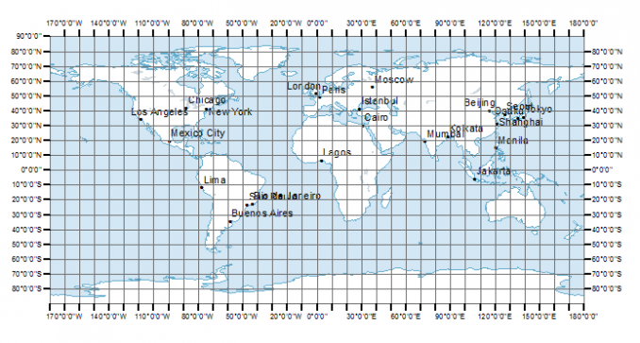
Map of 10-degree bins of latitude and longitude

