Slide 1
Core Java
Andy
Notes:
Interview question: -- ppt里没有
comparable and comparator interface
what's garbage collection
comparable vs comparator-->comparTo( Object o); compare(Object o1, Object o2)
reflection in java8
what is wrapper class
compiled language vs interpret language
what's the meaning of mutex
what's the deadlock issue, how to avoid it?
what's hash collision?

Slide 2
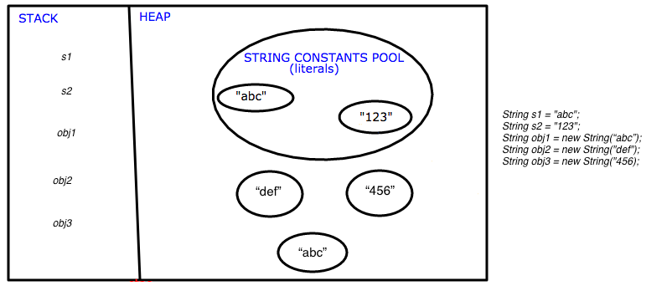
Topic: String - Memory & Constant Pool
Notes:
Interview question:
what's constant pool/string pool
What is Memory Leak?
Difference between Heap and Stack --- Heap includes Yong Generation, Old Generation and Permanent Generation (based on object age – how long it stays)

Slide 3
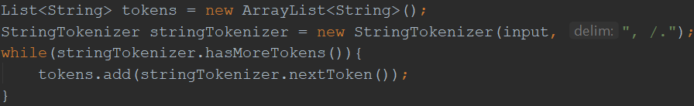
Topic : String
String is immutable
String str1 = “abc”; String str2 = new String(“abc”); String str3 = “abc”; String str4 = str1 + str2;
Reference vs Value: 1) str1 == str2 ? 2) Str1.equals(str2) ? 3) str1.compareTo(str2)
Constant Pool: How many objects ? (Pool)
Built-in Functions: charAt(), length(), substring(,), contains(), equals(), toUpperCase()
StringBuilder & StringBuffer
StringBuilder sb = new StringBuilder(“abc”); sb.append(“abc”);
sb.append(“abc”); sb.reverse(); sb.delete(startIndex, endIndex)
Mutable
toString()
Synchronized vs non-synchronized --- thread safe + performance
StringTokenizer
Notes:
Interview question:
what's the difference between String str1 = "abc" and String str2 = new String("abc")
difference between equals() and ==
what's the difference between String vs StringBuilder vs StringBuffer?
What is StringTokenizer?

Slide 4
Topic: final
Field :
public static final String APP_NAME=“testApp”
Purpose: define constants
Method:
public final int add(int a, int b){ return a + b; }
Purpose: prevent override
Class:
final class MyClass(){}
Purpose: 1) prevent inheritance, like Integer, String etc; 2) Make class immutable
Difference: final, finally, finalize
Notes:
Interview question:
what's the key word "finalize" means?
how to make a class as immutable
what's the final class-->final keyword
what's the difference between final vs finally vs finalize

Slide 5
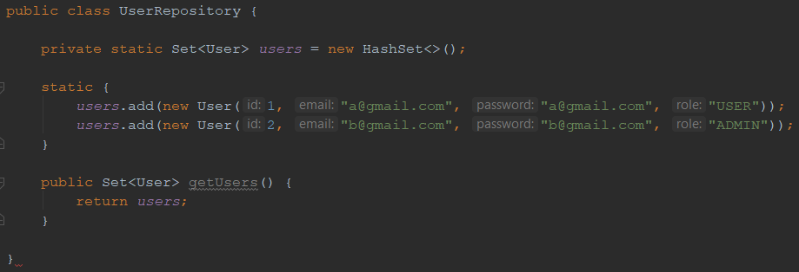
Topic: static –variable/block
Only One Instance!
Question
1. Java Variable Scope ?
2. scope of static block ?
Notes:
Interview question:
1) When/How to use static

Slide 6
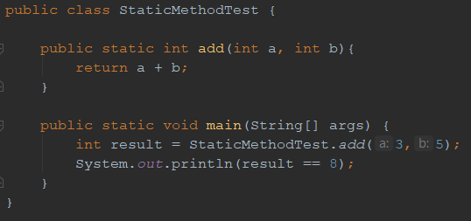
Topic: static - method
2) Static Method
Question:
1) Can static method access non-static variables ?
2) How to call static method in/outside of enclosing class?
3) Common Static Methods?
4) When to use static Methods?
-- util, helper

Slide 7
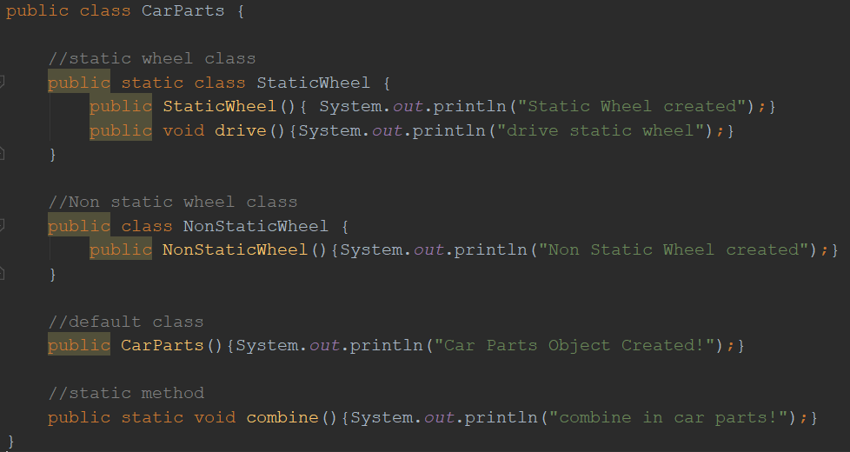
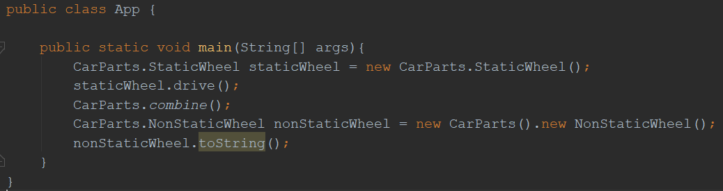
Topic: static - class
3) Static Class

Slide 8
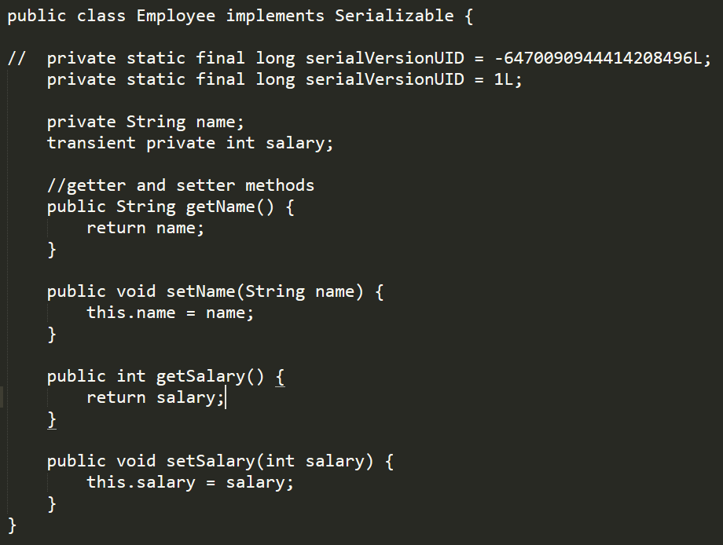
Serializable
1) serialVersionUID
2) transient: to avoid serialization
Static field or class is not serialized

Slide 9
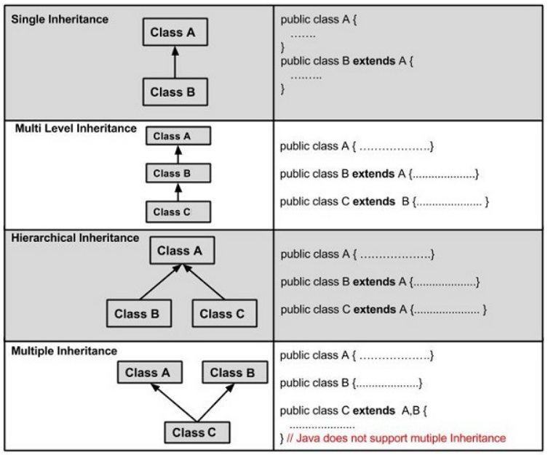
Topic: OOP(PIE)
Inheritance
Extends: Class
Implements: Interface
Question:
1. Abstract Class
2. Abstract class vs Interface
3. Marker Interface (Serializable， Cloneable)
4. Multiple Inheritance
Tips:
> Multiple Inheritance (extends) is not allowed
> Multiple Implementation (implements) is allowed
> Use “super()” to access parent class
Cloneable: shallow clone
shallow clone vs deep clone
Notes:
Interview question:
what's the difference between abstract class and interface
what's abstract class
what's mark interface?
What's the OOP means?
what's the difference between class and object?

Slide 10
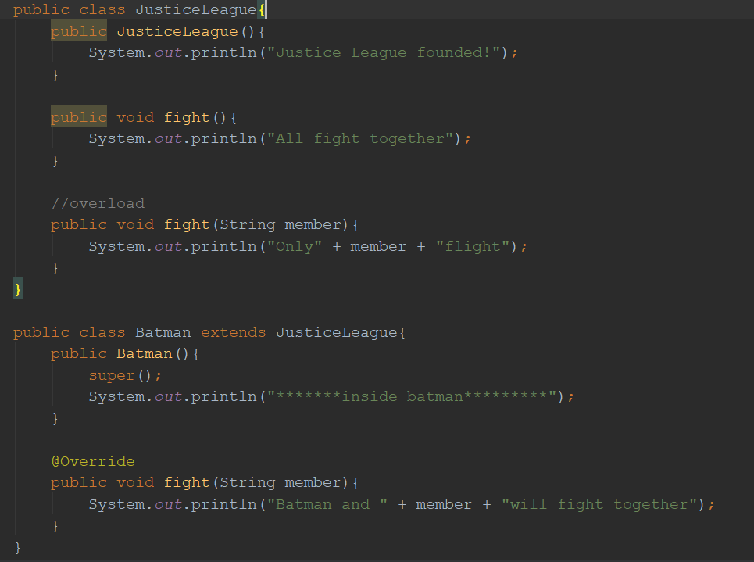
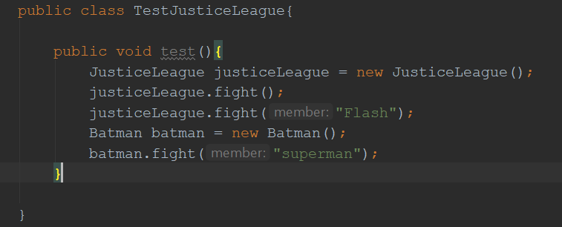
Topic: OOP(PIE)
Polymorphism
Static Polymorphism / Dynamic Polymorphism
Overload (same class) / Override (child class)
Override can NOT be applied to static method
Notes:
Interview question:
override vs overload/static polymorphism vs dynamic polymorphism
can we override a field?
What's the Polymophism means?

Slide 11
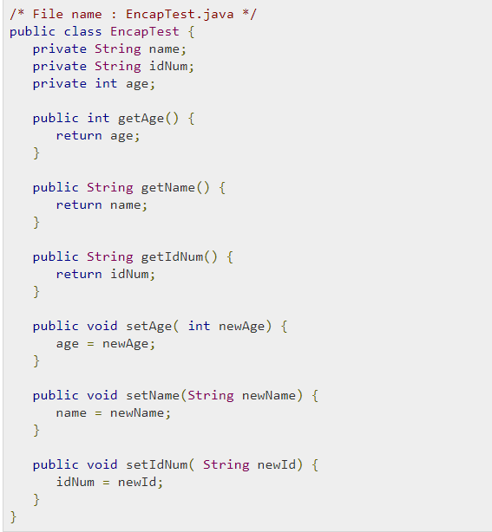
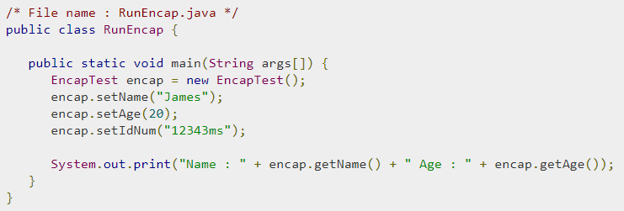
Topic: OOP(PIE)
Encapsulation
Tips: use getter/setter instead of direct access
Industry standard code structure

Slide 12
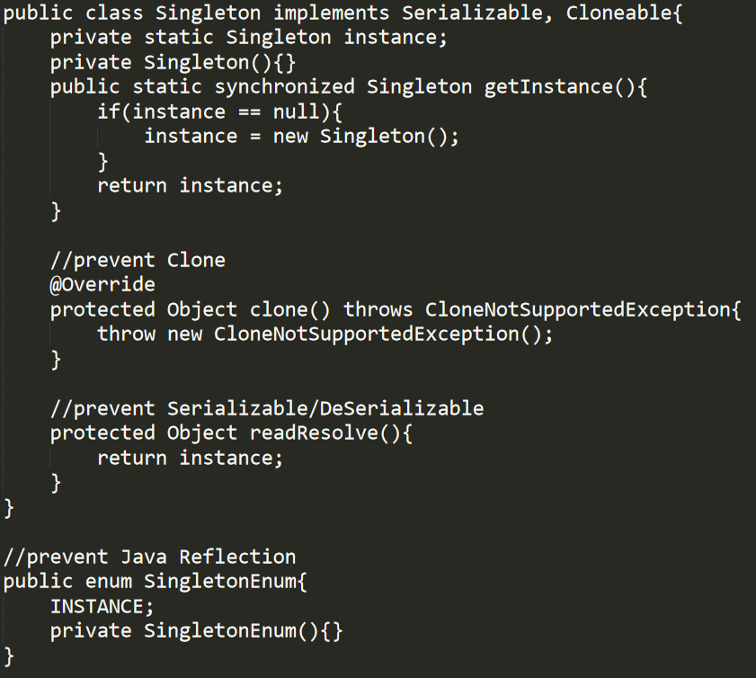
Topic: Design Pattern (Singleton)
1
Steps to make singleton
1. private Constructor
2. static synchronized getInstance method
3. override clone() method
4. override readResolve() method
Disadvantage of Singleton
1. it carries state of object
2. it prevents dependency injection and cannot be unit tested
2
3
4
*
*To Clone(): 1) class should implements Cloneable; 2) It is only a shallow clone; 3) avoid to use
Notes:
Note1): Use java IO stream to serialize the singleton to a file and then deserialize it from the file. The deserialized object will be different from the original object. To prevent this issue, use the readResolve() method in step 4.
Note2): Use java reflection can get the constructor of the singleton class and then change the accessible to true (private -> public). Then the private constructor is broken. To prevent this issue, change the class to enum, because enum is made to only return one instance by default.
Interview question:
how to create a singleton in java
how many design pattern as you known?
why use singleton ?
Is singleton per JVM or per Application? --- Per class loader. For example, if you have two applications each has a singleton. The singleton scope is their application. But if JRE singleton will work for both applications – JRE is the web application server level, it uses web server class loader, different from application class loader.

Slide 13
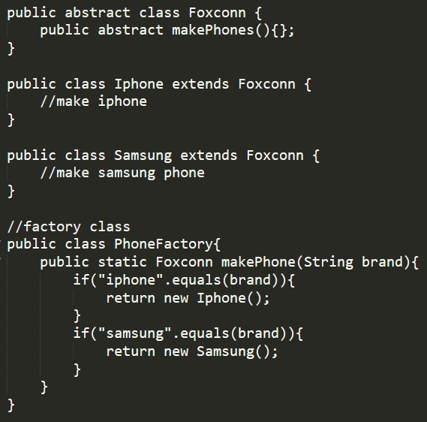
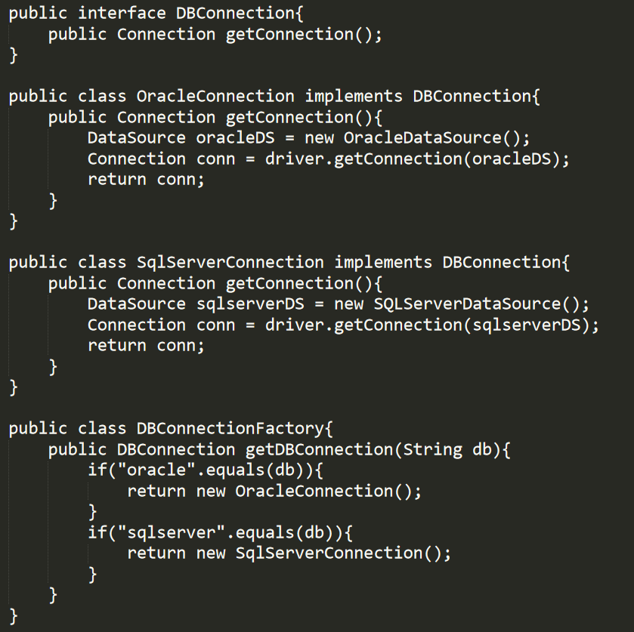
Topic: Design Pattern (Factory)
Example 1
Example 2
Notes:
Interview question:
What is factory design pattern/give an example

Slide 14
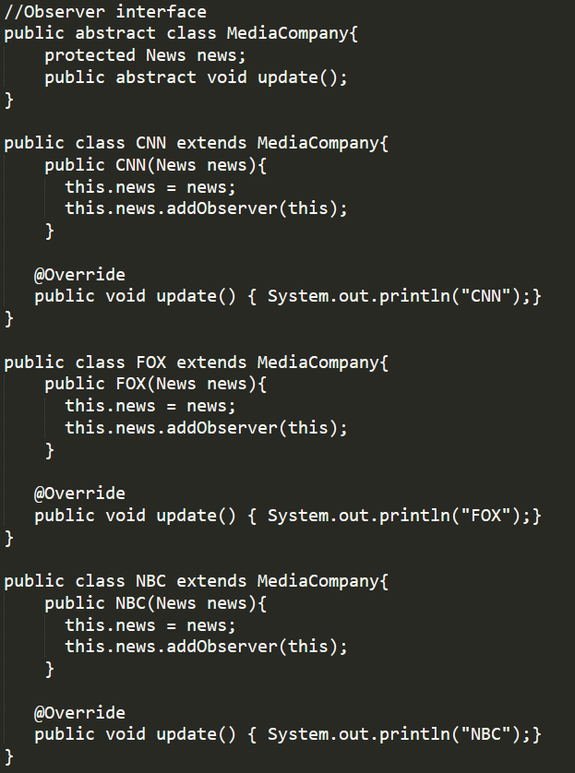
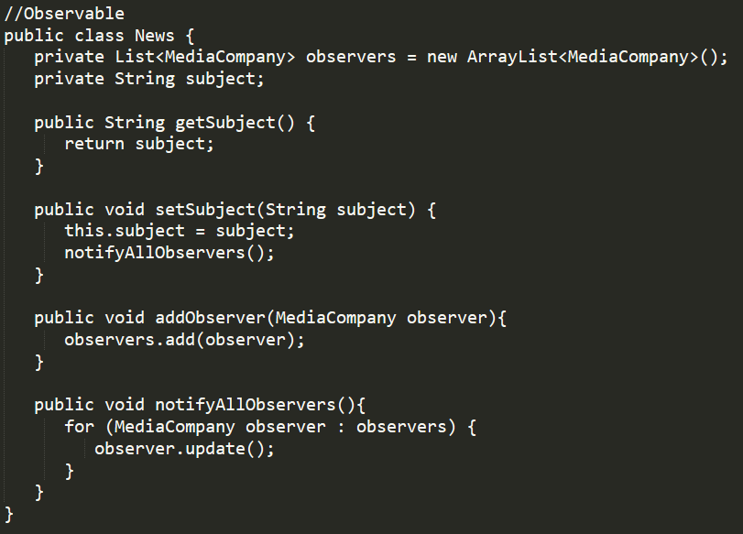
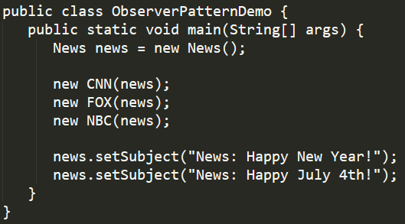
Topic: Design Pattern (Observer)
It is similar to “subscribe” in Angular/Redux and Reactive Programming

Slide 15
Topic: Design Pattern (Others)
Popular Design Pattern to choose:
Decorator, Façade, Strategy, Builder, Composite etc
DO NOT SAY “MVC”

Slide 16
Topic: Real Scenario
1. Design a Vending Machine
2. Design an Elevator System
3. Design a Parking Lot
Notes:
VendingMachine(List<> items, double balance, 1. getPriceForItem(), 2. vendingItem(), 3.insertPayment(), 4. refund() 5. Exchange())
Item(type, price)

Slide 17
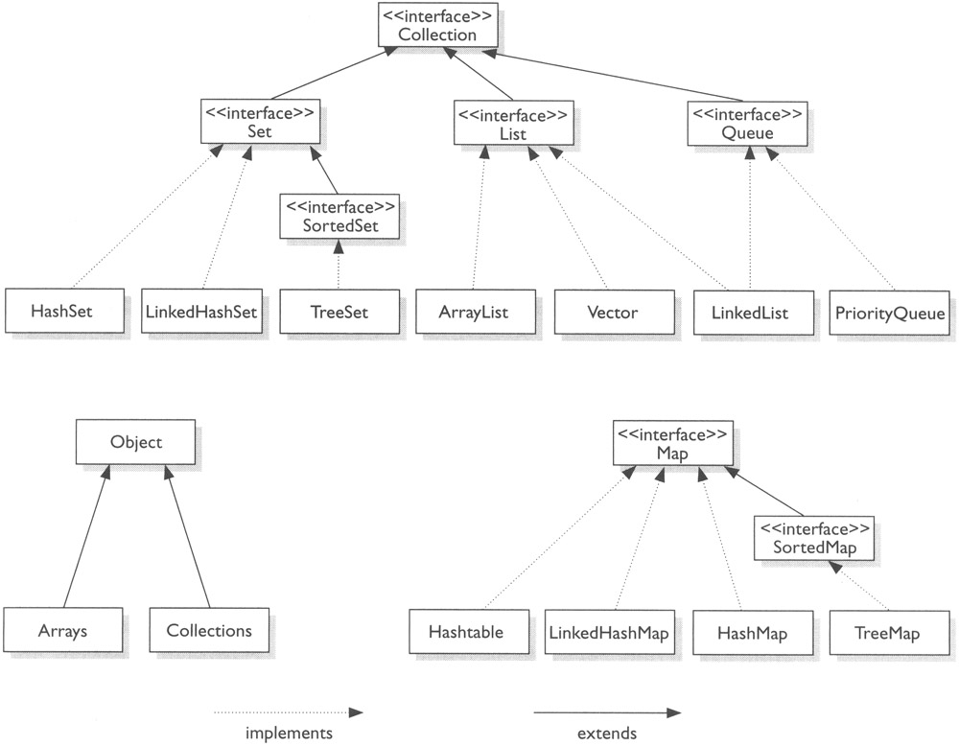
Topic: Collection
Notes:
Interview question:
How many kinds of Collections you already knew?
what's the data structure of HashMap / principle of HashCode / internal process of hashMap ?
what's the difference between ArrayList and LinkedList / arraylist vs vector vs hashTable / List vs set vs hashmap / hashtable vs hashmap vs concurrenthashmap / set vs list
what's thread-safe means?
Steps to sort HashMap by values / by keys
what's the difference between stack vs queue
what's treeMap / hashset? difference: HashSet vs TreeSet
what are methods in stack data structure
difference between which better to get an element-->list vs tree
collections.sort(), which algorithm is it used? (quick sort/ merge sort)
could you give me an example when you use linkedlist? >> web history, one page directs to ather pages, use linkedlist can find next node that give previous page.
what's the difference between java7 and 8 for Hashmap? ….so wired…quesiton…

Slide 18
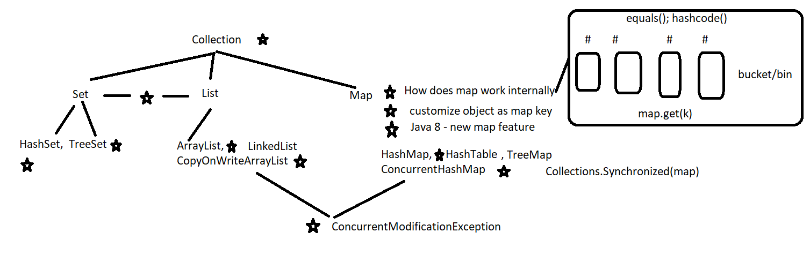
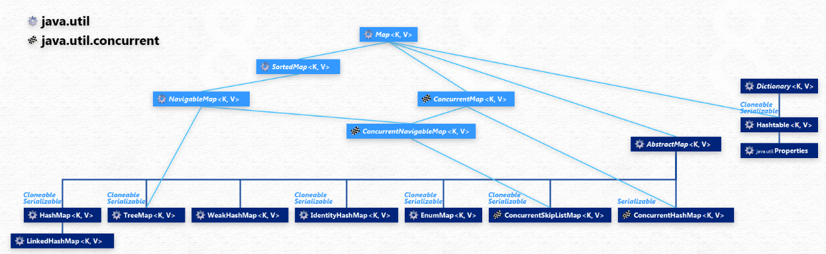
Collection – interview questions
Notes:
Source: http://www.falkhausen.de/Java-8/java.util/Map-Hierarchy.html
Interview question:
1) When did you use concurrentHashMap?

Slide 19
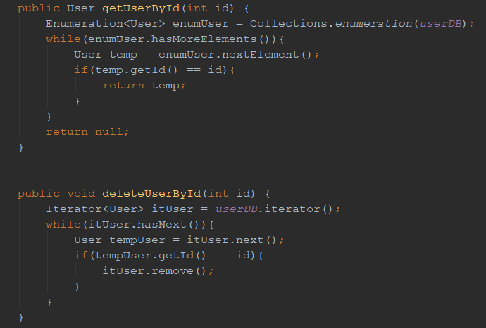
Topic: Iterator vs Enumeration
Notes:
Interview question:
what's the Enum means
binary search : iterator vs recursive

Slide 20
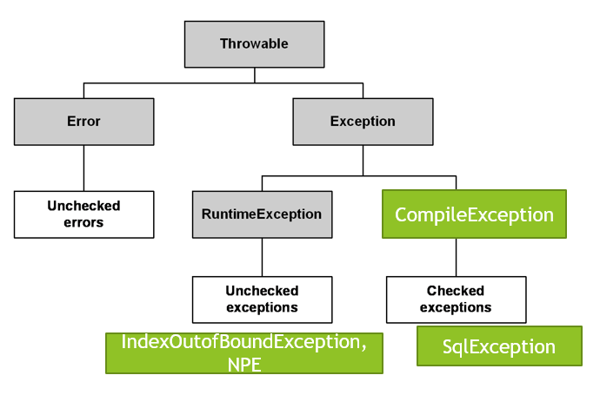
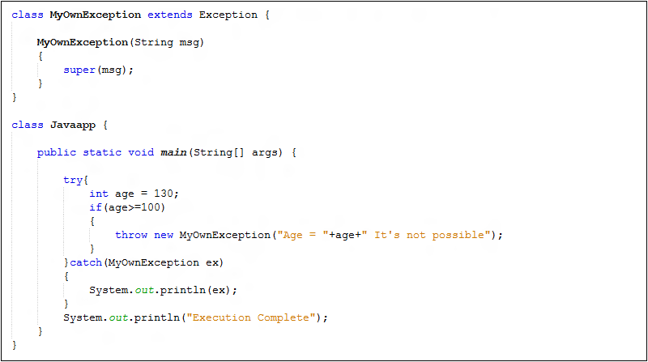
Topic: Exception Handling
Exception Structure Define your own Exception
(try-catch, throw, throws)
Notes:
Interview question:
what's checked/ unchecked exception
what's the OutOfMemoryError means?

Slide 21
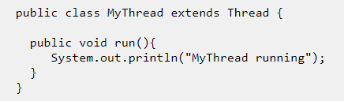
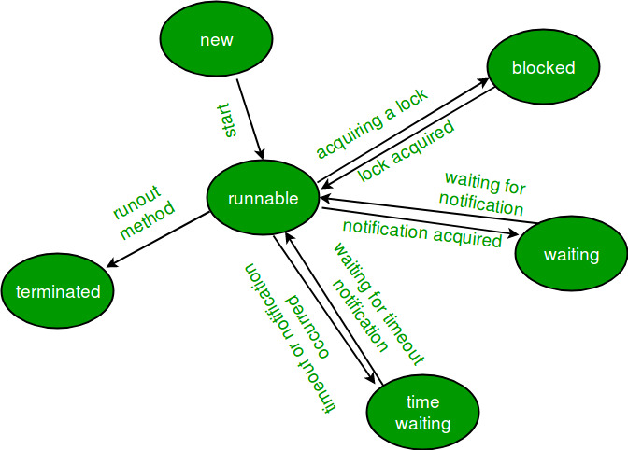
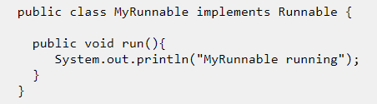
Topic: Multithreading(thread – java18)
1. Create a thread
2. Race Condition
Multiple Threads try to change the same object status.
3. Start() vs Run()
A: t.start() create and run a new thread. t.run() run the thread in current thread
4. Thread LifeCycle
5.ThreadLocal vs Volatile
A: ThreadLocal: create thread level copy of object
Volatile: All threads share and update same object
Notes:
Interview question:
what's the Multithreading
what's the difference between thread and process
why we need threads?
how can you create thread? (2 ways)

Slide 22
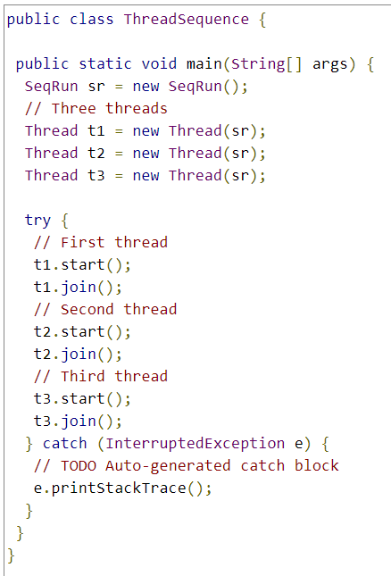
Topic: Multithreading
6. join(s) tells other threads to wait until this thread is completed or just wait for the given s seconds
Question: Given three threads, how to let them run in order?

Slide 23
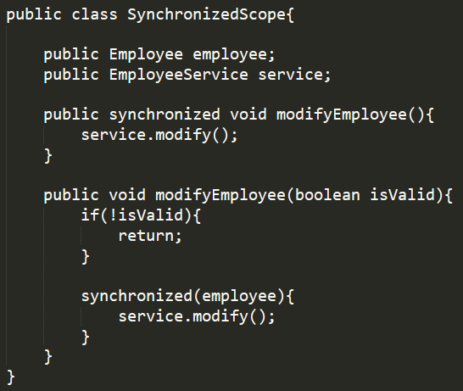
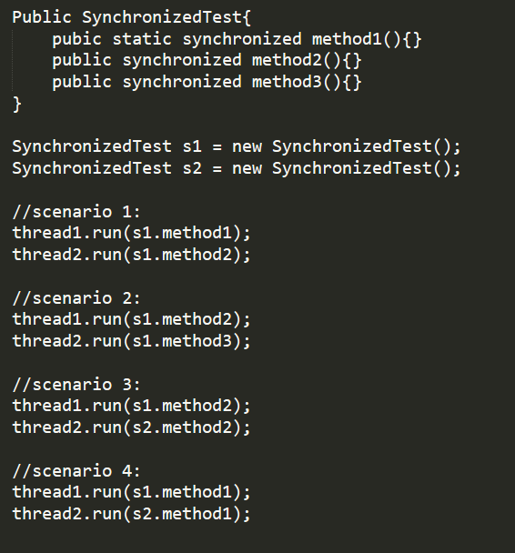
Topic: Synchronized
Synchronized on Method;
Synchronized on Block
Static synchronized vs Synchronized
(Analyze 4 scenarios)
Notes:
Interview question:
what's the key word "synchronized" means?
what's thread-safe means?
If we don't use synchronized , what could be happened?

Slide 24
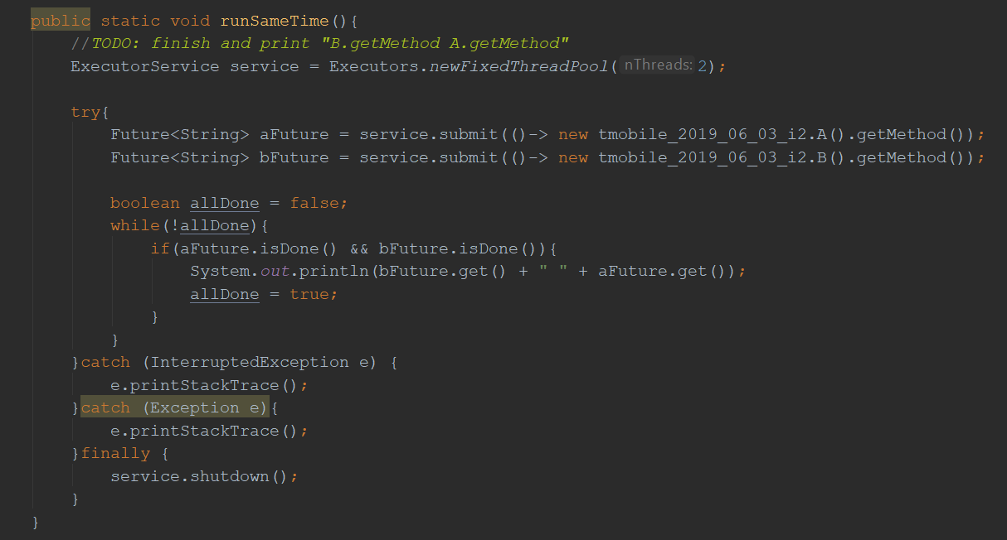
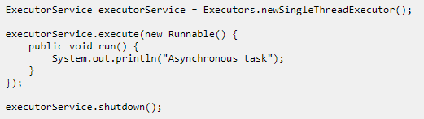
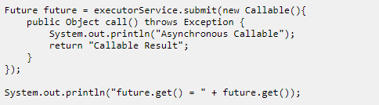
Topic: Concurrency -- 1) ExecutorService
ExecutorService maintains thread pool
Executors.newCachedThreadPool(size)
newFixedThreadPool(size)
Execute(), submit(), invokeAny(), invokeAll()
Runnable vs Callable
Future.get(*time), Future.isDone(), Future.cancel()
Executor.shutdown()
Notes:
newCachedThreadPool – thread will die if not been used for 60 seconds; NewFixedThreadPool – thread will exist forever
Execute(runnable) vs Submit(callable) – invoke(callable)
Future<String> future = executorService.submit();
String result = future.get(); ---------- use get() to get the object returned.
Remember to shutdown()
Interview question:
what's executor service
what's the meaning of Concurrency ?
what's thread pool? How many various thread pools in java do you know?

Slide 25
Topic: Concurrency -- 2) Semaphore and Mutex
package com.bht.aop.main;
import java.util.concurrent.Semaphore;
public class SemaphoreMain {
static Semaphore semaphore = new Semaphore(3);
//static Semaphore semaphore = new Semaphore(1);
static class MyATMThread extends Thread {
String name;
MyATMThread(String name){ this.name = name; }
public void run(){
try{
semaphore.acquire();
System.out.println(name + " : got the permit!");
try{
System.out.println(name + " is doing work now! ");
Thread.sleep(5000);
}finally {
System.out.println(name + " : releasing lock...");
semaphore.release();
}
}catch (InterruptedException e){e.printStackTrace();}
}
}
public static void main(String[] args) {
System.out.println("Total available Semaphore permits :" + semaphore.availablePermits());
MyATMThread t1 = new MyATMThread("A");
t1.start();
MyATMThread t2 = new MyATMThread("B");
t2.start();
MyATMThread t3 = new MyATMThread("C");
t3.start();
MyATMThread t4 = new MyATMThread("D");
t4.start();
MyATMThread t5 = new MyATMThread("E");
t5.start();
}
}
Semaphore – limits the number of threads to access one resource concurrently
Semaphore semaphore = new Semaphore(4)
Mutex – limits only 1 thread to access one resource concurrently
Mutex is not native in java, Semaphore(1) is Mutex
Notes:
New Semaphore(*) cannot be empty in constructor

Slide 26
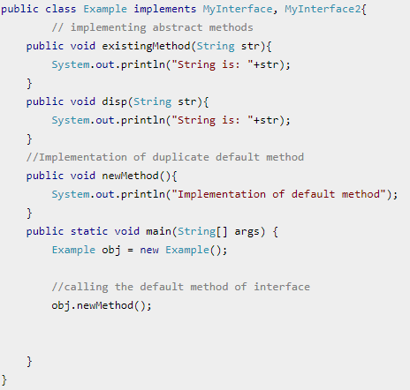
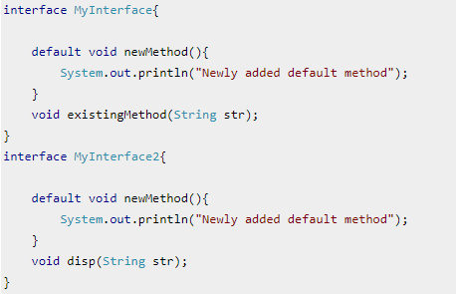
Topic: Java 8(default & static methods)
Problem with java interfaces: children must implements all methods in interface, if adding new definitions to interface, all children have to update.
Solution: default methods in interface
Problem: multiple implementations –> override
Static methods: the same as defaults method,
but does not allow override
Notes:
Interview question:
what's default method? Why do we need to add default method?

Slide 27
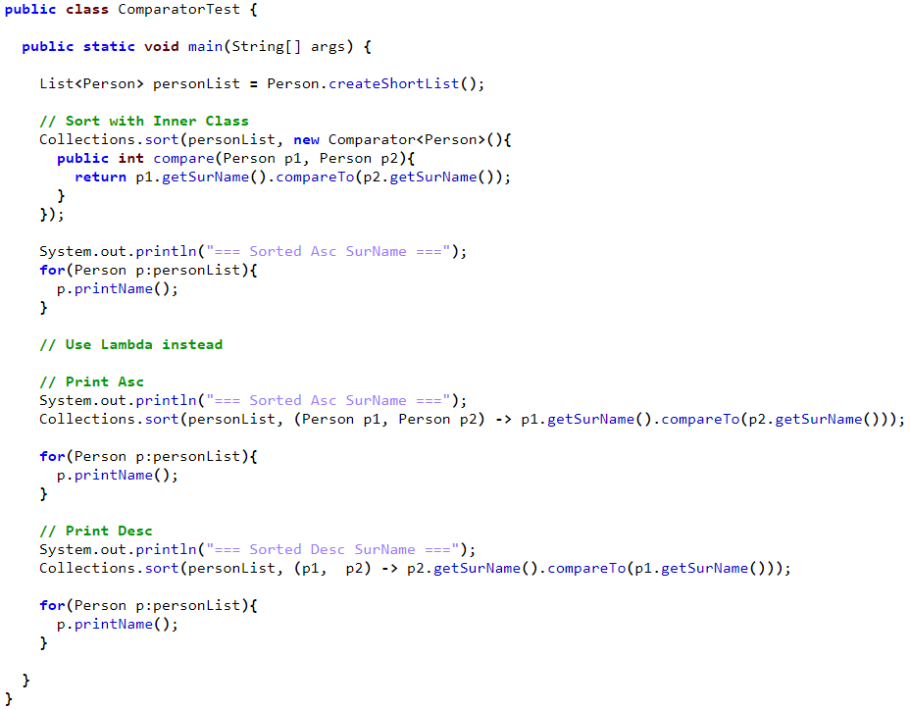
Topic: Java 8(lambda)
Why introducing lambda?
To replace anonymous class
Work with functional interface (next slide)
Tooltips:
Avoid large block of code and “return”
Avoid () around single input
Avoid input type
Notes:
Interview Question:
1) Benefit of using lambda

Slide 28
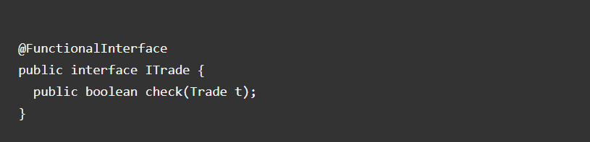
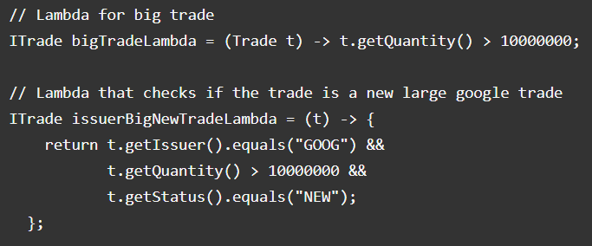
Topic: Java 8(Functional Interface)
has one Single Abstract Method (SAM)
@FunctionalInterface – for sanity check
Can have default methods
Lambda is the implementation of the abstract method
Notes:
Interview question:
what's functional interface

Slide 29
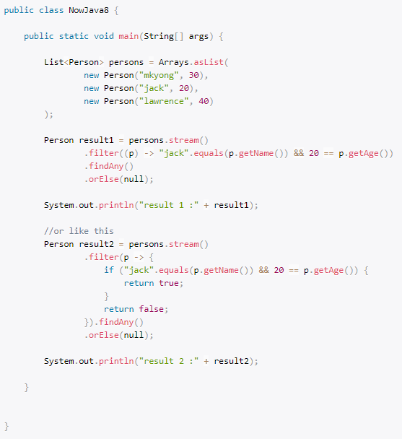
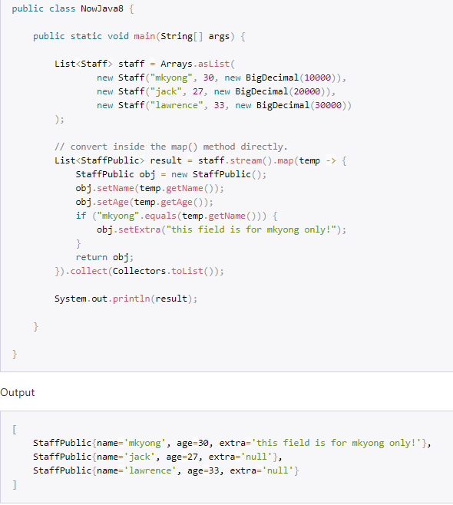
Topic: Java 8(stream)
filter map
Function
Predicate
Notes:
Predicate : a special function which only returns true or false – a judgement function
Interview question:
what's the Stream means

Slide 30
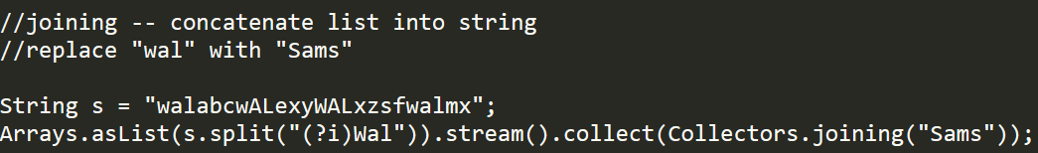
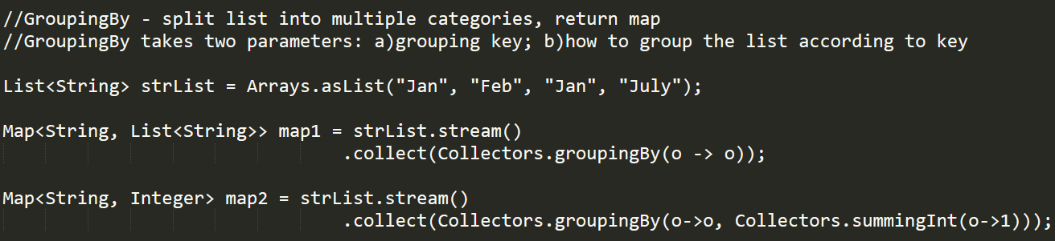
Topic: Java 8(stream)
Joining
GroupingBy
Notes:
Predicate : a special function which only returns true or false – a judgement function

Slide 31
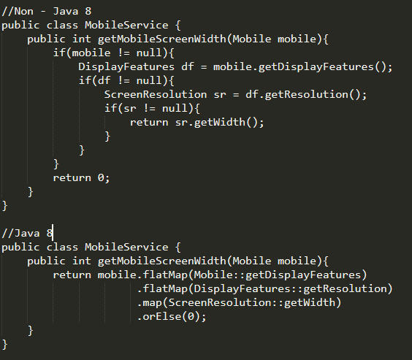
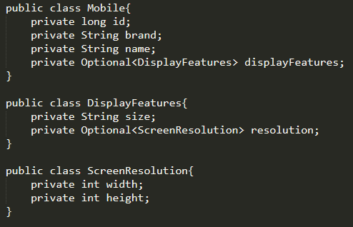
Topic: Java 8(optional)
To avoid Null checks and run time NullPointerExceptions
Notes:
Interview question:
1) what's optional in java 8

Slide 32
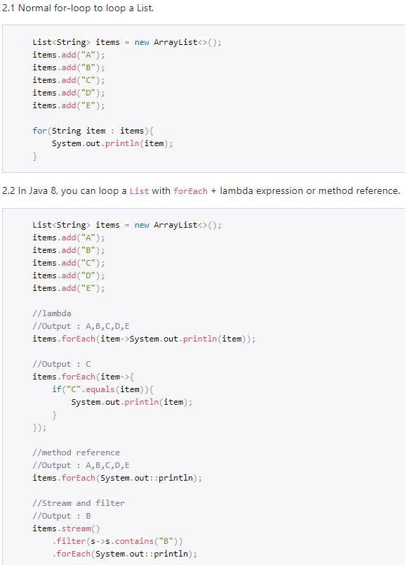
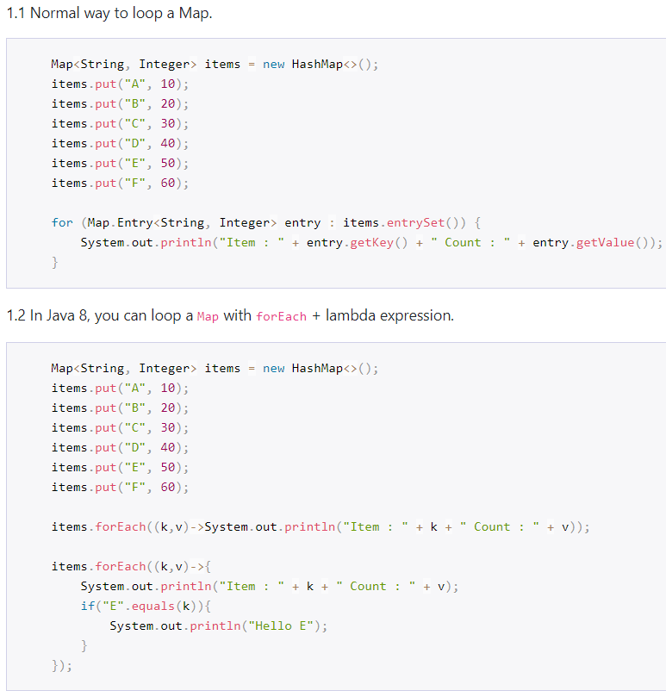
Topic: Java 8(forEach)

