Slide 1
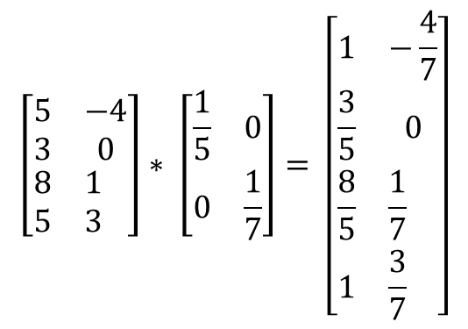
The following is the transformation
$$\left[\begin{aligned}&\begin{aligned}&\begin{matrix}5 & −4 \\ 3 & 0\end{matrix} \\ &\begin{matrix}8 & 1 \\ 5 & 3\end{matrix}\end{aligned}\end{aligned}\right]∗ \left[\begin{matrix}\frac{1}{5} & 0 \\ 0 & \frac{1}{7}\end{matrix}\right]= \left[\begin{aligned}&\begin{aligned}&\begin{matrix}1 & −\frac{4}{7} \\ \frac{3}{5} & 0\end{matrix} \\ &\begin{matrix}\frac{8}{5} & \frac{1}{7} \\ 1 & \frac{3}{7}\end{matrix}\end{aligned}\end{aligned}\right]$$

Slide 2
