Slide 1
PCA as a dimensionality reduction tool on MNIST Data
Ruoting Wang
MET CS 677

Slide 2
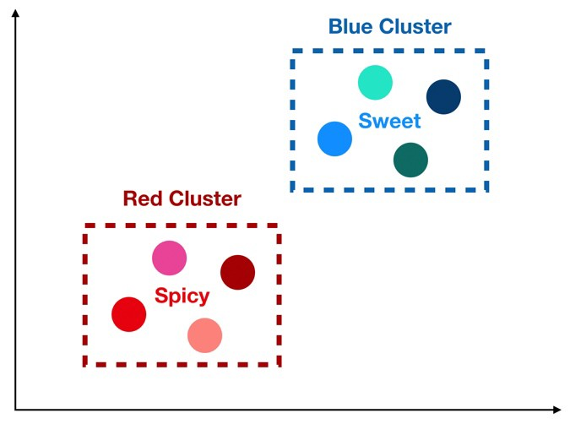
Curse of Dimensionality
Source: https://towardsdatascience.com/the-curse-of-dimensionality-50dc6e49aa1e

Slide 3
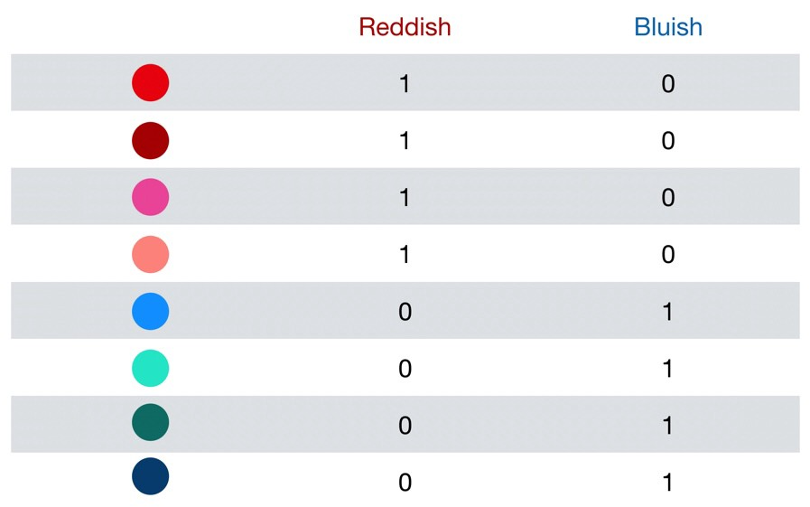
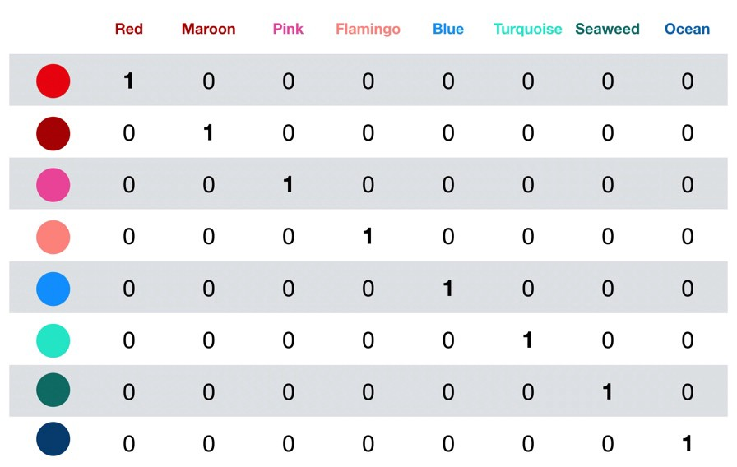
Curse of Dimensionality (cont.)
Source: https://towardsdatascience.com/the-curse-of-dimensionality-50dc6e49aa1e

Slide 4
Manifolds and Homeomorphism
Manifold Hypothesis:
The manifold hypothesis is that real-world high dimensional data (such as images) lie on low-dimensional manifolds embedded in the high-dimensional space.
What does this really mean?
If we can reduce the dimensionality to only meaningful data, we can do better analysis on it.
Notes:
https://deepai.org/machine-learning-glossary-and-terms/manifold-hypothesis#:~:text=The%20Manifold%20Hypothesis%20states%20that,within%20the%20high%2Ddimensional%20space.&text=A%20manifold%20is%20really%20just,classify%20spaces%20of%20arbitrary%20dimension.
http://bjlkeng.github.io/posts/manifolds/
https://en.wikipedia.org/wiki/Homeomorphism
Manifold hypothesis tells us (informally) that in low dimensional space, there can exist a homeomorphic neighborhood that resembles the Euclidean representation of that space
Homeomorphism is the continuous mapping between topological spaces
An example of homeomorphism is something like a piece of paper being rolled up. It can be unrolled to a flat paper again.
An example of a manifold is us standing on the earth. While our local area is a flat area, the earth is actually round. The earth is in 3-D space while we feel like we’re walking on 2-D space. Locally, the manifold (topological space) resembles 2-D Euclidean space, but globally it lives in 3-D Euclidean space.

Slide 5
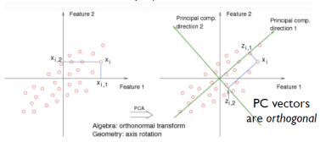
Principal Component Analysis (PCA)
Capturing variance in data
Source: https://bigdata-madesimple.com/decoding-dimensionality-reduction-pca-and-svd/

Slide 6
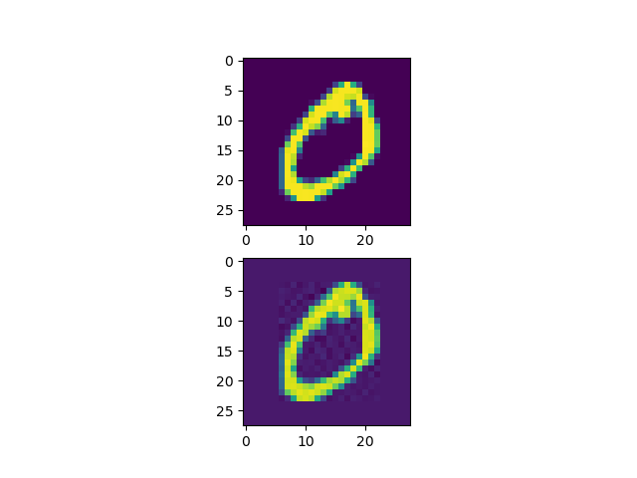
MNIST and Classifiers
28x28 Handwritten Images
60,000 Training, 10,000 Test
Classify with KNN, Decision Tree, Random Forest
Objective: Can accuracy be improved by reducing dimensionality first?

Slide 7
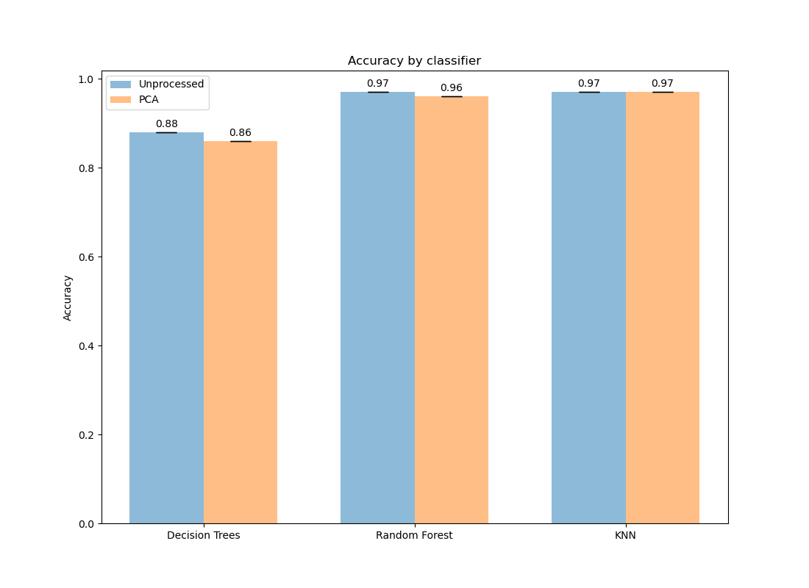
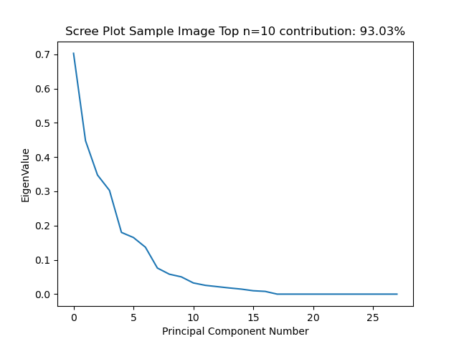
Results

Slide 8
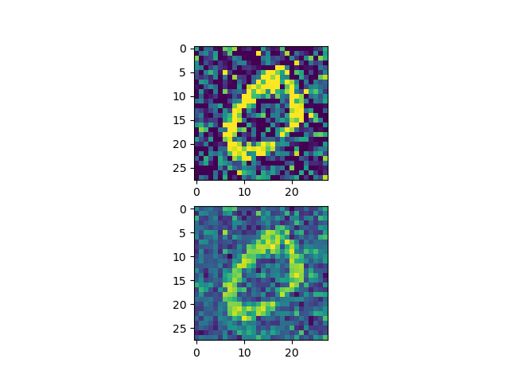
Addition of noise

Slide 9
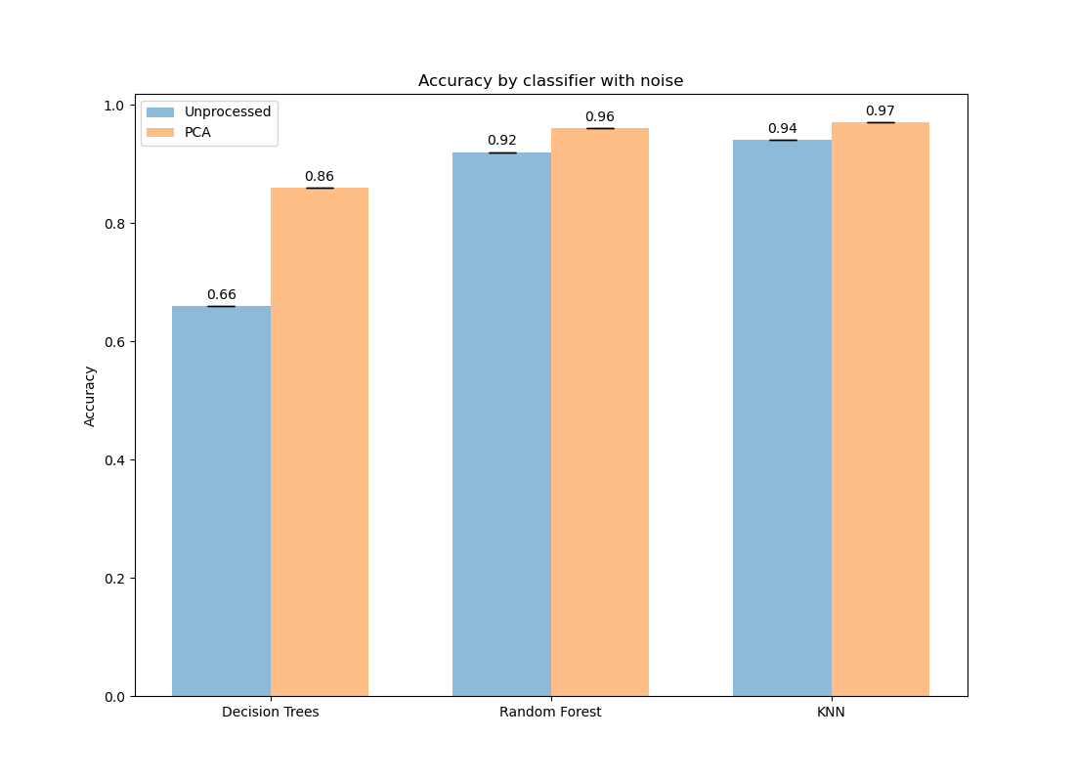
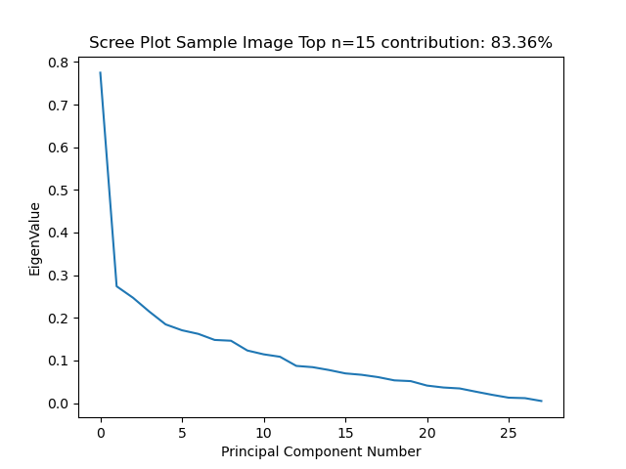
Results with Noise

