Slide 1
PhD Proposal Defense
A realtime and parallel look-ahead control and feedrate compensation strategy for CNC reference-pulse interpolation.
Faculty of Mechanical Engineering,
University Malaysia Pahang (UMP)
Pekan, Pahang, Malaysia.
Student: Wan Ruslan Yusoff, PFD18001
Supervisor: Dr Fadhlur Rahman bin Mohd Romlay
Co-Supervisor: Prof Yaswant Prasad Singh
Date: Thu, 27 December 2018

Slide 2
Outline of Presentation
(1) Introduction to CNC
(2) Problem issues in CNC operations
(3) Research proposal objectives addressing problem issues
(4) Proposed research scope
(5) Research motivations
(6) Expected knowledge contributions
(7) Literature survey (in 3 parts)
(8) Proposed research methodology
(9) Related research work (previous works)
(10) Proposed research implementation plan
(11) Proposed publication plan
(12) Conclusion (Q & A)

Slide 3
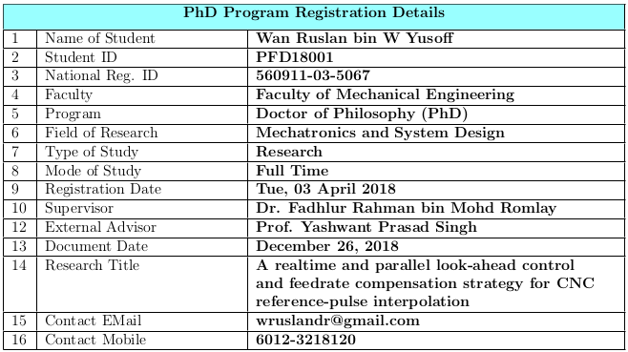
PhD Proposal Defense

Slide 4
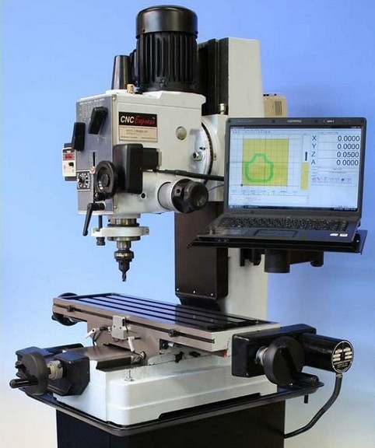
CNC Milling
Machine

Slide 5
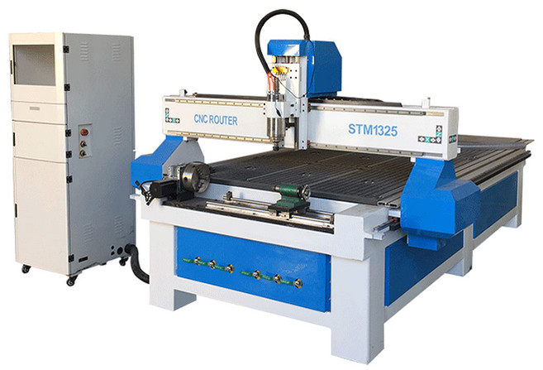
CNC Router
Machine

Slide 6
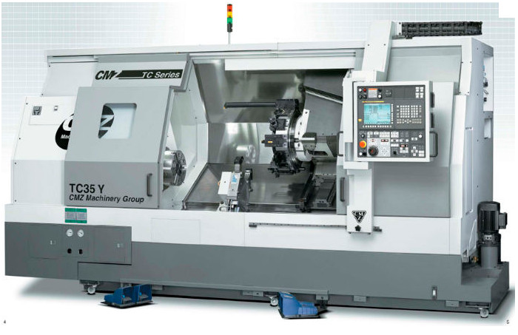
CNC Lathe
Machine

Slide 7
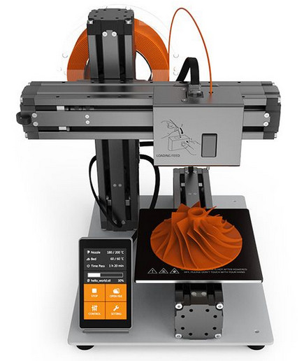
CNC 3D
Printing
Machine

Slide 8
1. Introduction to CNC
CNC is an abbreviation for Computer Numerical Control
In a CNC machine, the function of CNC interpolation is simultaneously
to generate coordinated 3D movements
to drive the separate axis-of-motions and/or rotation axes
to achieve the desired path of the part model
for the CNC cutting or milling tool relative to the workpiece.
NC = Numerical Control means the control of a machine by using numbers.
CNC = Computer Numerical Control means using numbers and a computer to control a machine tool.

Slide 9
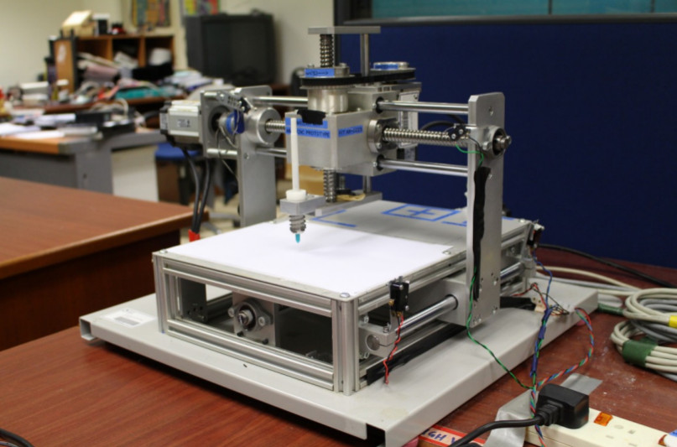
UMP CNC
Research
Machine

Slide 10
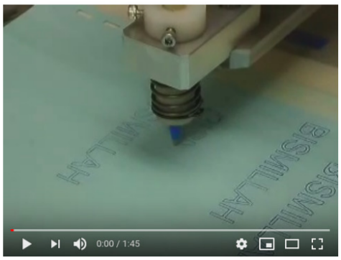
Youtube video
CNC Research
Machine Operation

Slide 11
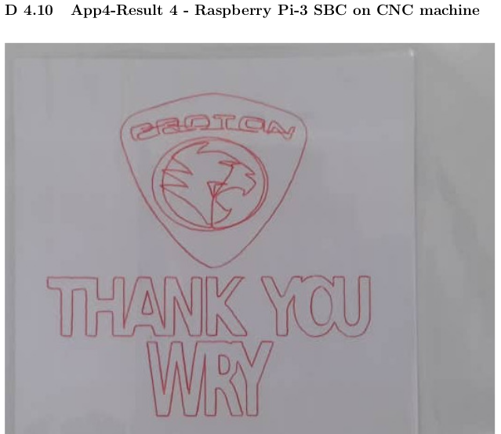
A little more sophistication

Slide 12
2. Problem issues in CNC Interpolation
(1) Accuracy of reproducing the original drawing model part (2D or 3D)
ISSUE: This is about minimizing contour tracking or geometric errors to
preserve accurate reproduction.
(2) Fast machining operations to produce the model part.
ISSUE: This is about the time it takes to finish machining the model part. It is
related directly to the interpretation/interpolation of the G-Code files, speed
and methods used in software computations and other hardware
performance limitations.
(3) Smooth machining operations, not jerky moves of cutting tool.
ISSUE: This is about velocity profile of the cutting tool as it moves to
machine a part. For example, avoid machine vibrations and machined part
overheating.

Slide 13
3. Research Proposal Objectives
(1) Accuracy of reproducing the original drawing model part (2D or 3D)
SOLUTION: Look-ahead control and feedrate compensation strategies for
minimizing contour errors. This is the proposed method or technique.
(2) Fast machining operations to produce the model part.
SOLUTION: Suitably implement realtime and parallel computing strategies
based on modern software engineering technologies. This is the proposed
back-end software engine.
(3) Smooth machining operations, not jerky moves of cutting tool.
SOLUTION: A balanced control between contour error minimization and
feedrate velocity (machining speed) to achieve smooth movements of the
cutting tool. For example, slow down the cutting tool at sharp curves to get
good contour accuracy. This is the proposed control strategy.

Slide 14
PhD Research Proposal Topic
To address the three issues:
A realtime and parallel look-ahead control and feedrate compensation strategy for CNC reference-pulse interpolation.

Slide 15
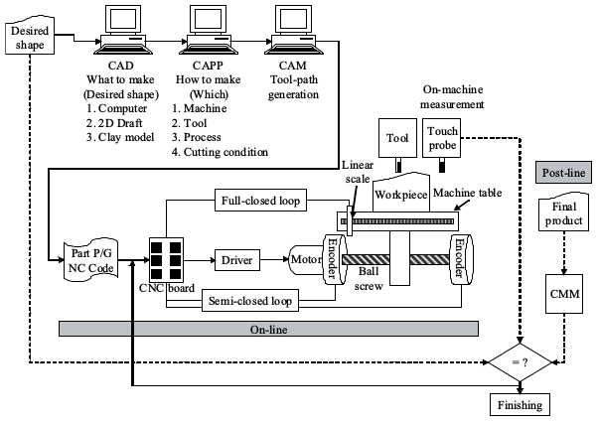
CNC System
Architecture

Slide 16
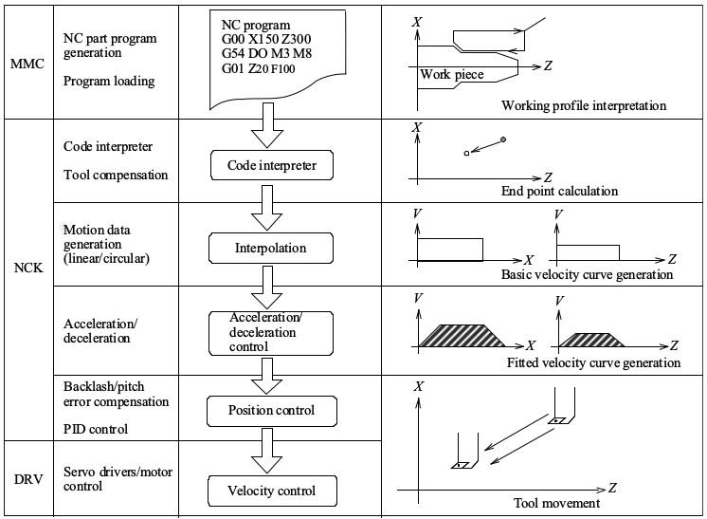
CNC Generic
Process Flow

Slide 17
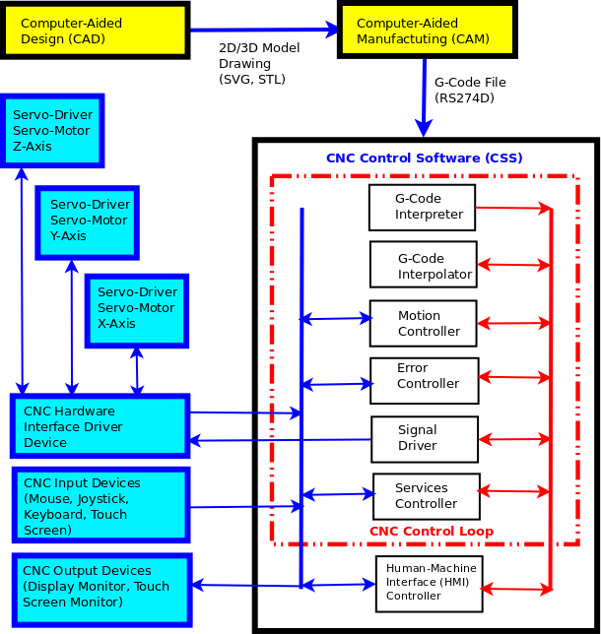
CNC Functional
Block Diagram

Slide 18
4. Proposed Research Scope
(1) Start with G-Codes, specifically RS274D NGC standard G-Code.
(2) Choose Reference-pulse CNC interpolation for computing efficiency.
(3) Implement look-ahead and feedrate error compensation.
(4) Execute realtime, parallel, online/offline for the CNC control loop.
(5) Conduct parallel execution methods for 2D/3D G-Code interpolation.
(6) Address design for extension to 5-axis interpolation implementation.

Slide 19
5. Research Motivations
(1) Commercial interest – interpolation is the ”brain & heart” of CNC machine
(2) Intellectual ownership and sense of accomplishment
(3) Wants to be an enterpreneur
(4) Exciting technical challenges
(5) Future potential and possibilities

Slide 20
6. Expected Knowledge Contributions
(1) Implementation of a simple, practical and achievable strategy in CNC interpolation
(2) A technique that utilizes both true realtime and parallel execution in CNC interpolation
(3) Innovative ideas for an efficient design of the CNC interpolator based on modern software engineering methods

Slide 21
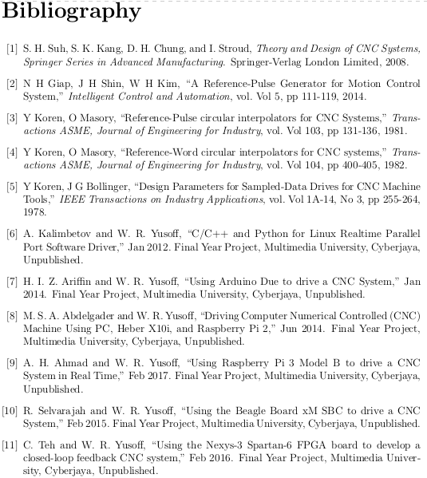
7. Literature
Survey Part 1

Slide 22
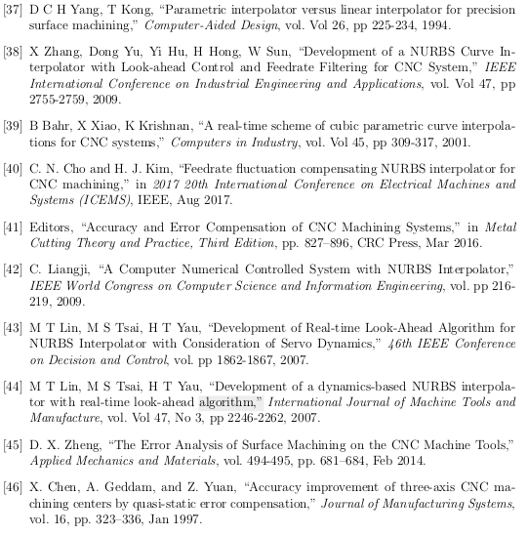
7. Literature
Survey Part 2

Slide 23
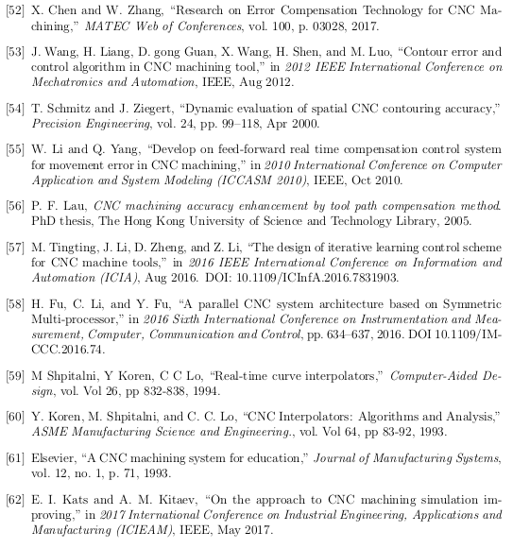
7. Literature
Survey Part 3

Slide 24
8. Proposed Research Methodology – Part 1
(1) Software engineering perspective - not from a control or instrument engineer‘s perspective. Improvement in core CNC Control Software.
(2) Software engineering methods – development and delivery of the CNC control software product, inclusion of software components, like Rust, Python, Julia, Octave and Scilab, in addition to the base C/C++ codes.
(3) Linux, open source and cost-free software completely – making CNC machines affordable, available community support, and so on.
(4) Use of own developed motion control devices – Microchip Curiosity Demo Board for some user prototyping, and full prototyping using Microchip 28-Pin-LIN Demo Board.
(5) Research validation - ”The proof of the pudding is in the eating.” Real manual measurements and compare against desired model dimensions.

Slide 25
8. Proposed Research Methodology – Part 2
(1) Reference-Pulse CNC Interpolation method for computing efficiency.
(2) Feedrate look-ahead control algorithm - to deal with sudden changes of
feedrate pulses, essentially the CNC cutting tool move velocity smoothness.
(3) Feedrate compensation is adjusting move velocities but for reducing
contouring path errors, instead of maintaining movement smoothness.
(4) Adoption of realtime execution strategies for CNC Control Loop
(5) Adoption of parallel execution strategies for CNC Control Loop
(6) Infrastructure design for extension to 5-axis CNC interpolation

Slide 26
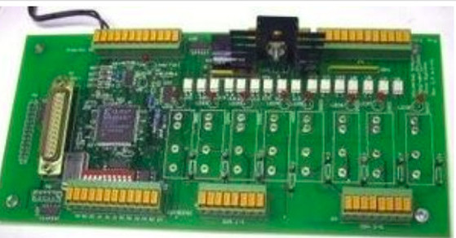
8.1. PWM Board
Implementation as pulse driver device

Slide 27
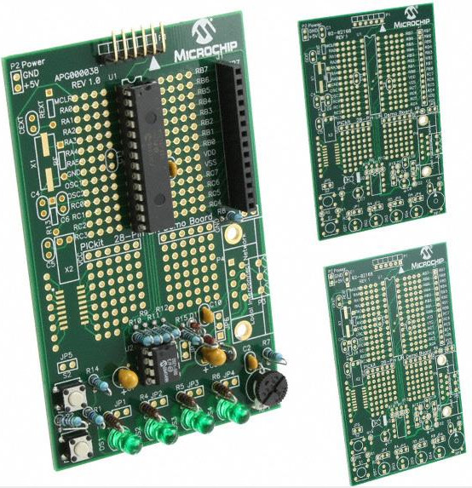
8.2. MCU 28-Pin LIN
Dev Board as pulse generator device

Slide 28
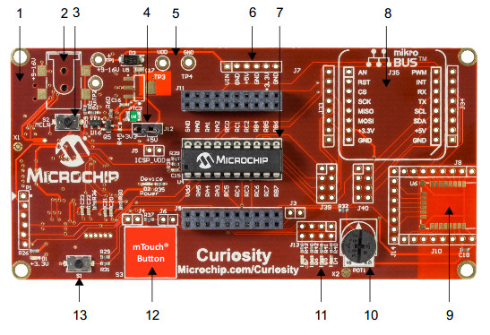
8.3 MCU Curiosity
Dev Board as pulse generator device

Slide 29
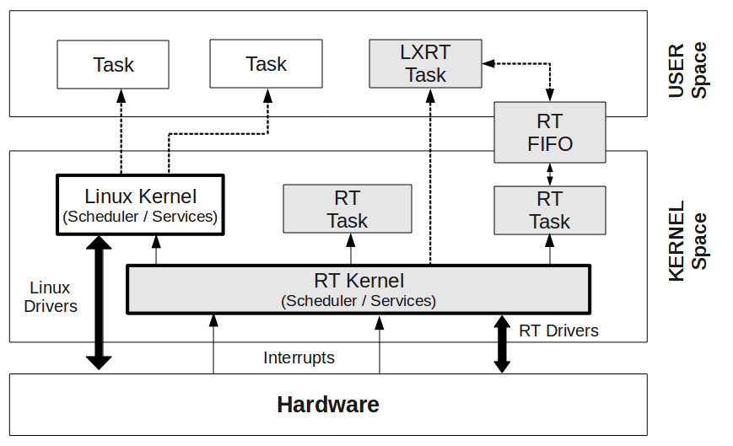
8. Realtime Infrastructure - RTAI

Slide 30
9. Related Research Work (Previous Works Part 1)
Previous projects we have undertaken using computer extension boards as pulse generator devices that successfully drive the CNC research machine.
(1) PC parallel port, [1.26], [1.27], [1.28].
(2) Velleman K8000 Parallel extension board, [1.30].
(3) Velleman K8055 USB extension board, [1.31].
(4) Heber X10i USB extension board, [1.32].
(5) Arduino Due USB extension board, [1.33].
(6) Digilent Nexys-3 Spartan-6 FPGA board. [1.34].

Slide 31
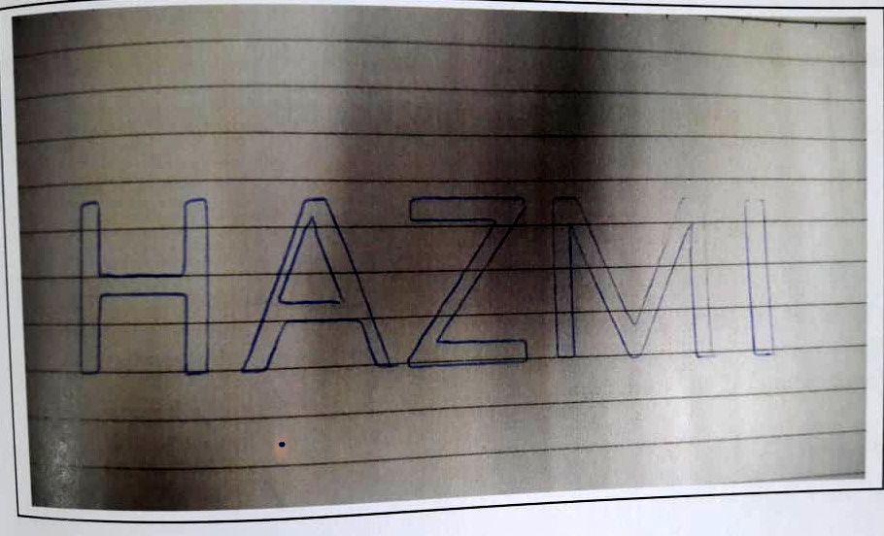
9. Previous Project – Arduino Due drive CNC machine

Slide 32
9. Related Research Work (Previous Works Part 2)
Previous projects we have undertaken using Single Board Computers (SBC) as pulse generator devices that successfully drive the CNC research machine.
(1) Raspberry Pi SBC, General purpose. [1.35], [1.36].
(2) Banana Pi SBC, Graphic processing focus. [1.37]
(3) Beagle-Board xM SBC. Graphic processing plus DSP focus. [1.38].

Slide 33
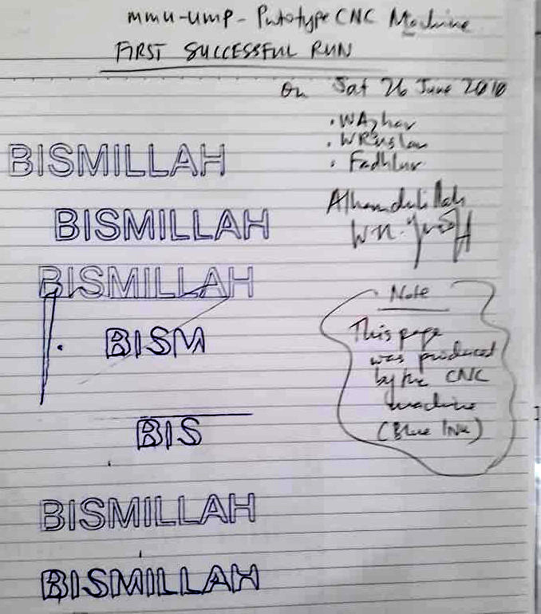
9. Realtime parallel port device drive CNC machine

Slide 34
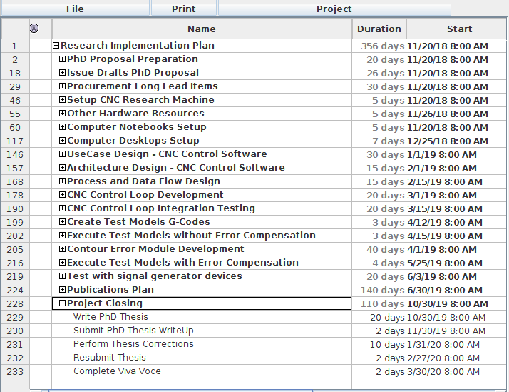
10. Proposed
Research
Implementation
Plan - Part 1

Slide 35
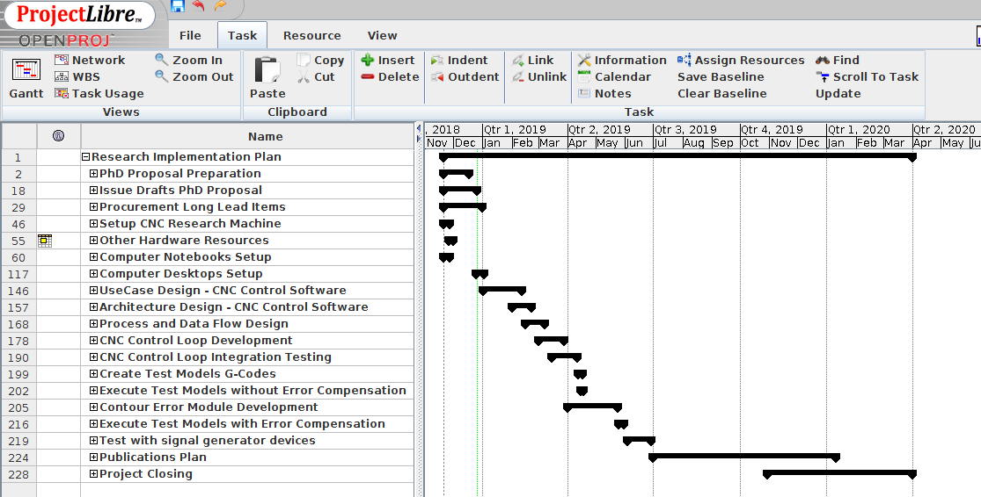
10. Proposed Research Implementation Plan – Part 2

Slide 36
11. Proposed Publication Plan
(1) Three publications total spread three months apart.
(2) Two conference publications and one journal publication.
(3) Conference Publications
    Pico Universal PWM hardware with LinuxCNC
    Microchip MCU Curiosity and 28-Pin LIN Development Boards
(2) Journal publication
    On the subject of PhD thesis

Slide 37
12. Question & Answer
Thank you.
Question & Answer session.

