Slide 1
Using Spam Emails as Data for a Predictive Model
Ryan Williams, Claire Shifflett, Jesse Stout

Slide 2
Background
Interest
Spam mail is a growing phenomenon as is the need for the correct screening of spam mail
Spam uses can help business practices determine whether or not their employee’s are being tricked
As active users of the internet our emails are widely available and subject to receiving spam mail
Data Information
Spam dataset contained 57 total variables that HP labs deemed as possible markers of spam emails.
These variables were applied to 4,601 emails with the categorical response of 1 for spam and 0 for not spam
How can we create an accurate model to be used in blocking spam emails?

Slide 3
Original Model and Division into pieces
We started by looking at boxplots of each covariate vs whether or not they are more likely to be spam, and from that picked 4 covariates for a hand-picked model.
Since the original data set was so large (>250,000 individual observations), it was decided that splitting up the data was the best way to tackle this issue.
The models were split up into spam emails containing capital letters, specific word usage, or special character usage.
This proved to be beneficial in the end because we were able to get rid of many covariates that were not statistically significant.

Slide 4
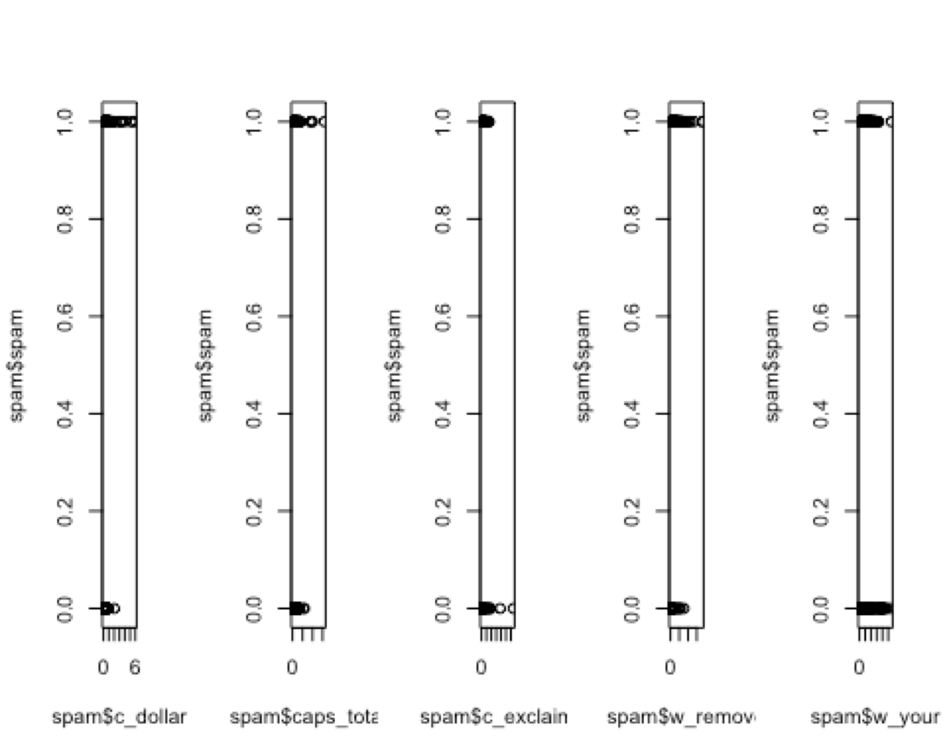
Multicollinearity and Correlation
Looking at correlation print outs, it can be seen that caps_total, c_dollar, c_exclaim, w_remove, w_your have relatively large correlations to being correctly labeled as spam or not spam, since most values only are around .15.
The pairs function did not produce any values that were troubling, so the analysis on the dataset continued.

Slide 5
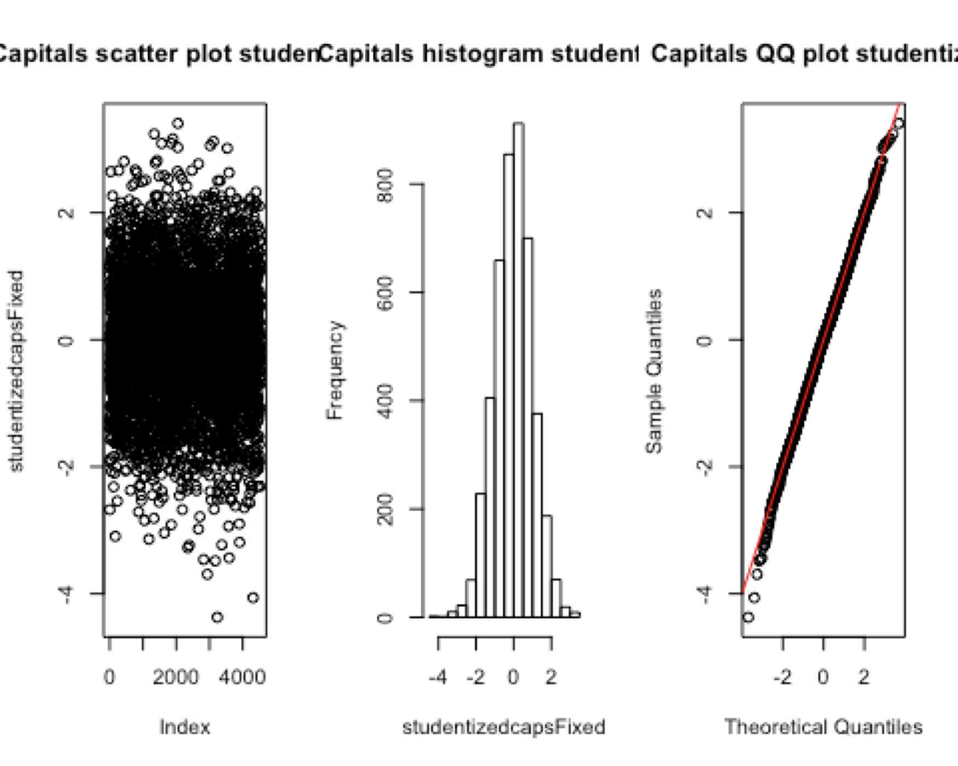
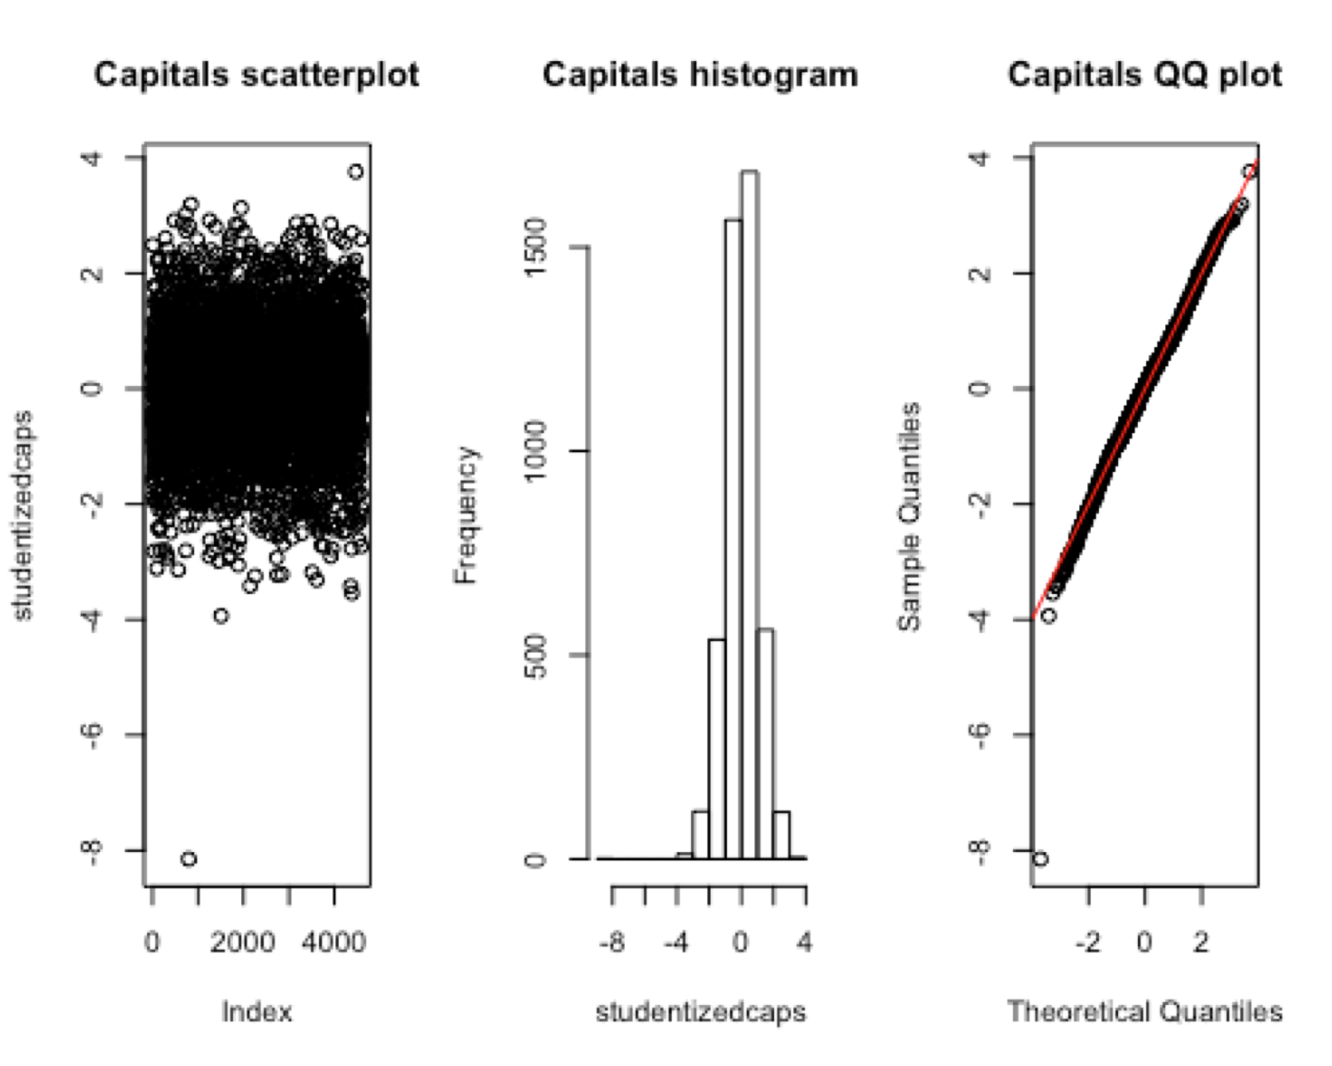
Capitals
D²= 17.08%
BIC = 5150.076
D²= 23.1%
BIC = 4814.757

Slide 6
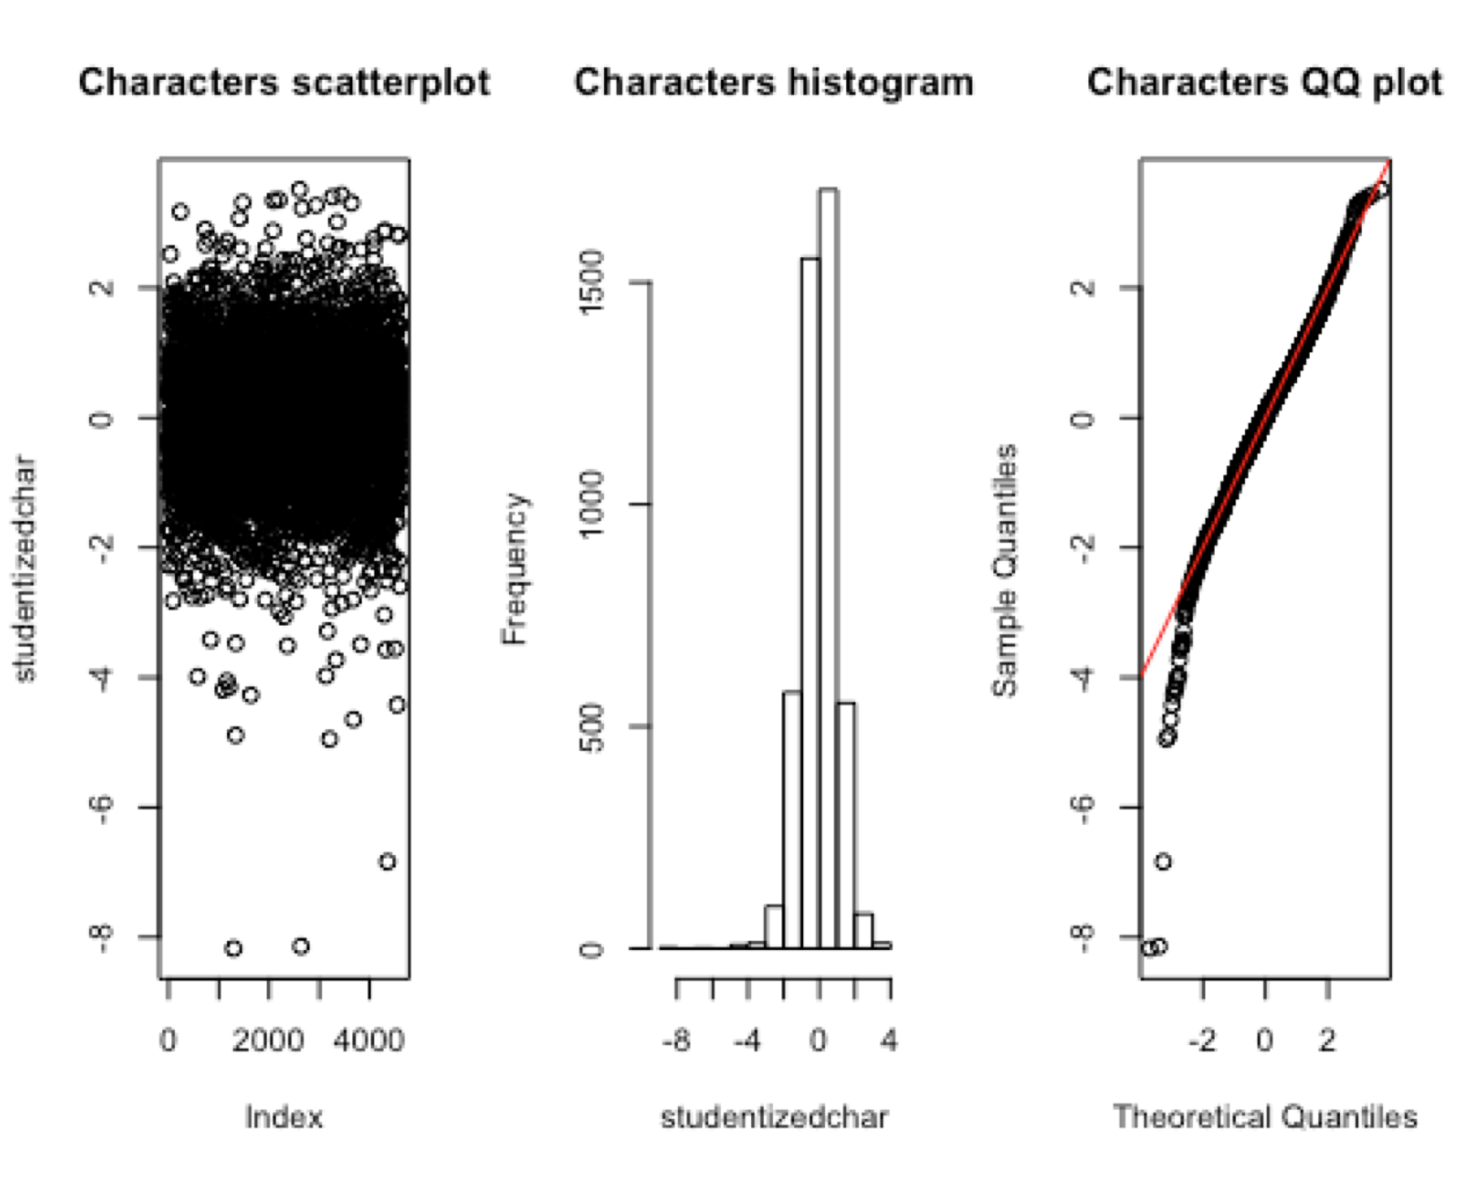
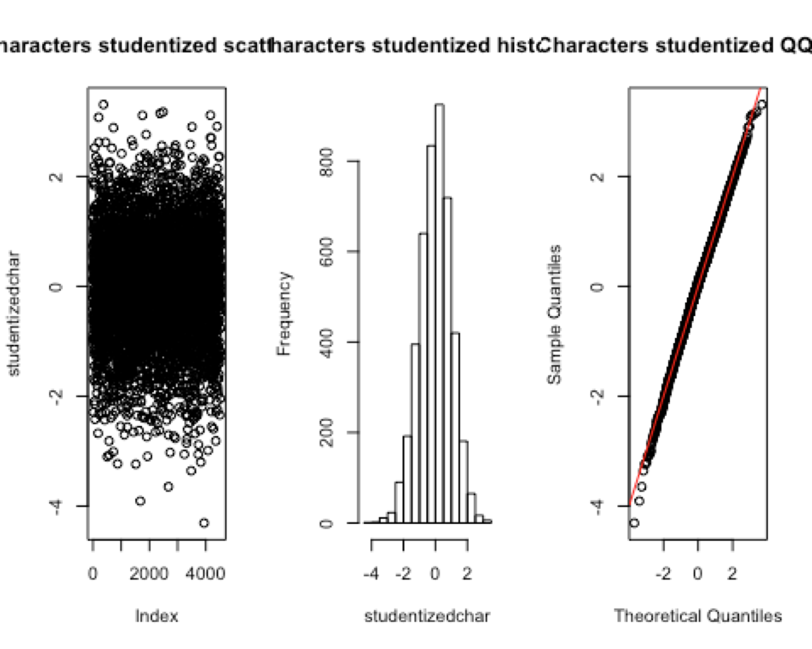
Characters
D²= 28.965%
BIC = 4442.078
D²= 40.84%
BIC = 3627.937

Slide 7
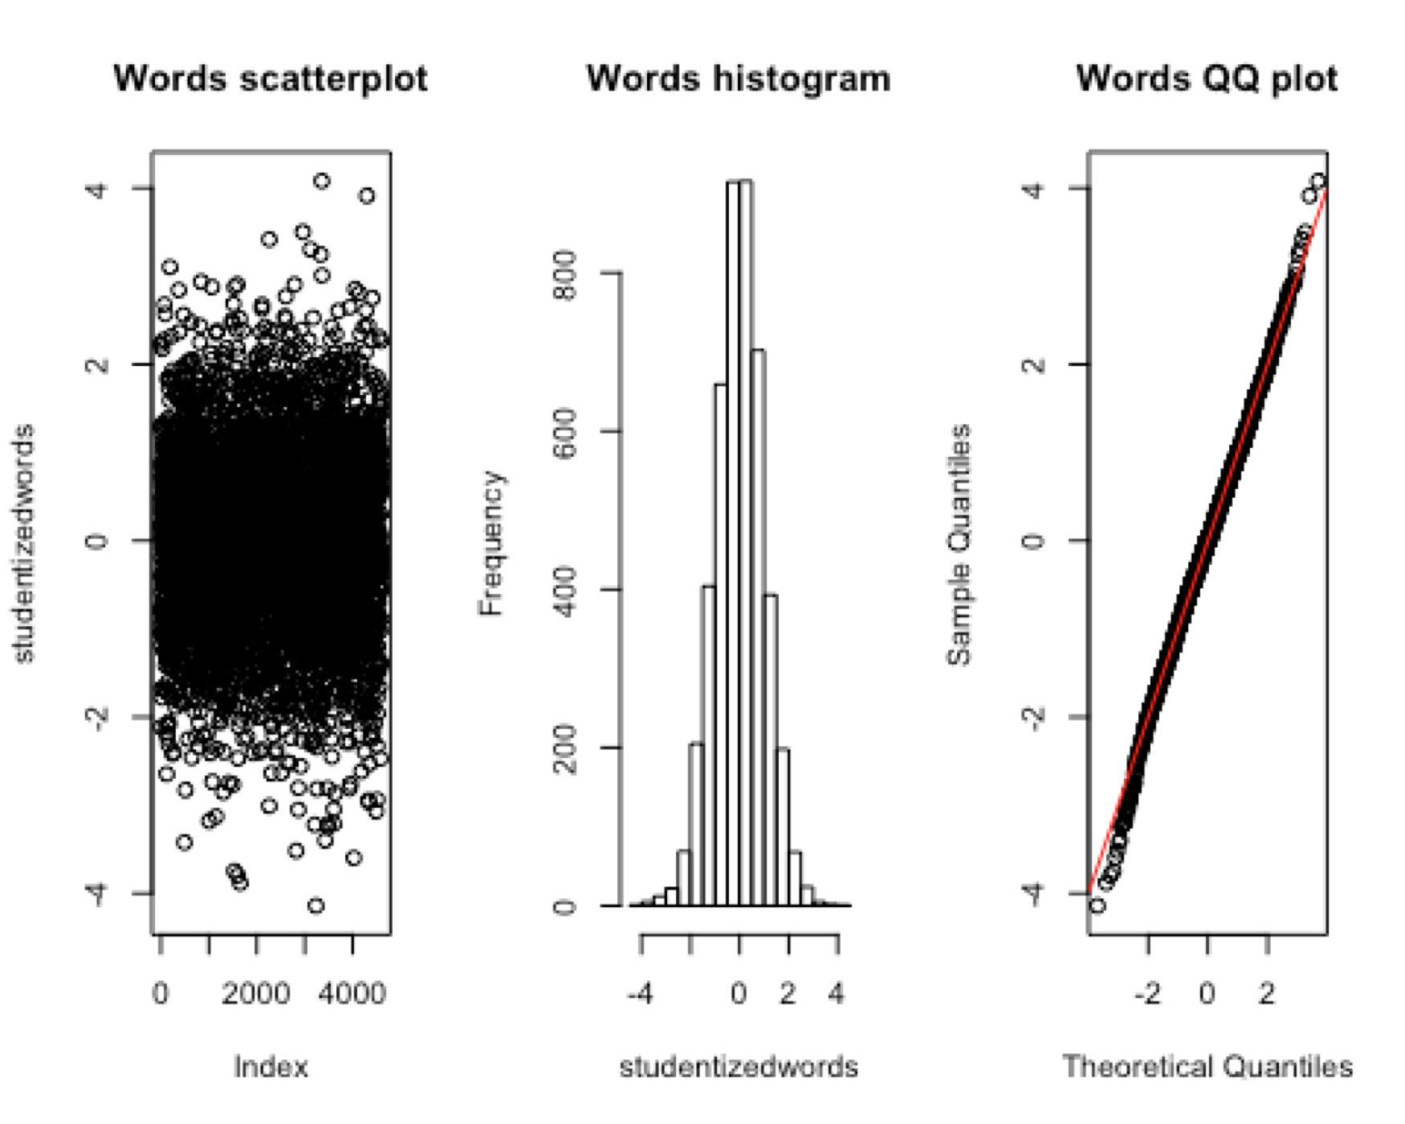
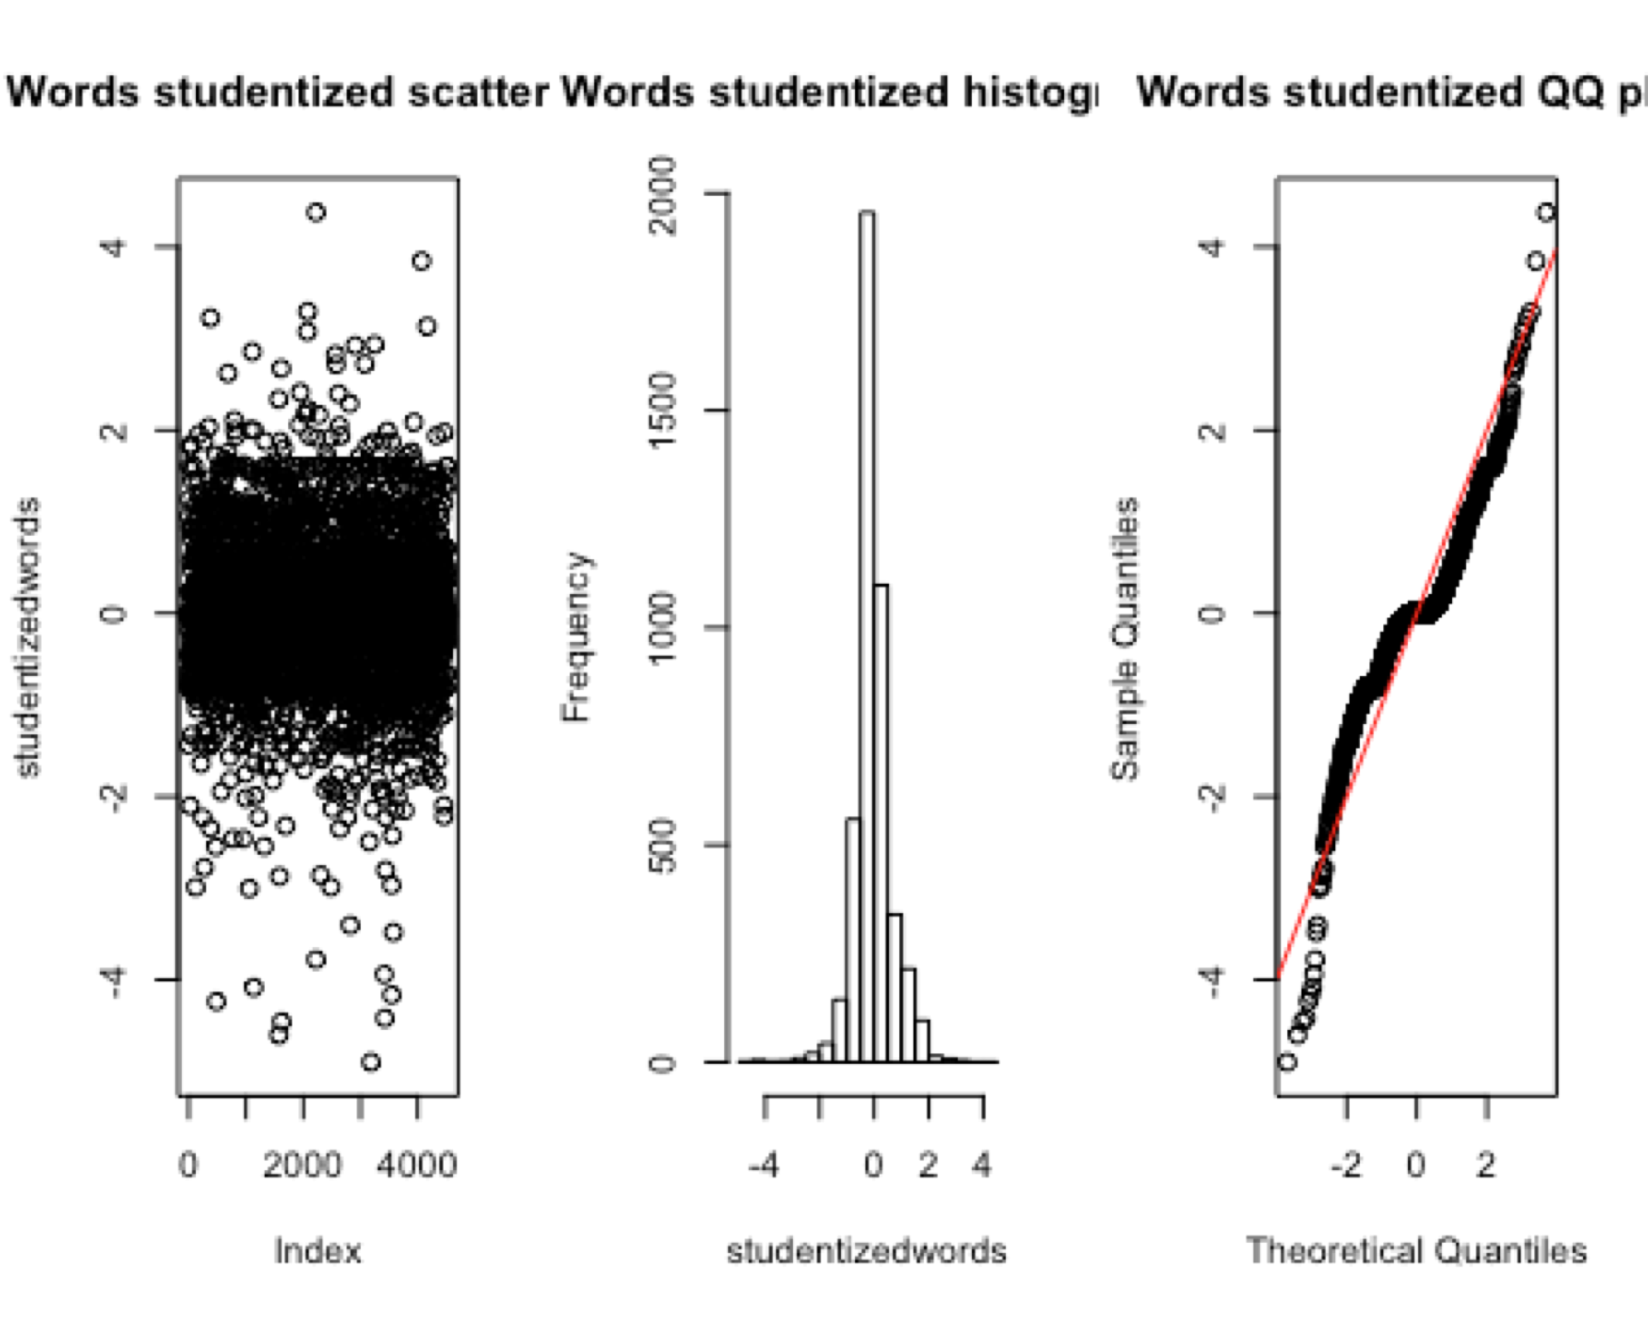
Words
D²= 64.69%
BIC = 2473.636
D²= 65.6%
BIC = 2386.805

Slide 8
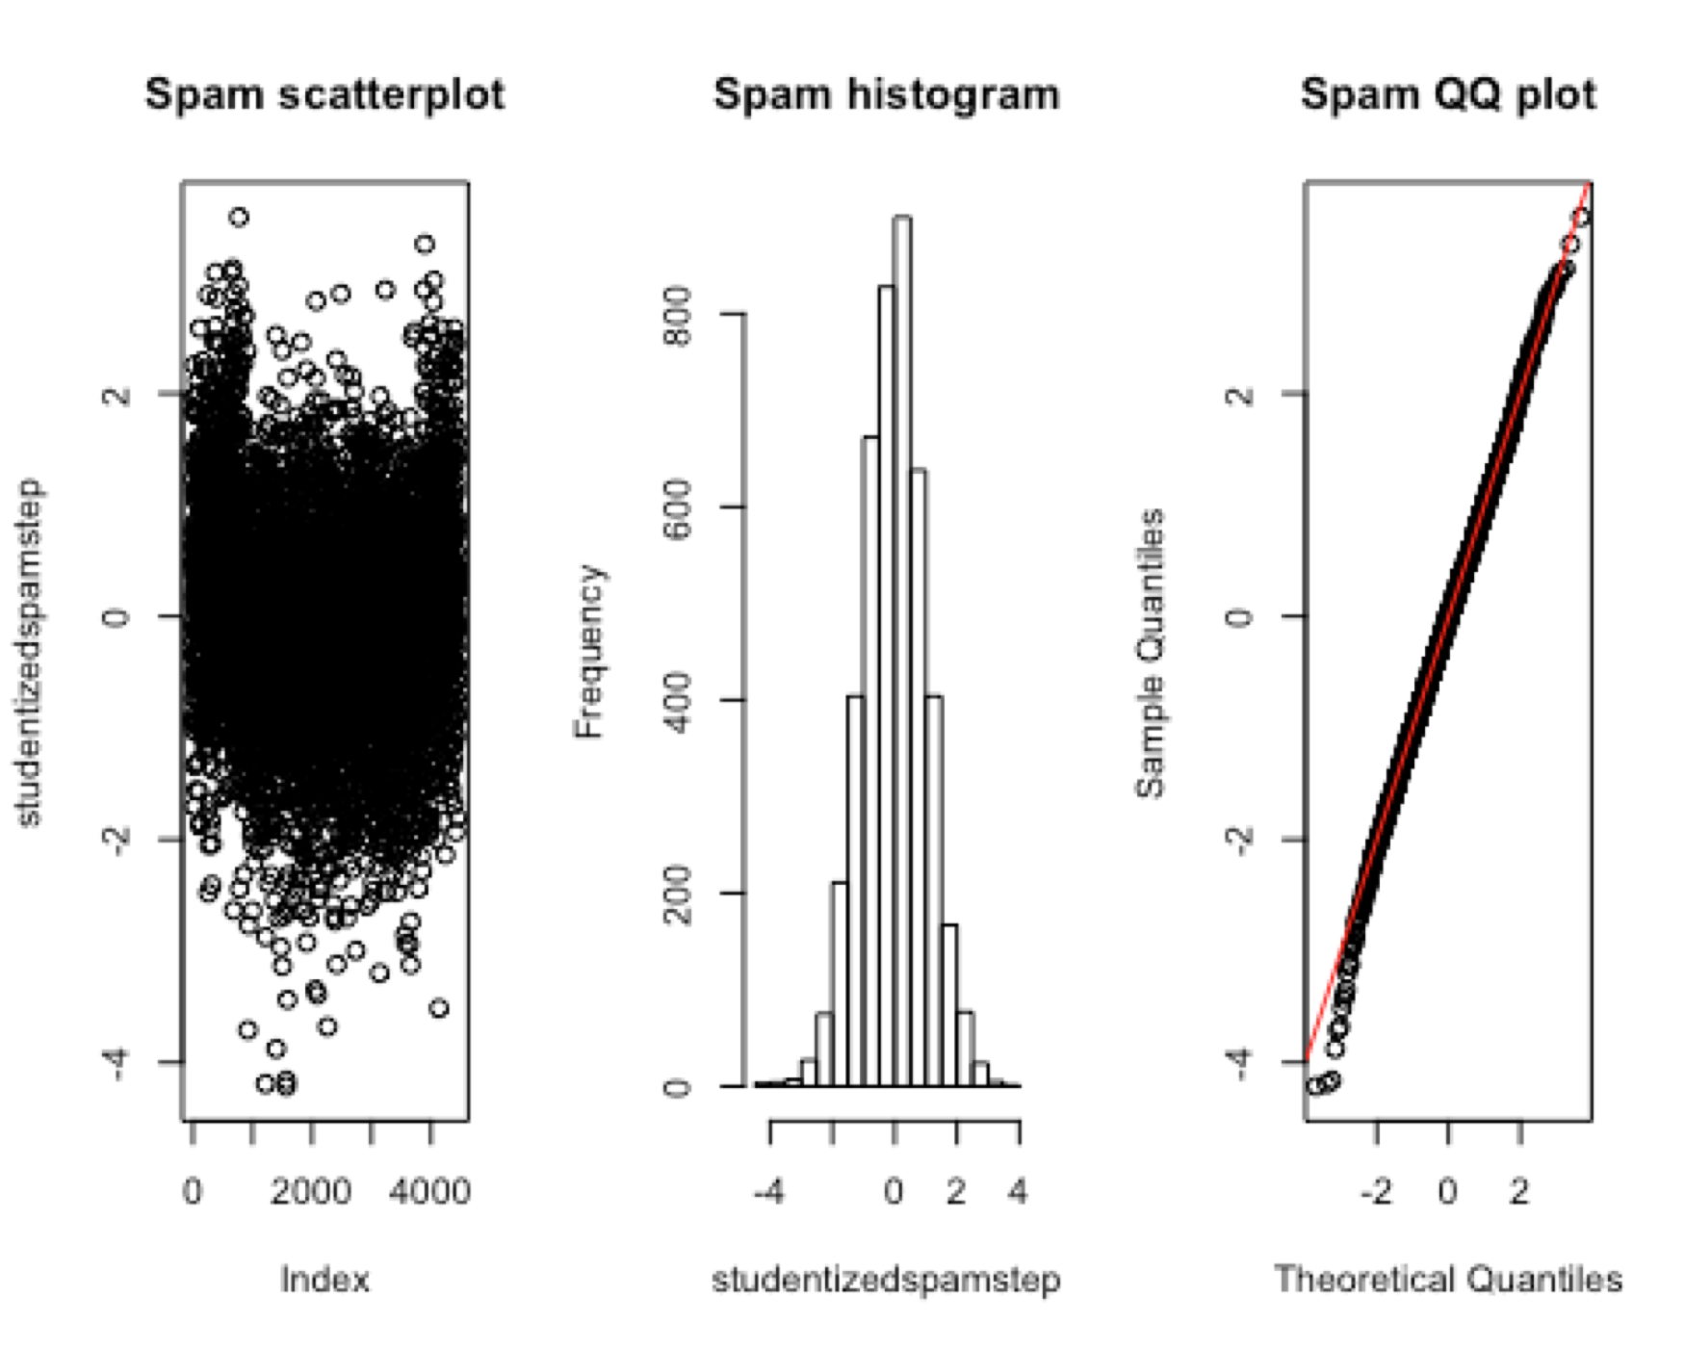
New Combined Model
D²= 63.89%
BIC = 2335.889

Slide 9
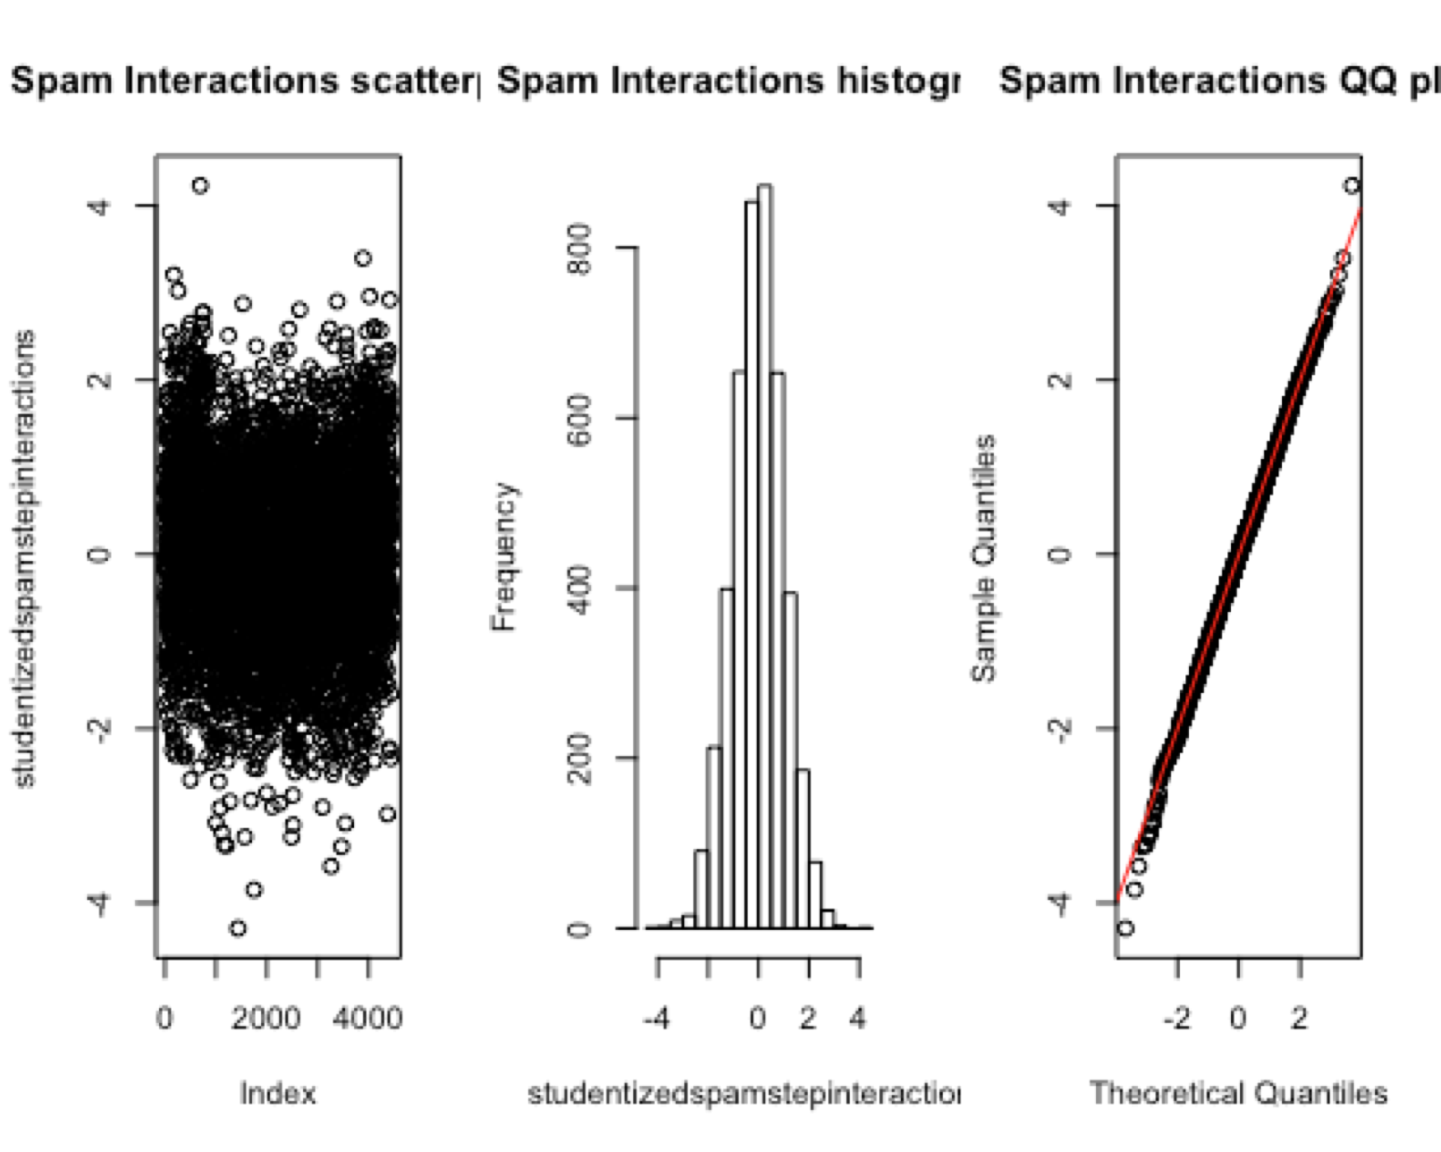
Step Function of Data Interactions
D²= 72.52%
BIC = 2222.992

Slide 10
Comparison of all Models
Model | BIC | D2
Hand-Picked | 4022.28 | 0.3549
Capitals Before | 5150.076 | .1708
Capitals After | 4814.757 | .231
Characters Before | 4442.078 | .2896
Characters After | 3627.937 | .4084
Words Before | 2473.636 | .6469
Words After | 2386.805 | .656
Spam-Step | 2335.889 | .6389
Spam-Step Interactions | 2222.992 | .7252

Slide 11
Predictive Model
This is the final and best step model that has been created. The AIC for this model is 1781.13. And the D2 for this model is .7252.
It can be seen that it includes both single covariates along with interactions between covariates for a total of 67 factors.
spamstepinteractions = glm(formula = spam ~ c_dollar + c_exclaim + w_remove + w_your + w_free + w_re + caps_avg + w_will + w_over + caps_total + c_exclaim:caps_long + w_our:w_you + c_exclaim:w_free + w_you:w_will + w_internet:w_you + c_exclaim:caps_avg + w_free:c_roundparen + c_dollar:c_roundparen + w_money:w_over + caps_avg:w_money + c_dollar:w_re + w_remove:w_000 + w_money:c_roundparen + w_re:w_credit + w_your:w_free + c_exclaim:caps_total + caps_avg:w_over + w_you:c_roundparen + w_remove:c_roundparen + w_your:w_you + w_000:caps_total + w_internet:caps_total + w_our:caps_total + w_re:caps_avg + caps_long:w_re + caps_long:w_money + w_internet:caps_avg + w_remove:caps_avg + w_money:caps_total + w_your:w_re + w_000:w_internet + w_your:caps_total + w_000:w_money + w_free:w_re + w_re:caps_total + w_free:caps_total + w_internet:c_roundparen + c_exclaim:w_re + caps_avg:w_will + caps_long:w_will + w_internet:c_semicolon + w_you:w_over + w_credit:w_money + w_credit:w_will + w_you:w_credit +
w_free:w_credit + c_exclaim:w_remove + w_remove:w_you +
w_your:w_money + c_dollar:w_free + w_remove:caps_long + caps_long:w_credit + w_credit:caps_total +c_exclaim:w_credit + c_exclaim:w_internet + caps_long:w_free + w_internet:w_credit + caps_long:w_you, family = binomial(link = "logit"), data = spamfinalFixed)

Slide 12
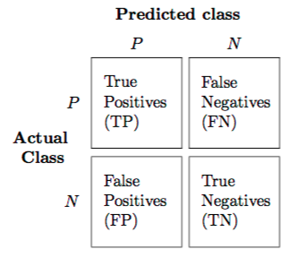
Confusion Matrix
To test whether or not our spam interactions predictive model was effective, a Confusion Matrix was used.
A confusion matrix uses the predictive model and testing data to run through all the data and print out the results of your model
Notes:
https://rasbt.github.io/mlxtend/user_guide/evaluate/confusion_matrix/

Slide 13
Conclusions
This is the end confusion matrix. It shows that 840 out of the total 891 tested “emails” were labeled correctly as spam or not spam.
This leads us to conclude that our predictive model is 94.29% (0.9254, 0.9571) accurate at the 95% confidence interval.
To solve the original problem, we would use the combinations of words, special characters, and capital letters to build someone’s spam filter.
 | Predicted Not Spam | Predicted Spam
Actual Not Spam | 520 | False Positive (36)
Actual Spam | False Negative (15) | 320

