Slide 1
Summit Sporting Goods
Designed by
Zachary Hall

Slide 2
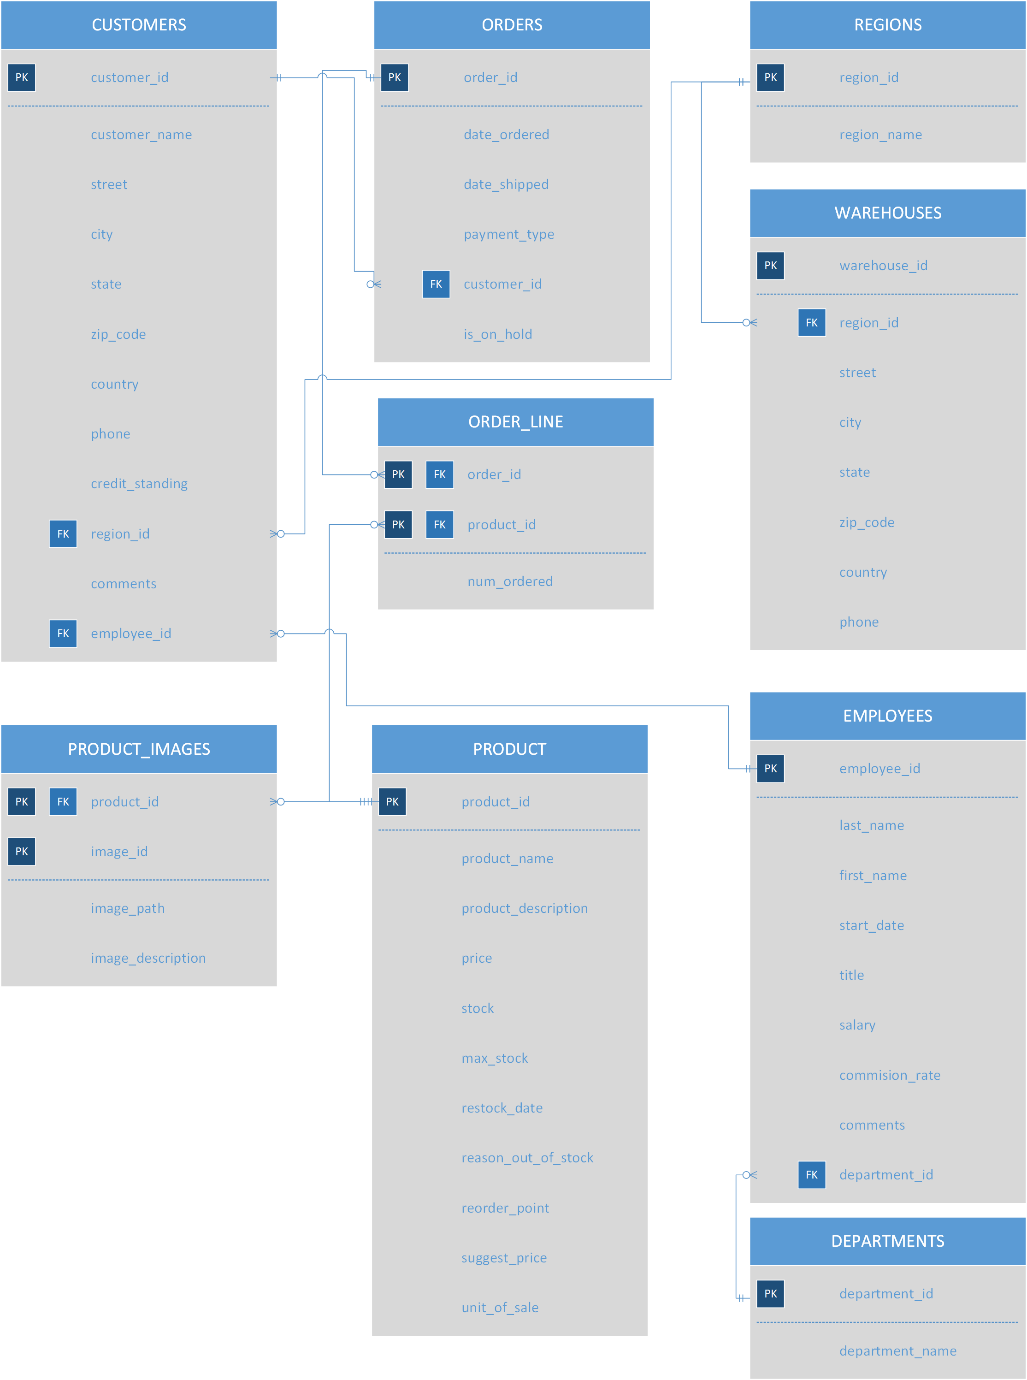
E-R Diagram

Slide 3
Business Rules
Each Customer can have many Orders
Each Order can only have one customer
An Order can have many Order Lines
Each Order Line can only be associated with one Order
A Region can have many Warehouses within.
A Warehouse can only be in one Region
A Region can have many Customers.
A Customer can only be in one Region
An Employee can represent many Customers
A Customer can only be represented by one Employee
Each Department contains many Employees.
Each Employee can only be in one Department.
A Product can have many Product Images.
A Product Image can only be associated with one Product.
A Product can be on many Order Lines.
An Order Line can only have one Product on it.

Slide 4
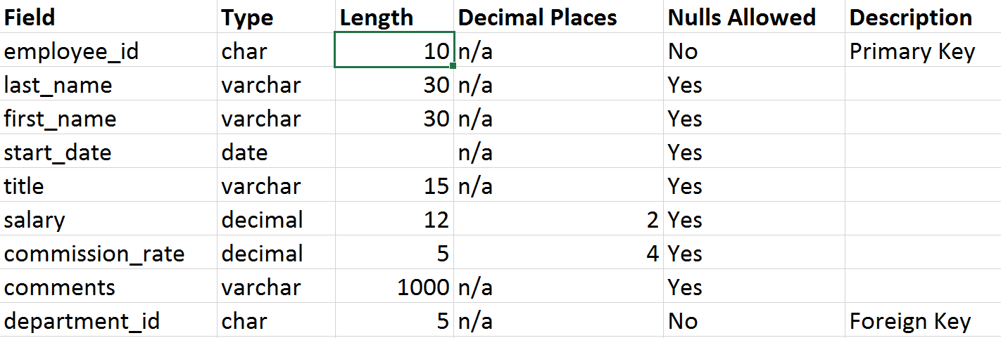
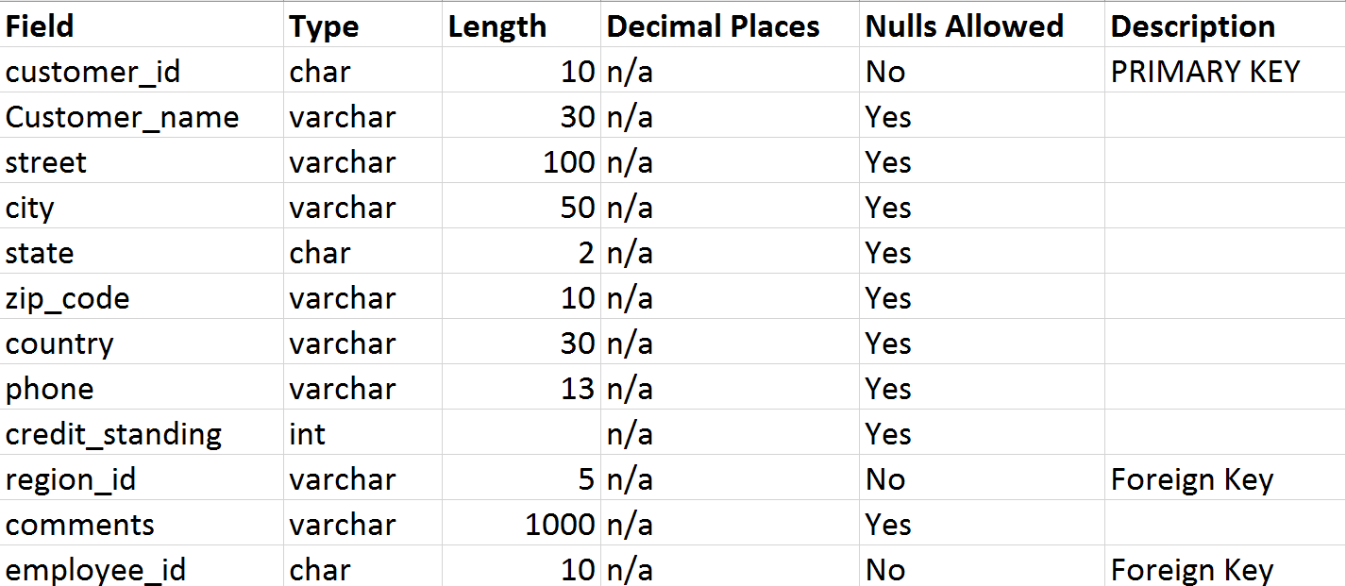
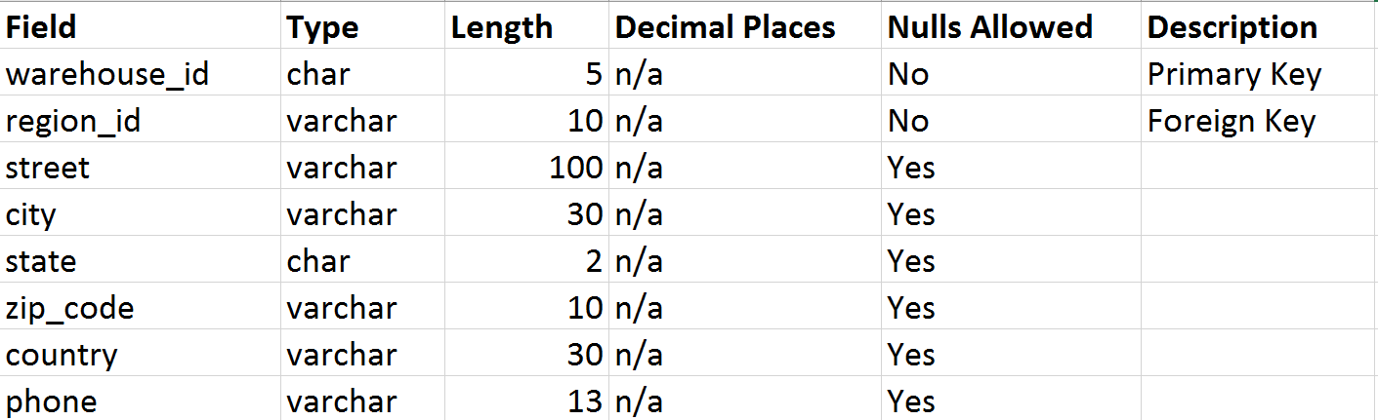
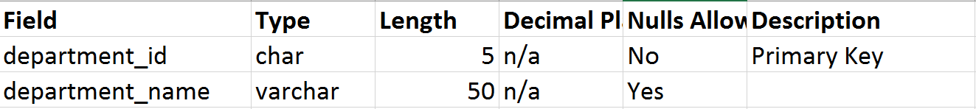
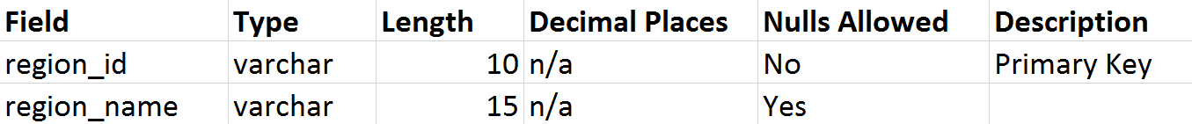
Data Dictionaries | Part I
Employees
Customers
Warehouses
Departments
Regions

Slide 5
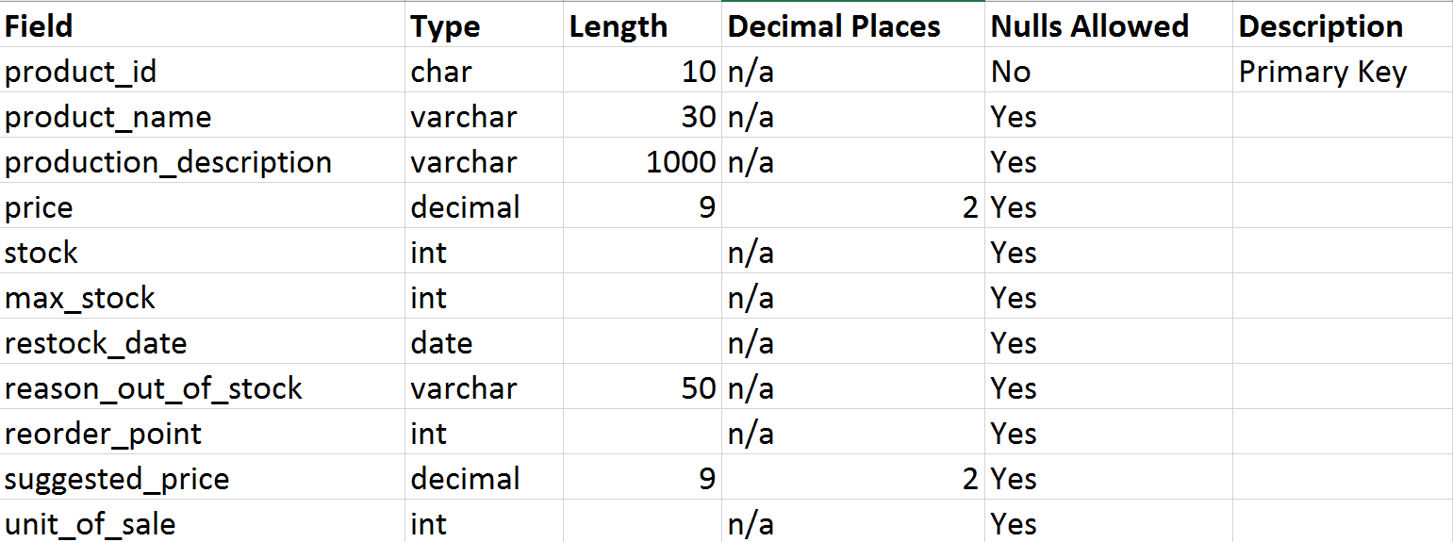
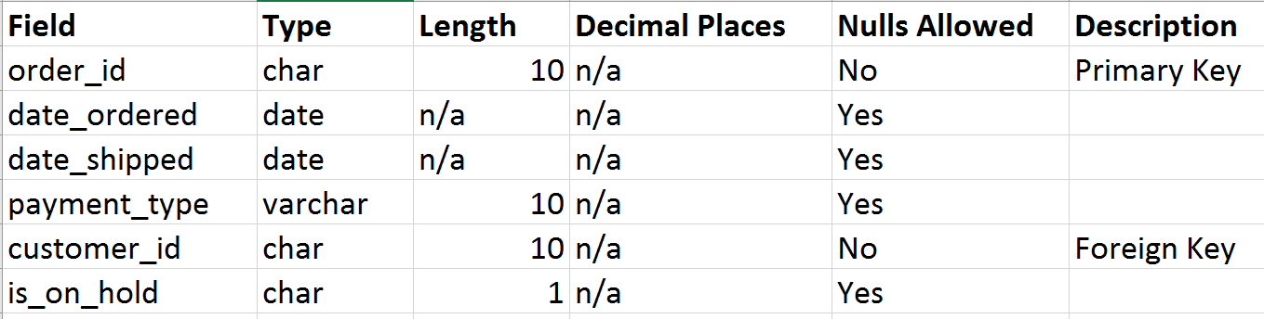
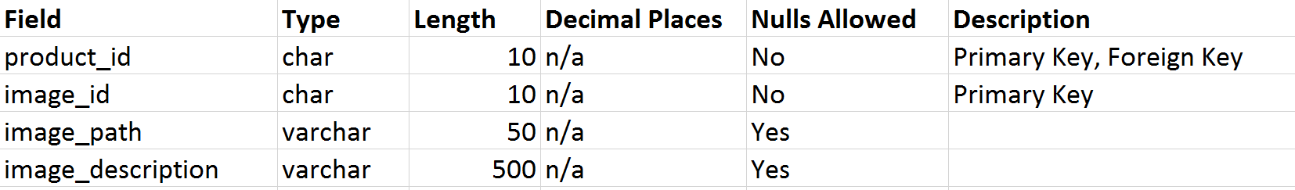
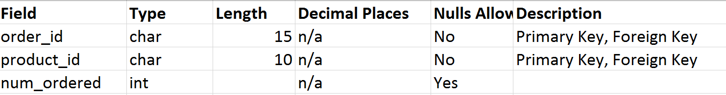
Data Dictionaries | Part II
Products
Orders
Product Images
Order Line

Slide 6

CREATe Database script

Slide 7
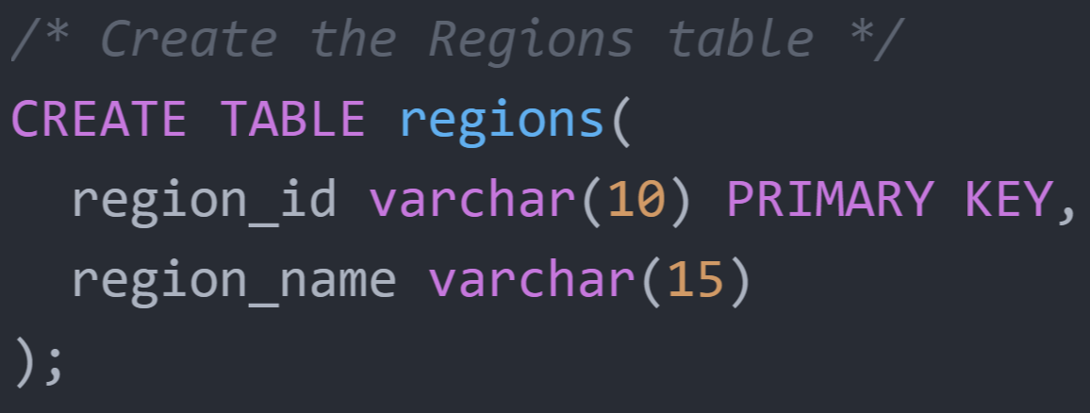
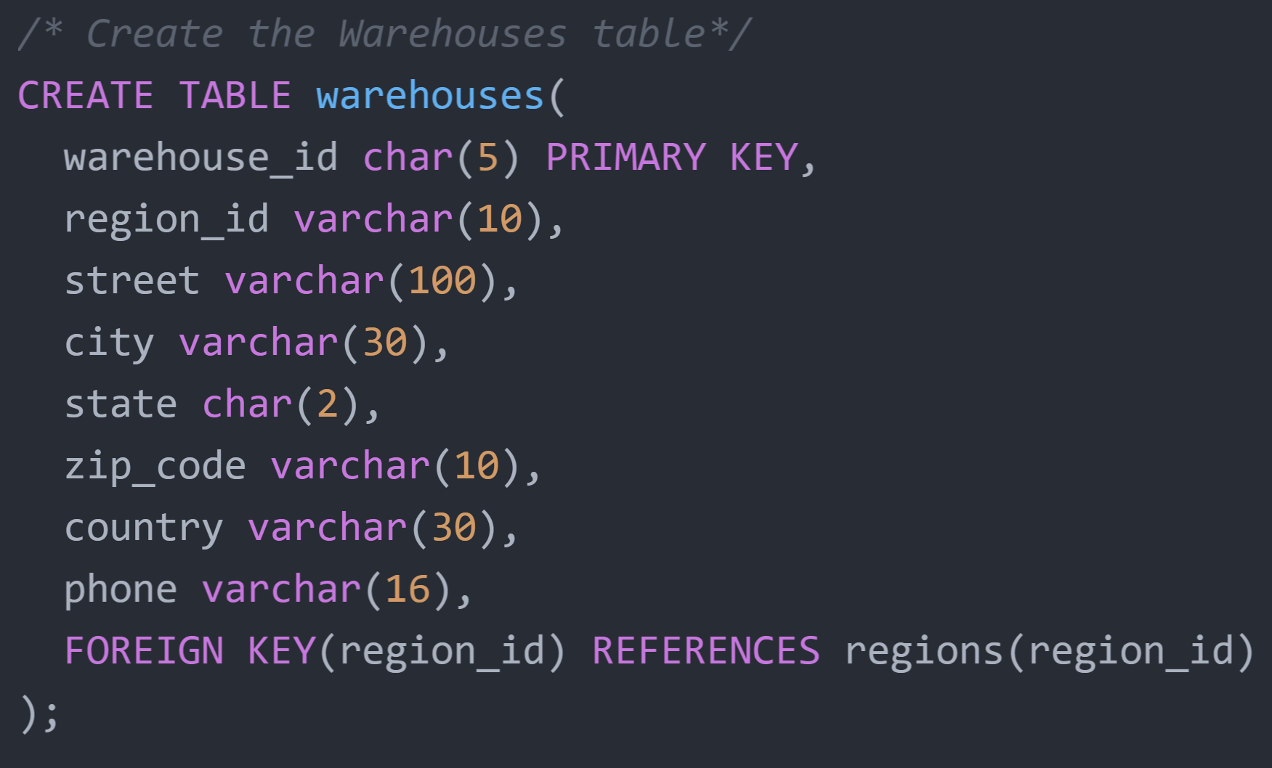
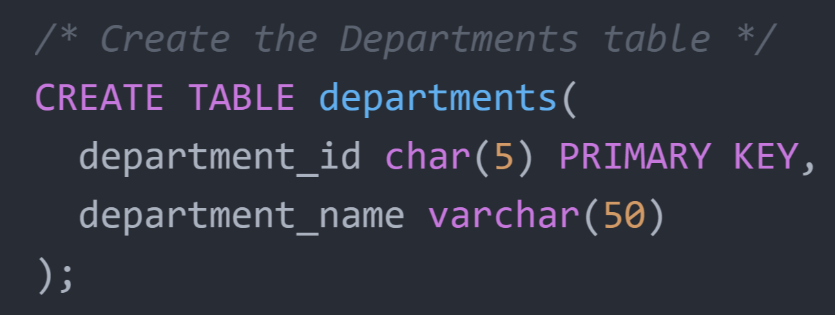
Create Table Scripts | Part I

Slide 8
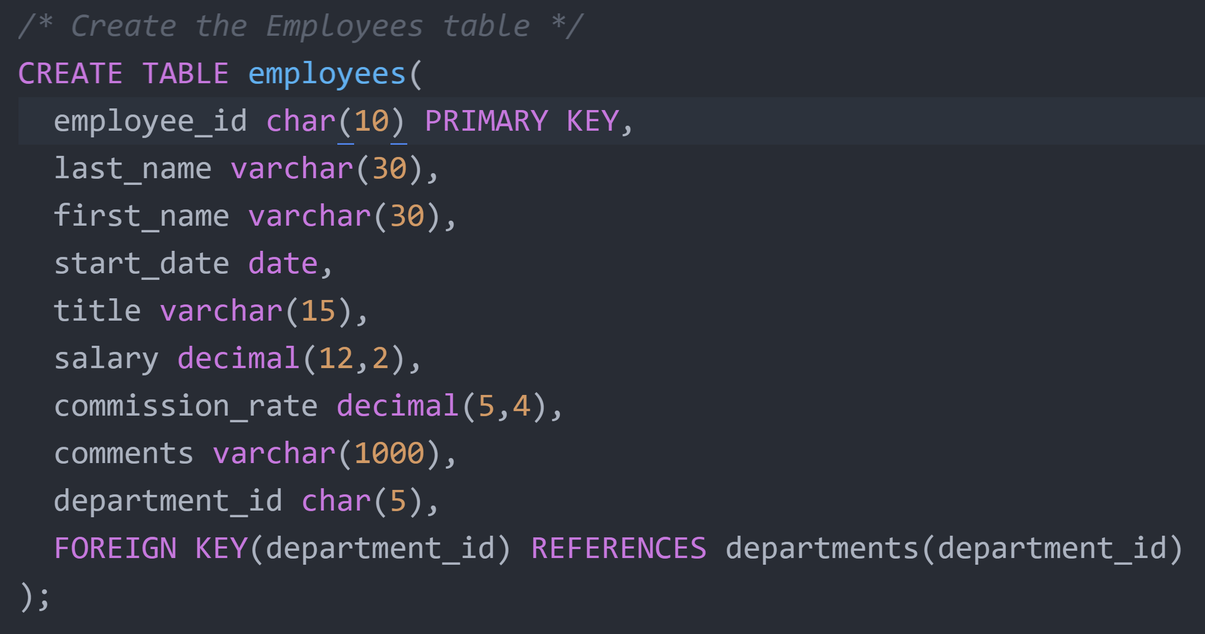
Create Table Scripts | Part II

Slide 9
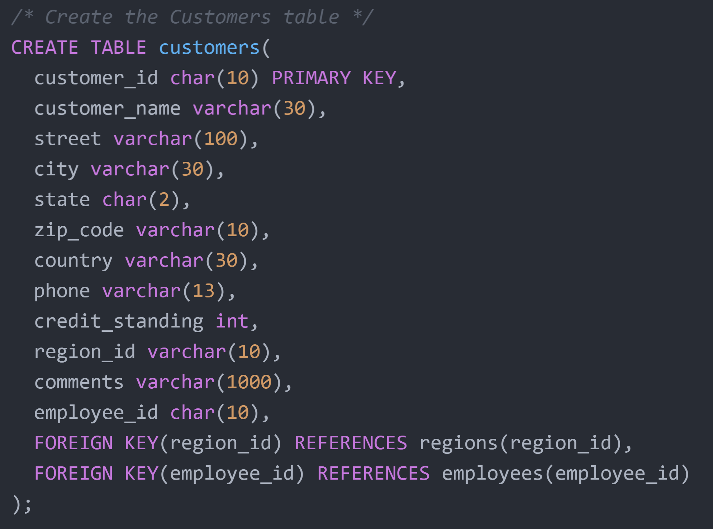
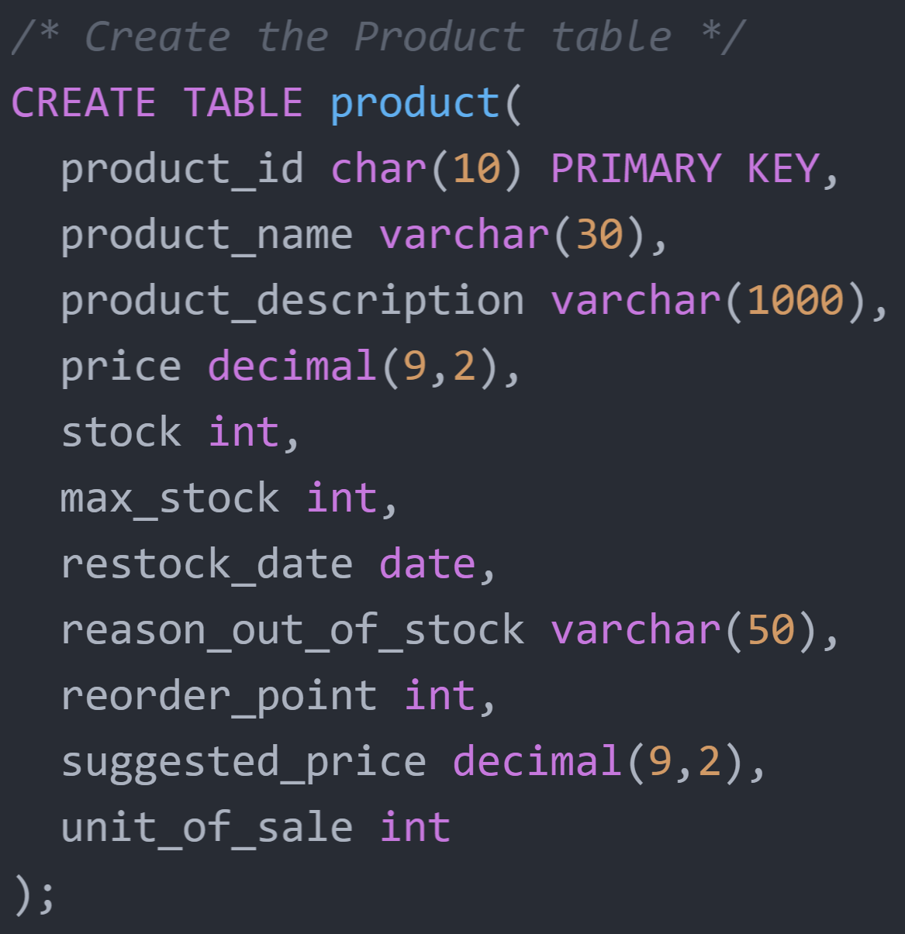
Create Table Scripts | Part III

Slide 10
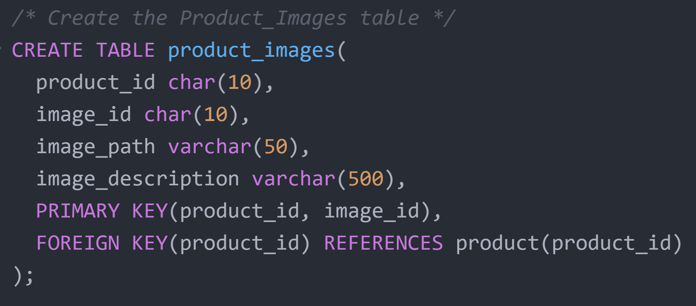
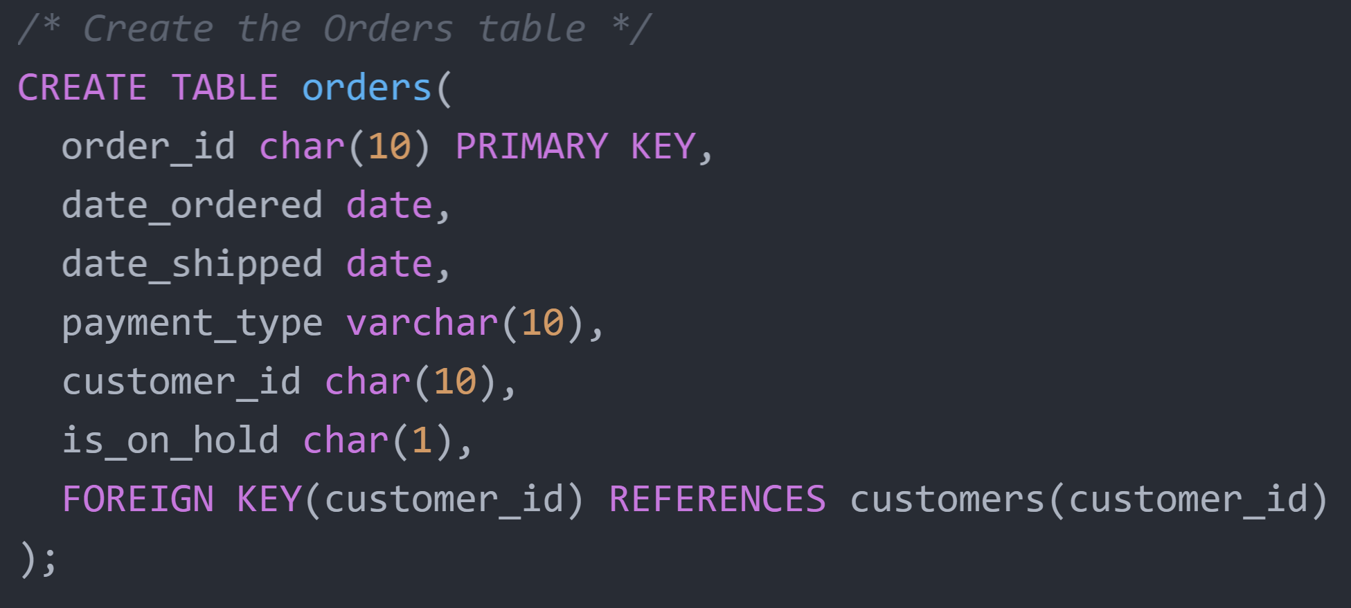
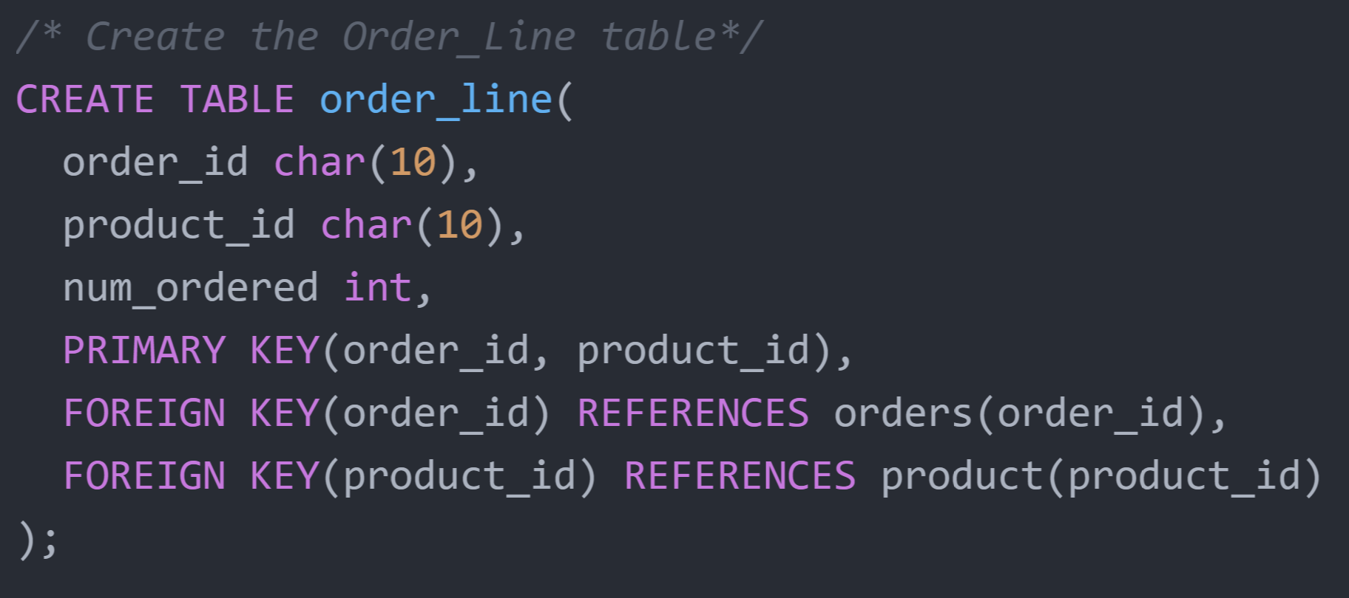
Create Table Scripts | Part IV

Slide 11
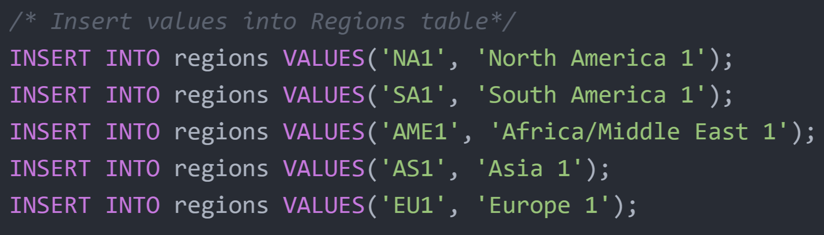
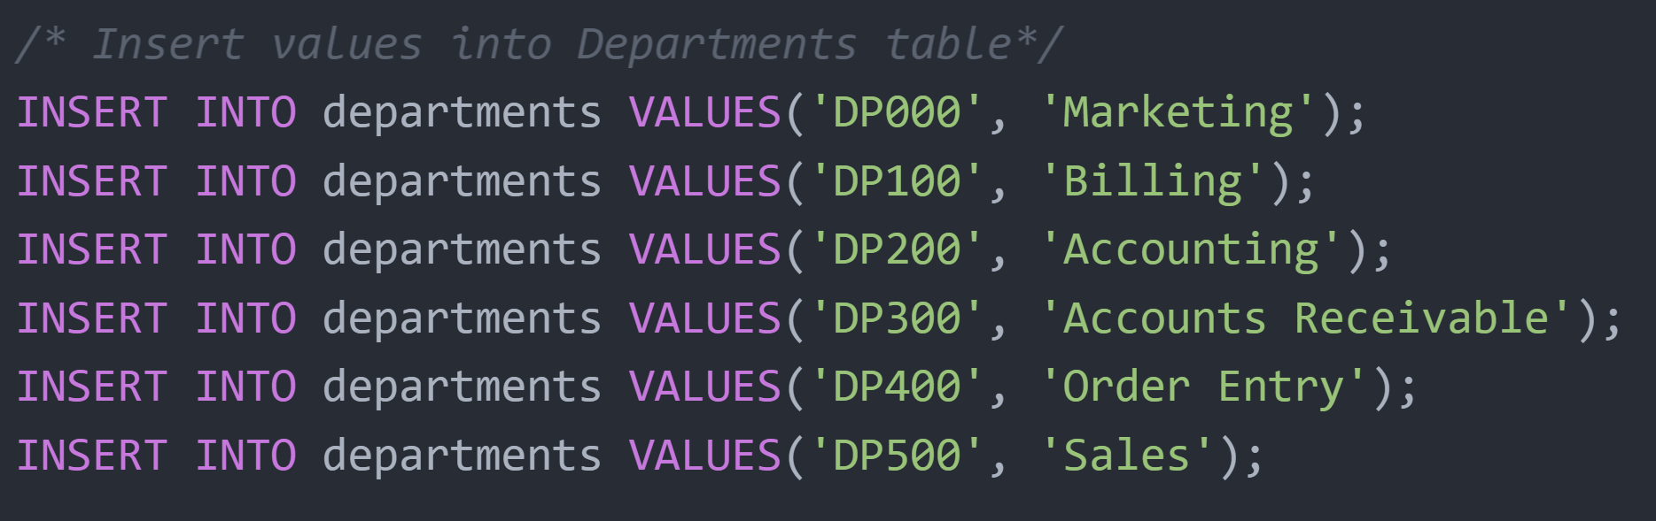
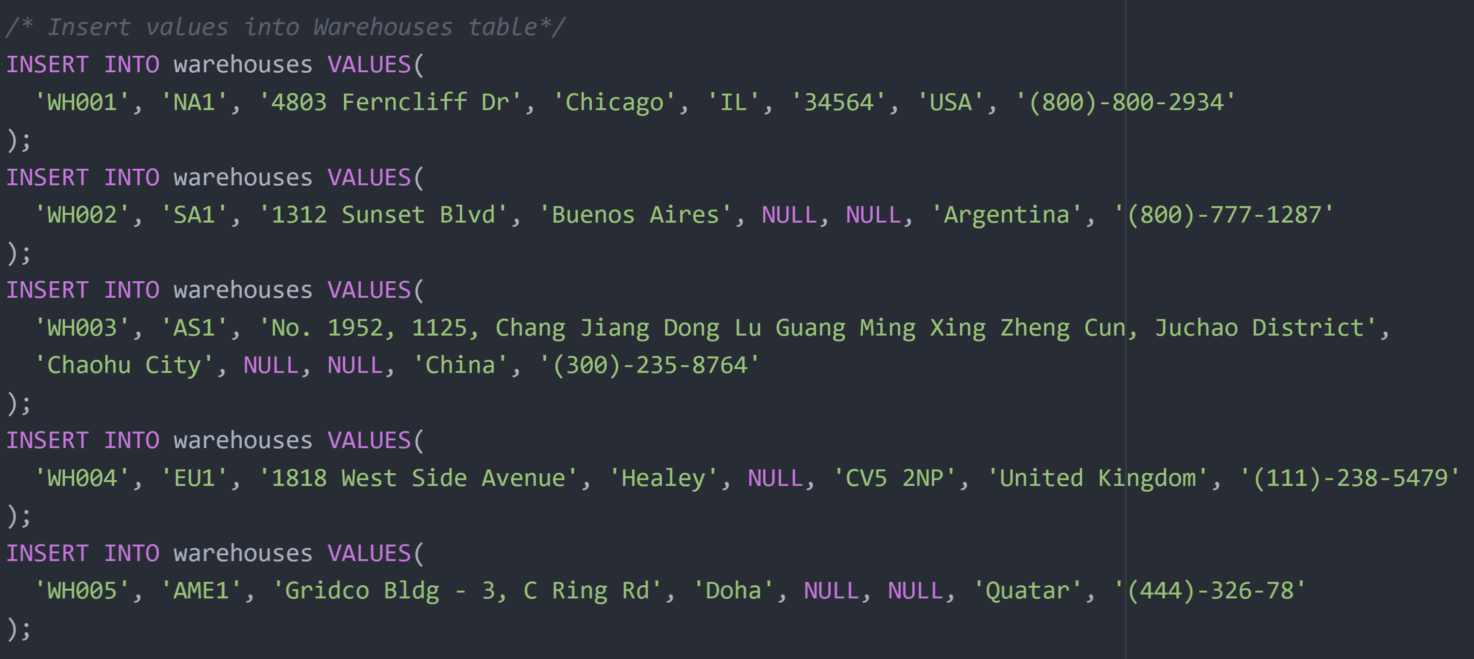
INSERT Statements | Part I

Slide 12
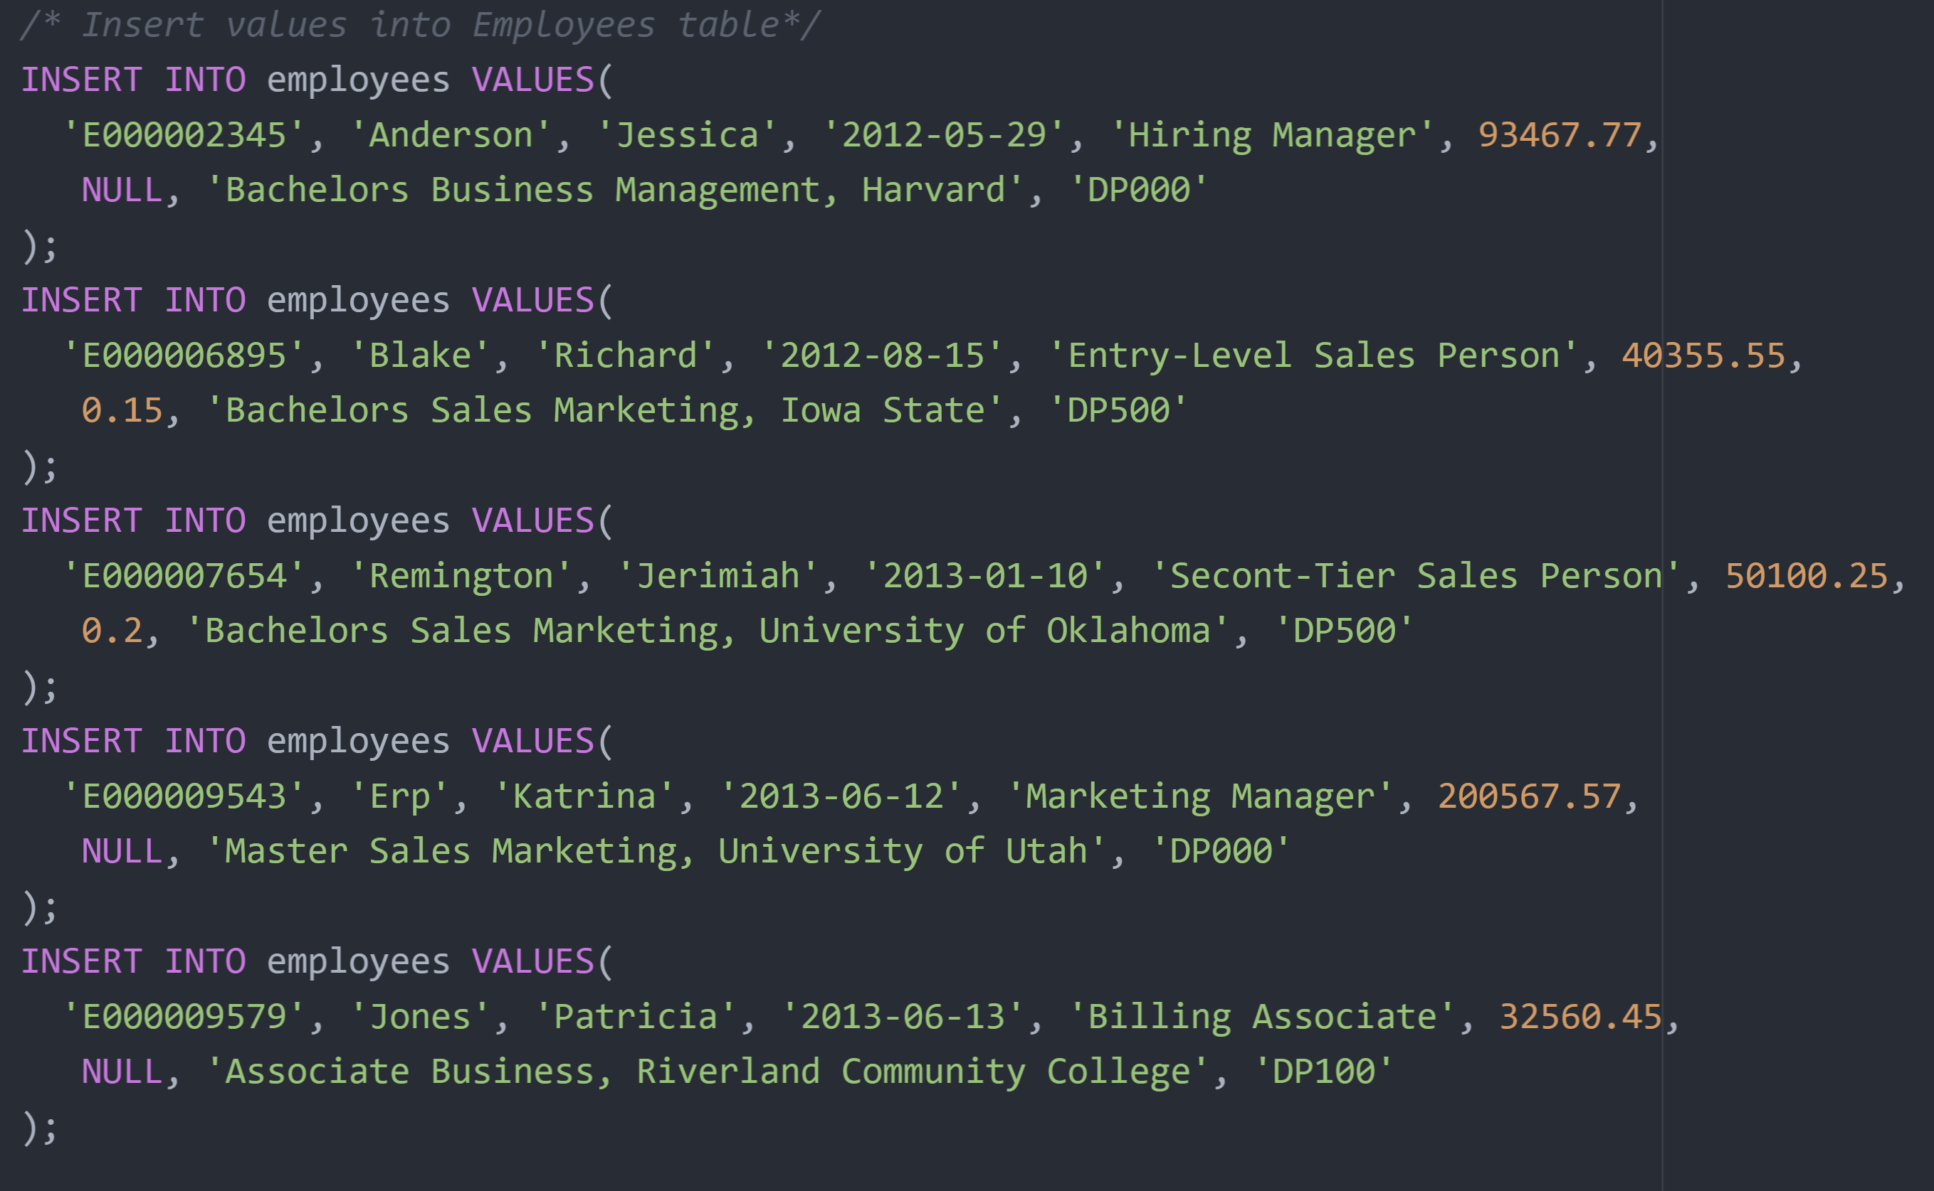
INSERT Statements | Part II

Slide 13
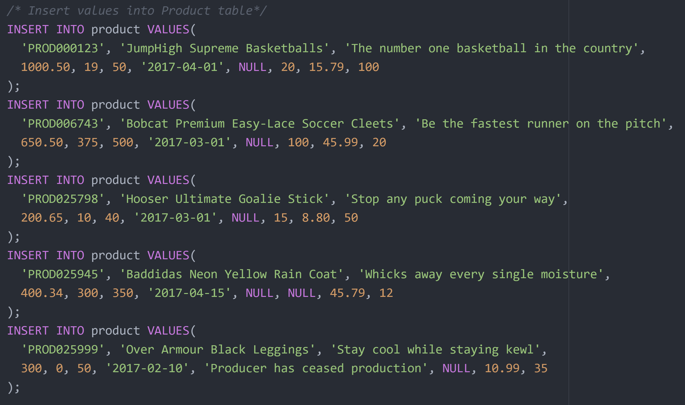
INSERT Statements | Part III

Slide 14
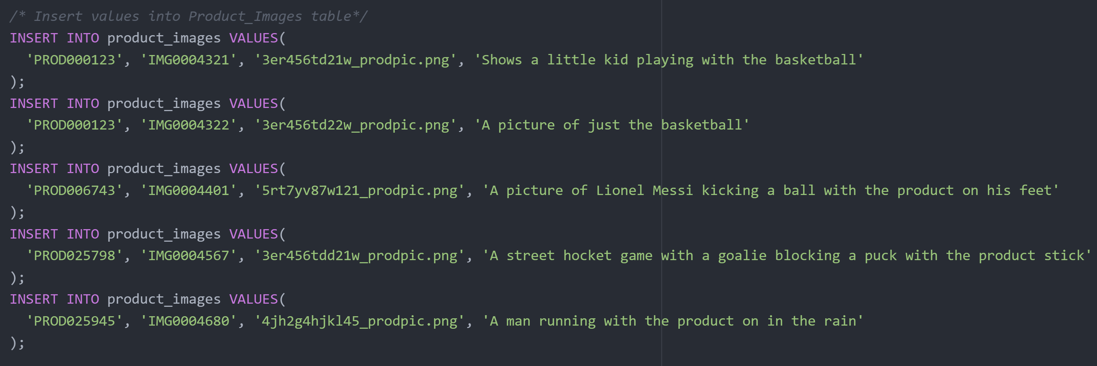
INSERT Statements | Part IV

Slide 15
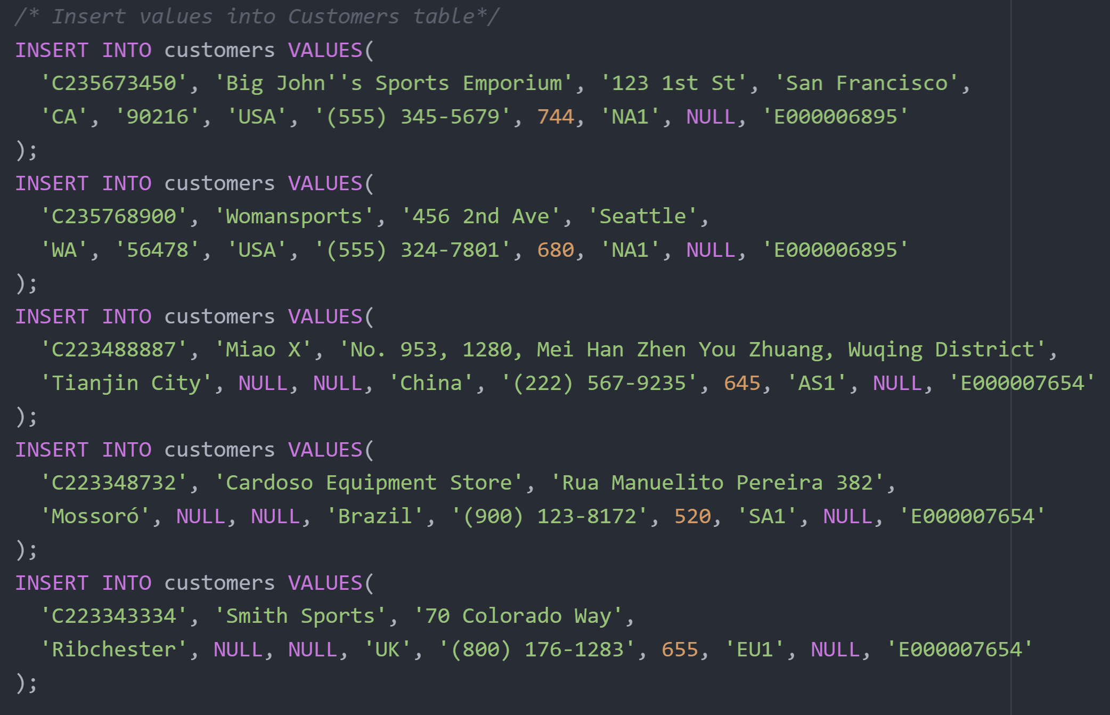
INSERT Statements | Part V

Slide 16
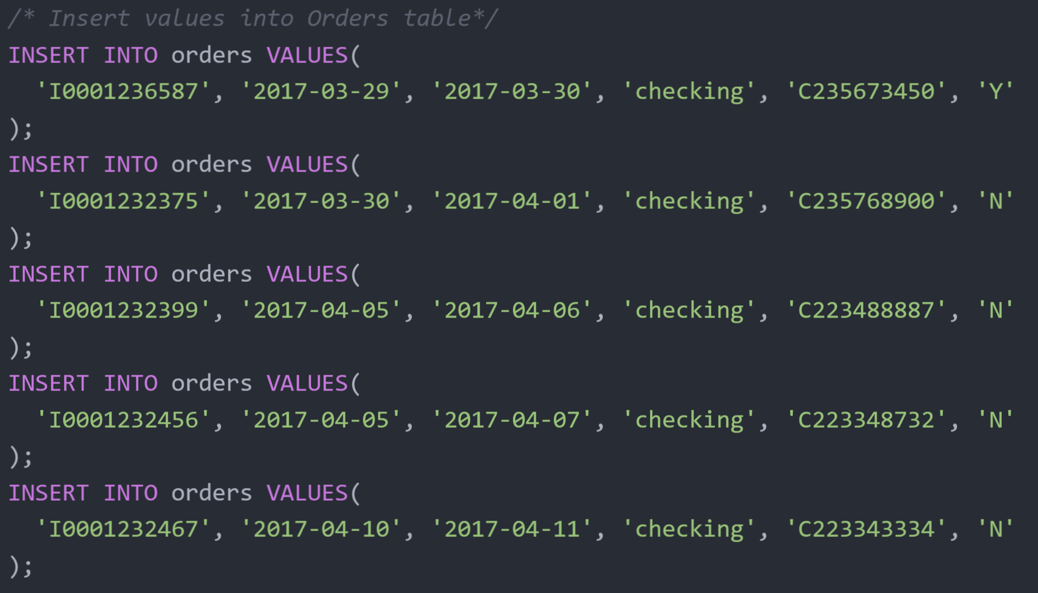
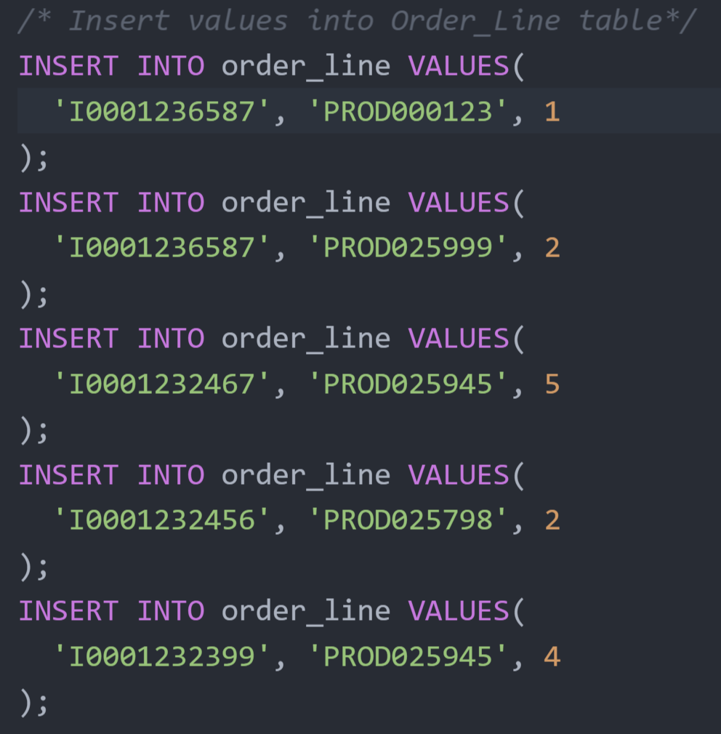
INSERT Statements | Part VI

Slide 17
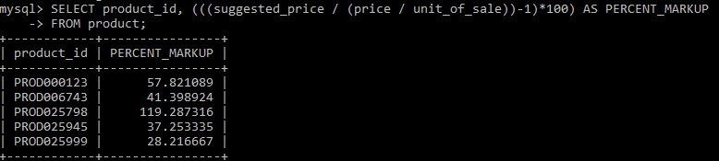
Single Table Query I
The marketing team wants to know how much the markup is (in percent) of the suggested price they give to the customer compared to the cost price. They want this information because they want to make sure the current markup percent matches current and future trends. If the markup doesn’t match, then the suggested price will be changed to match the trends.

Slide 18
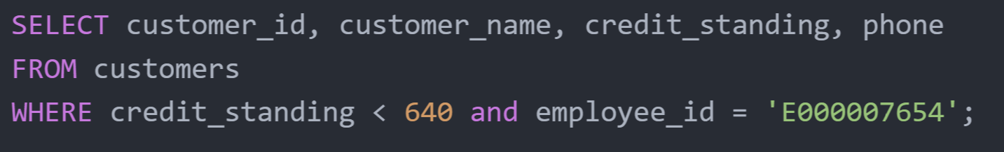
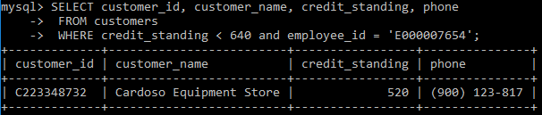
Single Table Query II
Jerimiah Remington is a Sales Associate and wants a list of all of their customers that are in bad credit standing so that they can call each customer and go over with them the proper procedures to handle the bad credit rating before the next time they order something.

Slide 19
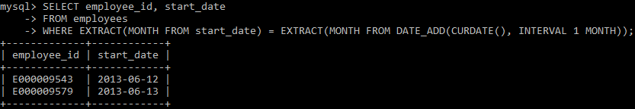
Single Table Query III
It is the last day of the month and the HR manager wants a list of all the employees who were hired in the month following the current month in the past. This is so they can schedule the employees annual evaluation.

Slide 20
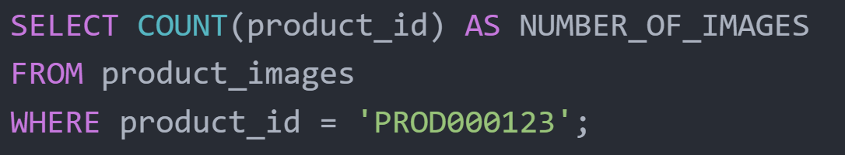
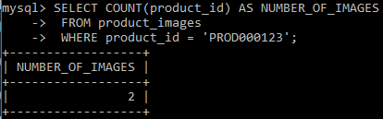
Single Table Query IV
A customer wants to know how many images are associated with the JumpHigh Supreme Basketballs so that they can strategize and organize proper floor displays for the product

Slide 21
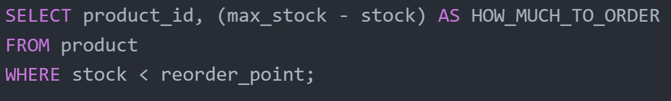
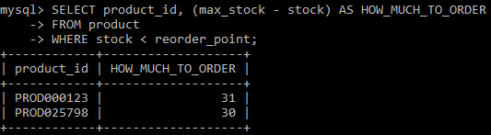
Single Table Query V
A member of Product Acquisitions wants a list of all the products whose stock is below the reorder point so that they can order more to stock. With each product listed, they also want to know how much of each product they should order

Slide 22
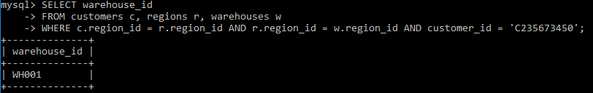
MUlti-Table Query I
Big John's Sports Emporium just placed an order. The order entry people need to know which warehouse to send the order to in order to be fulfilled.

Slide 23
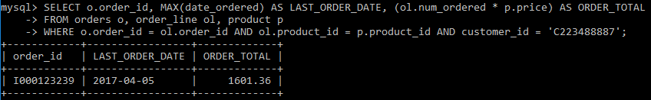
MUlti-Table Query II
Miao X Wants to know how much their most recent order was so that they can put it in their system.

Slide 24
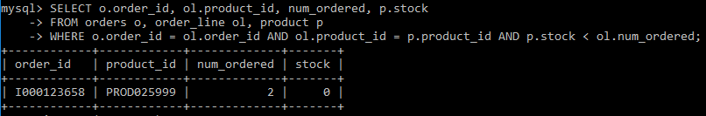
MUlti-Table Query III
An Order Fulfillment Employee wants a list of all the orders that are on hold, and Product that they are on hold for so that they can inquire about ordering more of the product to eventually fulfill the order

