Slide 1
VG100 Lab 8 Phase 1 Report Feedback on Figures
Wang ruizhe
2023.7.5

Slide 2
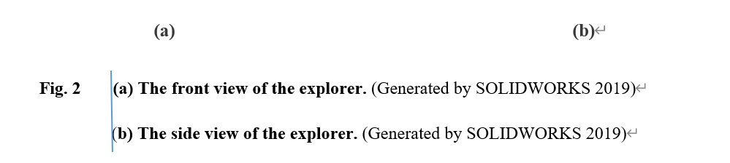
Figures
Figure caption: capitalize，“.”after, software information
eg. Fig.+space+2+Tab+Capitalize.
Two figures put in the same line: (1) add (a) and (b)
(2) Fig.+space+A3+Tab+ (a)+ Tab+ Capitalize.
(3) (a) and (b) be aligned to each other
Spacing between figure and the caption (consistency)
Figure quality: No border, no background, font style, font color, …

Slide 3
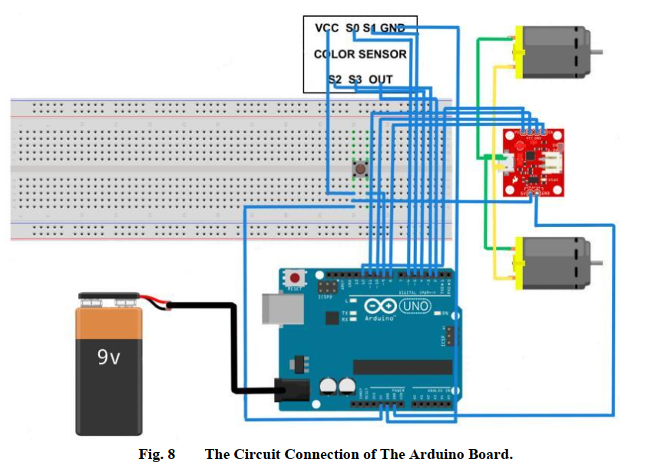
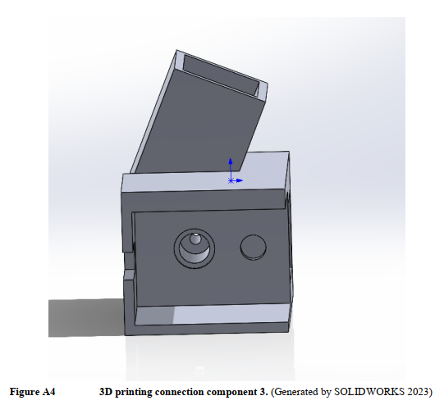
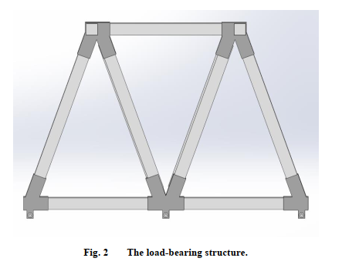
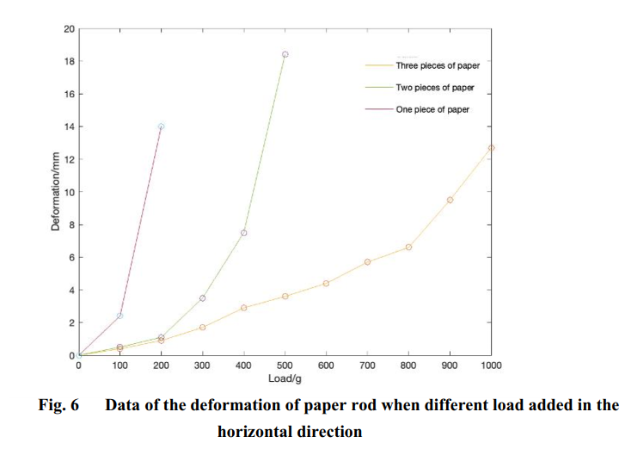
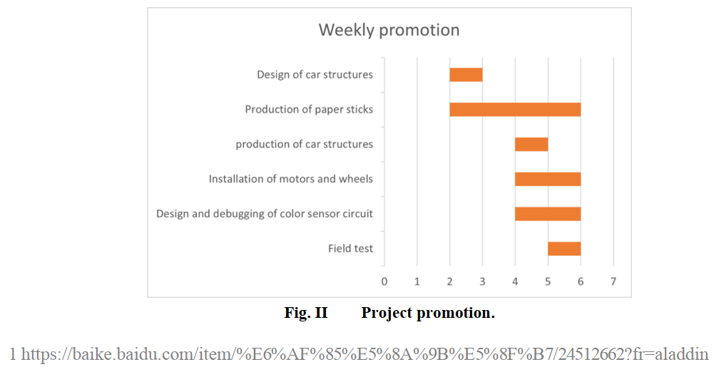
Examples

Slide 4
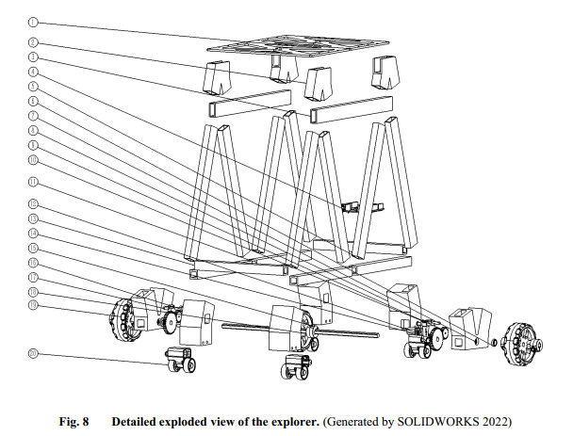
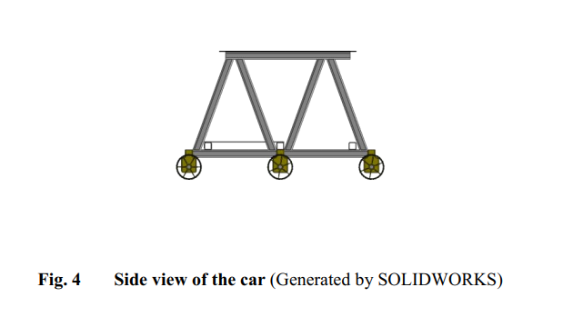
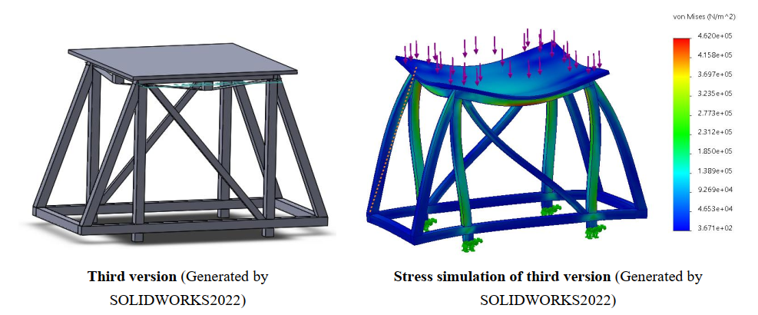

Examples

Slide 5
References
Bai, Xiaoyan, Sun, Haojia, VG100 Lab3 TC, 2022.

