Slide 1
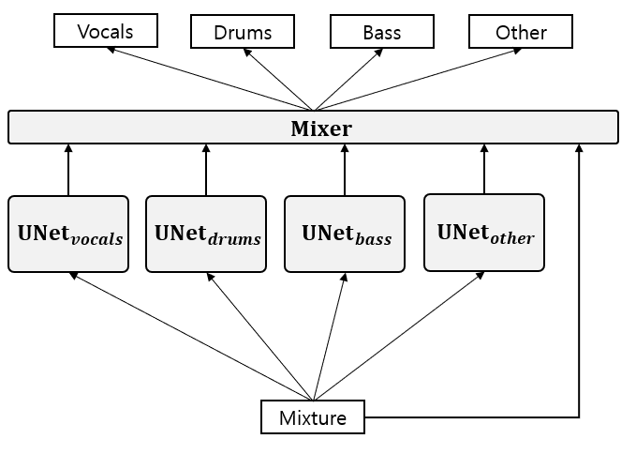

Slide 2










$$vocals$$
$$drums$$
$$bass$$
$$other$$
$$Mixer$$
$$U−{Net}_{vocals}$$
$$U−{Net}_{drums}$$
$$U−{Net}_{bass}$$
$$U−{Net}_{other}$$
$$mixture$$

Slide 3









$$vocals$$
$$drums$$
$$bass$$
$$other$$
$$Mixer$$
$$U−{Net}_{vocals}$$
$$U−{Net}_{drums}$$
$$U−{Net}_{bass}$$
$$U−{Net}_{other}$$
$$mixture$$

Slide 4


















$$vocals$$
$$drums$$
$$bass$$
$$other$$
$$blend$$
$$vocals$$
$$drums$$
$$bass$$
$$other$$
$$vocals$$
$$drums$$
$$bass$$
$$other$$
$$Mixer$$
$$Demucs \\ (without fine−tuning)$$
$$U{Net}_{vocals}$$
$$U{Net}_{drums}$$
$$U{Net}_{bass}$$
$$U{Net}_{other}$$
$$mixture$$

