Slide 1
Detecting Cancer in Gigapixel Pathology Images
Wen Shen 05/17/2019
Columbia University Department of Biomedical Informatics

Slide 2
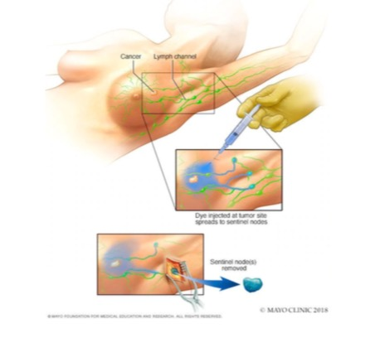
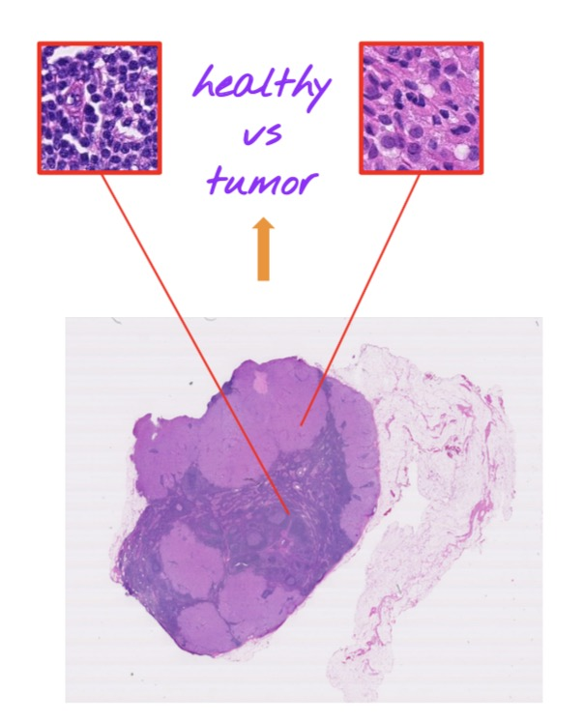
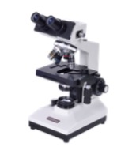
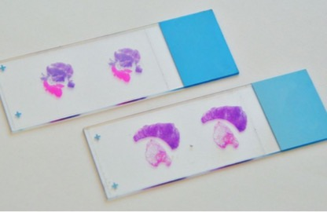
Healthy
vs
Tumor
Diagnosis → Treatment Plan
Biopsy
Visual Inspection
Preparation

Slide 3
Visual Inspection
What can we help with? What can go wrong?
• Can be tedious and error prone (despite best efforts of pathologists).
• Tissue samples are volumes: when sliced, many images / samples.
• Each image is of high resolution (order of 100,000 × 100,000 pixels).
• Expertise is rare. Pathologists have many patients, and limited time to spend on each slide.
• Tumors can be small. Needle in a haystack.
• Fatigue. Mistakes happen.

Slide 4
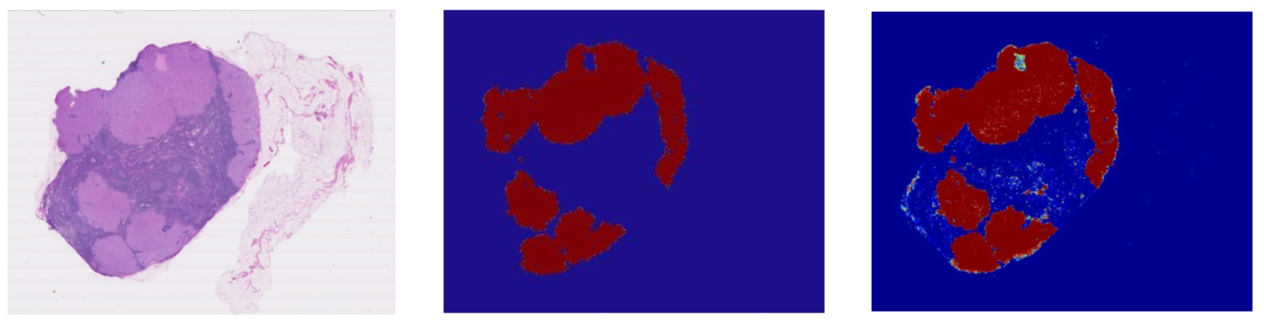
Project Idea: Develop a tool to assist physicians
• Given a collection of training data, develop a model that outputs a heatmap showing regions of a biopsy image likely to contain cancer.
Biopsy Image Ground Truth Model Predictions
(from pathologist)
Liu, Yun et al. “Detecting Cancer Metastases on Gigapixel Pathology Images.” CoRRabs/1703.02442 (2017): n. pag.

Slide 5
WORKFLOW

Slide 6
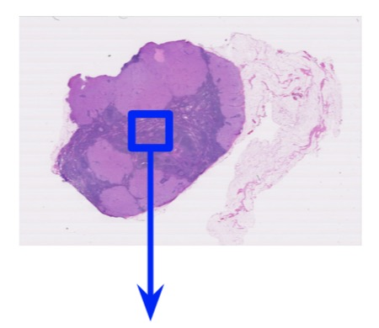
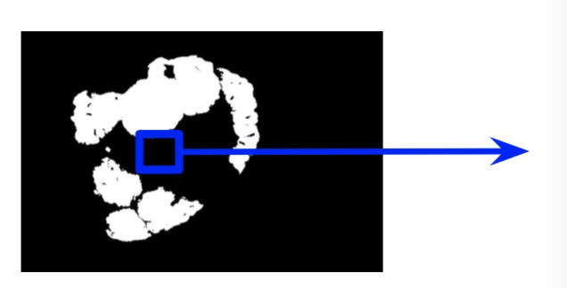
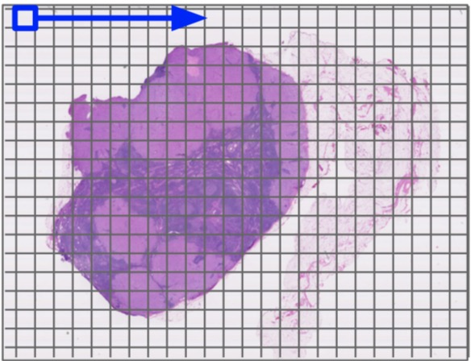
CAMELYON16 Dataset
13 slides for training, 3 for testing
Slide
Get patches and labels
60 × 60 patch of interest
Label
(binary)
Mask
1. Label a patch of interest as tumor if at least one pixel in the patch is annotated as tumor.
2. Determine the patch is tissue or background first to improve efficiency. (>10% tissue pixels)

Slide 7
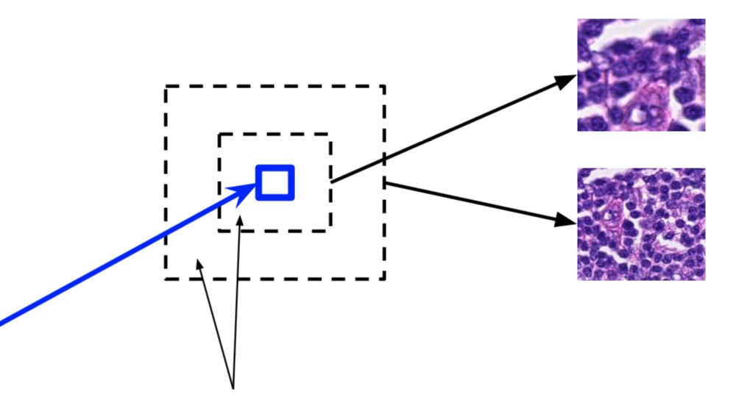


Get patches and labels
5X patch
(100 × 100)
2.5X patch
(downsampled
to 100 × 100)
Slide
60 × 60 patch of interest
Input images
Surrounding context
Label (binary)
Model
Mask

Slide 8
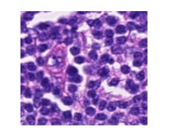
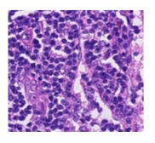
Tumor yes/no
CAMELYON16 Dataset
Output
13 slides for training, 2 for testing
Fully connected
Logits
Logits
Get patches and labels
Independent VGG16 towers
Design a model
Multi-scale model
details & context
resembles microscope magnifications
Input
Input
100×100 input patches at different scales
5X
2.5X

