Slide 1
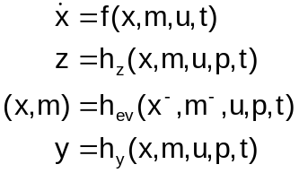

originally provided by T. Blochwitz (ITI)
GUI
p
Enclosing Model
u
y
External Model
x
t
Solver

Slide 2

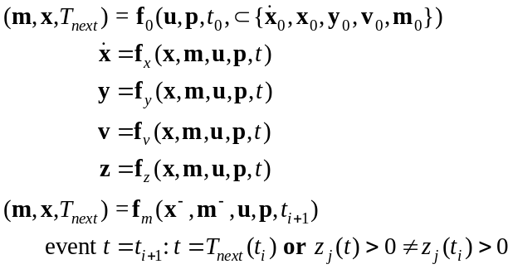

Graphical User Interface (GUI)
Enclosing Model
u
y
External Model
x
t
v
Solver

Slide 3
originally provided by M. Otter (DLR)
x(t)
m(t)
time
t₀
m¯(t₁)
t₁
m(t₁)
t₂

Slide 4
originally provided by M. Otter (DLR)
z(t)
z > 0
time
z ≤ 0
t₀
t₁
t₂

Slide 5
originally provided by M. Otter (DLR)
φ
h
w

Slide 6
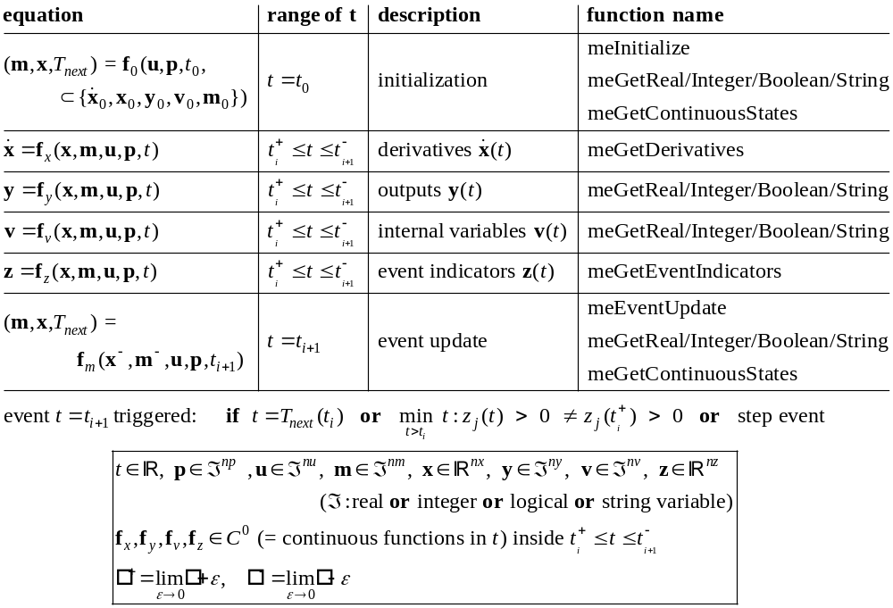

Slide 7



