Slide 1
Solution 1
Solution 2
Solution 3
Solution 4
In the viewport
Out of viewport
Solution 5

Slide 2
In the viewport
Out of viewport
Background
Object A
Object B
Solution 5

Slide 3

Client
(Before video display)
Client
(In video display)
Real-time Head Movement Reading
Network Capacity Estimation
VR Display
Legend
Viewpoint/speed/tracking Prediction
Project, render, display
Input
PSPNR Computation
MPD File Reading
Decoded Frame Buffer
Request
Output
Rate Allocation
Request
Encoded Tile Buffer
MP4
MP4
Data Structure
Tiles Gathering &Decoding
Working process in traditional video streaming
Response
MPD File
Response
Encoded Video Tiles
New Working process
Content-aware Tiling & Encoding
PSPNR Precomputation
Server
MP4
MP4
Raw VR Video

Slide 4
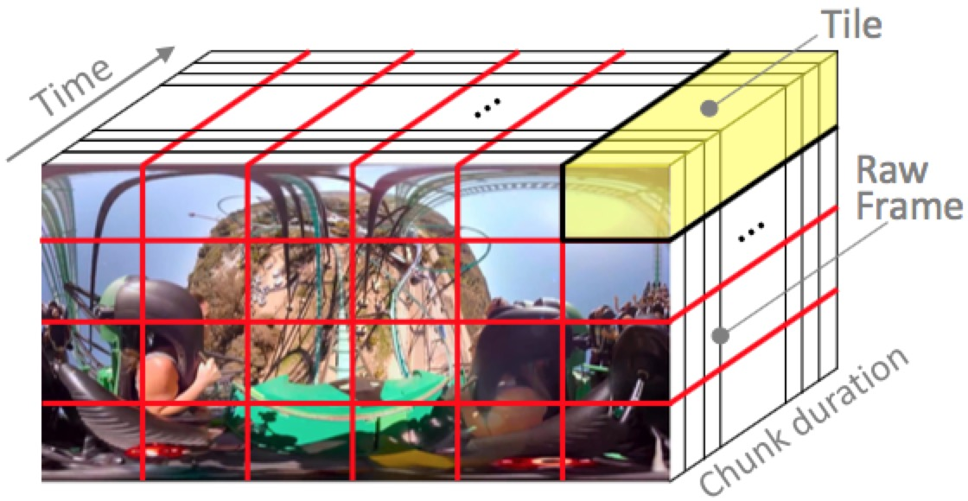
Server
Client
MPD
MPD
1. MPD Downloading
Quality
2. Quality Selection
High
Medium
Low
3. Video Downloading
Video Content

Slide 7
1 2 3 4 5
Bad Poor Fair Good Excellent

