Slide 1
Undirected Graph
Graph G=(V,E)
V = set of vertices (nodes)
E = set of edges
2
1
3
undirected graph V = {1, 2, 3, 4, 5}
E={(1,2),(1,3),(2,3),(3,4),(4,5)}
5
4
1

Slide 2
Directed Graph
Graph G=(V,E)
V = set of vertices (nodes)
E = set of edges
2
1
3
directed graph
V = {1, 2, 3, 4, 5}
E={‹1,2›, ‹2,1› ‹1,3›, ‹3,2›, ‹3,4›, ‹4,5›}
5
4

Slide 3
Weighted Graph
Graph G=(V,E)
V = set of vertices (nodes)
E = set of edges and their weights
2
𝑤12
𝑤23
1
𝑤13
3
Weights can be either distances or similarities
𝑤34
5
𝑤45
4
Weighted graph
V = {1, 2, 3, 4, 5}
E = {(1,2, 12),(1,3,
12),(2,3,
12),(3,4
12),(4,5,
12)}

Slide 4



Undirected graph
Neighborhood of node
2
For any node , in an undirected graph, the set of nodes it is connected to via an edge is called its neighborhood and is represented as
1
3
degree of node
Size of
number of edges incident on
5
4

Slide 5
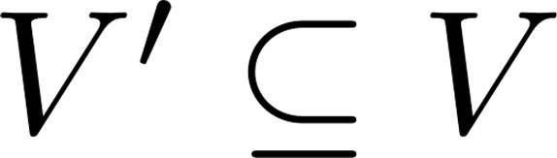





















Subgraph
Graph
where
can be represented as a pair
is the node set and is the edge set
is a subgraph of
•
5
5
6
4
3
1
1
3
2
2

Slide 6
Graph Representation
Adjacency Matrix
symmetric matrix for undirected graphs
2
1 1 0
⎢ 0 1 0
A = ⎢1 1 0 1 0⎥
⎢0 0 1 0 ⎥
⎢⎣0 0 0 1
⎡0
0⎤
⎢₁
₀⎥
⎥
1
⎢
3
1⎥
0⎥⎦
5
4
7

Slide 7
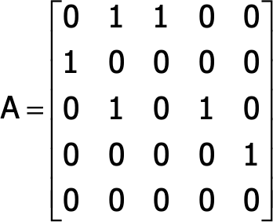
Graph Representation
However, social networks have very sparse Adjacency matrices
Adjacency Matrix
unsymmetric matrix for directed graphs
2
1
3
5
4

Slide 8
Edge Attributes
Possible options
Weight (e.g. frequency of communication)
Ranking (best friend, second best friend…)
Type (friend, relative, co‐worker)
Sign: Friend vs. Foe, Trust vs. Distrust
Properties depending on the structure of the rest of the graph: number of common friends

Slide 9
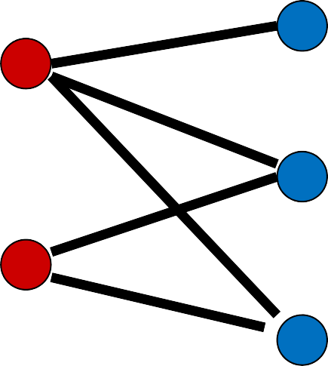
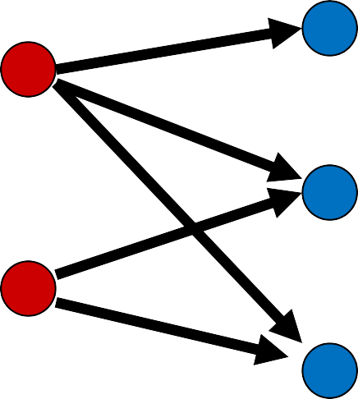
Bipartite Graphs
Graphs where the set of nodes V can be partitioned into two sets L and R, such that there are edges only between nodes in L and R, and there is no edge within L or R

Slide 10
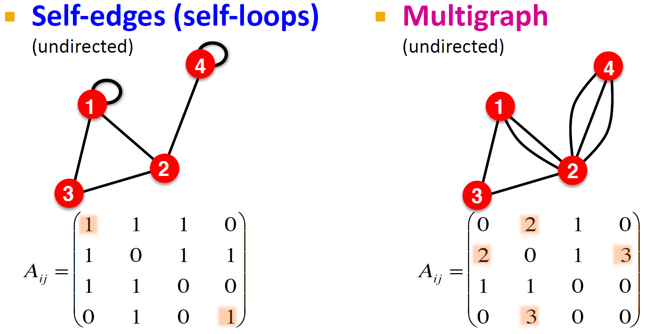
More Types of Graphs

