Slide 1


Graph Representation Learning
Learning node embeddings in a graph
Machine Learning with Graphs (MLG)
Cheng‐Te Li (李政德)
Institute of Data Science
National Cheng Kung University
chengte@mail.ncku.edu.tw

Slide 2
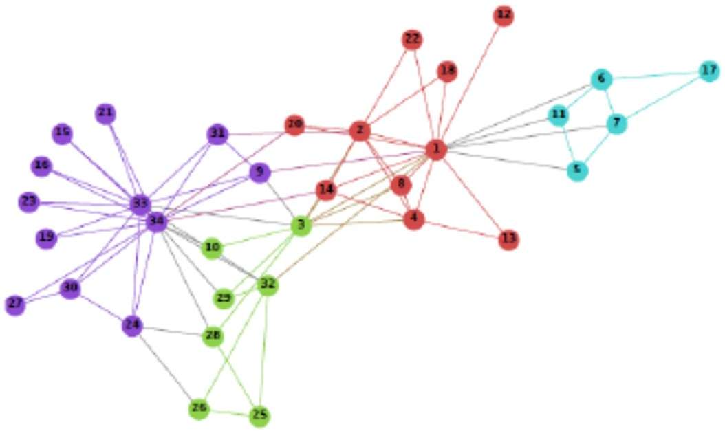
Graph Representation:
from Hand‐crafted Features to Learned Features
𝑥_{ij}: node 𝑣_{i}’s 𝑗^{th} feature,
e.g., 𝑣_{i}’s degree, centrality, and pagerank values
Feature Engineering
𝑣_{i}
Machine Learning Models
Network Analysis Tasks
Node Classification
Link Prediction
Community Detection
User Profiling
etc.
Hand‐craft Feature Matrix
𝑥_{ij}: node 𝑣_{i}’s 𝑗^{th} learned feature
𝑣_{i}
Feature Learning
Machine Learning Models
Learned Latent Feature Matrix

Slide 3
Roadmap on GRL
Introduction to NRL
From Word Embedding to Network Embedding
NRL Models
Factorization‐based
Graph Factorization, GraRep, HOPE
Random Walk‐based
DeepWalk, node2vec, LINE

Slide 4











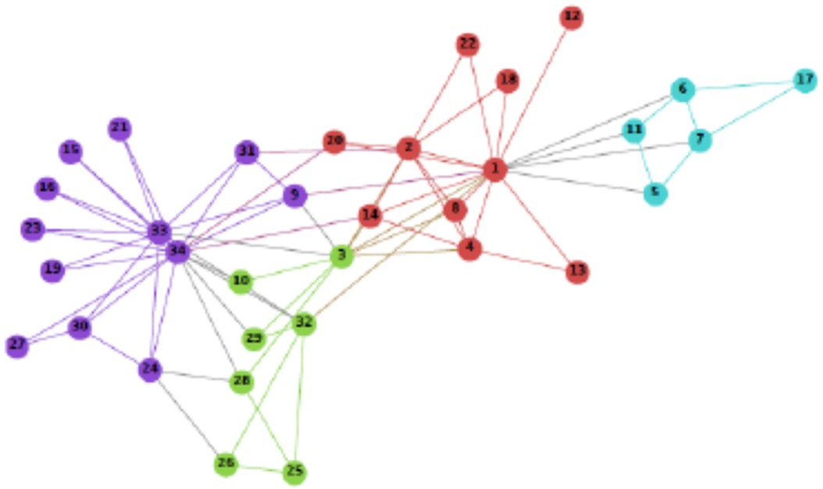
Graph Representation Learning
Problem: Graph Representation Learning, (a.k.a. Network Embedding Learning)
Input: a network
V ×d
Output: , ‐dim vector _{v} for each node
The goal is to map each node into a latent low‐dimension space such that network structure information is encoded into distributed node representations
𝑥_{ij}: node 𝑣_{i}’s 𝑗^{th} learned feature
𝑣_{i}
Feature Learning
Learned Latent Feature Matrix

Slide 5
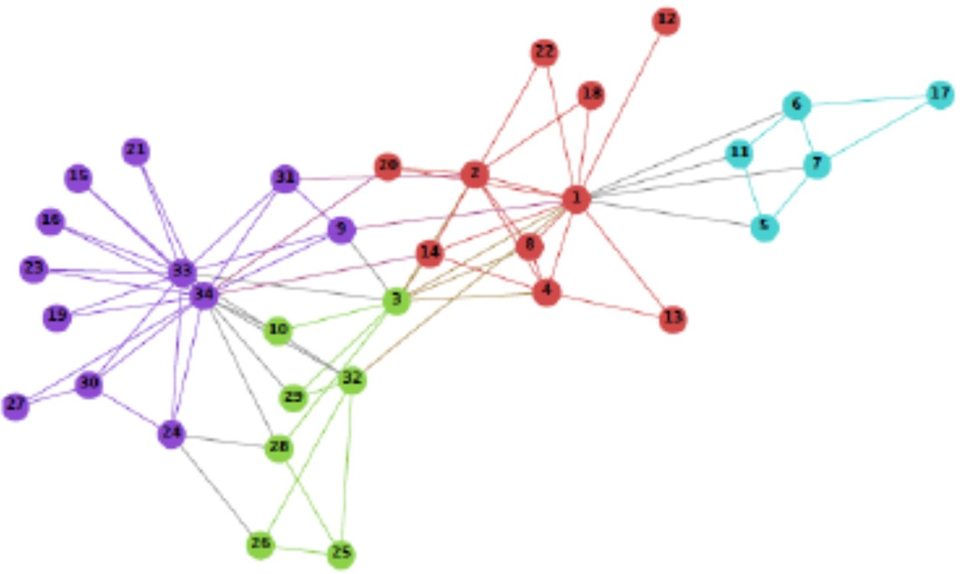

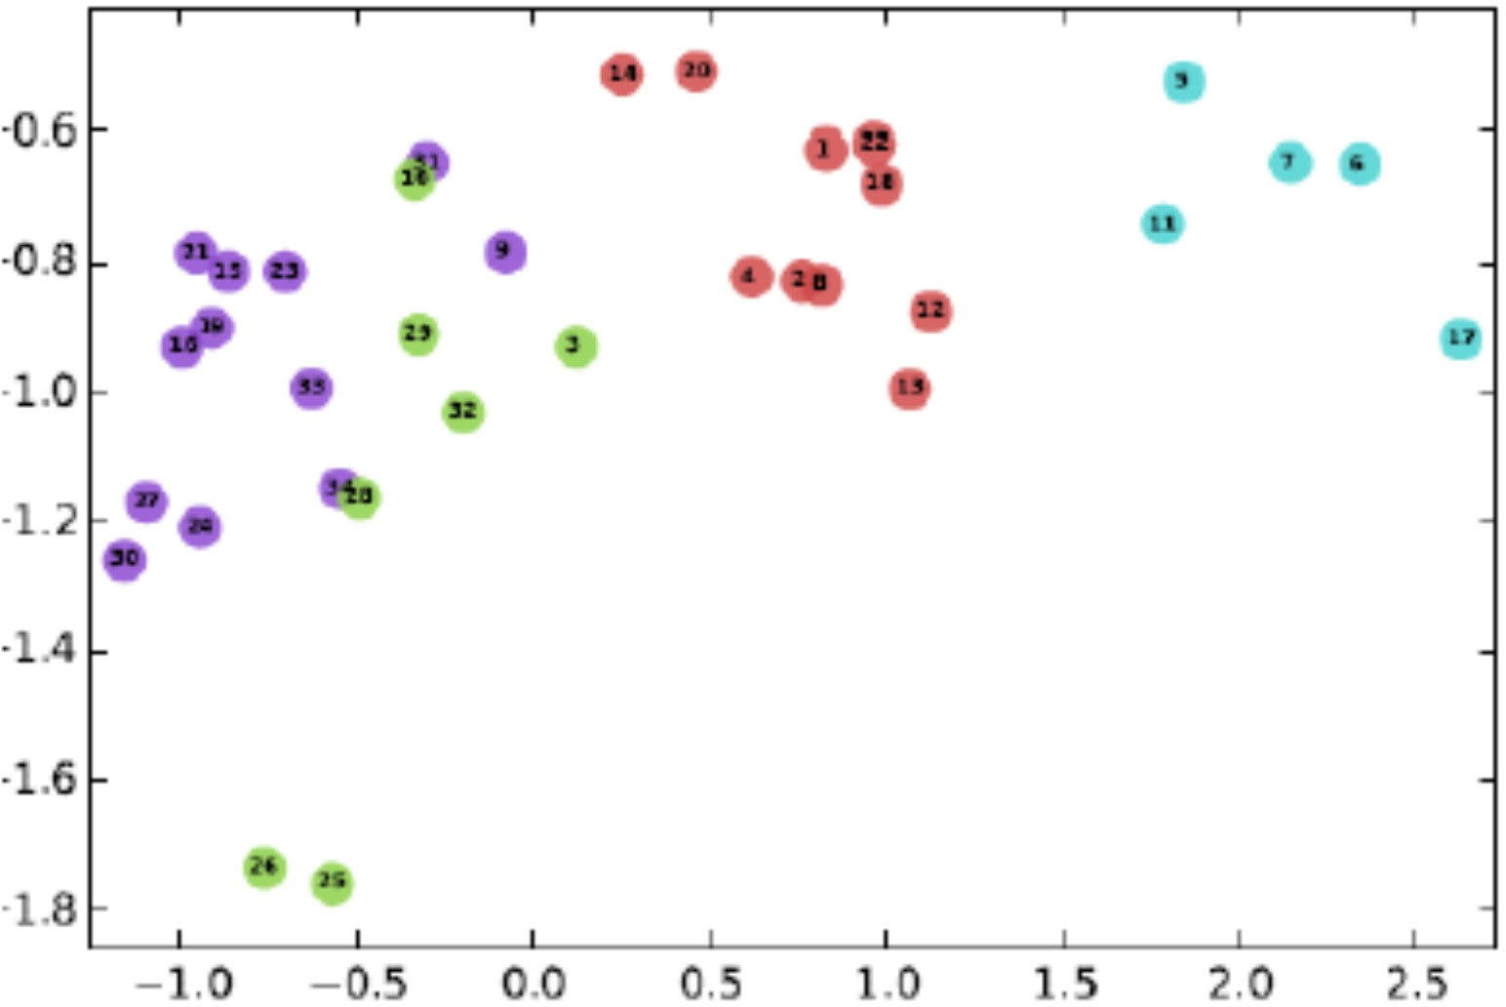
Graph Representation Learning
[Perozzi et al.’14, Tang et al.’15, Grover & Leskovec’16]
d
d
Embedding Learning
Embedding Vector
e.g.,
Network of Zachary’s Karate Club
Embedding learning:
map each node into a low‐ dimensional space
Preserving proximity:
similarity between node embeddings indicates proximity between nodes

Slide 6



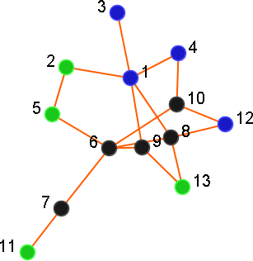
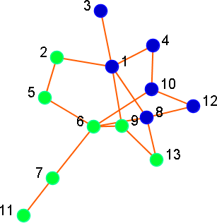

Typical Application 1: Node Classification
Source: http://istockphoto.com/jarun011
Potential Labels: Disease Spread Fake News Spread Political opinion User Profiles
Given labels of some nodes,
predicting labels of the remaining nodes
: Patient
: Non‐Patient
: ? Unknown
predict
6: Non‐Patient
7: Non‐Patient
8: Patient
9: Non‐Patient
10: Patient

Slide 7
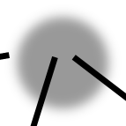




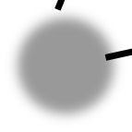
















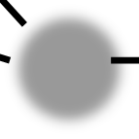

Typical Application 2: Link Prediction
Given the current network structure, predicting which links will be created
Friend Recommendation
Item Recommendation
Alice
?
Alice
?
Bob
Bob
Charlie

Slide 8














Literatures on GRL
FastGCNs, Graph Attention Net
NetMF & NetSMF
2018: Velickovic et al., ICLR’18, Chen et al., ICLR 2018 2018: Qiu et al., WSDM’18 & WWW’19
Neural message passing, GraphSage Gated graph neural network
structure2vec
2017: Gilmer et al., ICML’17; Hamilton et al., NIPS’17 2016: Li et al., ICLR’16
2016: Dai et al., ICML’16
Graph Convolutional Network
PTE, metapath2vec LINE, node2vec
2015: Duvenaud et al., NIPS’15; Kipf & Welling ICLR’17 2015: Tang et al., KDD’15; Dong et al., KDD’17
2015: Tang et al., WWW’15; Grover & Leskovec, KDD’16
DeepWalk Spectral graph convolution
2014: Perozzi et al., KDD’14 2014: Bruna et al., ICLR’14
word2vec (skip‐gram)
2013: Mikolov et al., ICLR’13
Graph neural network
2005: Gori et al., IJCNN’05
Spectral clustering
2000: Ng et al. & Shi, Malik
Spectral partitioning
1973: Donath & Hoffman
Credit: Jie Tang

Slide 9





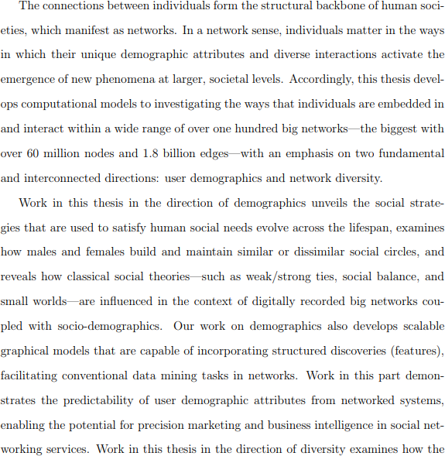

Word Embedding in NLP
Input: a text corpus
Output:
W ×d
, ‐dim vector _{w} for each word
Computational lens on big social and information networks.
The connections between individuals form the structural …
In a network sense,
individuals matters in the ways in which ...
Accordingly, this thesis develops computational models to investigating the ways that ...
o ... ...
^{𝑤}i–2
i–1
𝑤
𝑤_{i}
𝑤_{i}
^{𝑤}i+1
i+2
𝑤
Sentences
Skip‐gram Model
Latent Feature Matrix
… …
𝑤_{i}
^{𝑤}i–2 ^{𝑤}i–1 ^{𝑤}i+1 ^{𝑤}i+2
Words in similar contexts have similar meanings
Key idea: try to predict the words that surrounding each one

Slide 10
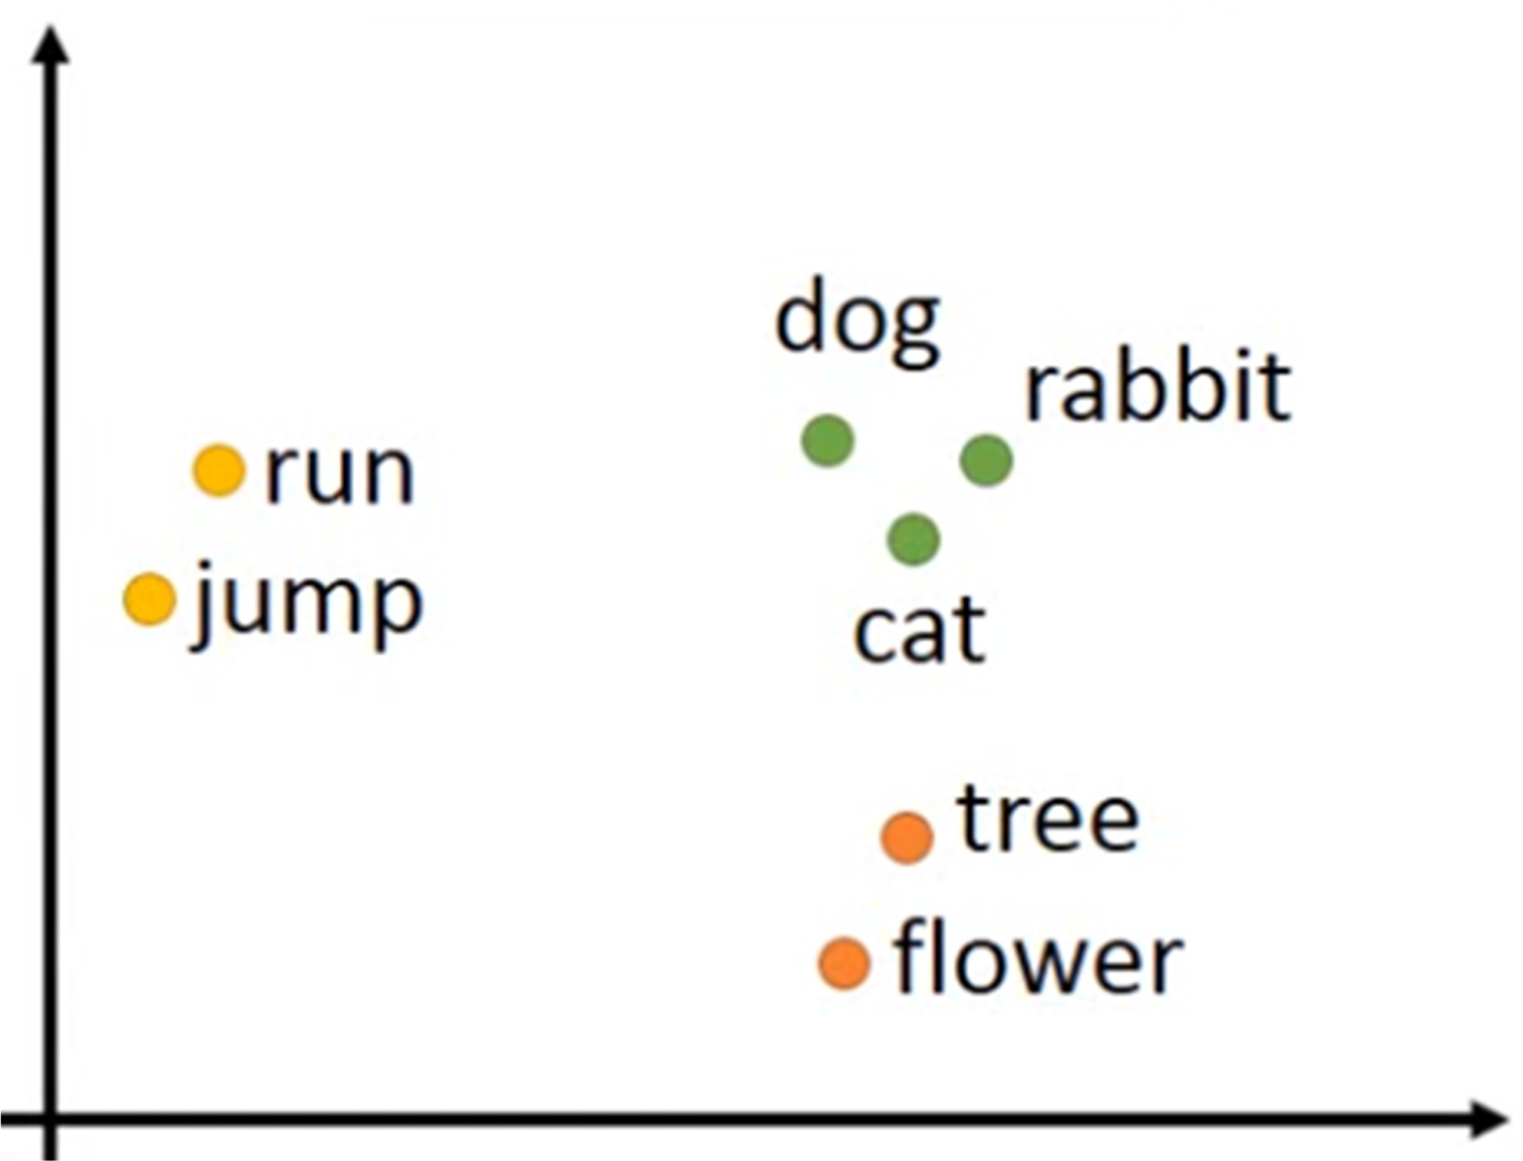
Illustration of Word Embedding
Word Embedding

Slide 11




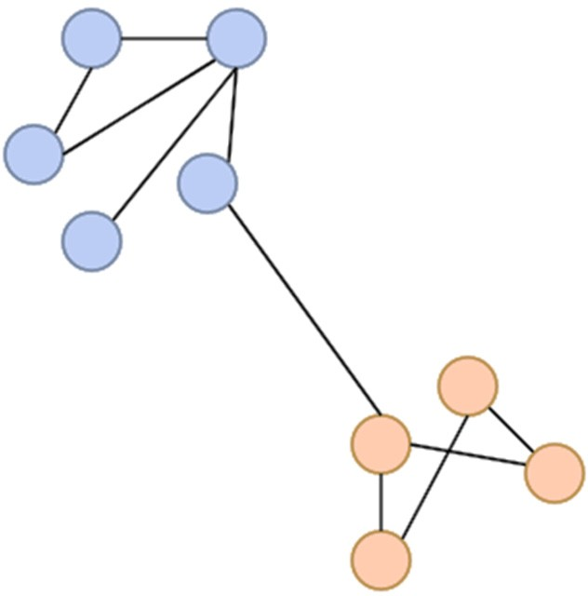

















Network Embedding
Input: a text corpus
Output:
V ×d
, ‐dim vector _{v} for each node
Computational lens on big social and information networks.
The connections between individuals form the structural …
In a network sense,
individuals matters in the ways in which ...
Accordingly, this thesis develops computational models to investigating the ways that ...
o ... ...
^{𝑣}i–2
i–1
𝑣
𝑣_{i}
𝑣_{i}
^{𝑣}i+1
i+2
𝑣
Node Sequence
Skip‐gram Model
Latent Feature Matrix
… …
𝑣_{i}
^{𝑣}i–2 ^{𝑣}i–1 ^{𝑣}i+1 ^{𝑣}i+2
Nodes in similar contexts have close to each other
Key idea: try to predict the nodes that surrounding each one

Slide 12
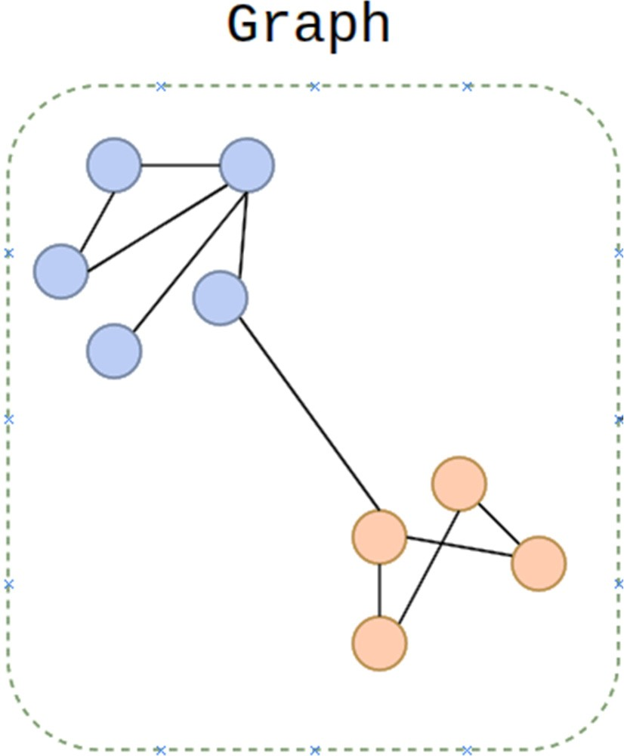
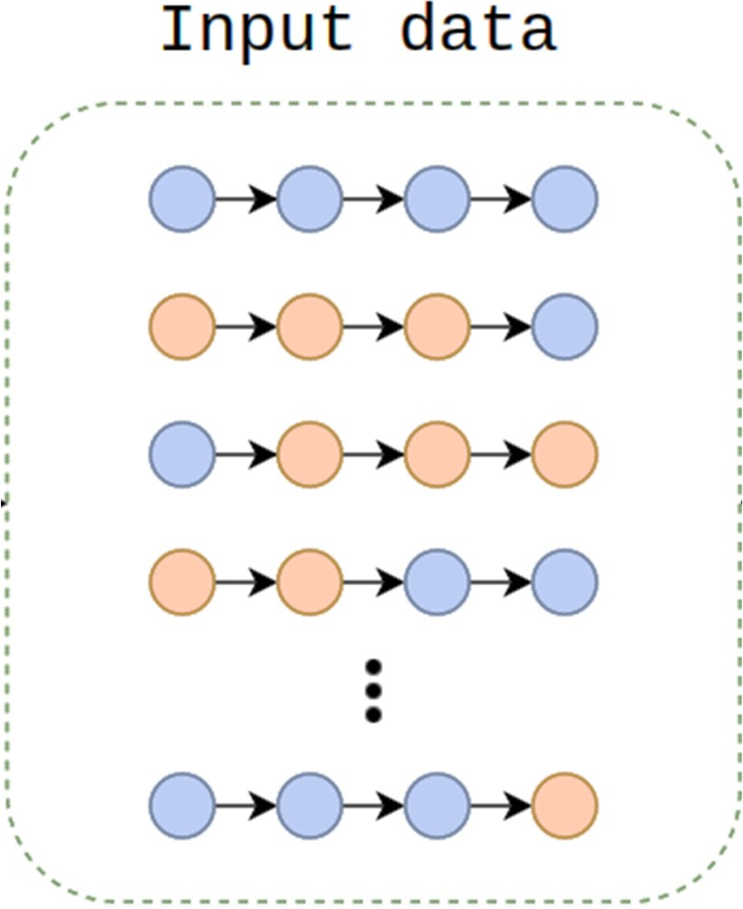
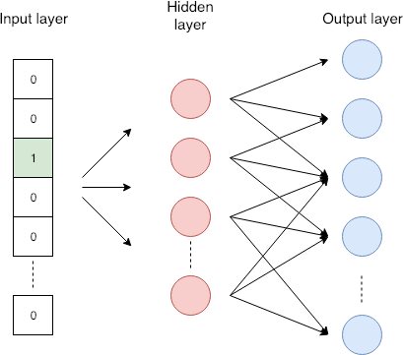
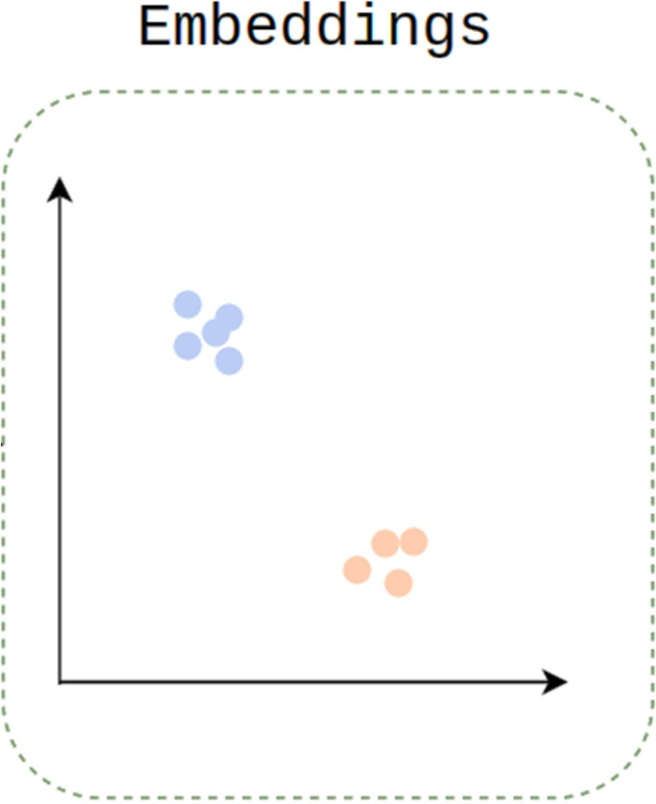
Network Embedding: Basic Idea
Random Walk Sampling
[Mikolov et al. 2013]
Skip‐Gram Model
Learning Embeddings

Slide 13
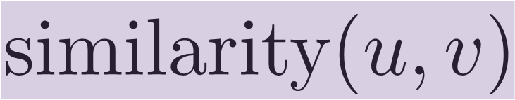

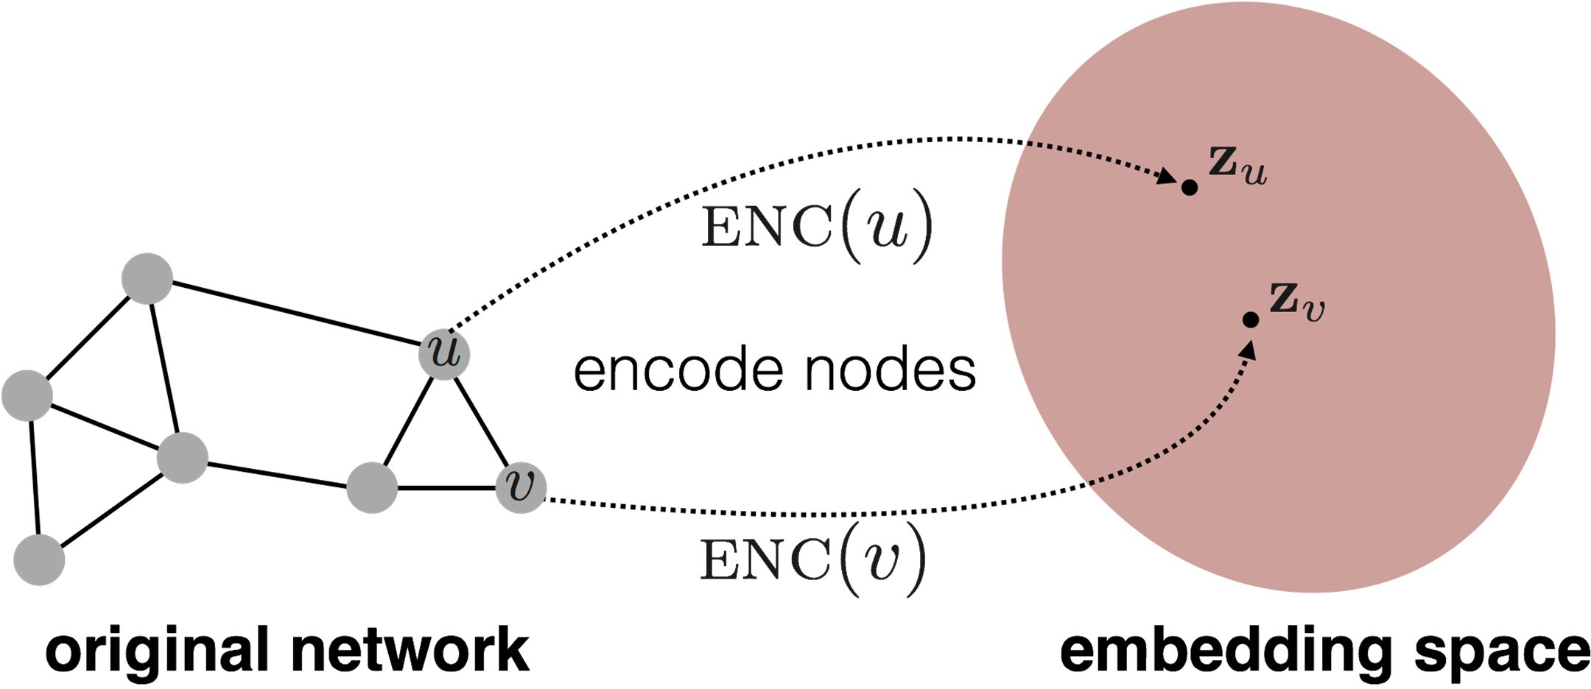
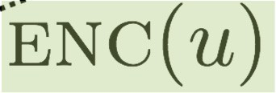
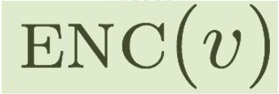
Embedding Nodes
Goal is to encode nodes so that similarity in the embedding space (e.g., dot product) approximates similarity in the original network
Goal:
Need to define!

Slide 14

Learning Node Embeddings
1. Define an encoder
i.e., a mapping from nodes to embeddings
2. Define a node similarity function
i.e., a measure of similarity in original network
3. Optimize the parameters of the encoder so that:

Slide 15





“Shallow” Encoding
Simplest encoding approach:
E.g., node2vec, DeepWalk, LINE
encoder is just an embedding‐lookup
matrix, each column is node embedding [what we learn!]
indicator vector, all zeroes except a one in column indicating 𝑣
embedding vector for a specific node
^{𝑣}i–2
^{𝑣}i–1
Dimension/size of embeddings
𝑣_{i}
Embedding matrix
𝑣
i+1
one column per node
^{𝑣}i+2

Slide 16












Graph Factorization
[Ahmed et al., 2013]
Similarity function
Adjacency‐based similarity
Or the edge weight between and in the network
Intuition: dot products between node embeddings approximate edge existence
loss (what we want to minimize)
embedding similarity
(weighted) adjacency matrix for the graph
sum over all node pairs
Ahmed et al. Distributed Natural Large Scale Graph Factorization. WWW 2013

Slide 17







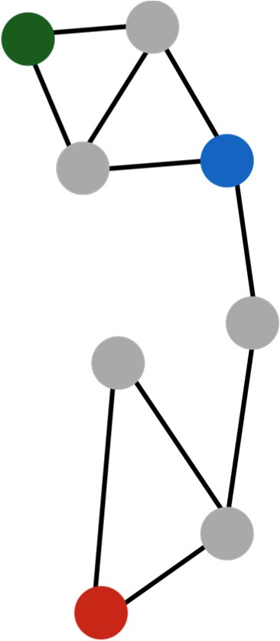

Graph Factorization
[Ahmed et al., 2013]
Goal: find embedding matrix that minimizes the loss
d ×|V|
Option 1: Use stochastic gradient descent (SGD) for optimization
Highly scalable, general approach
Option 2: Solve matrix decomposition solvers (e.g., SVD or QR)
Only works in limited cases
Drawbacks
2
runtime (must consider all node pairs)
■
Only consider direct local connections
e.g., the blue node is obviously more similar to green compared to red node, despite none having direct connections

Slide 18






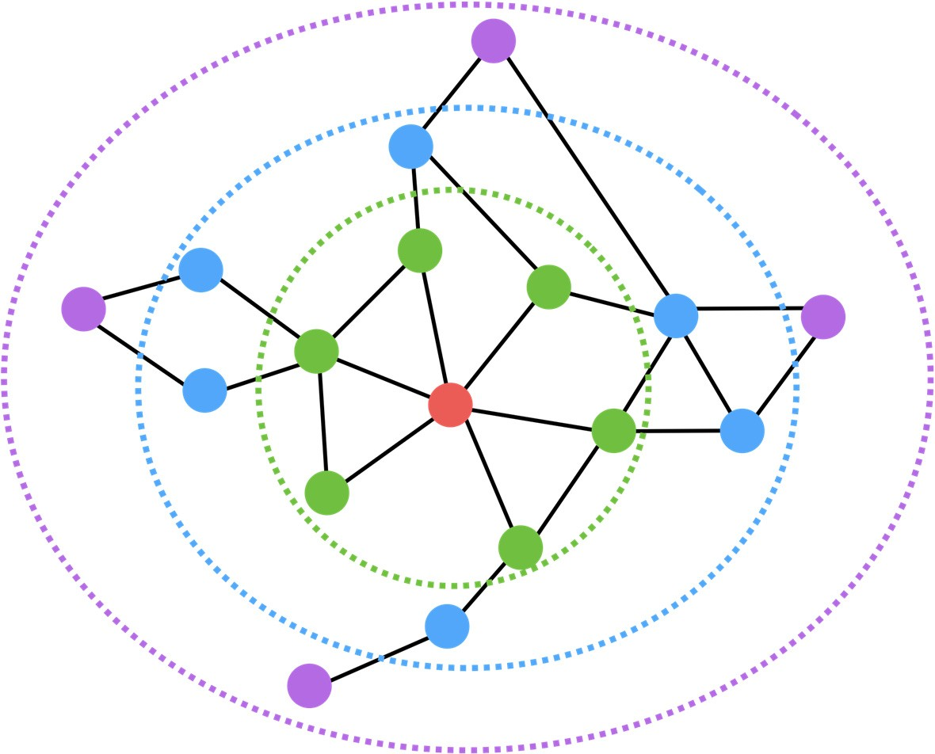


Multi‐hop Similarity: GraRep
Idea: Consider k‐hop node neighbors
E.g., two or three‐hop neighbors
[Cao et al., 2015]
Train embeddings to predict k‐hop neighbors
Red: Target node
Green: 1‐hop neighbors
(i.e., adjacency matrix)
Blue: 2‐hop neighbors
•
𝟐
Purple: 3‐hop neighbors
•
𝟑
Cao et al. 2015. GraRep: Learning Graph Representations with Global Structural Information. CIKM.

Slide 19


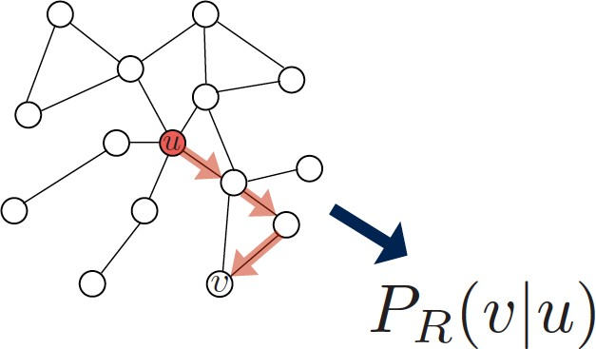
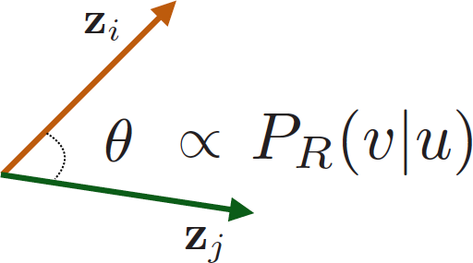
Random‐Walk Embeddings
probability that and co‐occur on a random walk over the network
Estimate probability of visiting node on a random walk starting from node using some random walk strategy
Optimize embeddings to encode these random walk statistics

Slide 20
Why Random Walks?
Expressivity
Flexible stochastic definition of node similarity that incorporates both local and higher‐order neighborhood information
Efficiency
Do NOT need to consider all node pairs when training
Only need to consider pairs that co‐occur on random walks

Slide 21













Random Walk‐based Optimization
1) Run short random walks starting from each node on the graph using some RW strategy
2) For each node , collect
, the multiset* of
𝑅
nodes visited on random walks starting from
3) Optimize embeddings to according to:
* can have repeat elements since nodes
𝑅
can be visited multiple times on random walks

Slide 22
























Random Walk‐based Optimization
Intuition: Optimize embeddings to maximize likelihood of random walk co‐occurrences
Parameterize via softmax:
Putting things together:
𝑢
Optimize random walk embeddings = Find embeddings _{𝑢} minimizing
sum over all nodes 𝑢
sum over nodes 𝑣 seen on random walks starting from 𝑢
predicted probability of
𝑢 and 𝑣 co‐occuring on random walk

Slide 23





























Negative Sampling
Nested sum over nodes gives 𝑂(|𝑉|²) complexity!!
The normalization term from the softmax is the culprit! Can we approximate it?
sigmoid function
random distribution over all nodes
i.e., instead of normalizing w.r.t. all nodes,
just normalize against random “negative samples”
Note 1: Sample negative nodes proportional to degree Note 2: Higher 𝑘 gives more robust estimates

Slide 24
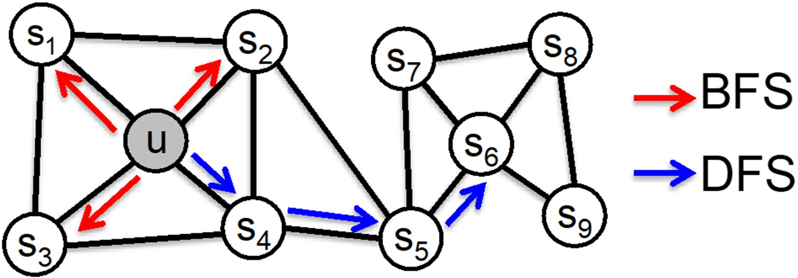


_{node2vec: Biased RW} [Grover et al., 2016]
Idea: use flexible, biased random walks that can trade off between local and global views of the network
Two classic strategies to define a neighborhood of a given node :
R
BFS DFS
1 2 3
4 5 6
Local microscopic view Global macroscopic view
Grover et al. node2vec: Scalable Feature Learning for Networks. KDD 2016

Slide 25


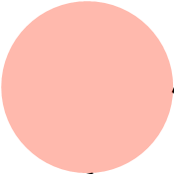


node2vec: Biased RW
Biased random walk
that given a node generates with two parameters
neighborhood
R
Return parameter 𝑝: Return back to the previous node
In‐out parameter 𝑞: Moving outwards (DFS) vs. inwards (BFS)
Idea: Remember where that walk came from
RW started at and is now at
Insight: neighbors of can only be
1/𝑝, 1/𝑞, 1 are unnormalized transition probabilities
Same distance to 𝑢
1
2
Farther from 𝑢
3
BFS‐like walk: Low value of
DFS‐like walk: Low value of
1/𝑞
1/𝑝
Closer to 𝑢
1
are the nodes visited by the walker
S

Slide 26
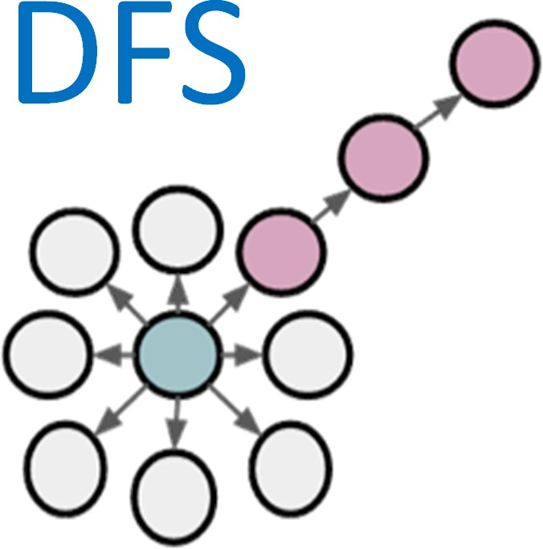
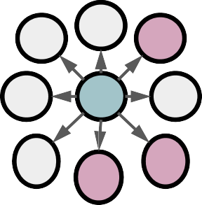
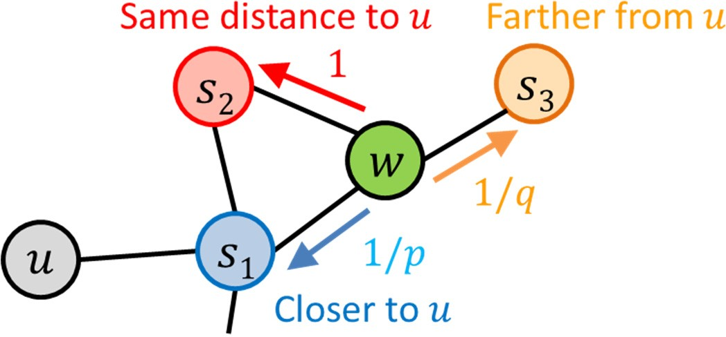
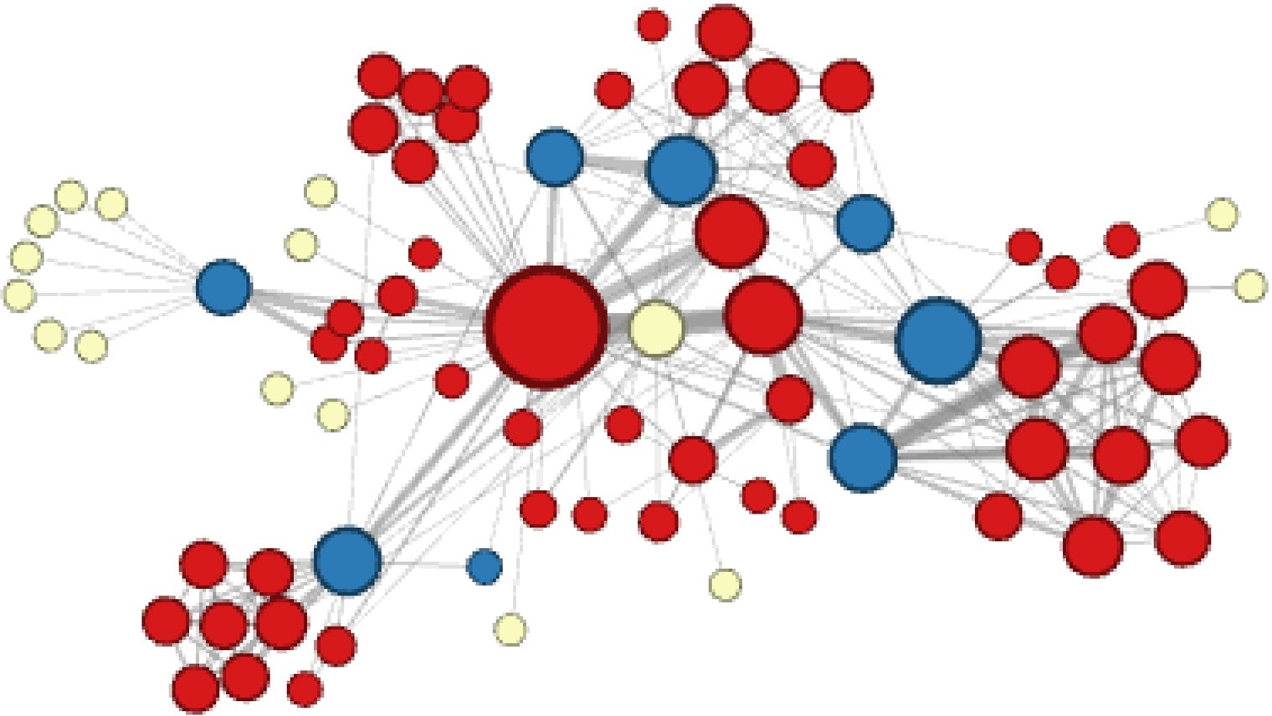
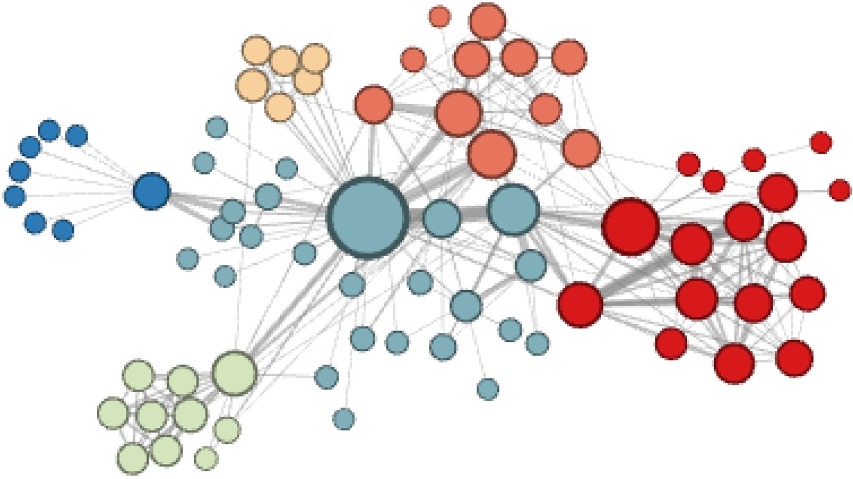

node2vec: BFS vs.
DFS
𝑢
Breadth‐First Search: Micro‐view of neighborhood
Depth‐First Search: Macro‐view of neighborhood
Structural Equivalence
Homophily (Community)

Slide 27
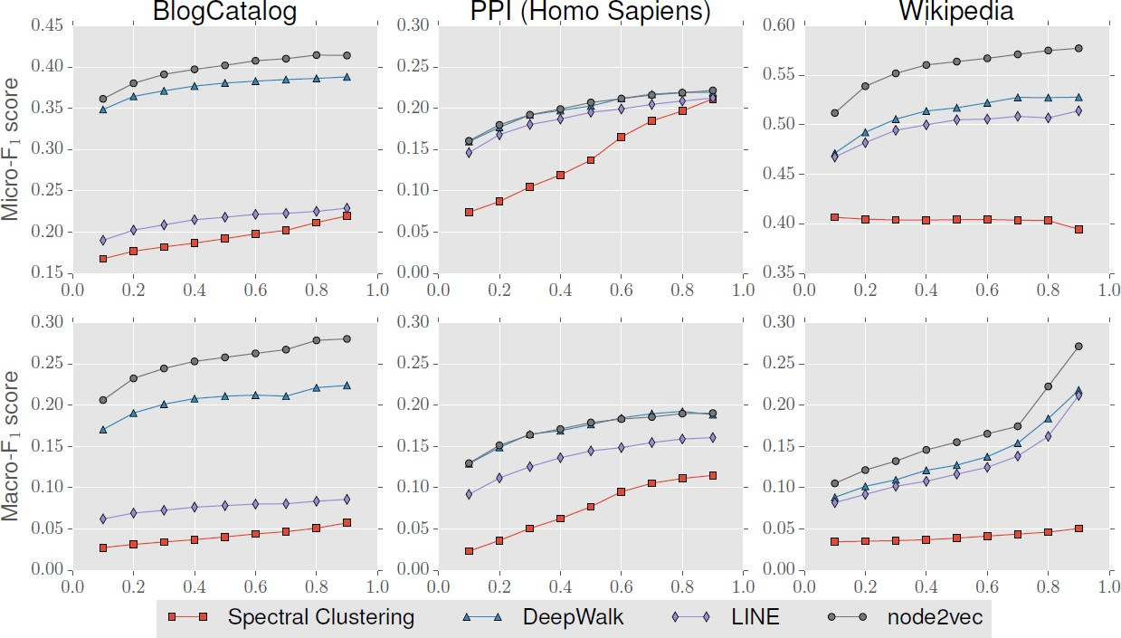
Performance on Node Classification

Slide 28
References
A. Ahmed et al. “Distributed Large‐scale Natural Graph Factorization” WWW 2013 444 cites
S. Cao et al. “GraRep: Learning Graph Representations with Global Structural Information”
ACM CIKM 2015 1033 cites
M. Ou et al. “Asymmetric Transitivity Preserving Graph Embedding” ACM KDD 2016 731 cites
B. Perozzi et al. “DeepWalk: Online Learning of Social Representations” ACM KDD 2014 4964 cites
A. Grover and J. Leskovec. “node2vec: Scalable Feature Learning for Networks” ACM KDD 2016 4914 cites
J. Tang et al. “LINE: Large‐scale Information Network Embedding” WWW 2015 3234 cites
H.‐Y. Lin and C.‐T. Li. “Structural Hierarchy‐Enhanced Network Representation Learning” Applied Sciences 2020

