Slide 1
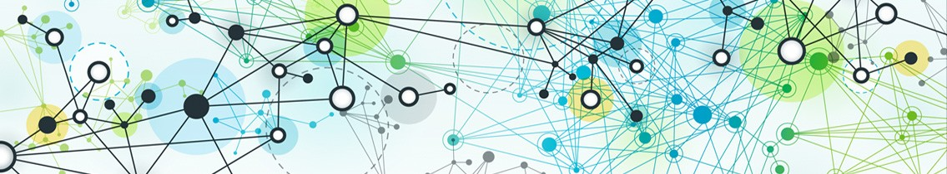

Graph Neural Networks (GNN)
The basic form of neighborhood aggregation
Machine Learning with Graphs (MLG)
Cheng‐Te Li (李政德)
Institute of Data Science
National Cheng Kung University
chengte@mail.ncku.edu.tw

Slide 2
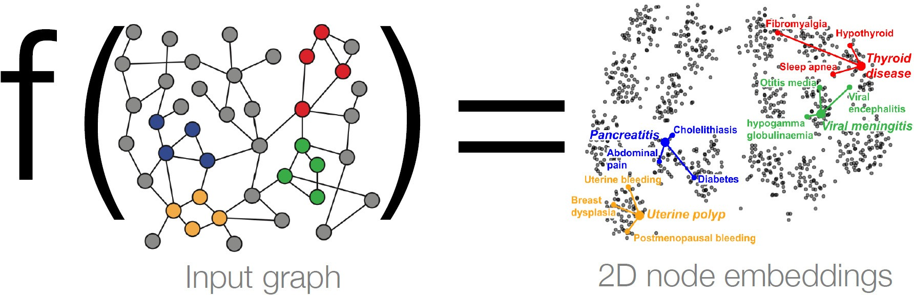
Node Embeddings
Intuition: Map nodes to ‐dimensional embeddings such that similar nodes in the graph are embedded close together
How to learn mapping function ?

Slide 3
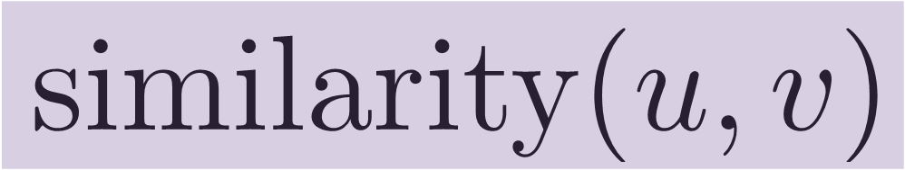





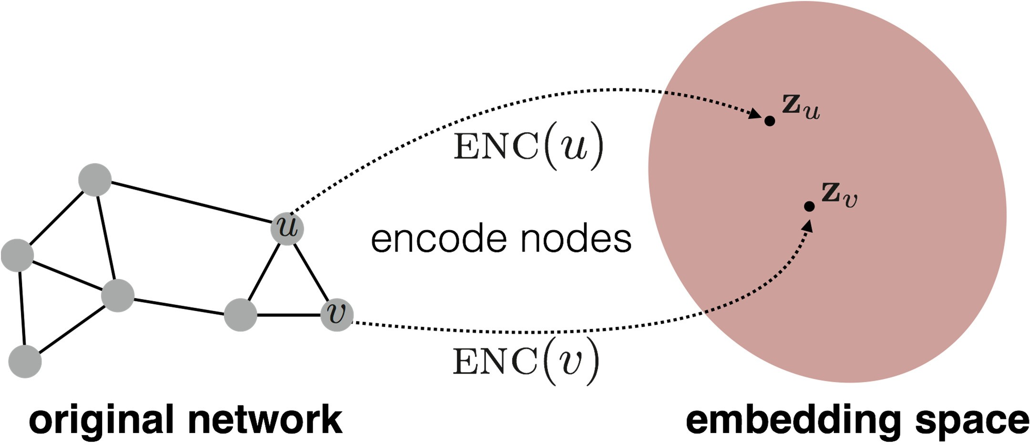





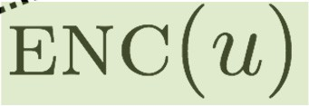
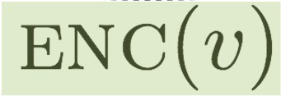
Embedding Nodes
Goal is to encode nodes so that similarity in the embedding space (e.g., dot product) approximates
node similarity in the original network
Shallow ENCoding
^{𝑣}i–2
^{𝑣}i–1
Goal:
𝑣_{i}
Need to define: (1) Similarity (2) Encoder
^{𝑣}i+1
^{𝑣}i+2

Slide 4
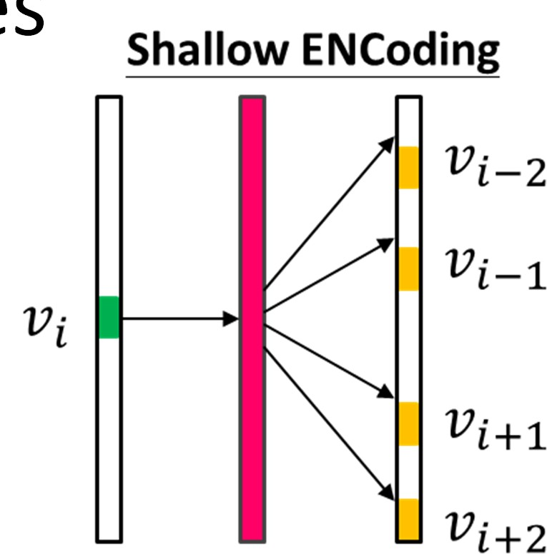
Limitations of Shallow Encoding
Require learnable parameters
No sharing of parameters between nod
Inherently “transductive”
Cannot generate embeddings for nodes that are not seen during training
Unable to incorporate node features
Many graphs have node attributes that we can and should leverage
es

Slide 5
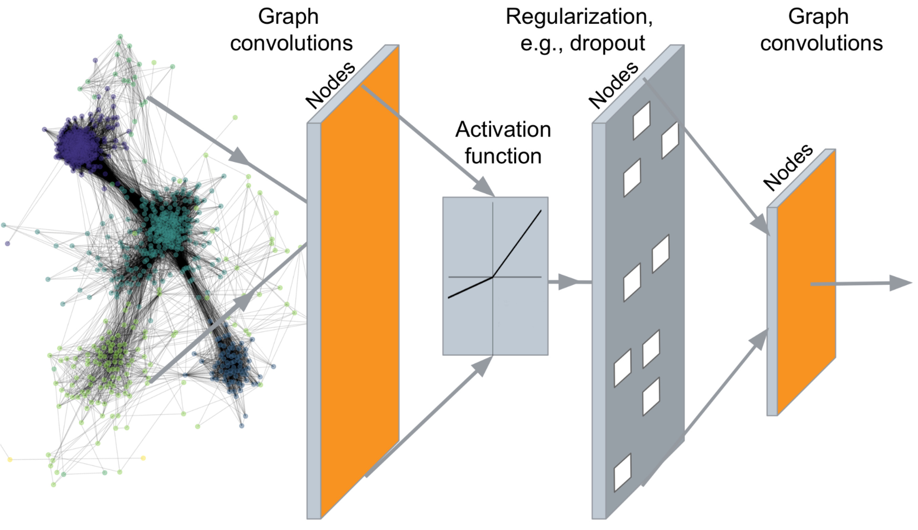
Graph Neural Networks (GNN)
Encoding every node in a graph through multiple layers of non‐linear transformations of graph structure
Node Classification Link Prediction Community Detection Centrality Prediction Cascade Prediction Popularity Prediction Recommendation NLP tasks
(e.g., text classification)

Slide 6




Notations
Assume we have a graph
is the node set
is the adjacency matrix (assume binary)
•
•
•
m× V
is a matrix of node features
: a node in
: the set of neighbors of
Node features
Social networks: user profiles, user posts
When there is no node feature in the graph dataset:
Indicator vectors (one‐hot encoding of a node)
Vector of constant 1: [1, 1, …, 1]

Slide 7
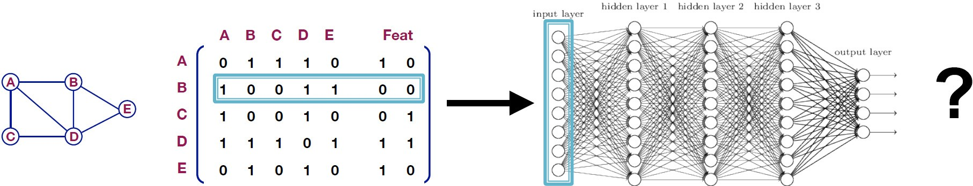
A Naïve Approach
Join adjacency matrix and features
Feed them into deep (fully connected) NN
Issues with this approach
parameters
■
Not applicable to graphs of different sizes
Sensitive to node ordering

Slide 8
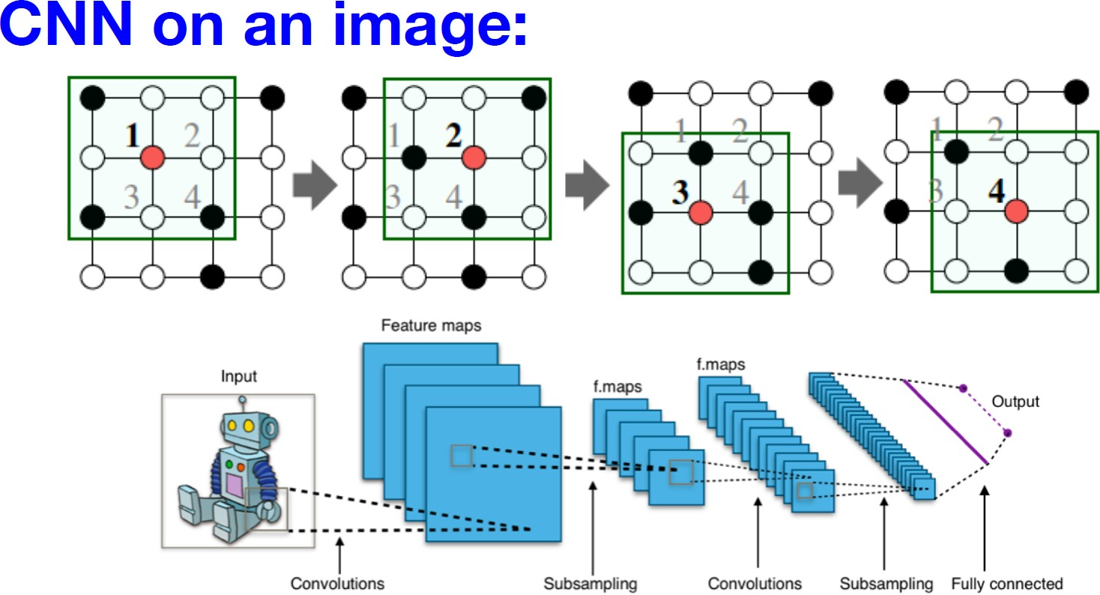
Idea from Convolutional Neural Nets
Goal is to generalize convolutions beyond simple lattices
Leverage node features/attributes (e.g., text, images)

Slide 9
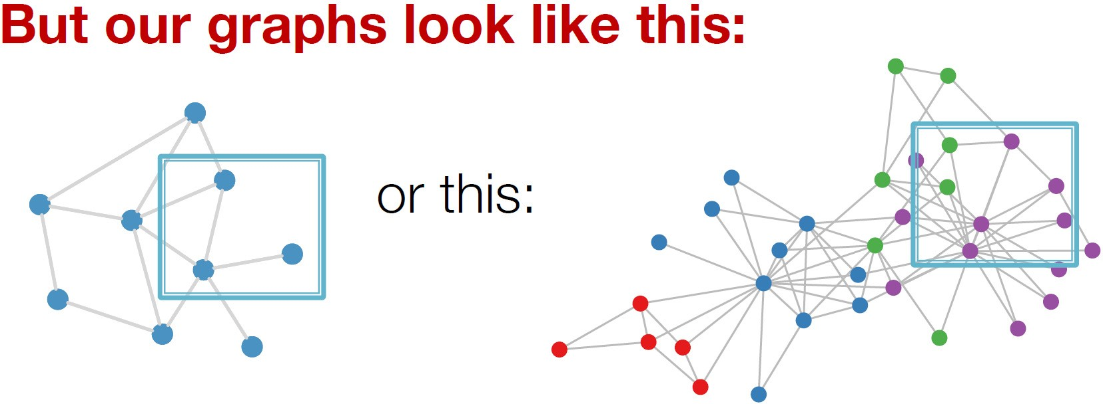
However, Real‐world Graphs
No fixed notion of locality or sliding window on graphs
Graph is permutation invariant

Slide 10
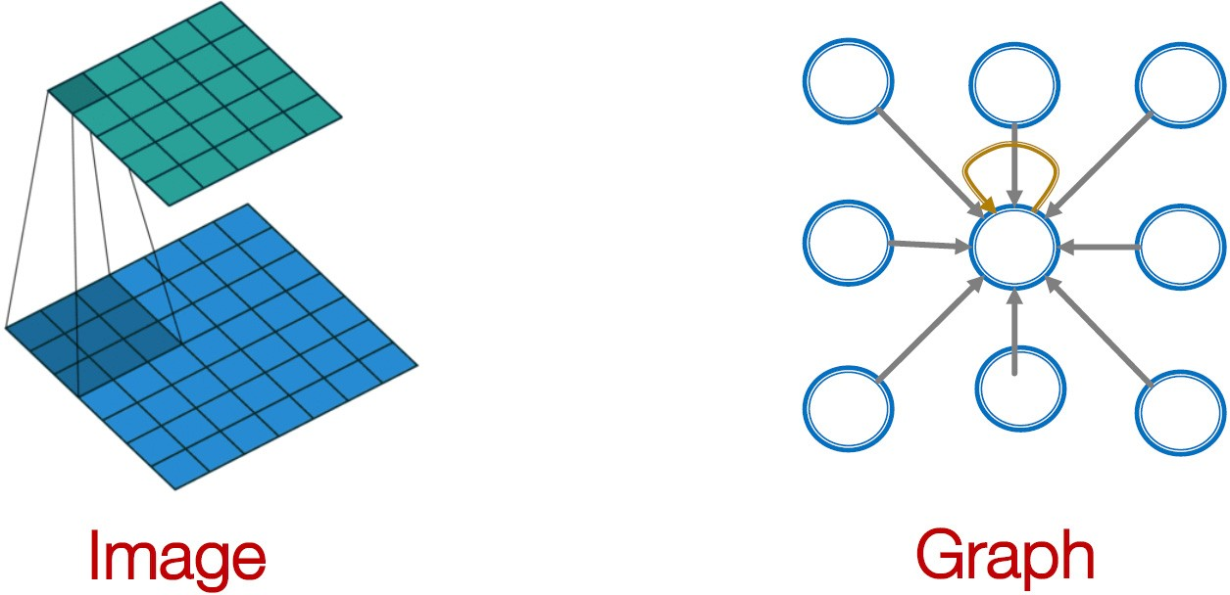
From Images to Graphs
Convolutional neural net (CNN) layer with 3x3 filter
Idea: transform information of neighbors & combine it
Transform “messages” _{i} from neighbors:
i i
Add them up:
i
i i

Slide 11
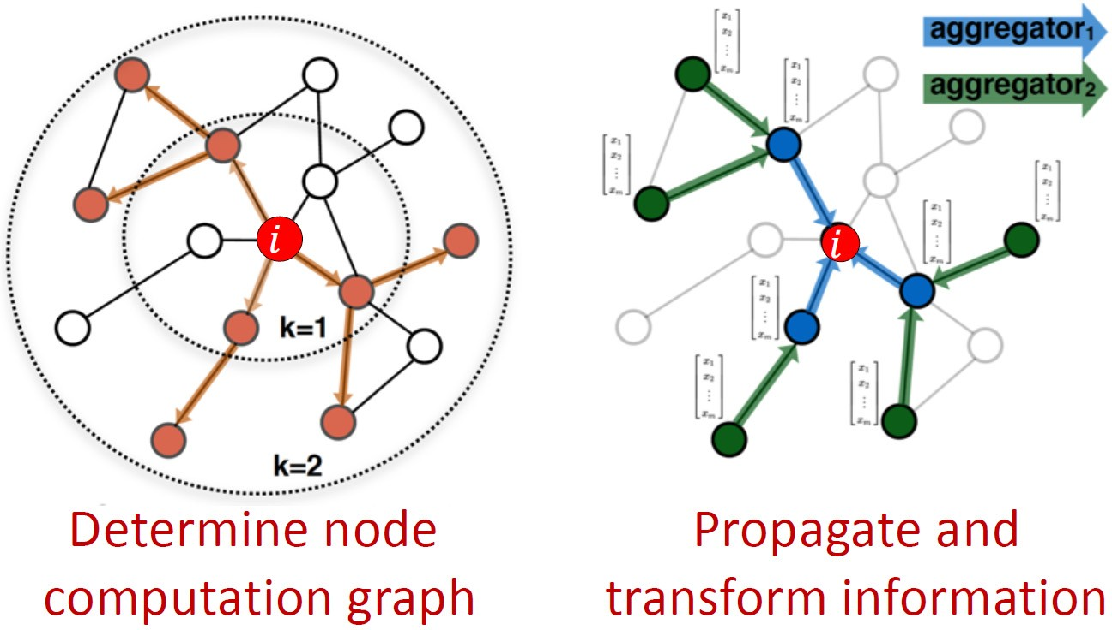
Graph Neural Networks
Idea: Node’s neighborhood defines a computation graph
Learn how to propagate information across the graph to compute node features

Slide 12
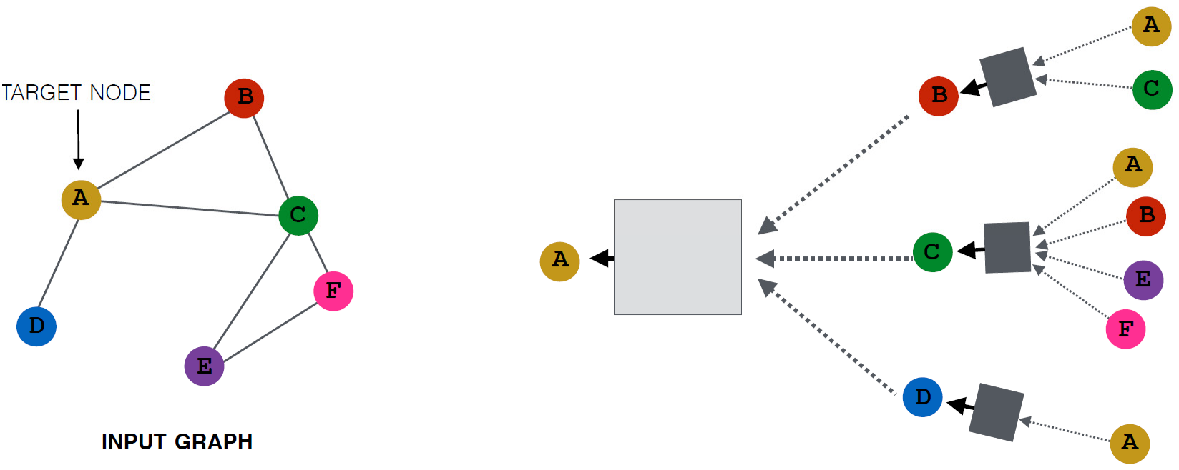
Neighborhood Aggregation
Intuition: Generate node embeddings based on local network neighborhoods
Nodes aggregate info from their neighbors using NN
NN
NN
NN
NN

Slide 13
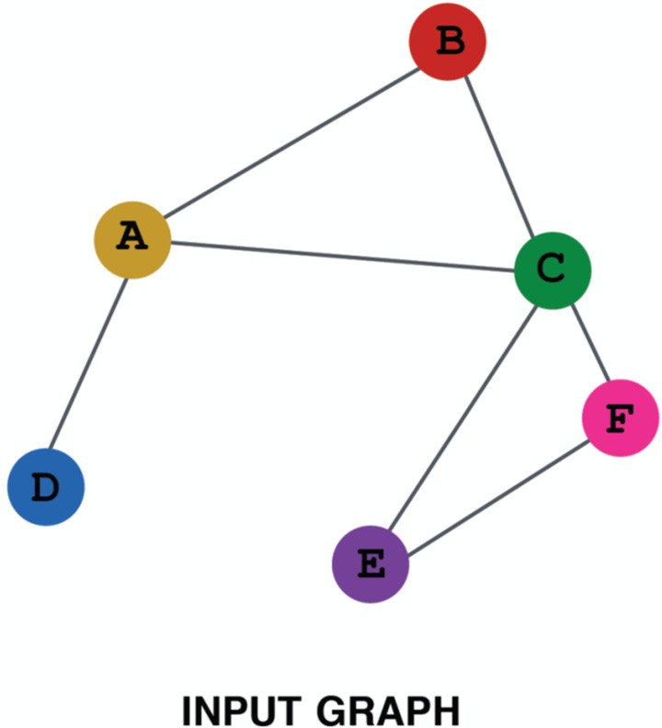
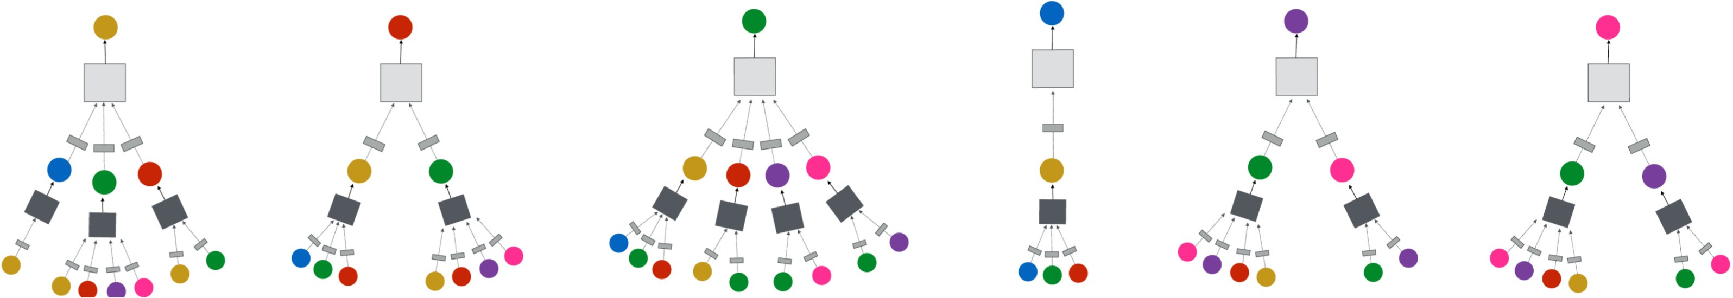
Neighborhood Aggregation
Network neighborhood defines a computation graph
Every node defines a computation graph based on its neighborhood!

Slide 14


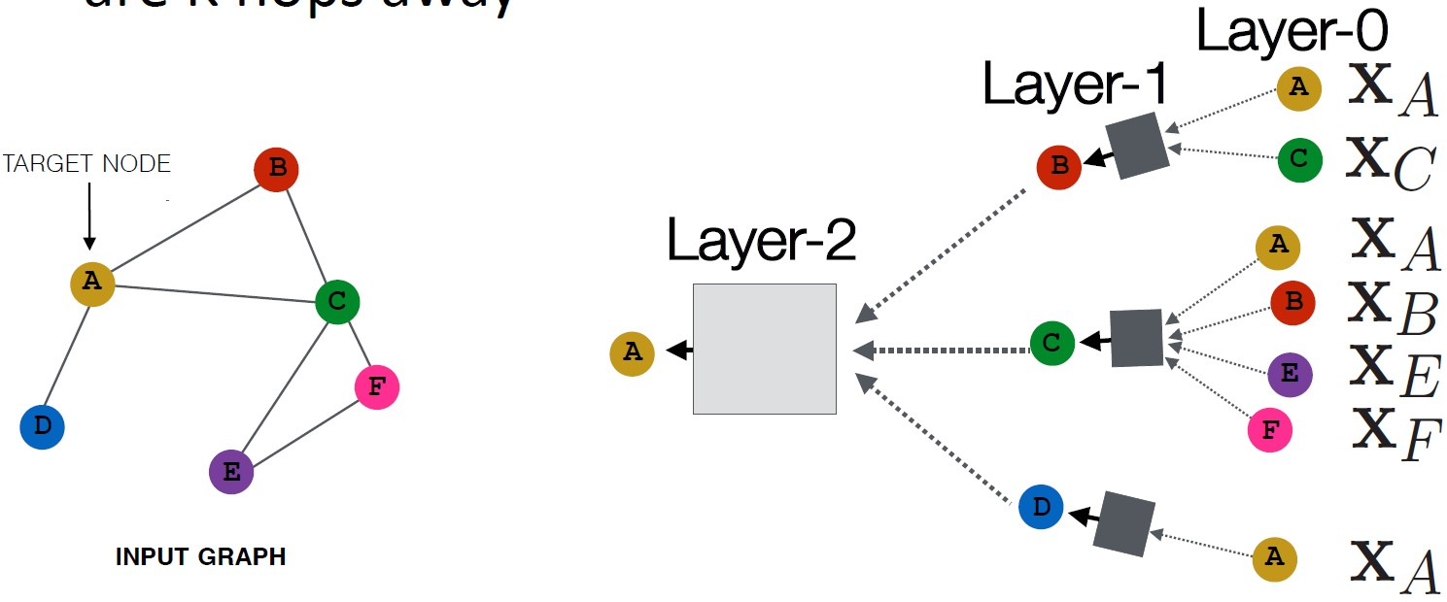
Deep Model: Multiple Layers
Model can be of arbitrary depth
Nodes have embeddings at each layer
Layer‐0 embedding of node is its input feature,
u
Layer‐ embedding gets information from nodes that are hops away
2
1
0

Slide 15
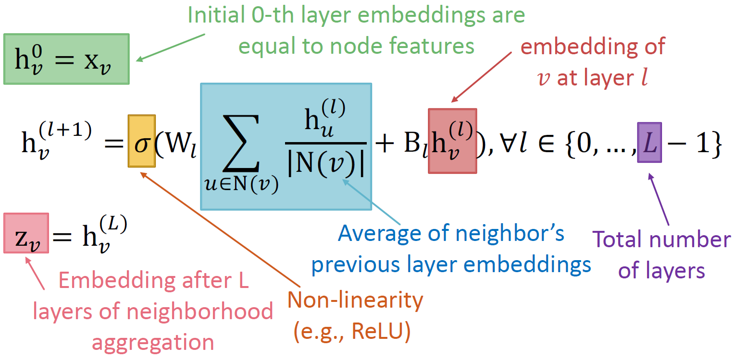

Neighborhood Aggregation
Average neighbor messages and apply a NN

