Slide 1

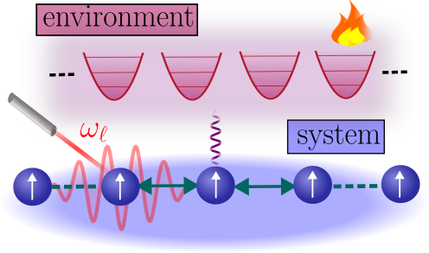
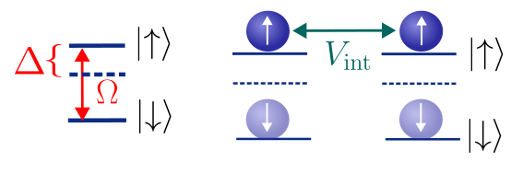
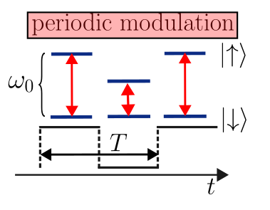
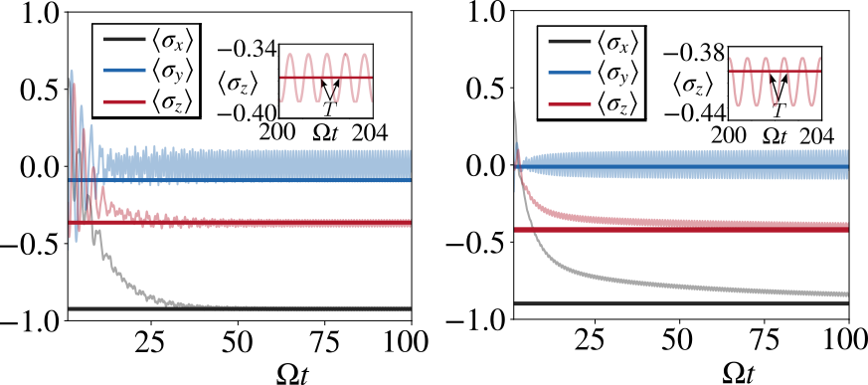
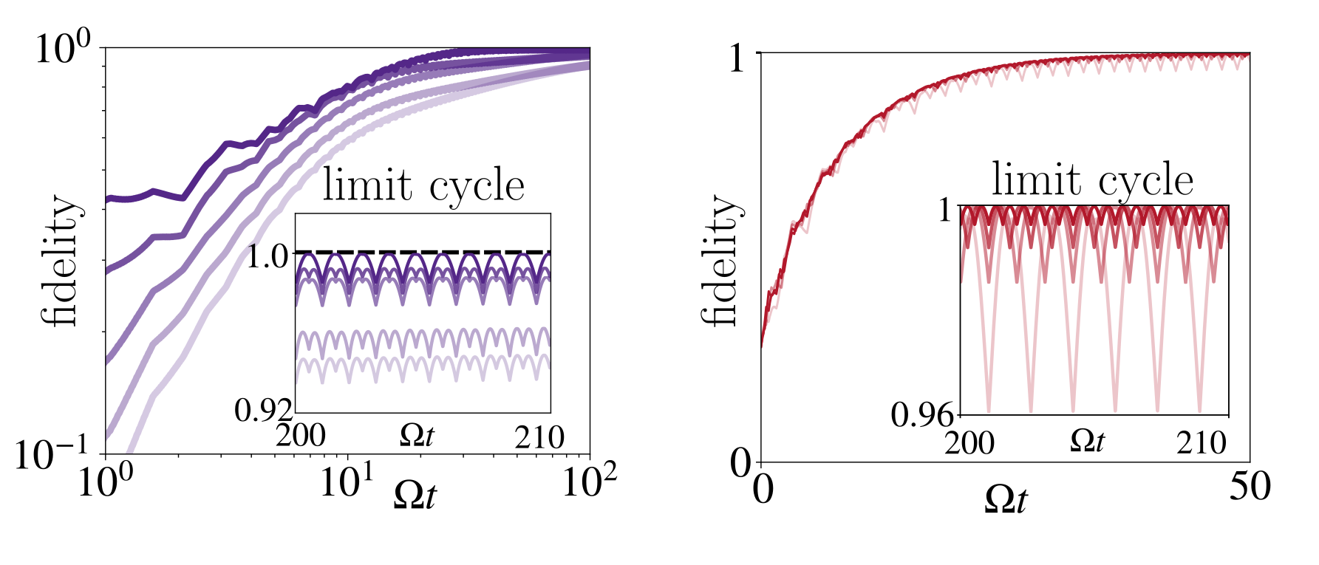

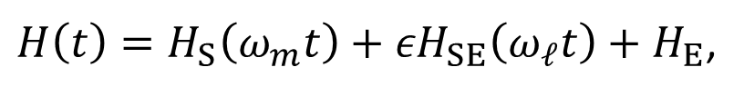

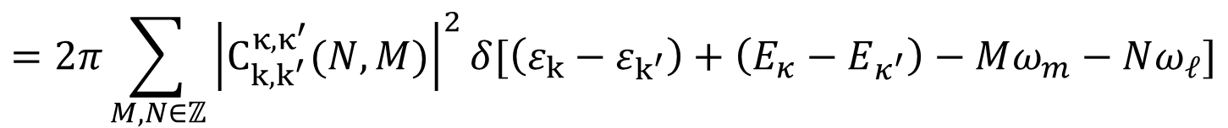
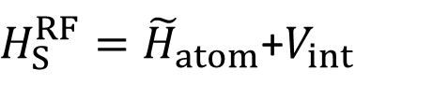
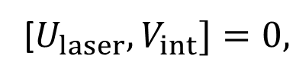
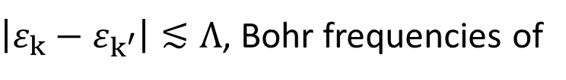
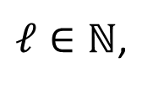
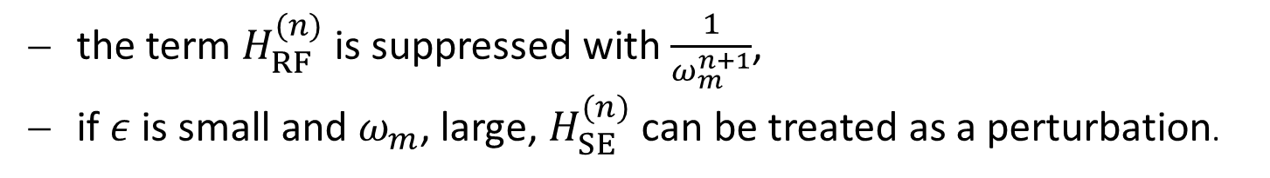
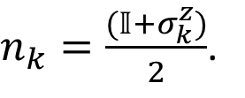

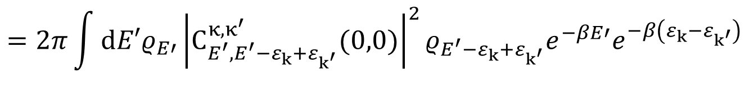
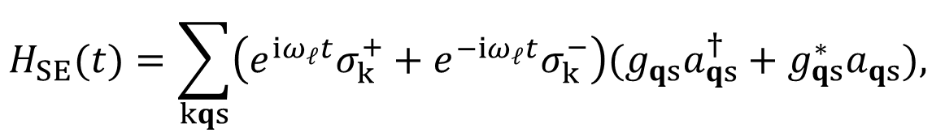

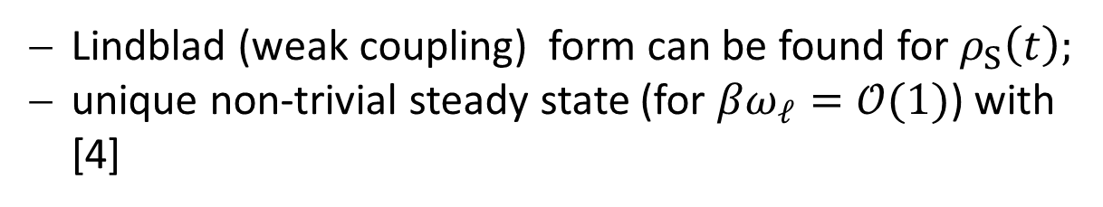

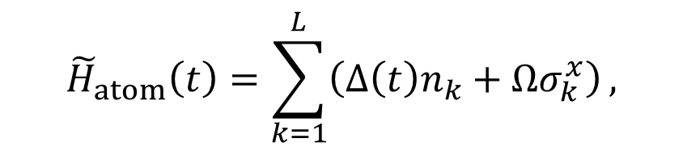
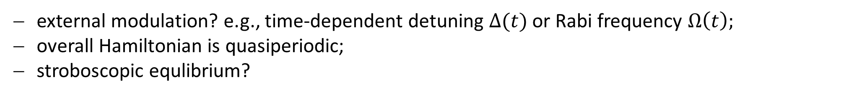
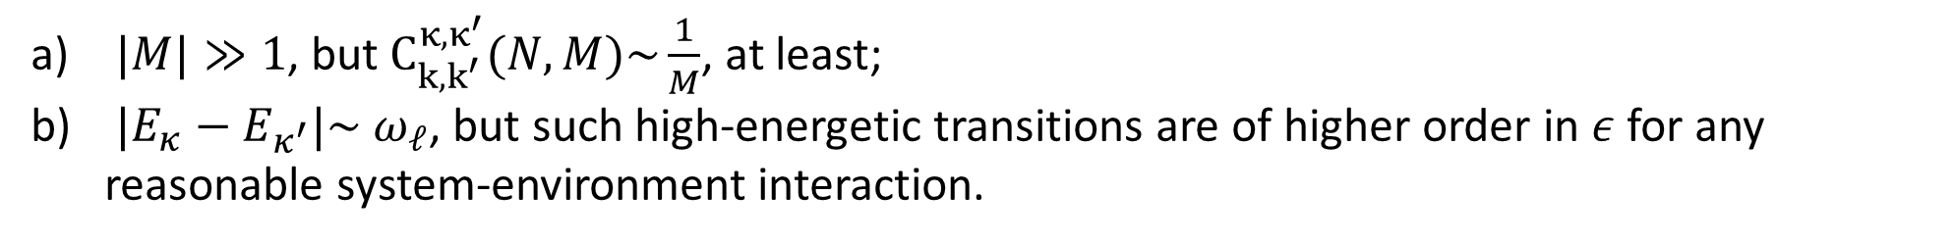


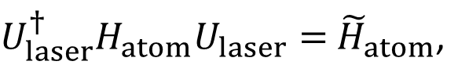

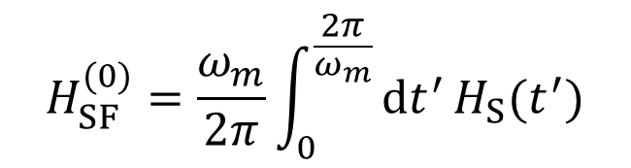

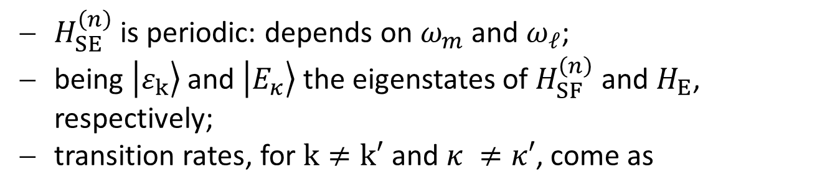
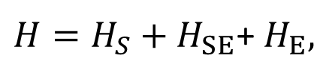

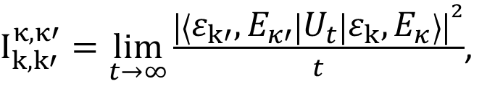
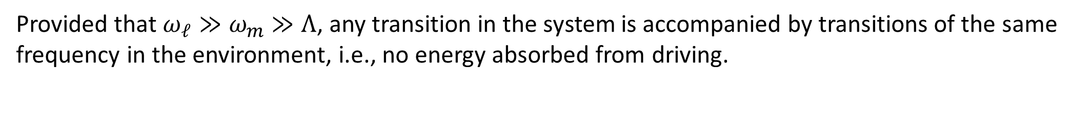

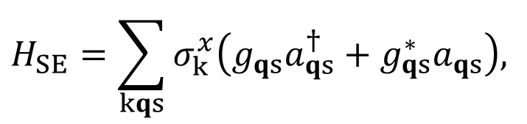


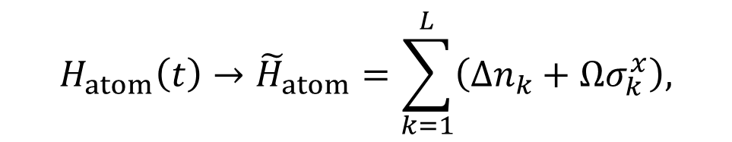
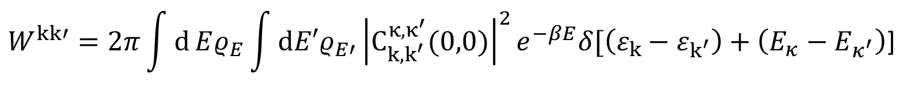
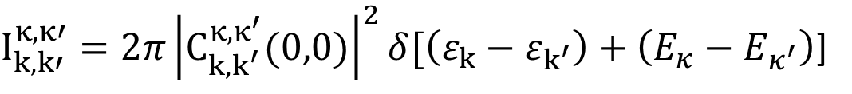

Faculty of Science
Institute for Theoretical Physics
Theoretical Atomic Physics and Synthetic Quantum Systems
Floquet-Gibbs states in laser driven atomic systems
Wilson S. Martins [Tübingen], Kay Brandner [Nottingham], Federico Carollo [Tübingen], and Igor Lesanovsky [Nottingham, Tübingen]
Institut für Theoretische Physik, Universität Tübingen, Auf der Morgenstelle 14, 72076 Tübingen, Germany
1 Introduction
Periodically driven quantum systems in a thermal environment generically settle to a Floquet-Gibbs state in a rotating frame (high driven frequency).
In laser-driven atomic systems the situation is typically more complicated, since the corresponding Hamiltonian is time-independent only in the rotating frame of the laser.
If such systems are exposed to periodic variations of external parameters, their actual Hamiltonian usually becomes a quasi-periodic function of time.
We show that systems of this type approach a stable Floquet-Gibbs state in an interaction picture that is connected to the Schrödinger picture by a quasi-periodic unitary transformation.
2 Model Hamiltonian
3 Rotating frame of the laser
4 External modulation of parameters: Redfield equation vs. Effective Floquet-Gibbs ensemble
5 Weak coupling and Magnus expansion
6 Perturbation theory
Considering the overall quasiperiodic Hamiltonian with $ε$ setting the interaction strength
$H\left(t\right)=H_{S}\left(ω_{m}t\right)+{εH}_{SE}\left(ω_{ℓ}t\right)+H_{E}$,
Floquet theorem gives a way to decompose the system dynamics in terms of periodic and time-independent part
$${𝒯e}^{−i\int_{t_{0}}^{t}{dt^{′}}H_{S}\left(ω_{m}t^{′}\right)}={V_{ω_{m}t}e}^{−itH_{SF}/ℏ},$$
$H_{SF}={−iV}_{ω_{m}t}^{†}{\dot{V}}_{ω_{m}t}{+V}_{ω_{m}t}^{†}H_{S}$ $V_{ω_{m}t}.$
Operator can be expanded in terms of asymptotic Magnus series [6]:
$$H_{SF}^{(n)}=\sum_{k=0}^{n}{\frac{1}{ω_{m}^{k}}h_{k},}$$
$H_{S}→$ $H_{SF}^{(n)}.$
Applying to the overall Hamiltonian we obtain:
the term $H_{RF}^{(n)}$ is suppressed with $\frac{1}{ω_{m}^{n+1}}$,
if $ε$ is small and $ω_{m}$, large, $H_{SE}^{(n)}$ can be treated as a perturbation.
${−iV}_{ω_{m}t}^{\left(n\right)†}{\dot{V}}_{ω_{m}t}^{\left(n\right)}{+V}_{ω_{m}t}^{\left(n\right)†}H\left(t\right)V_{ω_{m}t}^{\left(n\right)}=H_{SF}^{(n)}+$ ${εV_{ω_{m}t}^{\left(n\right)†}H}_{SE}V_{ω_{m}t}^{\left(n\right)}$+ $H_{RF}^{(n)}+H_{E}$
System and environment are described by the Hamiltonian
$$H_{SE}^{\left(n\right)}(ω_{m}t,ω_{ℓ}t)$$
$H=H_{S}+H_{SE}$+ $H_{E},$
in which the system Hamiltonian can be re-written in terms of a time-independent and time-dependent contribution
3.1 Fermi Golden Rule
$$H_{S}=H_{atom}+V_{int},$$
$H_{SE}^{\left(n\right)}$ is periodic: depends on $ω_{m}$ and $ω_{ℓ}$;
being $\left.\left|ε_{k}\right.\right\rangle$ and $\left.\left|E_{κ}\right.\right\rangle$ the eigenstates of $H_{SF}^{\left(n\right)}$ and $H_{E}$, respectively;
transition rates, for $k≠k′$ and $κ ≠κ′$, come as
being
$H_{atom}\left(t\right)=\sum_{k=1}^{L}{{ω_{0}σ}_{k}^{z}}+\sum_{k=1}^{L}{Ω{(e^{−iω_{ℓ}t}σ}_{k}^{+}{+σ}_{k}^{−}e^{iω_{ℓ}t})}$,
Fig. 1. Sketch of the system and environment. The system consists in a chain of atoms embedded in a thermal environment of harmonic oscillators. The atomic states are driven by a laser field and the atoms interact locally.
the interaction laser-atomic dipole. Coupling and environment Hamiltonian are defined as [1,2]
$I_{k,k′}^{κ,κ′}=\lim_{t→∞}{\frac{{\left|\left\langle ε_{k′},E_{κ′} | U_{t} | ε_{k},E_{κ}\right\rangle \right|}^{2}}{t}}$,
$\left\langle ε_{k′},E_{κ′} | H_{SE}^{\left(n\right)} | ε_{k},E_{κ}\right\rangle$= $\sum_{M,N∈ℤ}{C_{k,k^{′}}^{κ,κ^{′}}(N,M)e^{i\left(Mω_{m}+Nω_{ℓ}\right)t}},$
$$H_{SE}=\sum_{kqs}{σ_{k}^{x}\left(g_{qs}a_{qs}^{†}+g_{qs}^{∗}a_{qs}\right),}$$
$$H_{E}=\sum_{qs}{ω_{q}a_{qs}^{†}a_{qs}.}$$
$$I_{k,k′}^{κ,κ′}=2π\sum_{M,N∈ℤ}{{\left|C_{k,k^{′}}^{κ,κ^{′}}(N,M)\right|}^{2}δ[\left(ε_{k}−ε_{k^{′}}\right)+\left(E_{κ}−E_{κ^{′}}\right)−Mω_{m}−Nω_{ℓ}]}$$
$$=2π\sum_{M,N∈ℤ}{{\left|C_{k,k^{′}}^{κ,κ^{′}}(N,M)\right|}^{2}δ[\left(ε_{k}−ε_{k^{′}}\right)+\left(E_{κ}−E_{κ^{′}}\right)−Mω_{m}−Nω_{ℓ}]}$$
There is a transformation to the rotating frame of the laser that makes the atomic Hamiltonian time-independent [3]
3.2 Important perturbative scales
$U_{laser}^{†}{H_{atom}U}_{laser}=$ ${\tilde{H}}_{atom}$,
$${H_{atom}\left(t\right)→\tilde{H}}_{atom}=\sum_{k=1}^{L}{\left(Δn_{k}+Ωσ_{k}^{x}\right),}$$
$Δ=$ $ω_{0}$- $ω_{ℓ},$
$\left|ε_{k}−ε_{k^{′}}\right|≲Λ$, Bohr frequencies of
$$H_{SF}^{(0)}=\frac{ω_{m}}{2π}\int_{0}^{\frac{2π}{ω_{m}}}{dt^{′}}H_{S}(t^{′})$$
[$U_{laser},V_{int}]=0,$
$n_{k}=\frac{(𝕀+σ_{k}^{z})}{2}$.
When $\left(ε_{k}−ε_{k^{′}}\right)+\left(E_{κ}−E_{κ^{′}}\right)−Mω_{m}−Nω_{ℓ}=0?$
rotating frame Hamiltonian:
$H_{S}^{RF}={\tilde{H}}_{atom}$+$V_{int}$
Being $N≠0$ this condition can only be satisfied if:
Lindblad (weak coupling) form can be found for $ρ_{S}\left(t\right);$
unique non-trivial steady state (for $βω_{ℓ}=𝒪(1)$) with [4]
$|M|≫1$, but $C_{k,k^{′}}^{κ,κ^{′}}(N,M)\sim \frac{1}{M}$, at least;
$|E_{κ}−E_{κ^{′}}|\sim$ $ω_{ℓ}$, but such high-energetic transitions are of higher order in $ε$ for any reasonable system-environment interaction.
$$ρ_{ss}\left(ℓT\right)∝e^{−βH_{S}^{RF}},$$
$ℓ∈ℕ$,
${T=2π/ω}_{ℓ}$.
Fig. 2. Energy level in the rotating frame and Rydberg interaction. The new frame introduces the detuning, and the interaction is set to be nearest-neighbour.
Repeating the argument for $N=0$ and $M≠0$ we obtain the important contributions coming from $N=M=0:$
external modulation? e.g., time-dependent detuning $Δ(t)$ or Rabi frequency $Ω\left(t\right);$
overall Hamiltonian is quasiperiodic;
stroboscopic equlibrium?
$I_{k,k′}^{κ,κ′}=2π{\left|C_{k,k^{′}}^{κ,κ^{′}}(0,0)\right|}^{2}δ[\left(ε_{k}−ε_{k^{′}}\right)+\left(E_{κ}−E_{κ^{′}}\right)$]
Provided that $ω_{ℓ}≫ω_{m}$ $≫Λ$, any transition in the system is accompanied by transitions of the same frequency in the environment, i.e., no energy absorbed from driving.
$$W^{kk′}=2π\int{d}Eρ_{E}\int{dE′ρ_{E′}}{\left|C_{k,k^{′}}^{κ,κ^{′}}(0,0)\right|}^{2}e^{−βE}δ[\left(ε_{k}−ε_{k^{′}}\right)+\left(E_{κ}−E_{κ^{′}}\right)\text{]}$$
We compare the exact solution of the time-dependent Redfield equation [5] for a generic many-body system composed of Rydberg atoms with the corresponding Floquet-Gibbs state:
$$=2π\int{dE′ρ_{E′}}{\left|C_{E^{′},E^{′}−ε_{k}+ε_{k^{′}}}^{κ,κ^{′}}(0,0)\right|}^{2}ρ_{E^{′}−ε_{k}+ε_{k^{′}}}e^{−βE′}e^{−β\left(ε_{k}−ε_{k^{′}}\right)}$$
$${\tilde{H}}_{atom}\left(t\right)=\sum_{k=1}^{L}{\left(Δ\left(t\right)n_{k}+Ωσ_{k}^{x}\right)},$$
$$V_{int}=\sum_{k=1}^{L}{Vn_{k}}n_{k+1},$$
${=W}^{k′k}$ $e^{−β\left(ε_{k}−ε_{k^{′}}\right)}$
Detailed balance condition
The system relaxes to an effective Gibbs state at the temperature of the reservoir:
in which, now, the coupling system-environment becomes time-dependent,
$$ρ_{SF}^{(n)}=\frac{e^{−βH_{SF}^{\left(n\right)}}}{Z_{SF}^{(n)}}$$
$$H_{SE}(t)=\sum_{kqs}{\left(e^{iω_{ℓ}t}σ_{k}^{+}+e^{−iω_{ℓ}t}σ_{k}^{−}\right)(g_{qs}a_{qs}^{†}+g_{qs}^{∗}a_{qs}),}$$
7 Conclusions
Our work offers:
theoretical modelling for reservoir-induced stabilized system at long times within a class of experimentally relevant systems;
statistical counterpart for nonequilibrium, system and reservoir;
route for application of such scenarios in quantum devices with thermodynamically consistent description.
and the environment Hamiltonian remains as before.
Fig. 3. External modulation of parameters. We propose the modulation of the ground state-Rydberg level frequency, that can be reached using magnetic fields applied to the atomic ensemble.
Fig. 4. Quantum fidelities for Redfield equation states and EFG ensembles. Fidelities show the convergence of the exact dynamics towards equilibrium states obtained by truncated effective Hamiltonians at long times.
Fig. 4. Dynamics of local observables for long times. Modulating the detuning, the system dynamics at long times coincides stroboscopically with the states taken from the truncated Floquet-Gibbs ensembles.
References
[1] R. H. Lehmberg, Radiation from an 𝑁-Atom System. I. General Formalism, Phys. Rev. A 2, 883 (1970).
[2] C. Nill, K. Brandner, B. Olmos, F. Carollo, and I. Lesanovsky, Many-Body Radiative Decay in Strongly Interacting Rydberg Ensembles, Phys. Rev. Lett. 129, 243202 (2022).
[3] K. B. Whaley and J. C. Light, Rotating-frame transformations: A new approximation for multiphoton absorption and dissociation in laser fields, Phys. Rev. A 29, 1188 (2022).
[4] T. Mori, Floquet States in Open Quantum Systems, Annu. Rev. Condens. Matter Phys 14, 35 (2023)
[5] J. R. Johansson, P. D. Nation, and F. Nori, QuTiP 2: A Python framework for the dynamics of open quantum systems, Comp. Phys. Comm. 184, 1234 (2013),
[6] T. Kuwahara, T. Mori and K. Saito, Floquet–Magnus theory and generic transient dynamics in periodically driven many-body quantum systems, Ann. Phys., 367 (2016).
Contact
Wilson S. Martins
wilson.santana-martins@uni-tuebingen.de
Institut für Theoretische Physik
Auf der Morgenstelle 14
72076 Tübingen, Germany

