Slide 1
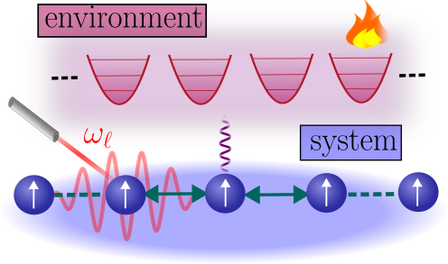

Floquet-Gibbs States in Laser-Driven Atomic Systems
Wilson S. Martins
27 June 2024
wilson.santana-martins@uni-tuebingen.de
arXiv: soon
Bringing the physics and mathematics of quantum many-body chaos, Helsinki
F. Carollo
I. Lesanovsky
K. Brandner (Nottingham)

Slide 2

Laser-driven atomic system in radiation field
R. H. Lehmberg, Phys. Rev. A 2, 883 (1970)
$H=H_{S}+H_{SE}$+ $H_{E}$
1

Slide 3
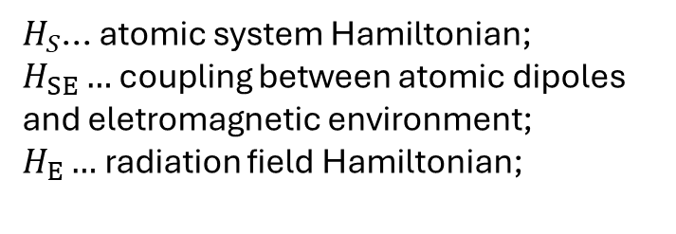
Laser-driven atomic system in radiation field
R. H. Lehmberg, Phys. Rev. A 2, 883 (1970)
$H=H_{S}+H_{SE}$+ $H_{E}$
$H_{S}$... atomic system Hamiltonian;
$H_{SE}…$ coupling between atomic dipoles and eletromagnetic environment;
$H_{E}…$ radiation field Hamiltonian;
1

Slide 4

Laser-driven atomic system in radiation field
R. H. Lehmberg, Phys. Rev. A 2, 883 (1970)
$H=H_{S}+H_{SE}$+ $H_{E}$
$H_{S}$... atomic system Hamiltonian;
$H_{SE}…$ coupling between atomic dipoles and eletromagnetic environment;
$H_{E}…$ radiation field Hamiltonian;
$$H_{S}=H_{atom}+V_{int}$$
1

Slide 5
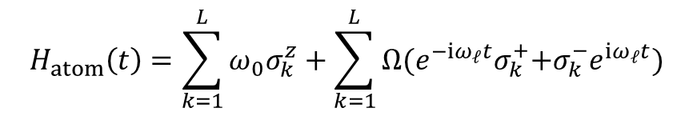

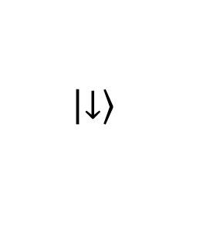
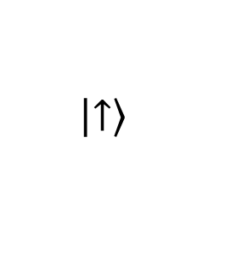
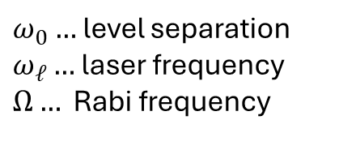
Laser-driven atomic system in radiation field
R. H. Lehmberg, Phys. Rev. A 2, 883 (1970)
$H=H_{S}+H_{SE}$+ $H_{E}$
$H_{S}$... atomic system Hamiltonian;
$H_{SE}…$ coupling between atomic dipoles and eletromagnetic environment;
$H_{E}…$ radiation field Hamiltonian;
$$H_{S}=H_{atom}+V_{int}$$
Laser field
system Hamiltonian incorporates coupling with the laser field:
$$\left.\left|↑\right.\right\rangle$$
$$ω_{0}$$
$$H_{atom}\left(t\right)=\sum_{k=1}^{L}{{ω_{0}σ}_{k}^{z}}+\sum_{k=1}^{L}{Ω{(e^{−iω_{ℓ}t}σ}_{k}^{+}{+σ}_{k}^{−}e^{iω_{ℓ}t})}$$
$$\left.\left|↓\right.\right\rangle$$
$ω_{0}…$level separation
$ω_{ℓ}…$ laser frequency
$Ω…$ Rabi frequency
1

Slide 6
Laser-driven atomic system in radiation field
R. H. Lehmberg, Phys. Rev. A 2, 883 (1970)
$H=H_{S}+H_{SE}$+ $H_{E}$
$H_{S}$... atomic system Hamiltonian;
$H_{SE}…$ coupling between atomic dipoles and eletromagnetic environment;
$H_{E}…$ radiation field Hamiltonian;
$$H_{S}=H_{atom}+V_{int}$$
Laser field
system Hamiltonian incorporates coupling with the laser field:
$$\left.\left|↑\right.\right\rangle$$
$$ω_{0}$$
Radiative decay
$$H_{atom}\left(t\right)=\sum_{k=1}^{L}{{ω_{0}σ}_{k}^{z}}+\sum_{k=1}^{L}{Ω{(e^{−iω_{ℓ}t}σ}_{k}^{+}{+σ}_{k}^{−}e^{iω_{ℓ}t})}$$
$$\left.\left|↓\right.\right\rangle$$
dynamics is not coherent: coupling atoms vs radiation field generates spontaneous emition;
long time dynamics: competition dissipation vs periodic driving .
$ω_{0}…$level separation
$ω_{ℓ}…$ laser frequency
$Ω…$ Rabi frequency
1

Slide 7
Rotating frame of the laser
2

Slide 8



Rotating frame of the laser
$H_{S}=H_{atom}$+$V_{int}$
$U_{laser}^{†}{H_{atom}U}_{laser}=$ ${\tilde{H}}_{atom}$,
[$U_{laser},V_{int}]=0$
2

Slide 9
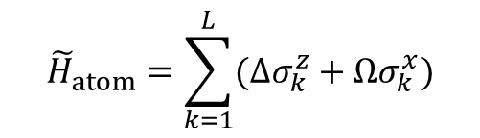

Rotating frame of the laser
$${\tilde{H}}_{atom}=\sum_{k=1}^{L}{(Δσ_{k}^{z}+Ωσ_{k}^{x})}$$
$Δ=$ $ω_{0}$- $ω_{ℓ}$
$H_{S}=H_{atom}$+$V_{int}$
$U_{laser}^{†}{H_{atom}U}_{laser}=$ ${\tilde{H}}_{atom}$,
[$U_{laser},V_{int}]=0$
2

Slide 10
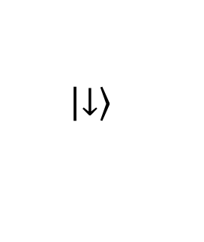
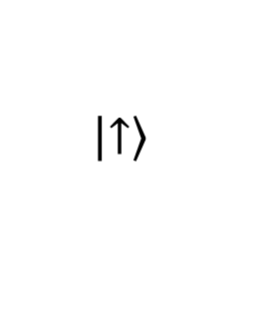


Rotating frame of the laser
$${\tilde{H}}_{atom}=\sum_{k=1}^{L}{(Δσ_{k}^{z}+Ωσ_{k}^{x})}$$
$Δ=$ $ω_{0}$- $ω_{ℓ}$
$H_{S}=H_{atom}$+$V_{int}$
$U_{laser}^{†}{H_{atom}U}_{laser}=$ ${\tilde{H}}_{atom}$,
[$U_{laser},V_{int}]=0$
$$\left.\left|↑\right.\right\rangle$$
$$Δ$$
$$Ω$$
$$\left.\left|↓\right.\right\rangle$$
2

Slide 11

Rotating frame of the laser
$${\tilde{H}}_{atom}=\sum_{k=1}^{L}{(Δσ_{k}^{z}+Ωσ_{k}^{x})}$$
$Δ=$ $ω_{0}$- $ω_{ℓ}$
$H_{S}=H_{atom}$+$V_{int}$
$U_{laser}^{†}{H_{atom}U}_{laser}=$ ${\tilde{H}}_{atom}$,
[$U_{laser},V_{int}]=0$
$$\left.\left|↑\right.\right\rangle$$
rotating frame Hamiltonian:
$H_{S}^{RF}={\tilde{H}}_{atom}$+$V_{int}$
$$Δ$$
$$Ω$$
$$\left.\left|↓\right.\right\rangle$$
2

Slide 12
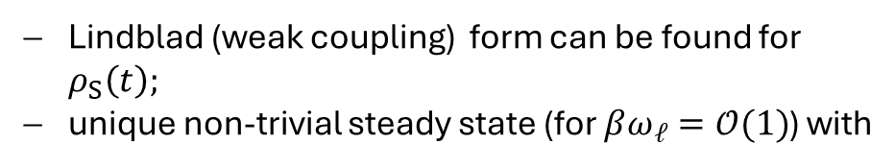
Rotating frame of the laser
$${\tilde{H}}_{atom}=\sum_{k=1}^{L}{(Δσ_{k}^{z}+Ωσ_{k}^{x})}$$
$Δ=$ $ω_{0}$- $ω_{ℓ}$
$H_{S}=H_{atom}$+$V_{int}$
$U_{laser}^{†}{H_{atom}U}_{laser}=$ ${\tilde{H}}_{atom}$,
[$U_{laser},V_{int}]=0$
$$\left.\left|↑\right.\right\rangle$$
rotating frame Hamiltonian:
$H_{S}^{RF}={\tilde{H}}_{atom}$+$V_{int}$
$$Δ$$
Lindblad (weak coupling) form can be found for $ρ_{S}\left(t\right);$
unique non-trivial steady state (for $βω_{ℓ}=𝒪(1)$) with
$$Ω$$
$$\left.\left|↓\right.\right\rangle$$
2

Slide 13



Rotating frame of the laser
$${\tilde{H}}_{atom}=\sum_{k=1}^{L}{(Δσ_{k}^{z}+Ωσ_{k}^{x})}$$
$Δ=$ $ω_{0}$- $ω_{ℓ}$
$H_{S}=H_{atom}$+$V_{int}$
$U_{laser}^{†}{H_{atom}U}_{laser}=$ ${\tilde{H}}_{atom}$,
[$U_{laser},V_{int}]=0$
$$\left.\left|↑\right.\right\rangle$$
rotating frame Hamiltonian:
$H_{S}^{RF}={\tilde{H}}_{atom}$+$V_{int}$
$$Δ$$
Lindblad (weak coupling) form can be found for $ρ_{S}\left(t\right);$
unique non-trivial steady state (for $βω_{ℓ}=𝒪(1)$) with
$$Ω$$
$$\left.\left|↓\right.\right\rangle$$
$$ρ_{ss}\left(ℓT\right)∝e^{−βH_{S}^{RF}},$$
$$ℓ∈ℕ$$
T. Mori, Annu. Rev. Condens. Matter Phys 14, 35 (2023)
$${T=2π/ω}_{ℓ}$$
2

Slide 14
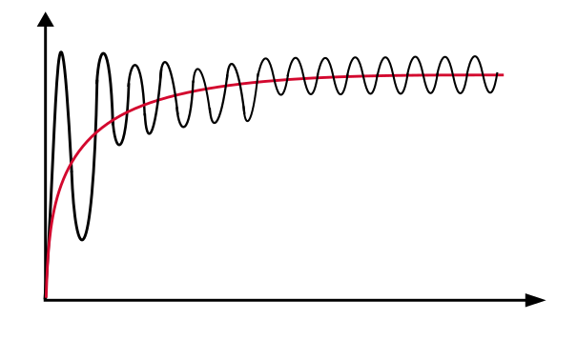



Rotating frame of the laser
$${\tilde{H}}_{atom}=\sum_{k=1}^{L}{(Δσ_{k}^{z}+Ωσ_{k}^{x})}$$
$Δ=$ $ω_{0}$- $ω_{ℓ}$
$H_{S}=H_{atom}$+$V_{int}$
$U_{laser}^{†}{H_{atom}U}_{laser}=$ ${\tilde{H}}_{atom}$,
[$U_{laser},V_{int}]=0$
$$\left.\left|↑\right.\right\rangle$$
rotating frame Hamiltonian:
$H_{S}^{RF}={\tilde{H}}_{atom}$+$V_{int}$
$$Δ$$
Lindblad (weak coupling) form can be found for $ρ_{S}\left(t\right);$
unique non-trivial steady state (for $βω_{ℓ}=𝒪(1)$) with
$$Ω$$
$$\left.\left|↓\right.\right\rangle$$
$$ρ_{ss}\left(ℓT\right)∝e^{−βH_{S}^{RF}},$$
$$ℓ∈ℕ$$
T. Mori, Annu. Rev. Condens. Matter Phys 14, 35 (2023)
$$\left\langle O_{S} (t)\right\rangle$$
$$tr[O_{S}ρ_{l.c.}]$$
$${T=2π/ω}_{ℓ}$$
$$t$$
2

Slide 15
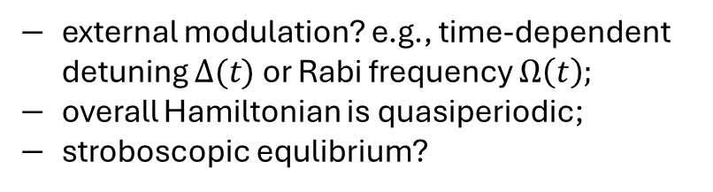
Rotating frame of the laser
$${\tilde{H}}_{atom}=\sum_{k=1}^{L}{(Δσ_{k}^{z}+Ωσ_{k}^{x})}$$
$Δ=$ $ω_{0}$- $ω_{ℓ}$
$H_{S}=H_{atom}$+$V_{int}$
$U_{laser}^{†}{H_{atom}U}_{laser}=$ ${\tilde{H}}_{atom}$,
[$U_{laser},V_{int}]=0$
$$\left.\left|↑\right.\right\rangle$$
rotating frame Hamiltonian:
$H_{S}^{RF}={\tilde{H}}_{atom}$+$V_{int}$
$$Δ$$
Lindblad (weak coupling) form can be found for $ρ_{S}\left(t\right);$
unique non-trivial steady state (for $βω_{ℓ}=𝒪(1)$) with
$$Ω$$
$$\left.\left|↓\right.\right\rangle$$
$$ρ_{ss}\left(ℓT\right)∝e^{−βH_{S}^{RF}},$$
$$ℓ∈ℕ$$
T. Mori, Annu. Rev. Condens. Matter Phys 14, 35 (2023)
external modulation? e.g., time-dependent detuning $Δ(t)$ or Rabi frequency $Ω\left(t\right);$
overall Hamiltonian is quasiperiodic;
stroboscopic equlibrium?
$$\left\langle O_{S} (t)\right\rangle$$
$$tr[O_{S}ρ_{l.c.}]$$
$${T=2π/ω}_{ℓ}$$
$$t$$
2

Slide 16
External modulation of parameters
prototype: Rydberg atoms‘ chain.
3

Slide 17
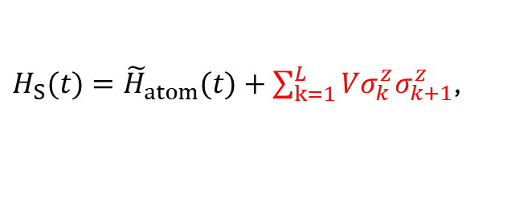
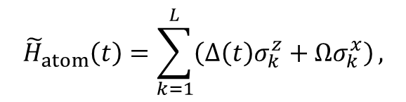

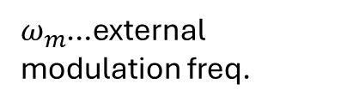

External modulation of parameters
$Δ(t)$=$Δ(ω_{m}t)$
$ω_{m}$…external modulation freq.
prototype: Rydberg atoms‘ chain.
$${T=2π/ω}_{m}$$
$${\tilde{H}}_{atom}\left(t\right)=\sum_{k=1}^{L}{\left(Δ\left(t\right)σ_{k}^{z}+Ωσ_{k}^{x}\right)},$$
$H_{S}(t)={\tilde{H}}_{atom}(t)+\sum_{k=1}^{L}{Vσ_{k}^{z}σ_{k+1}^{z}}$,
3

Slide 18
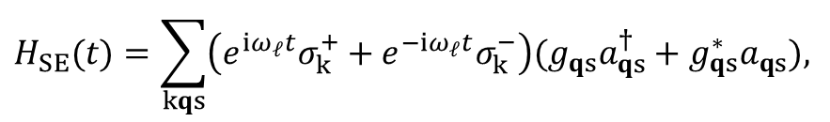
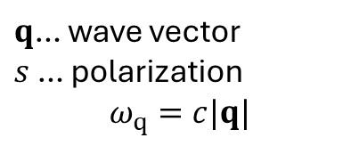
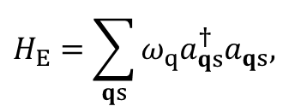
External modulation of parameters
$Δ(t)$=$Δ(ω_{m}t)$
$ω_{m}$…external modulation freq.
prototype: Rydberg atoms‘ chain.
$${T=2π/ω}_{m}$$
$${\tilde{H}}_{atom}\left(t\right)=\sum_{k=1}^{L}{\left(Δ\left(t\right)σ_{k}^{z}+Ωσ_{k}^{x}\right)},$$
$H_{S}(t)={\tilde{H}}_{atom}(t)+\sum_{k=1}^{L}{Vσ_{k}^{z}σ_{k+1}^{z}}$,
$$H_{SE}(t)=\sum_{kqs}{\left(e^{iω_{ℓ}t}σ_{k}^{+}+e^{−iω_{ℓ}t}σ_{k}^{−}\right)(g_{qs}a_{qs}^{†}+g_{qs}^{∗}a_{qs}),}$$
$$H_{E}=\sum_{qs}{ω_{q}a_{qs}^{†}a_{qs},}$$
$q$… wave vector
$s$ … polarization
$$ω_{q}=c|q|$$
3

Slide 19
External modulation of parameters
$Δ(t)$=$Δ(ω_{m}t)$
$ω_{m}$…external modulation freq.
prototype: Rydberg atoms‘ chain.
$${T=2π/ω}_{m}$$
$${\tilde{H}}_{atom}\left(t\right)=\sum_{k=1}^{L}{\left(Δ\left(t\right)σ_{k}^{z}+Ωσ_{k}^{x}\right)},$$
$H_{S}(t)={\tilde{H}}_{atom}(t)+\sum_{k=1}^{L}{Vσ_{k}^{z}σ_{k+1}^{z}}$,
$$H_{SE}(t)=\sum_{kqs}{\left(e^{iω_{ℓ}t}σ_{k}^{+}+e^{−iω_{ℓ}t}σ_{k}^{−}\right)(g_{qs}a_{qs}^{†}+g_{qs}^{∗}a_{qs}),}$$
$$H_{E}=\sum_{qs}{ω_{q}a_{qs}^{†}a_{qs},}$$
$q$… wave vector
$s$ … polarization
$$ω_{q}=c|q|$$
$$H\left(t\right)=H_{S}\left(ω_{m}t\right)+H_{SE}\left(ω_{ℓ}t\right)+H_{E}$$
3

Slide 20
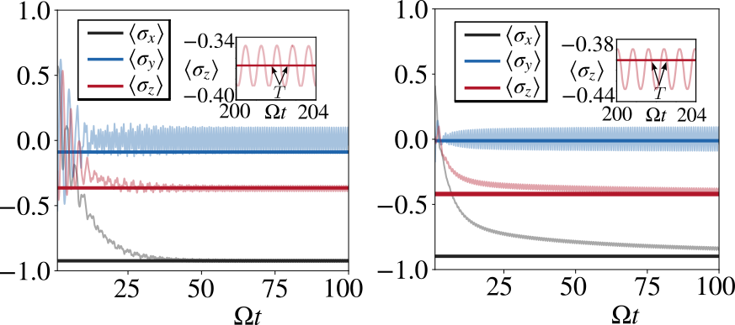

External modulation of parameters
$Δ(t)$=$Δ(ω_{m}t)$
$ω_{m}$…external modulation freq.
prototype: Rydberg atoms‘ chain.
$${T=2π/ω}_{m}$$
$${\tilde{H}}_{atom}\left(t\right)=\sum_{k=1}^{L}{\left(Δ\left(t\right)σ_{k}^{z}+Ωσ_{k}^{x}\right)},$$
$H_{S}(t)={\tilde{H}}_{atom}(t)+\sum_{k=1}^{L}{Vσ_{k}^{z}σ_{k+1}^{z}}$,
$$H_{SE}(t)=\sum_{kqs}{\left(e^{iω_{ℓ}t}σ_{k}^{+}+e^{−iω_{ℓ}t}σ_{k}^{−}\right)(g_{qs}a_{qs}^{†}+g_{qs}^{∗}a_{qs}),}$$
$$H_{E}=\sum_{qs}{ω_{q}a_{qs}^{†}a_{qs},}$$
$q$… wave vector
$s$ … polarization
$$ω_{q}=c|q|$$
$$H\left(t\right)=H_{S}\left(ω_{m}t\right)+H_{SE}\left(ω_{ℓ}t\right)+H_{E}$$
$$ρ_{ss}\left(ℓT\right)∝e^{−βH_{SF}^{(n)}},$$
3

Slide 21
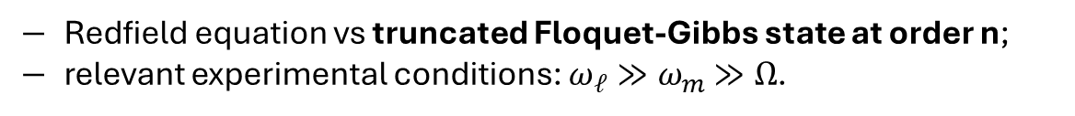
External modulation of parameters
$Δ(t)$=$Δ(ω_{m}t)$
$ω_{m}$…external modulation freq.
prototype: Rydberg atoms‘ chain.
$${T=2π/ω}_{m}$$
$${\tilde{H}}_{atom}\left(t\right)=\sum_{k=1}^{L}{\left(Δ\left(t\right)σ_{k}^{z}+Ωσ_{k}^{x}\right)},$$
$H_{S}(t)={\tilde{H}}_{atom}(t)+\sum_{k=1}^{L}{Vσ_{k}^{z}σ_{k+1}^{z}}$,
$$H_{SE}(t)=\sum_{kqs}{\left(e^{iω_{ℓ}t}σ_{k}^{+}+e^{−iω_{ℓ}t}σ_{k}^{−}\right)(g_{qs}a_{qs}^{†}+g_{qs}^{∗}a_{qs}),}$$
$$H_{E}=\sum_{qs}{ω_{q}a_{qs}^{†}a_{qs},}$$
$q$… wave vector
$s$ … polarization
$$ω_{q}=c|q|$$
$$H\left(t\right)=H_{S}\left(ω_{m}t\right)+H_{SE}\left(ω_{ℓ}t\right)+H_{E}$$
$$ρ_{ss}\left(ℓT\right)∝e^{−βH_{SF}^{(n)}},$$
Redfield equation vs truncated Floquet-Gibbs state at order n;
relevant experimental conditions: $ω_{ℓ}≫ω_{m}$ $≫Ω$.
3

Slide 22

Quasiperiodic Hamiltonian
$H\left(t\right)=H_{S}\left(ω_{m}t\right)+{εH}_{SE}\left(ω_{ℓ}t\right)+H_{E}$,
4

Slide 23


Quasiperiodic Hamiltonian
$H\left(t\right)=H_{S}\left(ω_{m}t\right)+{εH}_{SE}\left(ω_{ℓ}t\right)+H_{E}$,
using the Floquet theorem to write a time-independent Hamiltonian,
$${𝒯e}^{−i\int_{t_{0}}^{t}{dt^{′}}H_{S}\left(ω_{m}t^{′}\right)}={V_{ω_{m}t}e}^{−itH_{SF}/ℏ},$$
$H_{SF}={−iV}_{ω_{m}t}^{†}{\dot{V}}_{ω_{m}t}{+V}_{ω_{m}t}^{†}H_{S}$ $V_{ω_{m}t}$
4

Slide 24
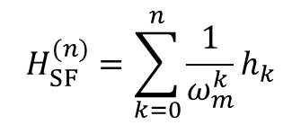

Quasiperiodic Hamiltonian
$H\left(t\right)=H_{S}\left(ω_{m}t\right)+{εH}_{SE}\left(ω_{ℓ}t\right)+H_{E}$,
using the Floquet theorem to write a time-independent Hamiltonian,
$${𝒯e}^{−i\int_{t_{0}}^{t}{dt^{′}}H_{S}\left(ω_{m}t^{′}\right)}={V_{ω_{m}t}e}^{−itH_{SF}/ℏ},$$
$H_{SF}={−iV}_{ω_{m}t}^{†}{\dot{V}}_{ω_{m}t}{+V}_{ω_{m}t}^{†}H_{S}$ $V_{ω_{m}t}$
assuming $V_{ω_{m}t}^{(n)}$ , the n-th order Magnus expansion:
$H_{S}→$ $H_{SF}^{(n)}$
$$H_{SF}^{(n)}=\sum_{k=0}^{n}{\frac{1}{ω_{m}^{k}}h_{k}}$$
4

Slide 25
Quasiperiodic Hamiltonian
$H\left(t\right)=H_{S}\left(ω_{m}t\right)+{εH}_{SE}\left(ω_{ℓ}t\right)+H_{E}$,
using the Floquet theorem to write a time-independent Hamiltonian,
$${𝒯e}^{−i\int_{t_{0}}^{t}{dt^{′}}H_{S}\left(ω_{m}t^{′}\right)}={V_{ω_{m}t}e}^{−itH_{SF}/ℏ},$$
$H_{SF}={−iV}_{ω_{m}t}^{†}{\dot{V}}_{ω_{m}t}{+V}_{ω_{m}t}^{†}H_{S}$ $V_{ω_{m}t}$
assuming $V_{ω_{m}t}^{(n)}$ , the n-th order Magnus expansion:
$H_{S}→$ $H_{SF}^{(n)}$
$$H_{SF}^{(n)}=\sum_{k=0}^{n}{\frac{1}{ω_{m}^{k}}h_{k}}$$
${−iV}_{ω_{m}t}^{\left(n\right)†}{\dot{V}}_{ω_{m}t}^{\left(n\right)}{+V}_{ω_{m}t}^{\left(n\right)†}H\left(t\right)V_{ω_{m}t}^{\left(n\right)}=H_{SF}^{(n)}+$ ${εV_{ω_{m}t}^{\left(n\right)†}H}_{SE}V_{ω_{m}t}^{\left(n\right)}$+ $H_{RF}^{(n)}+H_{E}$
4

Slide 26

Quasiperiodic Hamiltonian
$H\left(t\right)=H_{S}\left(ω_{m}t\right)+{εH}_{SE}\left(ω_{ℓ}t\right)+H_{E}$,
using the Floquet theorem to write a time-independent Hamiltonian,
$${𝒯e}^{−i\int_{t_{0}}^{t}{dt^{′}}H_{S}\left(ω_{m}t^{′}\right)}={V_{ω_{m}t}e}^{−itH_{SF}/ℏ},$$
$H_{SF}={−iV}_{ω_{m}t}^{†}{\dot{V}}_{ω_{m}t}{+V}_{ω_{m}t}^{†}H_{S}$ $V_{ω_{m}t}$
assuming $V_{ω_{m}t}^{(n)}$ , the n-th order Magnus expansion:
$H_{S}→$ $H_{SF}^{(n)}$
$$H_{SF}^{(n)}=\sum_{k=0}^{n}{\frac{1}{ω_{m}^{k}}h_{k}}$$
${−iV}_{ω_{m}t}^{\left(n\right)†}{\dot{V}}_{ω_{m}t}^{\left(n\right)}{+V}_{ω_{m}t}^{\left(n\right)†}H\left(t\right)V_{ω_{m}t}^{\left(n\right)}=H_{SF}^{(n)}+$ ${εV_{ω_{m}t}^{\left(n\right)†}H}_{SE}V_{ω_{m}t}^{\left(n\right)}$+ $H_{RF}^{(n)}+H_{E}$
$$H_{SE}^{\left(n\right)}(ω_{m}t,ω_{ℓ}t)$$
4

Slide 27
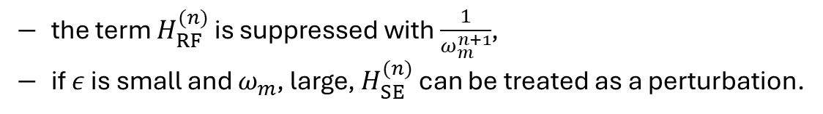
Quasiperiodic Hamiltonian
$H\left(t\right)=H_{S}\left(ω_{m}t\right)+{εH}_{SE}\left(ω_{ℓ}t\right)+H_{E}$,
using the Floquet theorem to write a time-independent Hamiltonian,
$${𝒯e}^{−i\int_{t_{0}}^{t}{dt^{′}}H_{S}\left(ω_{m}t^{′}\right)}={V_{ω_{m}t}e}^{−itH_{SF}/ℏ},$$
$H_{SF}={−iV}_{ω_{m}t}^{†}{\dot{V}}_{ω_{m}t}{+V}_{ω_{m}t}^{†}H_{S}$ $V_{ω_{m}t}$
assuming $V_{ω_{m}t}^{(n)}$ , the n-th order Magnus expansion:
$H_{S}→$ $H_{SF}^{(n)}$
$$H_{SF}^{(n)}=\sum_{k=0}^{n}{\frac{1}{ω_{m}^{k}}h_{k}}$$
${−iV}_{ω_{m}t}^{\left(n\right)†}{\dot{V}}_{ω_{m}t}^{\left(n\right)}{+V}_{ω_{m}t}^{\left(n\right)†}H\left(t\right)V_{ω_{m}t}^{\left(n\right)}=H_{SF}^{(n)}+$ ${εV_{ω_{m}t}^{\left(n\right)†}H}_{SE}V_{ω_{m}t}^{\left(n\right)}$+ $H_{RF}^{(n)}+H_{E}$
$$H_{SE}^{\left(n\right)}(ω_{m}t,ω_{ℓ}t)$$
the term $H_{RF}^{(n)}$ is suppressed with $\frac{1}{ω_{m}^{n+1}}$,
if $ε$ is small and $ω_{m}$, large, $H_{SE}^{(n)}$ can be treated as a perturbation.
4

Slide 28
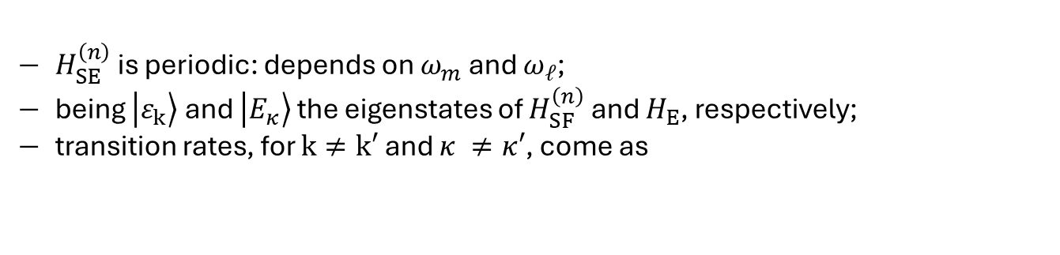
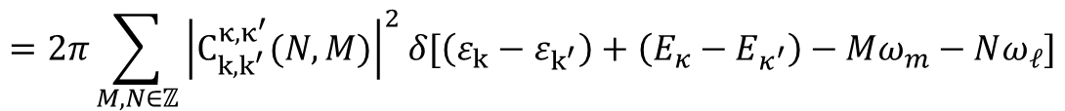

Fermi Golden‘s rule
${{−iV}_{ω_{m}t}^{\left(n\right)†}{\dot{V}}_{ω_{m}t}^{\left(n\right)}{+V}_{ω_{m}t}^{\left(n\right)†}H\left(t\right)V_{ω_{m}t}^{\left(n\right)}=H}_{SF}^{(n)}+$ $H_{SE}^{(n)} +H_{E}→{\dot{U}}_{t}=−i(H_{SF}^{\left(n\right)}+ H_{SE}^{\left(n\right)} +H_{E})U_{t}$
$H_{SE}^{\left(n\right)}$ is periodic: depends on $ω_{m}$ and $ω_{ℓ}$;
being $\left.\left|ε_{k}\right.\right\rangle$ and $\left.\left|E_{κ}\right.\right\rangle$ the eigenstates of $H_{SF}^{\left(n\right)}$ and $H_{E}$, respectively;
transition rates, for $k≠k′$ and $κ ≠κ′$, come as
$I_{k,k′}^{κ,κ′}=\lim_{t→∞}{\frac{{\left|\left\langle ε_{k′},E_{κ′} | U_{t} | ε_{k},E_{κ}\right\rangle \right|}^{2}}{t}}$,
$\left\langle ε_{k′},E_{κ′} | H_{SE}^{\left(n\right)} | ε_{k},E_{κ}\right\rangle$= $\sum_{M,N∈ℤ}{C_{k,k^{′}}^{κ,κ^{′}}(N,M)e^{i\left(Mω_{m}+Nω_{ℓ}\right)t}}$
$$=2π\sum_{M,N∈ℤ}{{\left|C_{k,k^{′}}^{κ,κ^{′}}(N,M)\right|}^{2}δ[\left(ε_{k}−ε_{k^{′}}\right)+\left(E_{κ}−E_{κ^{′}}\right)−Mω_{m}−Nω_{ℓ}]}$$
5

Slide 29
Transition rates
$$I_{k,k′}^{κ,κ′}=2π\sum_{M,N∈ℤ}{{\left|C_{k,k^{′}}^{κ,κ^{′}}(N,M)\right|}^{2}δ[\left(ε_{k}−ε_{k^{′}}\right)+\left(E_{κ}−E_{κ^{′}}\right)−Mω_{m}−Nω_{ℓ}]}$$
6

Slide 30
Transition rates
$$I_{k,k′}^{κ,κ′}=2π\sum_{M,N∈ℤ}{{\left|C_{k,k^{′}}^{κ,κ^{′}}(N,M)\right|}^{2}δ[\left(ε_{k}−ε_{k^{′}}\right)+\left(E_{κ}−E_{κ^{′}}\right)−Mω_{m}−Nω_{ℓ}]}$$
understanding the equality
$$\left(ε_{k}−ε_{k^{′}}\right)+\left(E_{κ}−E_{κ^{′}}\right)−Mω_{m}−Nω_{ℓ}=0,$$
6

Slide 31


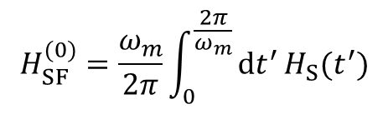

Transition rates
$$I_{k,k′}^{κ,κ′}=2π\sum_{M,N∈ℤ}{{\left|C_{k,k^{′}}^{κ,κ^{′}}(N,M)\right|}^{2}δ[\left(ε_{k}−ε_{k^{′}}\right)+\left(E_{κ}−E_{κ^{′}}\right)−Mω_{m}−Nω_{ℓ}]}$$
understanding the equality
$$\left(ε_{k}−ε_{k^{′}}\right)+\left(E_{κ}−E_{κ^{′}}\right)−Mω_{m}−Nω_{ℓ}=0,$$
$$H_{SF}^{(0)}=\frac{ω_{m}}{2π}\int_{0}^{\frac{2π}{ω_{m}}}{dt^{′}}H_{S}(t^{′})$$
$\left|ε_{k}−ε_{k^{′}}\right|≲Λ$, Bohr frequencies of
$ω_{ℓ}≫ω_{m}$ $≫Λ:$
$I_{k,k′}^{κ,κ′}=2π{\left|C_{k,k^{′}}^{κ,κ^{′}}(0,0)\right|}^{2}δ[\left(ε_{k}−ε_{k^{′}}\right)+\left(E_{κ}−E_{κ^{′}}\right)$]
6

Slide 32
Transition rates
$$I_{k,k′}^{κ,κ′}=2π\sum_{M,N∈ℤ}{{\left|C_{k,k^{′}}^{κ,κ^{′}}(N,M)\right|}^{2}δ[\left(ε_{k}−ε_{k^{′}}\right)+\left(E_{κ}−E_{κ^{′}}\right)−Mω_{m}−Nω_{ℓ}]}$$
understanding the equality
$$\left(ε_{k}−ε_{k^{′}}\right)+\left(E_{κ}−E_{κ^{′}}\right)−Mω_{m}−Nω_{ℓ}=0,$$
$$H_{SF}^{(0)}=\frac{ω_{m}}{2π}\int_{0}^{\frac{2π}{ω_{m}}}{dt^{′}}H_{S}(t^{′})$$
$\left|ε_{k}−ε_{k^{′}}\right|≲Λ$, Bohr frequencies of
$ω_{ℓ}≫ω_{m}$ $≫Λ:$
$I_{k,k′}^{κ,κ′}=2π{\left|C_{k,k^{′}}^{κ,κ^{′}}(0,0)\right|}^{2}δ[\left(ε_{k}−ε_{k^{′}}\right)+\left(E_{κ}−E_{κ^{′}}\right)$]
any transition in the system is accompanied by transitions of the same frequency in the environment, i.e., no energy absorbed from driving.
6

Slide 33
Environment in thermal equilibrium
6

Slide 34
Environment in thermal equilibrium
unconditional transition rates, assuming the environment in thermal equilibrium:
7

Slide 35
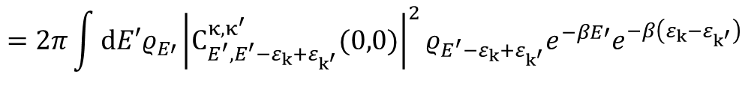
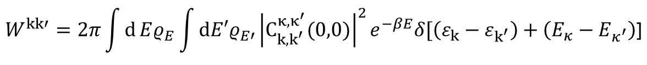

Environment in thermal equilibrium
unconditional transition rates, assuming the environment in thermal equilibrium:
$$W^{kk′}=2π\int{d}Eρ_{E}\int{dE′ρ_{E′}}{\left|C_{k,k^{′}}^{κ,κ^{′}}(0,0)\right|}^{2}e^{−βE}δ[\left(ε_{k}−ε_{k^{′}}\right)+\left(E_{κ}−E_{κ^{′}}\right)\text{]}$$
$$=2π\int{dE′ρ_{E′}}{\left|C_{E^{′},E^{′}−ε_{k}+ε_{k^{′}}}^{κ,κ^{′}}(0,0)\right|}^{2}ρ_{E^{′}−ε_{k}+ε_{k^{′}}}e^{−βE′}e^{−β\left(ε_{k}−ε_{k^{′}}\right)}$$
time-reversal symmetry
${=W}^{k′k}$ $e^{−β\left(ε_{k}−ε_{k^{′}}\right)}$
(Detailed balance condition)
7

Slide 36
Environment in thermal equilibrium
unconditional transition rates, assuming the environment in thermal equilibrium:
$$W^{kk′}=2π\int{d}Eρ_{E}\int{dE′ρ_{E′}}{\left|C_{k,k^{′}}^{κ,κ^{′}}(0,0)\right|}^{2}e^{−βE}δ[\left(ε_{k}−ε_{k^{′}}\right)+\left(E_{κ}−E_{κ^{′}}\right)\text{]}$$
$$=2π\int{dE′ρ_{E′}}{\left|C_{E^{′},E^{′}−ε_{k}+ε_{k^{′}}}^{κ,κ^{′}}(0,0)\right|}^{2}ρ_{E^{′}−ε_{k}+ε_{k^{′}}}e^{−βE′}e^{−β\left(ε_{k}−ε_{k^{′}}\right)}$$
time-reversal symmetry
${=W}^{k′k}$ $e^{−β\left(ε_{k}−ε_{k^{′}}\right)}$
(Detailed balance condition)
for long times, the system is in equilibrium w.r.t. the eigenfrequencies of the effective Floquet-Hamiltonian $H_{SF}^{\left(n\right)}$.
7

Slide 37
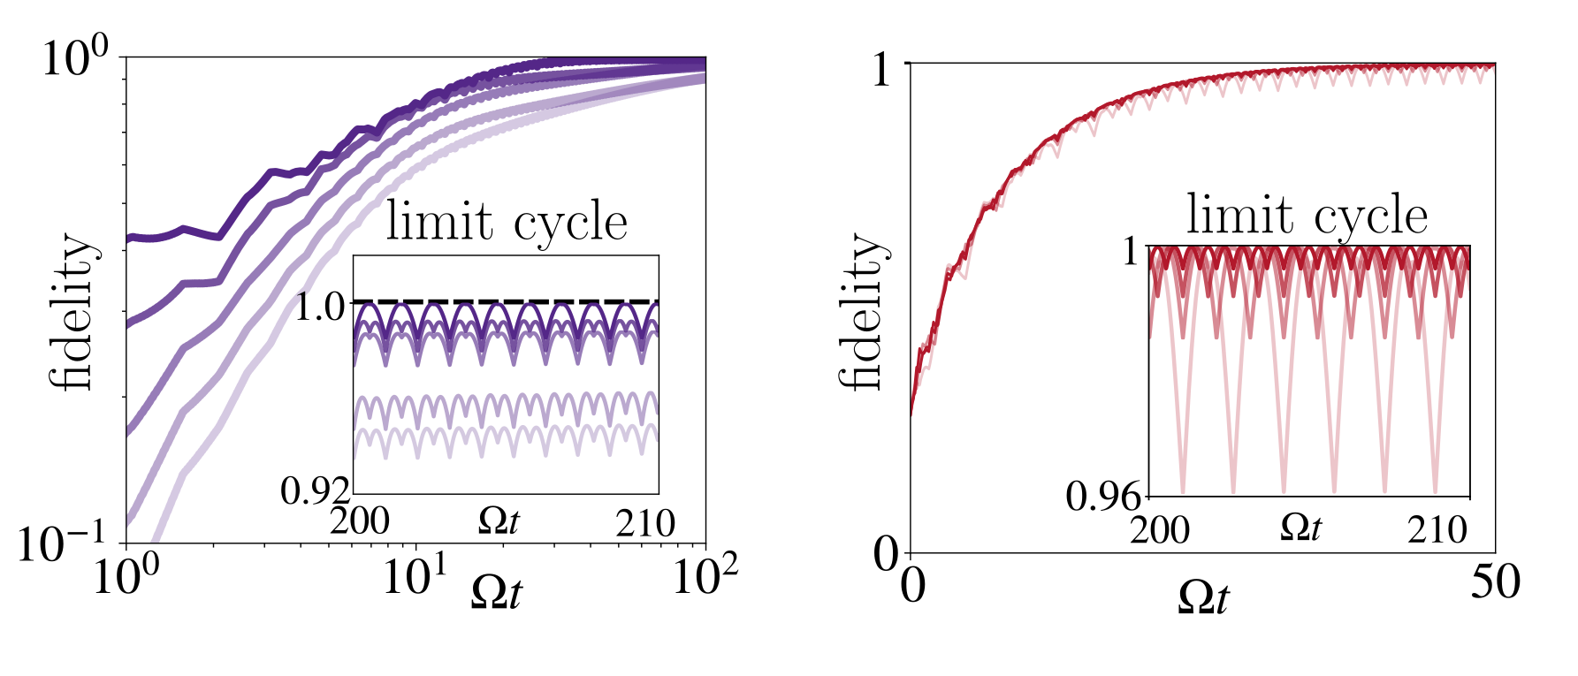


Contributions
Long-time dynamics for laser-driven systems are suitably described by effective Floquet-Gibbs ensembles;
Extend the results for strictly periodic quantum systems;
Description of stroboscopic equilibrium for an experimentaly relevant class of systems (trapped ions, cold atoms…);
Experimental tests for the emergence of EFG ensembles in dissipative scenarios?
$$ω_{m}$$
$$L$$
8

