Slide 1

Effective equilibrium states for quasiperiodic spin systems
Wilson S. Martins
22 March 2024
F. Carollo
I. Lesanovsky
K. Brandner

Slide 2

Equilibrium…?
Open systems
$H=H_{S}+H_{SE}$+ $H_{E},$
Environment
System
1

Slide 3
Equilibrium…?
Open systems
$H=H_{S}+H_{SE}$+ $H_{E},$
Environment
System
Born, Markov, secular approximation:
$∂_{t}ρ=−i\left[H_{S},ρ\right]+\sum_{αβω}{γ_{αβ}(ω)\left({S_{β}^{†}\left(ω\right)ρS}_{α}(ω)−\frac{1}{2}\{S_{α}^{†}{\left(ω\right)S}_{β}\left(ω\right),ρ\}\right)}$,
1

Slide 4


Equilibrium…?
Open systems
$H=H_{S}+H_{SE}$+ $H_{E},$
Environment
System
Born, Markov, secular approximation:
$∂_{t}ρ=−i\left[H_{S},ρ\right]+\sum_{αβω}{γ_{αβ}(ω)\left({S_{β}^{†}\left(ω\right)ρS}_{α}(ω)−\frac{1}{2}\{S_{α}^{†}{\left(ω\right)S}_{β}\left(ω\right),ρ\}\right)}$,
$$\left[H_{S},S_{α}\left(ω\right)\right]={−ωS}_{α}\left(ω\right)$$
$$\left[H_{S},{S_{β}^{†}\left(ω\right)S}_{α}\left(ω\right)\right]=0$$
1

Slide 5



Equilibrium…?
Open systems
$H=H_{S}+H_{SE}$+ $H_{E},$
Environment
System
Born, Markov, secular approximation:
$∂_{t}ρ=−i\left[H_{S},ρ\right]+\sum_{αβω}{γ_{αβ}(ω)\left({S_{β}^{†}\left(ω\right)ρS}_{α}(ω)−\frac{1}{2}\{S_{α}^{†}{\left(ω\right)S}_{β}\left(ω\right),ρ\}\right)}$,
$$\left[H_{S},S_{α}\left(ω\right)\right]={−ωS}_{α}\left(ω\right)$$
$$\left[H_{S},{S_{β}^{†}\left(ω\right)S}_{α}\left(ω\right)\right]=0$$
Correlation function:
$$C_{αβ}\left(−t−iβ,β\right)=C_{αβ}\left(t,β\right)$$
$$γ_{αβ}(−ω)=e^{−βω}γ_{αβ}(ω)$$
Off-diagonal terms vanish at long-times:
$$ρ_{SS}∝e^{−βH_{S}}$$
1

Slide 6
Equilibrium…?
Open systems
Active perturbation vs. dissipation
(out-of-equilibrium)
perturbation
Environment
System
1

Slide 7
Equilibrium…?
Open systems
Active perturbation vs. dissipation
(out-of-equilibrium)
perturbation
Environment
System
Long-time behavior of driven many-body systems are in general very complicated!
Is it possible to characterise long-time dynamics in terms of time-independent state?
1

Slide 8
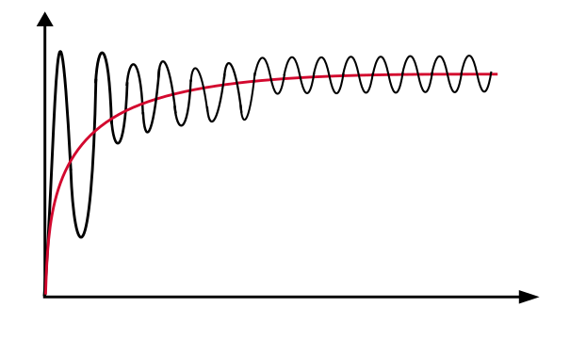
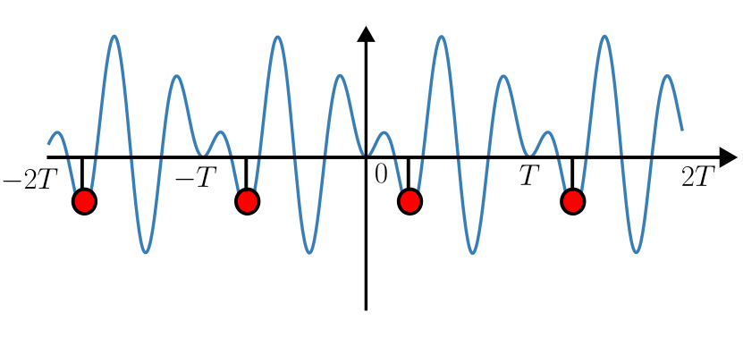



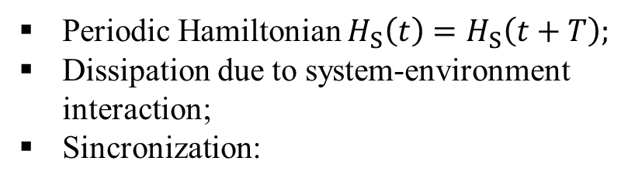

$H\left(t\right)=H_{S}(t)+H_{SE}$+ $H_{E}$
Periodic Hamiltonian $H_{S}\left(t\right)=H_{S}\left(t+T\right);$
Dissipation due to system-environment interaction;
Sincronization:
$$\left\langle O_{S} (t)\right\rangle$$
$ρ∝e^{−βH_{eff}}$?
$$t$$
2

Slide 9
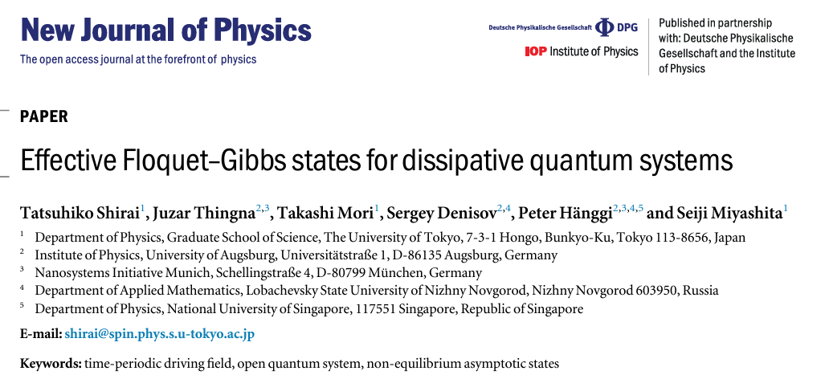

$H\left(t\right)=H_{S}(t)+H_{SE}$+ $H_{E}$
Periodic Hamiltonian $H_{S}\left(t\right)=H_{S}\left(t+T\right);$
Dissipation due to system-environment interaction;
Sincronization:
$$\left\langle O_{S} (t)\right\rangle$$
$ρ∝e^{−βH_{eff}}$?
$$t$$
$$H_{eff}=H_{F}^{(n)}$$
2

Slide 10
$H\left(t\right)=H_{S}(t)+H_{SE}$+ $H_{E}$
Periodic Hamiltonian $H_{S}\left(t\right)=H_{S}\left(t+T\right);$
Dissipation due to system-environment interaction;
Sincronization:
$$\left\langle O_{S} (t)\right\rangle$$
$$t$$
$$H_{eff}=H_{F}^{(n)}$$
Dissipation rate must be higher than the heating rate;
Time-dependent part of the Hamiltonian should commute with itself at different times;
Driving field should be much larger than the environment cutoff frequency.
2

Slide 11
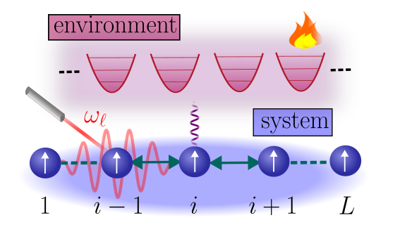


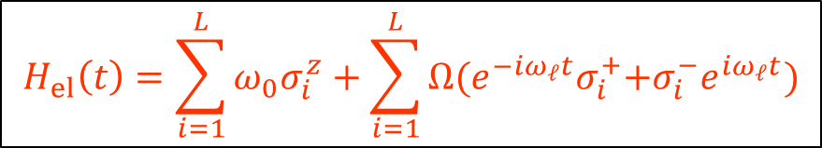

Periodically driven spin systems
$H\left(t\right)=H_{S}(t)+H_{SE}$+ $H_{E}$
$$H_{S}(t)=H_{el}(t)+H_{int}$$
$$H_{el}\left(t\right)=\sum_{i=1}^{L}{{ω_{0}σ}_{i}^{z}}+\sum_{i=1}^{L}{Ω{(e^{−iω_{ℓ}t}σ}_{i}^{+}{+σ}_{i}^{−}e^{iω_{ℓ}t})}$$
$$ω_{0},ω_{ℓ}≫Ω$$
3

Slide 12
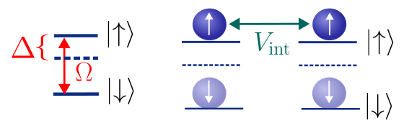

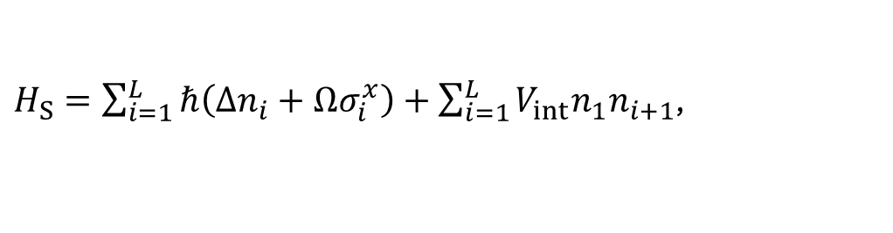
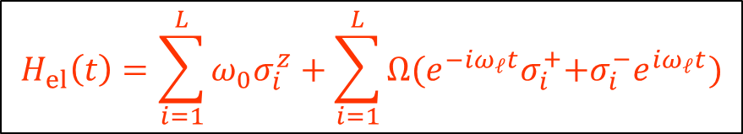


Periodically driven spin systems
$H\left(t\right)=H_{S}(t)+H_{SE}$+ $H_{E}$
$$H_{S}(t)=H_{el}(t)+H_{int}$$
$$H_{el}\left(t\right)=\sum_{i=1}^{L}{{ω_{0}σ}_{i}^{z}}+\sum_{i=1}^{L}{Ω{(e^{−iω_{ℓ}t}σ}_{i}^{+}{+σ}_{i}^{−}e^{iω_{ℓ}t})}$$
$$ω_{0},ω_{ℓ}≫Ω$$
Can one eliminate this time dependency? Rotating frame of the laser!
$H_{S}=\sum_{i=1}^{L}{ℏ\left(Δn_{i}+Ωσ_{i}^{x}\right)}+\sum_{i=1}^{L}{V_{int}n_{1}n_{i+1}}$,
$Δ=$ $ω_{0}$- $ω_{ℓ}$
3

Slide 13





$Δ=$ $ω_{0}$- $ω_{ℓ}$
${U_{L}H}_{SE}U_{L}^{†}=$ $U_{L} SU_{L}^{†}⨂E$
$${U_{L}H}_{S}\left(t\right)U_{L}^{†}$$
$$H_{S}$$
$$H_{SE}(t)=S(ω_{ℓ}t)⨂E$$
4

Slide 14
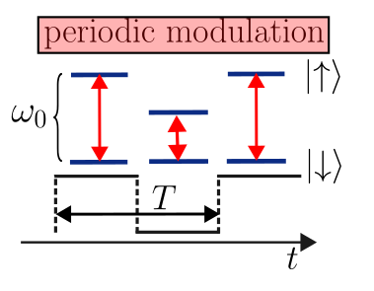


$Δ=$ $ω_{0}$- $ω_{ℓ}$
${U_{L}H}_{SE}U_{L}^{†}=$ $U_{L} SU_{L}^{†}⨂E$
$${U_{L}H}_{S}\left(t\right)U_{L}^{†}$$
$$H_{S}$$
$$H_{SE}(t)=S(ω_{ℓ}t)⨂E$$
$Δ=Δ$($ωt$)
$$H_{S}(t)$$
4

Slide 15

$Δ=$ $ω_{0}$- $ω_{ℓ}$
${U_{L}H}_{SE}U_{L}^{†}=$ $U_{L} SU_{L}^{†}⨂E$
$${U_{L}H}_{S}\left(t\right)U_{L}^{†}$$
$$H_{S}$$
$$H_{SE}(t)=S(ω_{ℓ}t)⨂E$$
$Δ=Δ$($ωt$)
$$H_{S}(t)$$
$$∂_{t}ρ=−\frac{i}{ℏ}\left[H_{S}\left(ωt\right),ρ\right]+D[ρ](ωt,ω_{ℓ}t)$$
Non-equilibrium environment + non-equilibrium system: could we anticipate the emergence of a stroboscopic equilibrium state?
Environment
System
4

Slide 16
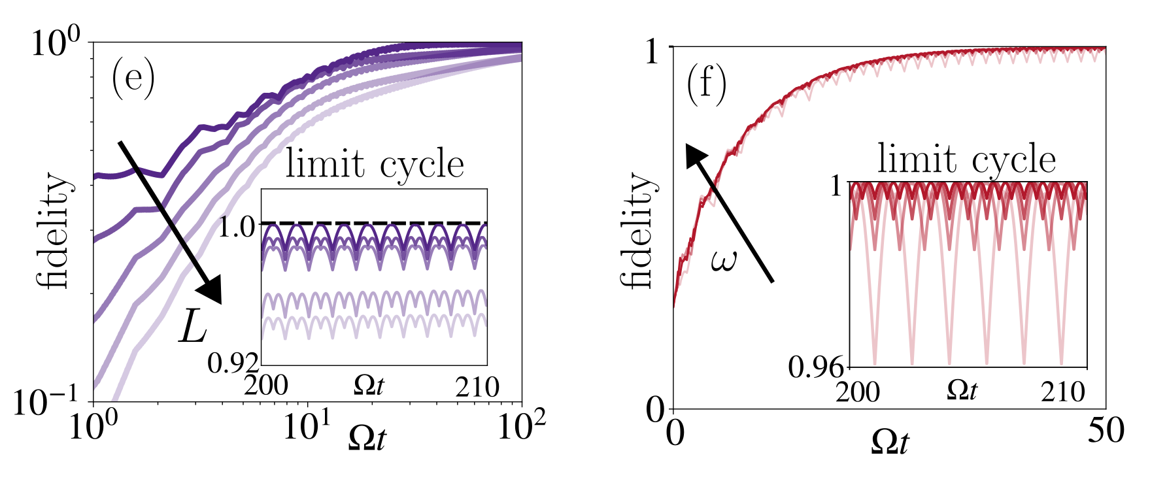
YES! For $ω_{ℓ}≫ω>s.f.$, still the effective Floquet Gibbs states:
How can we explain that? Floquet theory + Redfield equation
5

Slide 17

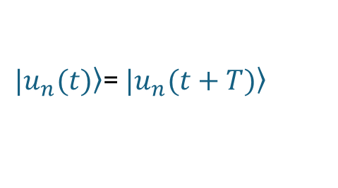
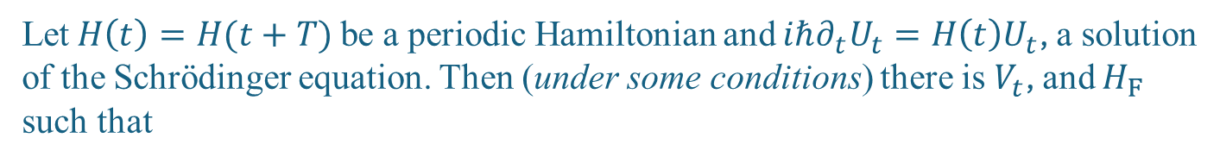
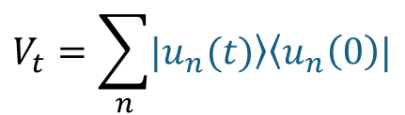

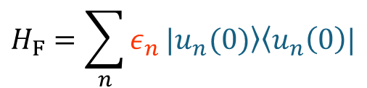

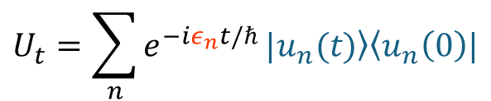


Floquet‘s theorem ($U_{t,0}=U_{t}$)
Let $H\left(t\right)=H(t+T)$ be a periodic Hamiltonian and ${iℏ∂_{t}U}_{t}=H\left(t\right)U_{t}$, a solution of the Schrödinger equation. Then (under some conditions) there is $V_{t}$, and $H_{F}$ such that
$$U_{t}={V_{t}e}^{−itH_{F}/ℏ},$$
$V_{t}=V_{t+T}$,
Time-independent $H_{F}$.
Notice: $U_{T}={V_{T}e}^{−iTH_{F}/ℏ},$ and $V_{T}=V_{0}=1$ $⟶$ $U_{T}=e^{−iTH_{F}/ℏ}$
$U_{ℓT}={(U_{T})}^{ℓ}$,
$$ℓ∈ℕ$$
More generaly:
$$H_{F}=\sum_{n}{ε_{n}}\left.|u_{n}(0)\right\rangle \left\langle u_{n}\left(0\right)|\right.$$
$$U_{t}=\sum_{n}{e^{−iε_{n}t/ℏ}}\left.|u_{n}(t)\right\rangle \left\langle u_{n}\left(0\right)|\right.$$
$$V_{t}=\sum_{n}{\left.|u_{n}(t)\right\rangle \left\langle u_{n}\left(0\right)|\right.}$$
quasienergies
Floquet modes
$\left.|u_{n}(t)\right\rangle$= $\left.|u_{n}(t+T)\right\rangle$
6

Slide 18
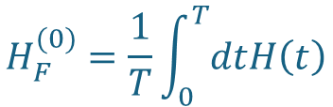
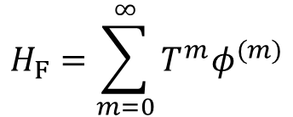

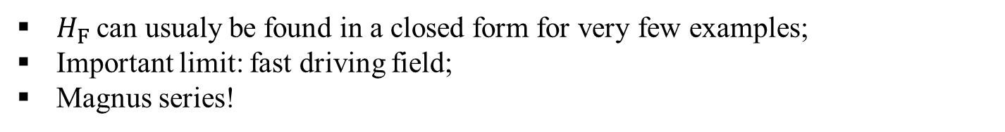

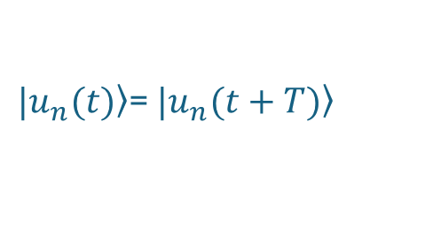

$$U_{t}=\sum_{n}{e^{−iε_{n}t/ℏ}}\left.|u_{n}(t)\right\rangle \left\langle u_{n}\left(0\right)|\right.$$
with
$\left.|u_{n}(t)\right\rangle$= $\left.|u_{n}(t+T)\right\rangle$
$$ε_{nm}=ε_{n}+ℏmω,$$
$$m∈ℤ$$
$H_{F}$ can usualy be found in a closed form for very few examples;
Important limit: fast driving field;
Magnus series!
$$H_{F}=\sum_{m=0}^{∞}{T^{m}φ^{(m)}}$$
0th order:
$$H_{F}^{(0)}=\frac{1}{T}\int_{0}^{T}{dtH\left(t\right)}$$
7

Slide 19


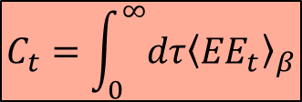
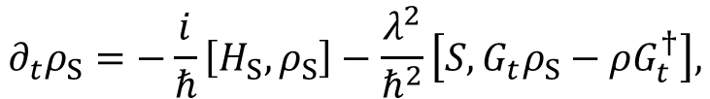
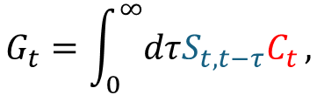


Redfield equation
$∂_{t}ρ_{S}=−\frac{i}{ℏ}{tr}_{E}\left[H,ρ\right]$,
$$H=H_{S}+H_{SE}+H_{E}$$
$$∂_{t}ρ_{S}=−\frac{i}{ℏ}\left[H_{S},ρ_{S}\right]−\frac{λ^{2}}{ℏ^{2}}\left[S,G_{t}ρ_{S}−ρG_{t}^{†}\right],$$
$$H_{SE}=ℏS⨂E$$
$$G_{t}=\int_{0}^{∞}{dτS_{t,t−τ}C_{t}},$$
$$C_{t}=\int_{0}^{∞}{dτ{\left\langle {EE}_{t}\right\rangle }_{β}}$$
$$S_{t,t−τ}=U_{t}U_{t−τ}^{†}SU_{t−τ}U_{t}^{†}$$
8

Slide 20
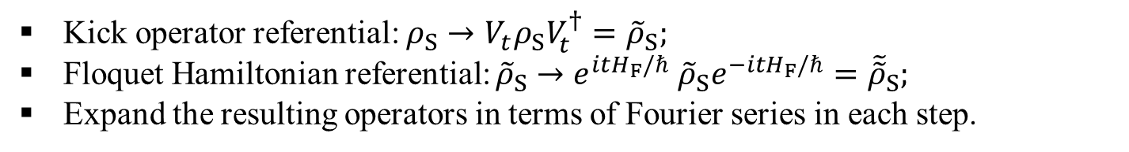
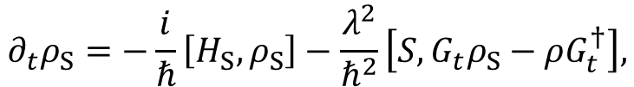
Redfield equation
$$∂_{t}ρ_{S}=−\frac{i}{ℏ}\left[H_{S},ρ_{S}\right]−\frac{λ^{2}}{ℏ^{2}}\left[S,G_{t}ρ_{S}−ρG_{t}^{†}\right],$$
Kick operator referential: $ρ_{S}→V_{t}ρ_{S}V_{t}^{†}={\tilde{ρ}}_{S};$
Floquet Hamiltonian referential: ${\tilde{ρ}}_{S}→e^{itH_{F}/ℏ}$ ${\tilde{ρ}}_{S}e^{−itH_{F}/ℏ}={\tilde{\tilde{ρ}}}_{S};$
Expand the resulting operators in terms of Fourier series in each step.
9

Slide 21

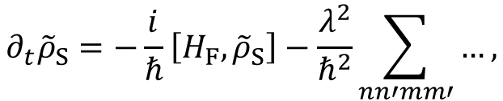

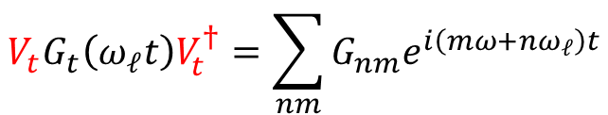

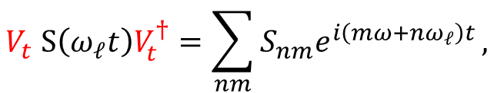

Redfield equation
$$∂_{t}ρ_{S}=−\frac{i}{ℏ}\left[H_{S},ρ_{S}\right]−\frac{λ^{2}}{ℏ^{2}}\left[S,G_{t}ρ_{S}−ρG_{t}^{†}\right],$$
$$U_{t}={V_{t}e}^{−itH_{F}/ℏ},$$
$$V_{t} S\left(ω_{ℓ}t\right)V_{t}^{†}=\sum_{nm}{S_{nm}e^{i\left(mω+nω_{ℓ}\right)t}},$$
$$V_{t}G_{t}\left(ω_{ℓ}t\right)V_{t}^{†}=\sum_{nm}{G_{nm}e^{i\left(mω+nω_{ℓ}\right)t}}$$
$$∂_{t}{\tilde{ρ}}_{S}=−\frac{i}{ℏ}\left[H_{F},{\tilde{ρ}}_{S}\right]−\frac{λ^{2}}{ℏ^{2}}\sum_{nn′mm′}{…},$$
$\left[H_{F},S_{nm}\left(κ\right)\right]={−κS}_{nm}\left(κ\right)$,
$$\left[H_{S},{S_{nm}^{†}\left(κ\right)S}_{n′m′}\left(κ\right)\right]=0$$
„Interaction picture“ with respect to $H_{F}$:
${e^{itH_{F}/ℏ}S}_{nm}\left(κ\right)e^{−itH_{F}/ℏ}={e^{−iκt}S}_{nm}\left(κ\right)$,
$$∂_{t}{\tilde{\tilde{ρ}}}_{S}=−\frac{1}{ℏ^{2}}\sum_{nn^{′}mm^{′}κκ′}{exp⁡\left[{\text{(}m+m′)ωt+(n+n′)ω_{ℓ}t+(κ+κ′)t}/{λ^{2}}\right]…},$$
10

Slide 22

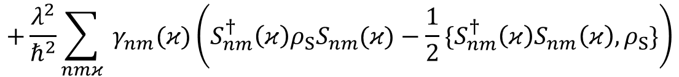

Redfield equation
$${\text{(}m+m′)ω+(n+n′)ω_{ℓ}+(κ+κ′)}/{λ^{2}}$$
These terms oscillate very fast: secular/rotating wave approximation!
$$∂_{t}ρ_{S}=−\frac{i}{ℏ}\left[H_{F}+H_{LS},ρ_{S}\right],$$
$$+\frac{λ^{2}}{ℏ^{2}}\sum_{nmκ}{{ γ}_{nm}(κ)\left({S_{nm}^{†}\left(κ\right)ρ_{S}S}_{nm}(κ)−\frac{1}{2}\{S_{nm}^{†}{\left(κ\right)S}_{nm}\left(κ\right),ρ_{S}\}\right)}$$
Floquet-Lindblad equation!!
11

Slide 23


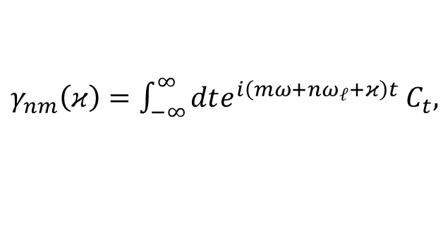


Decay rates and thermodynamics
${ γ}_{nm}\left(κ\right)=\int_{−∞}^{∞}{dte^{i\left(mω+nω_{ℓ}+κ\right)t}}$ $C_{t},$
$$C_{t}=C\left(t,β\right)$$
Riemman-Lebesgue lemma: terms with $m,n≠0$ go to zero…
$$C\left(−t−iβ,β\right)=C\left(t,β\right),$$
$$γ_{00}(−κ)=e^{−βκ}γ_{00}(κ)$$
$$ρ_{SS}∝e^{−βH_{F}}$$
12

Slide 24
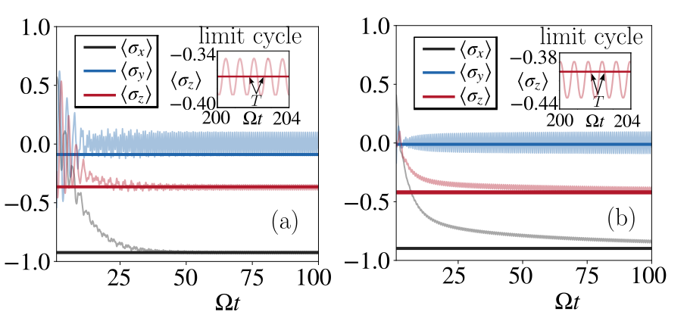

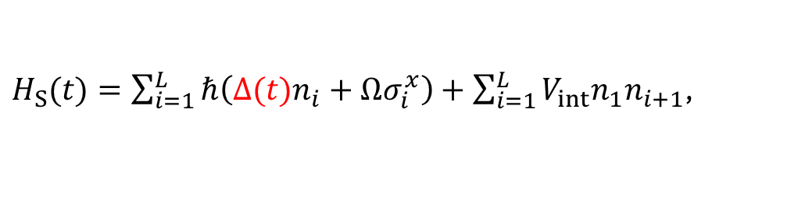


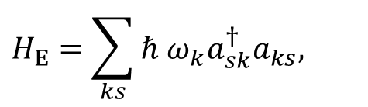
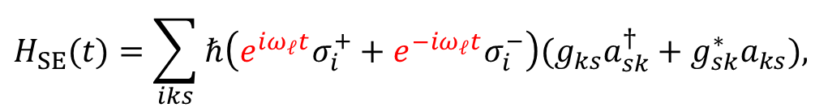
$H_{S}(t)=\sum_{i=1}^{L}{ℏ\left(Δ(t)n_{i}+Ωσ_{i}^{x}\right)}+\sum_{i=1}^{L}{V_{int}n_{1}n_{i+1}}$,
$$H_{SE}(t)=\sum_{iks}{ℏ\left(e^{iω_{ℓ}t}σ_{i}^{+}+e^{−iω_{ℓ}t}σ_{i}^{−}\right)(g_{ks}a_{sk}^{†}+g_{sk}^{∗}a_{ks}),}$$
$$H_{E}=\sum_{ks}{ℏ ω_{k}a_{sk}^{†}a_{ks},}$$
$${ γ}_{nm}=0,$$
$$n=+1, −1→$$
$$n≠+1, −1$$
$${ S}_{nm}=0,$$
13

Slide 25
Contributions
Description of stroboscopic equilibrium for an experimentaly relevant class of systems (cold atom platforms).
Experimental test for EFG.
Important starting for multiple frequencies models: thermalization using polichromatic Floquet theory.
14

