Slide 1

Effective equilibrium states for a class of quasiperiodic models
Wilson S. Martins
1 March 2024

Slide 2

Some motivation 1: (effective) Floquet-Gibbs states
$$ρ∝e^{−βH_{eff}}$$

Slide 3
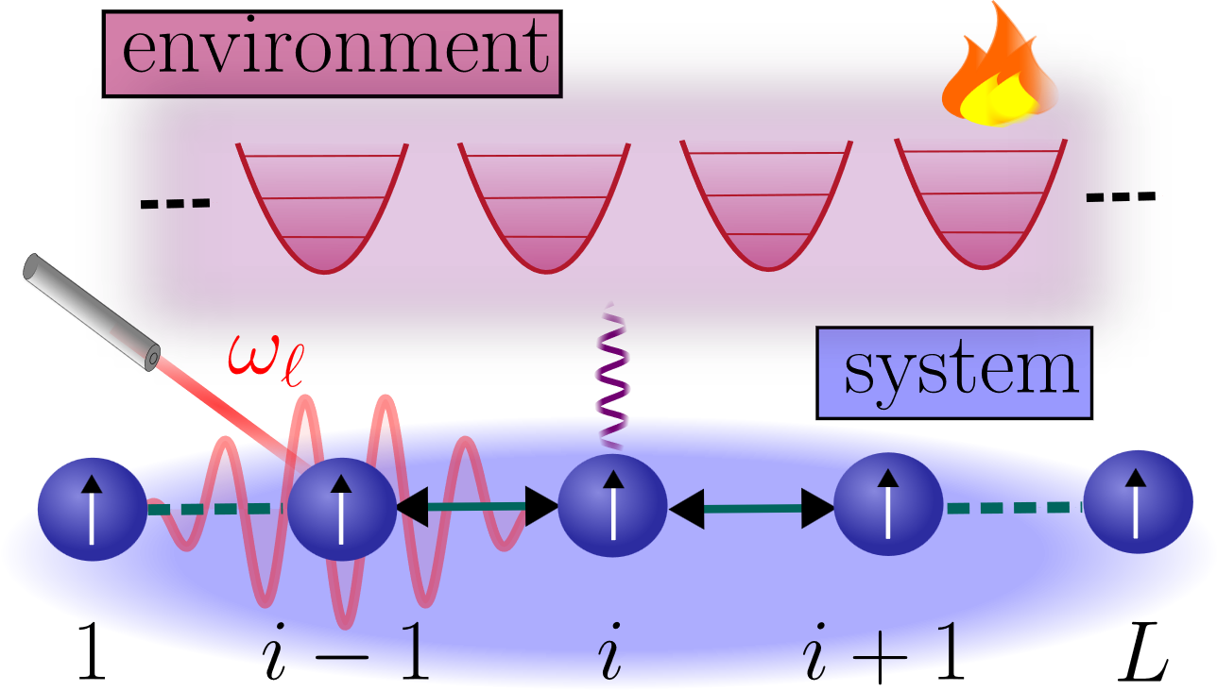


Some motivation 2: periodically driven spin systems
$$H_{SE}=S(t)⨂E$$
$$ρ∝e^{−βH_{eff}}$$

Slide 4


Some motivation 2: periodically driven spin systems
$$∂_{t}ρ=−i\left[H\left(t\right),ρ\right]+D[ρ]()$$
$$ρ∝e^{−βH_{eff}}$$

Slide 5
Are their steady states described by EFG ensembles?

Slide 6
Floquet theory

Slide 7
Redfield equation

