Slide 1
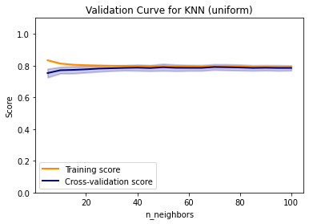
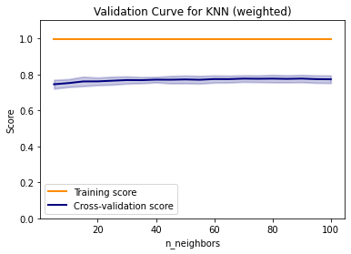
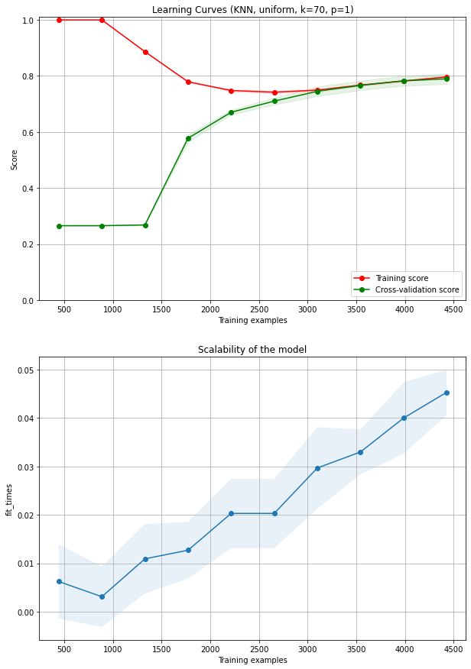
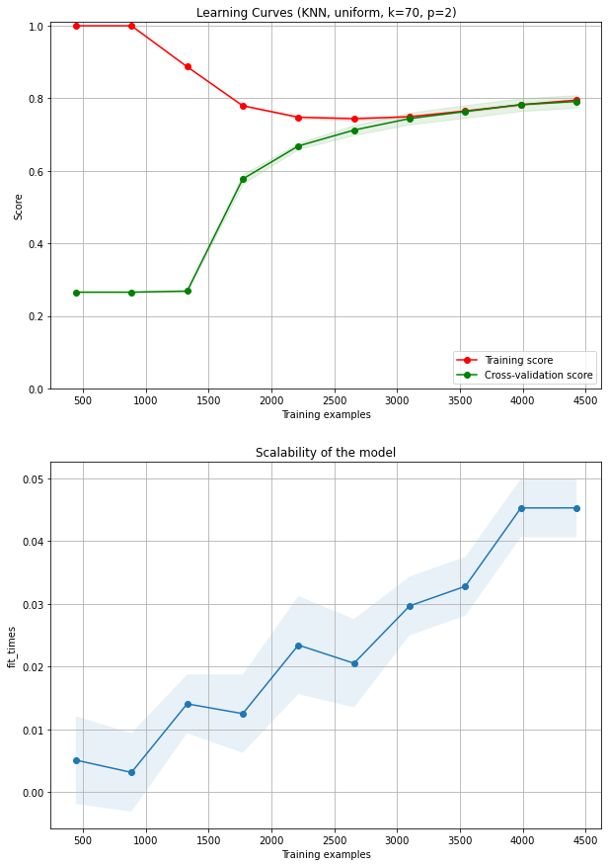
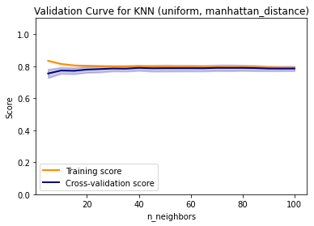
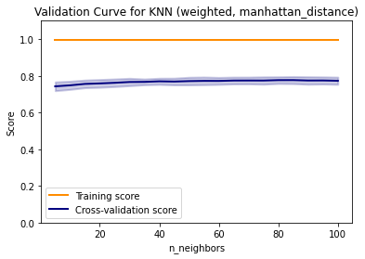
KNN –T (Miss one figure)
a
b
e
f
c
d

Slide 2
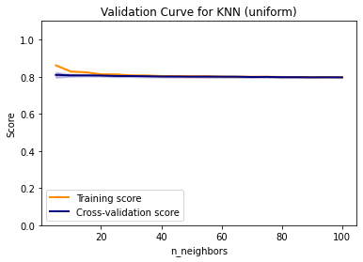
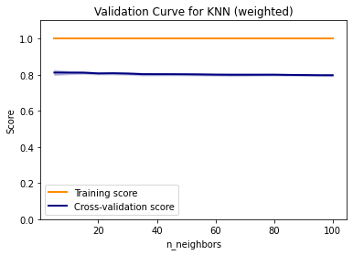
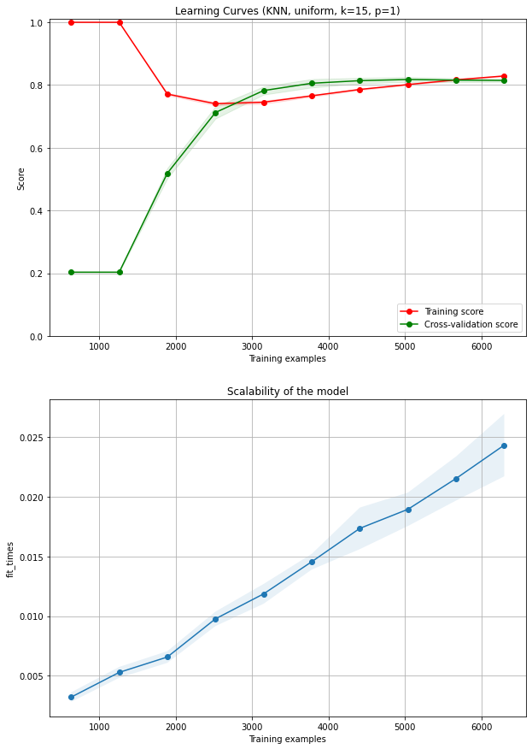
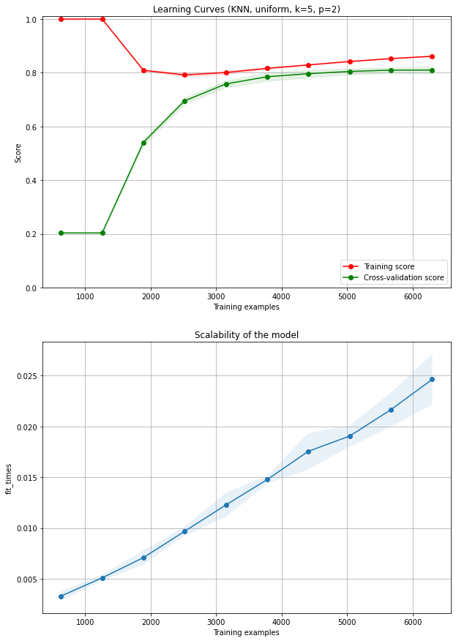
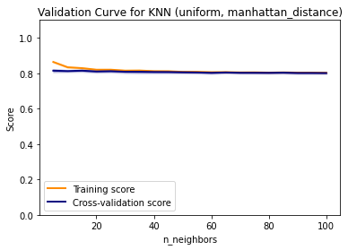
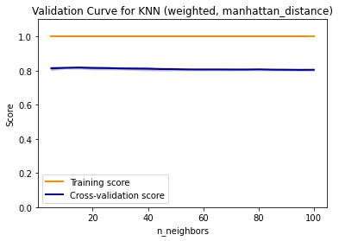
KNN_B
a
b
e
f
c
d

Slide 3
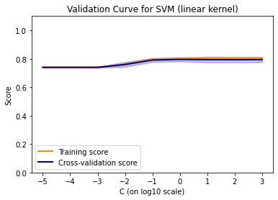
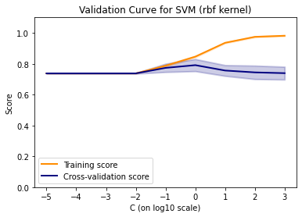
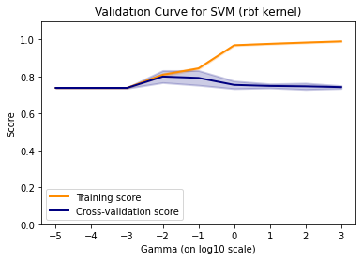
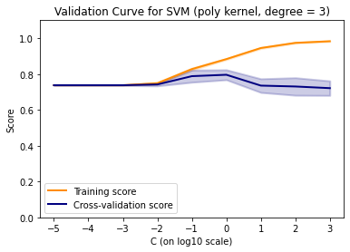
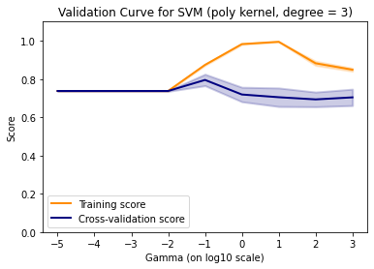
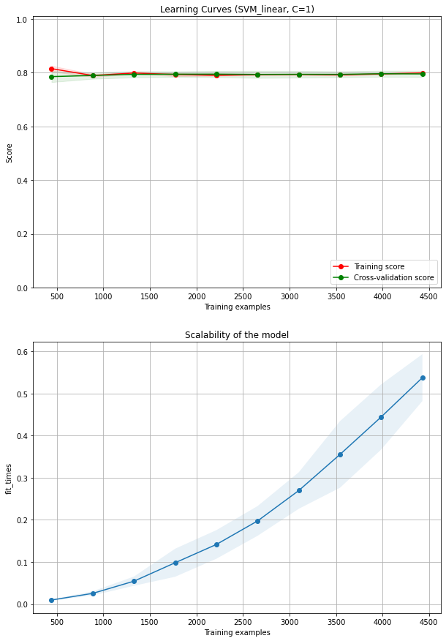
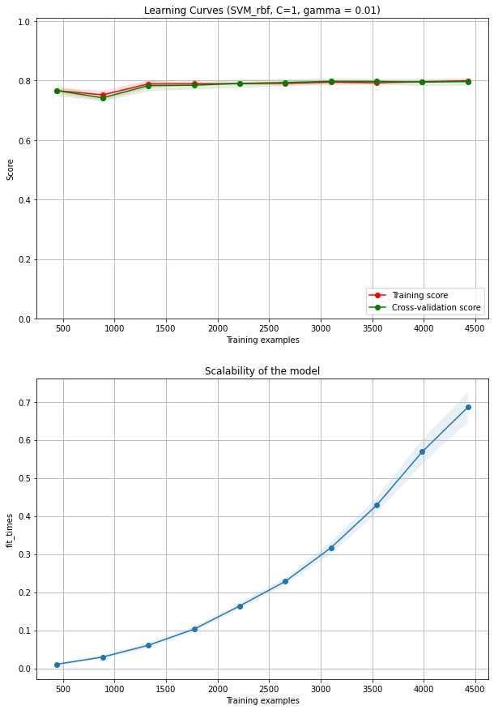
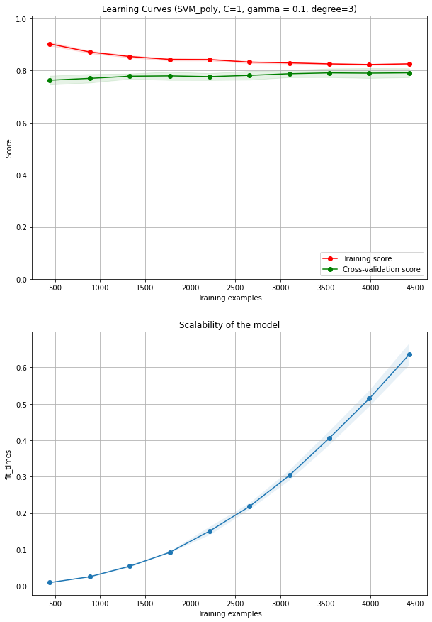
SVM - T (Miss feature imp)
a
b
c
d
e
f
g
h

Slide 4
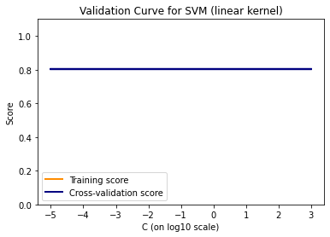
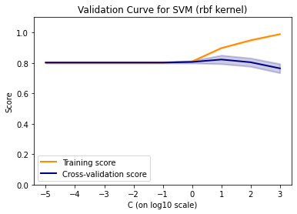
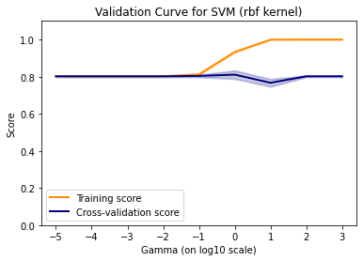
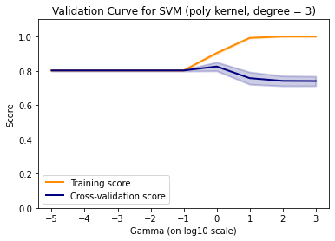
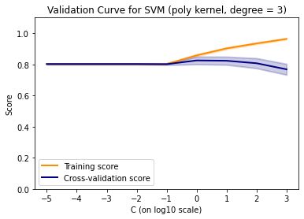
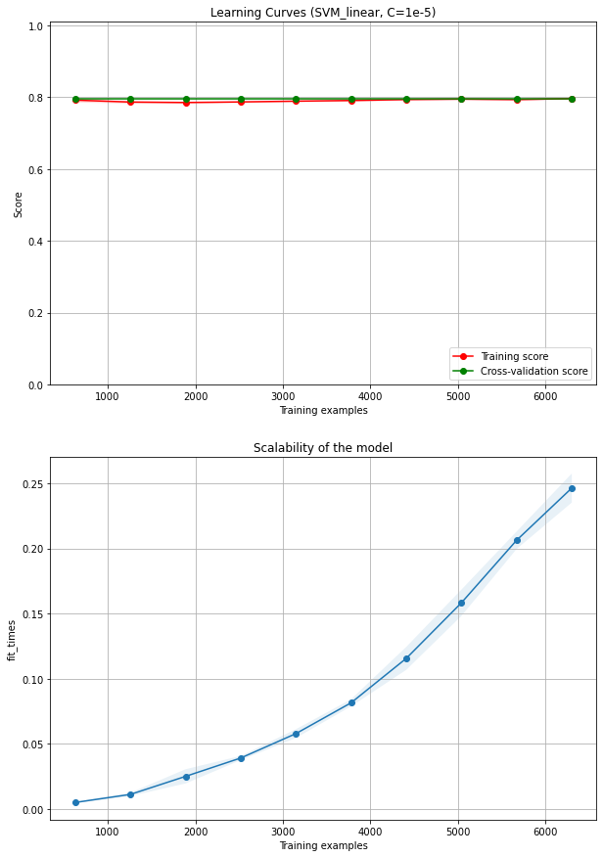
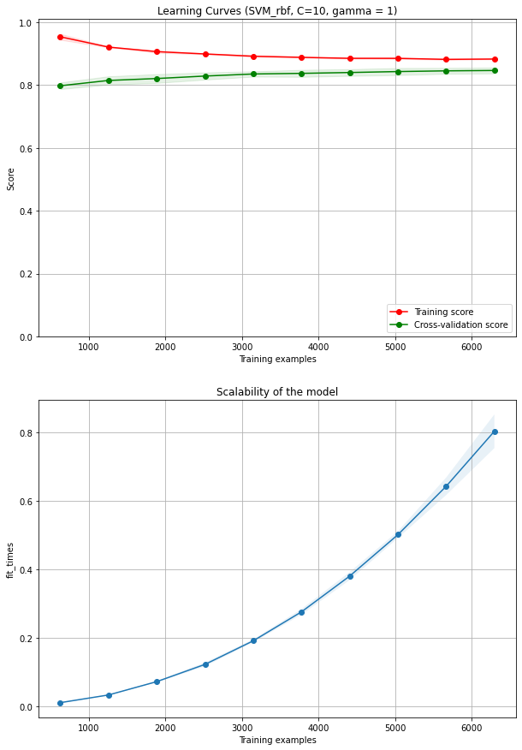
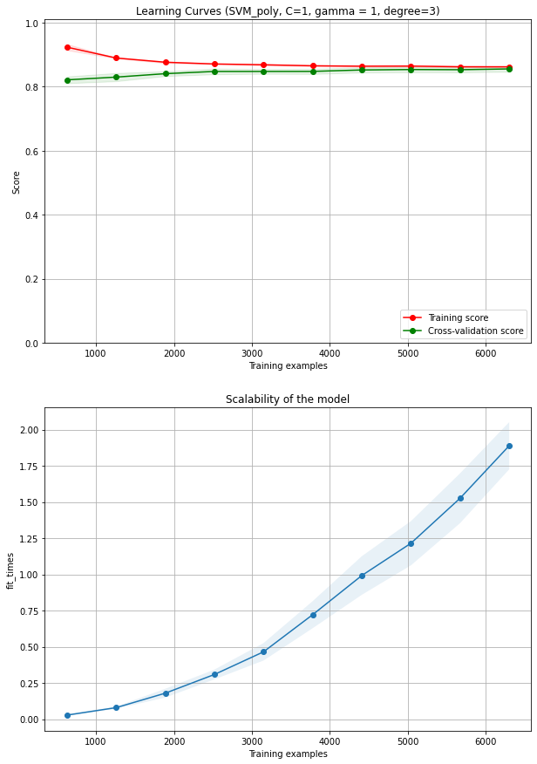
SVM - B (Miss feature imp)
a
b
c
d
e
f
g
h

Slide 5
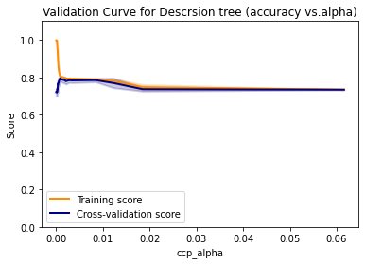
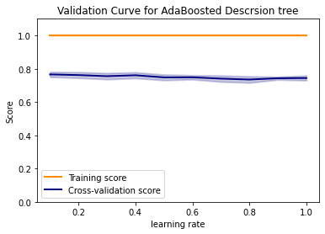
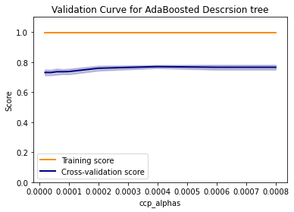
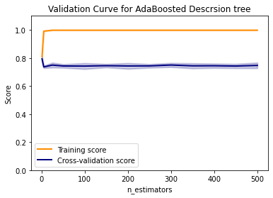
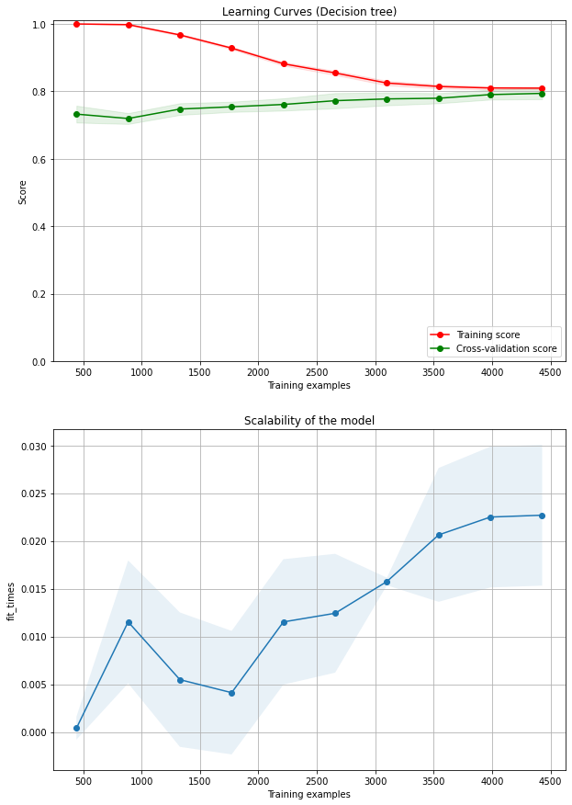
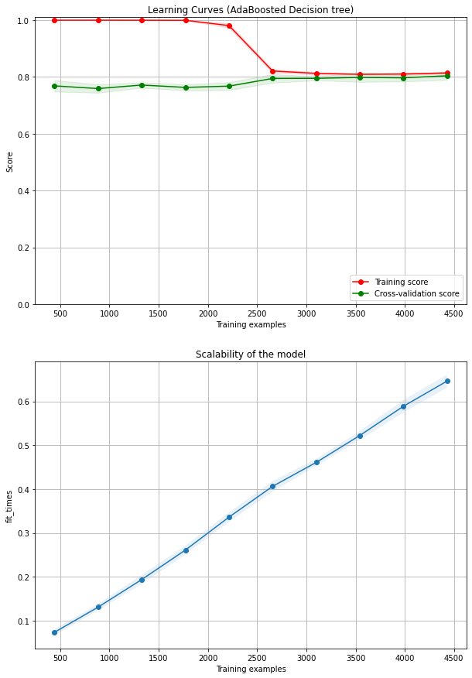
DT &BDT - T (Miss feature imp)
a
A
B
C
b
D

Slide 6
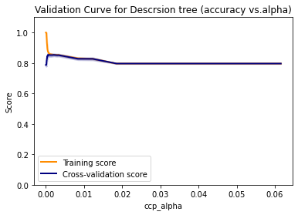
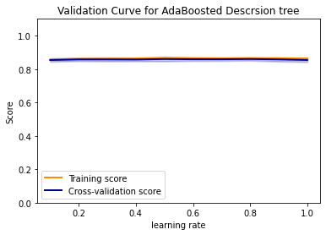
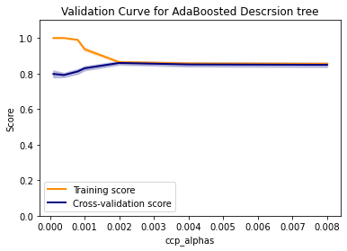
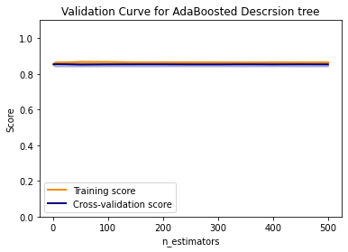
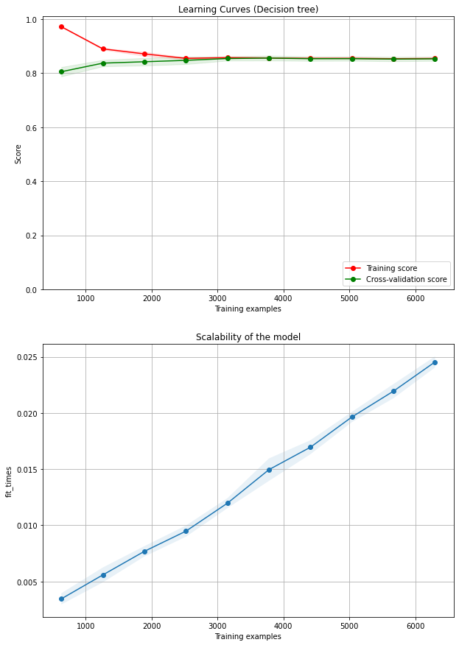
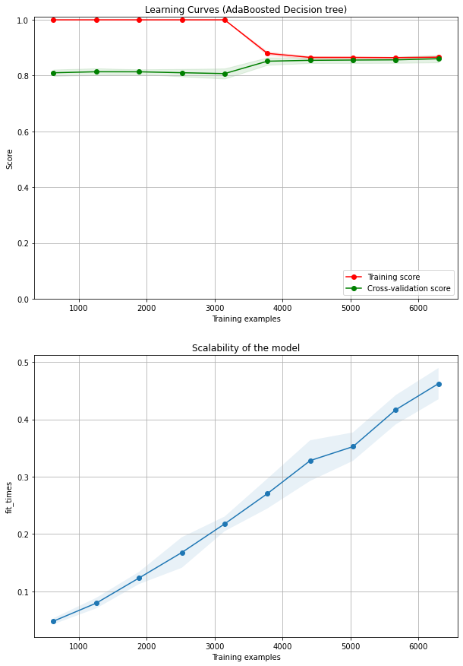
DT &BDT - B (Miss feature imp)
a
A
B
C
b
D

Slide 7
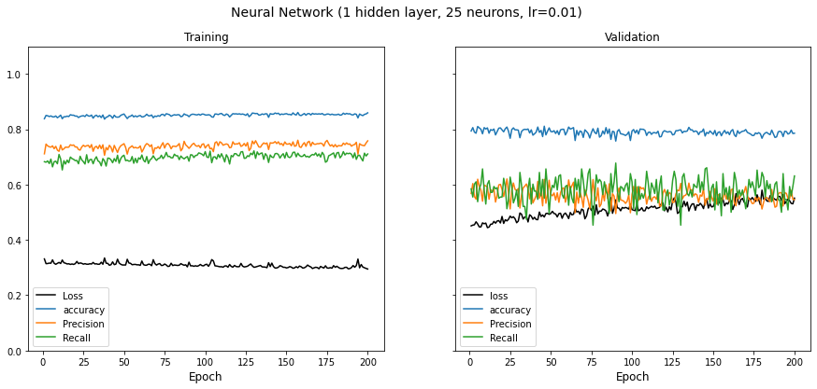
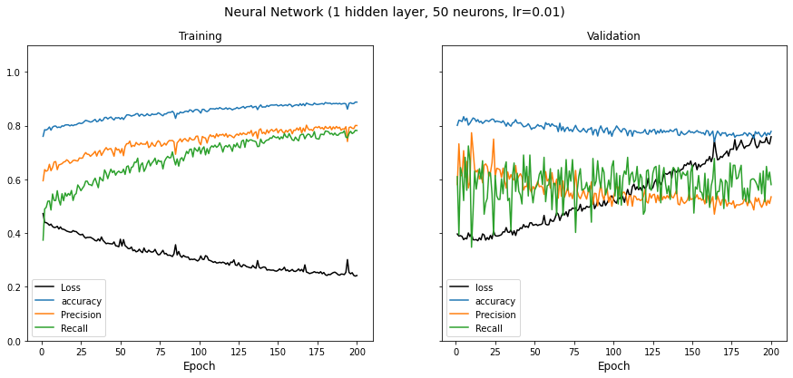
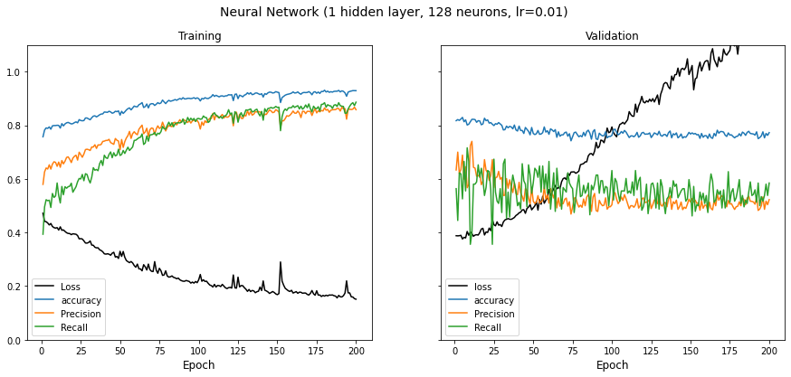
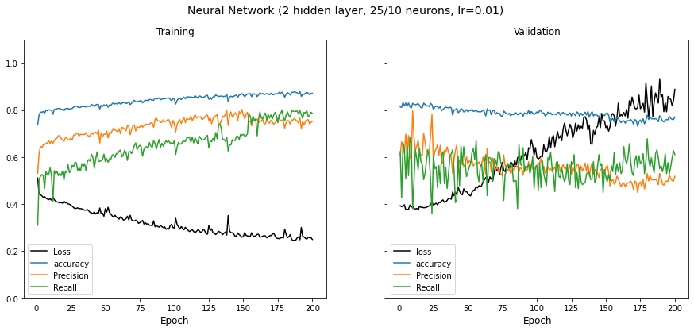
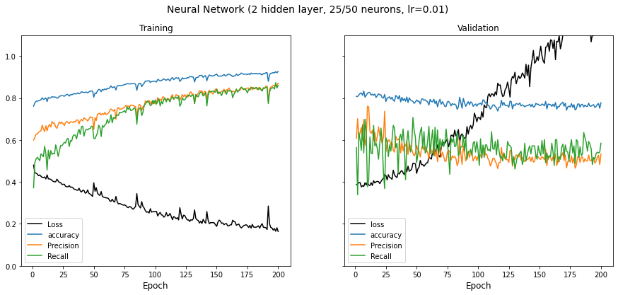
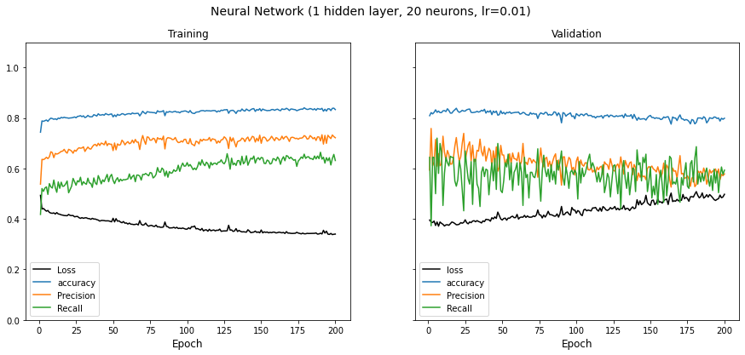
NN- T (Miss feature imp??)
Relu (neuron size 25, 50, 128, 0.01 lr)
a
b
c
d
e
f
Neural Network (1 hidden layer, 25 neurons, lr = 0.001)
Relu (25/0.001)
Relu (two layers lr=0.01)

Slide 8
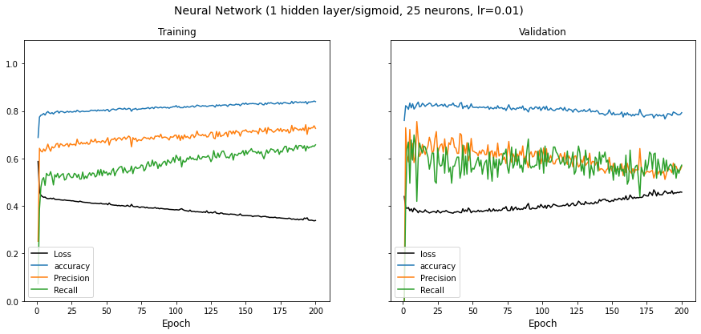
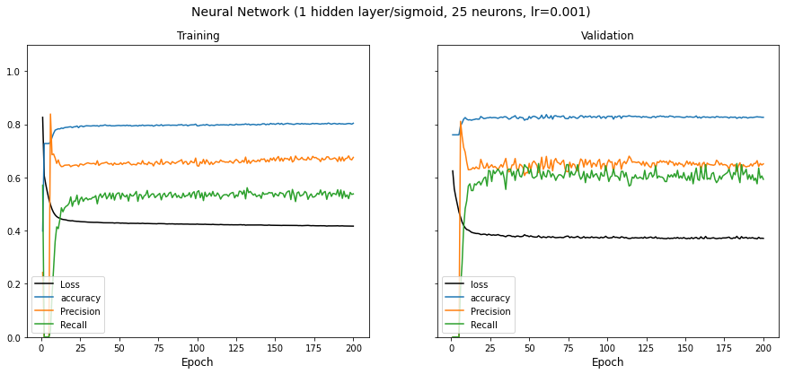
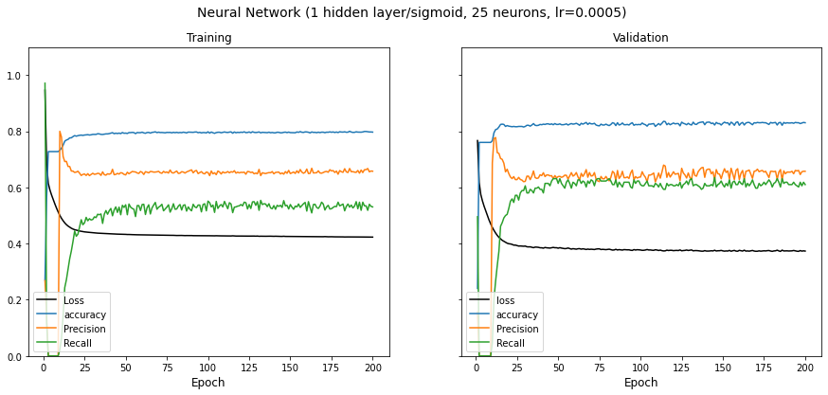
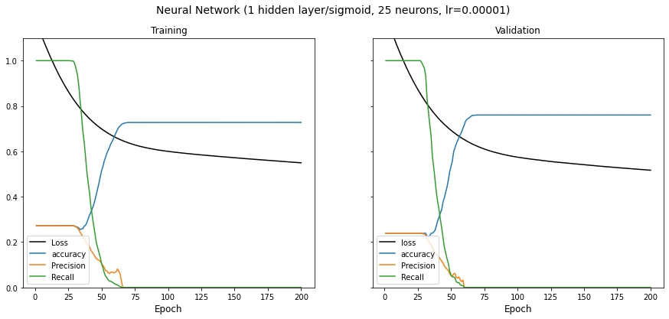

NN- T (Miss feature imp??)
Sigmoid (25 neuron LR, e: 50 NN 0.001 vs. b)
a
b
c
d
0.0001)
E (remove??)

Slide 9






NN- B (Miss feature imp??)
Relu (neuron size 10, 20, 50, 0.01 lr; 25 128 also tested but not present)
a
b
c
d
e
f
Relu (20/0.001)
Relu (two layers lr=0.01)

Slide 10



NN- B (Miss feature imp??)
Sigmoid (20 neuron LR)
a
Neural Network (1 hidden layer/sig, 20 neurons, lr= 0.01)
b
c
sig

Slide 11
Overall performance comparison
Train: 4922 (neg 3614; pos:1308)
Datasets | Algorithms | Train Dataset (70%) |  |  | Test Dataset (30%) |  |  | Fitting Time
 |  | Accuracy | Precision | Recall | Accuracy | Precision | Recall
Telecom Churns | KNN | 79.5% | 62.8% | 55.8% | 79.1% | 61.7% | 56.7% | ~ 0.045s
 | SVM | 79.9% | 64.7% | 53.5% | 79.5% | 63.8% | 53.3% | ~0.55s
 | Decision Tree | 80.4% | 68.3% | 48.7% | 79.7% | 66.1% | 48.7% | ~0.025s
 | Boosted Decision Tree | 81.2% | 74.4% | 55.3% | 80.5% | 67.1% | 52.0% | ~0.65s
 | Neural Network | 80.5% | 66.1% | 54.3% | 80.9% | 66.8% | 56.3% | ~50s
Bank Customer Churns | KNN | 82.3% | 75.8% | 24.1% | 81.5% | 65.1% | 20.4% | ~0.025s
 | SVM | 86.1% | 81.5% | 41.2% | 86.1% | 79.4% | 42.8% | ~1.9s
 | Decision Tree | 85.4% | 69.6% | 50.4% | 85.3% | 68.5% | 52.1% | ~0.025s
 | Boosted Decision Tree | 86.8% | 78.4% | 48.8% | 86.5% | 75.7% | 49.8% | ~0.45s
 | Neural Network | 86.2% | 74.0% | 49.8% | 85.7% | 70.6% | 51.3% | ~60s
sig

Slide 12



