Slide 1
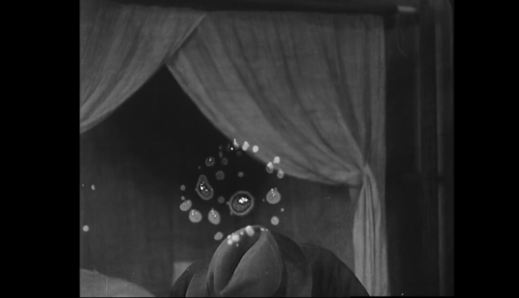
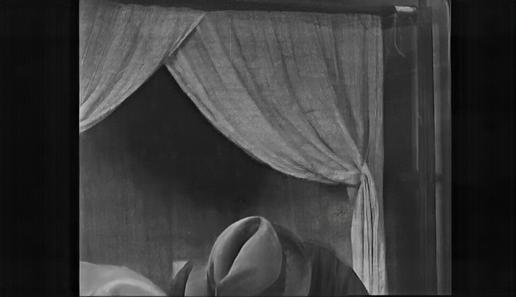
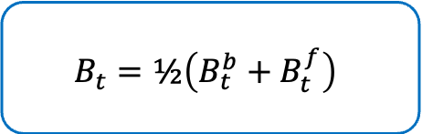









$$x_{t}$$
$$s_{t−1→t}$$
Flow Warp
Gated DCN Alignment
SSM Spatial Refinement
MGFE
$$B_{t}^{f}$$
$${\tilde{f}}_{t}^{f}$$
Bidirectional
Optical Flow
Estimation
Concat
Reconstruction
$${\tilde{f}}_{t}^{b}$$
Flow Warp
Gated DCN Alignment
SSM Spatial Refinement
MGFE
$$s_{t→t+1}$$
$$x_{t}$$
$$B_{t}^{b}$$
$$B_{t}=½\left(B_{t}^{b}+B_{t}^{f}\right)$$
RATR
(training only)
$$L_{ratr}$$

