Slide 1


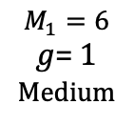







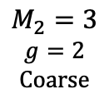

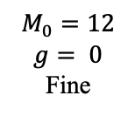







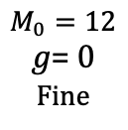
$$\tilde{f_{t}}$$
$$f_{t}$$
$$f_{t}⊙\left(1+tanh\left(γ\right)\right)+0.1·tanh\left(β\right)$$
$$f_{t}$$
Flatten
$$Z_{t}$$
Insert $Π$
(N+M) tokens
Image tokens
M = 12 restoration tokens inserted
$$C × H × W$$
Average
$$c_{t}$$
$$Ψ\left(·\right)$$
$$γ$$
$$β$$
$$M_{0}=12$$
$$g= 0$$
Fine
$$M_{0}=12$$
𝑔= 0
Fine
$$Φ_{0}$$
$$b^{0}$$
Average-Fuse ×2
$$M_{1}=6$$
𝑔= 1
Medium
RATR
(training only)
$$Φ_{1}$$
$$b^{1}$$
$$B_{t}$$
Average-Fuse ×4
$$M_{2}=3$$
$$g=2$$
Coarse
$$Φ_{2}$$
$$b^{2}$$

