Slide 1
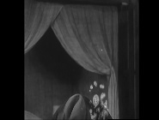


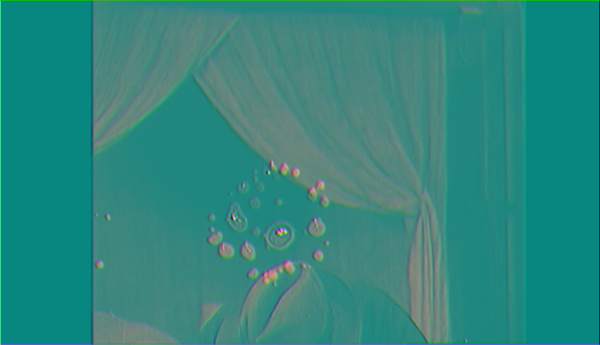
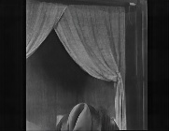
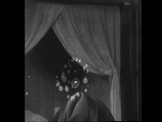


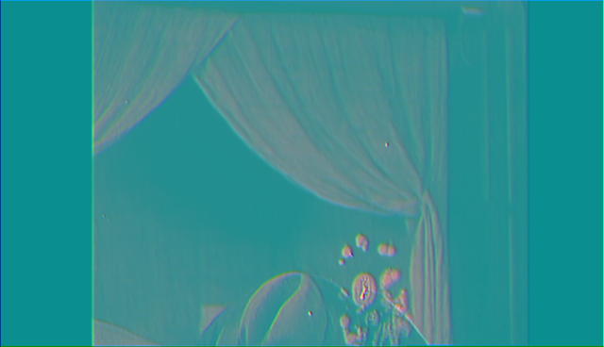




















$$M_{i−1 }$$
$$X_{i−1}$$
$$s_{i+1→i}$$
Optical Flow
Residual indicator
$$R_{b}$$
$$W$$
Estimation
MGFE
$$X_{i}$$
$$R_{b}$$
SSM
$$f_{i}$$
DPB
Gated DCN Aggregation
$$X_{i}$$
Concat
$${\hat{X}}_{i}$$
Encoder
MambaBlock
RATR
Reconstruction
$$M_{i }$$
$$X_{i}$$
$$s_{i−1→i}$$
Optical Flow
Residual indicator
$$R_{f}$$
Estimation
$$W$$
$$X_{i+1}$$
MGFE
$$R_{f}$$
SSM
$$f_{i+1}$$
DPB
Gated DCN Aggregation
$$X_{i+1}$$
$$W$$
Flow Warp
Encoder
$$M_{i+1 }$$
MambaBlock

