Slide 1




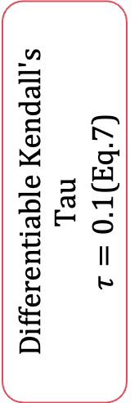


















Training Only — disabled at inference
$$B_{t−1}$$
Positive Set $P\left(i\right)$
$$S^{\left(0\right)}$$
Fine
$$t−1$$
$$t$$
$$t+1$$
$$N̄×N̄$$
Temporal neighbors
(Eq.17)
$$L_{intra}$$
$$B_{t}$$
$$S^{\left(1\right)}$$
Differentiable Kendall's Tau
$τ=0.1$(Eq.22)
Medium
L2 Normalize
(Eq.15)
Negative Set $N\left(i\right)$
$$⋯$$
$$⋯$$
$$L_{inter}$$
$$B_{t+1}$$
$$S^{\left(2\right)}$$
Same-video distant
Coarse
$$\left|t_{j}−t_{i}\right|>1$$
$$N̄×N̄$$
$L_{ratr}$(Eq.25)
$$ℬ∈ℝ^{N_{b}×T×G×D}$$
$$N̄=N_{b}T$$
cosine similarity
Cross-video centroids
(Eq.20)
$$λ_{intra}\text{= 1.0,}{ λ}_{inter}\text{= 0.5}$$
Training Only — disabled at inference

