Slide 1




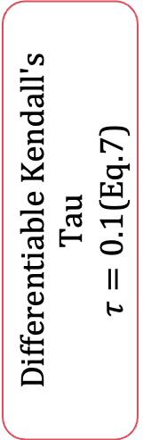


















Training Only — disabled at inference
$$B_{t−1}$$
Positive Set $P\left(i\right)$
$$S^{\left(0\right)}$$
Fine
$$t−1$$
$$t$$
$$t+1$$
$$N×N$$
Temporal neighbors
(Eq.5)
$$L_{intra}$$
$$B_{t}$$
$$S^{\left(1\right)}$$
Differentiable Kendall's Tau
$τ=0.1$(Eq.7)
Medium
L2 Normalize
(Eq.4)
Negative Set $N\left(i\right)$
$$⋯$$
$$⋯$$
$$L_{inter}$$
$$B_{t+1}$$
$$S^{\left(2\right)}$$
Same-video distant
Coarse
$$\left|τ_{j}−τ_{i}\right|>1$$
$$N×N$$
$L_{ratr}$(Eq.10)
$$B∈ℝ^{B×T×G×D}$$
$$N=BT$$
cosine similarity
Cross-video centrioids
(Eq.6)
$$λ_{intra}\text{= 1.0,}{ λ}_{inter}\text{= 0.5}$$
Training Only — disabled at inference

