Slide 1
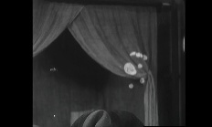
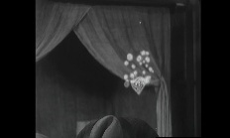
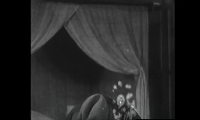
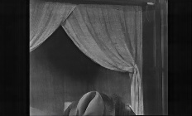










Input Frames
$$m_{t}^{\text{local}}$$
Local HF Mask
$$I_{t−1}^{\text{LQ}}$$
Geometric Mean + CNN
$$m_{t}^{wavelet}$$
Haar
DWT
LL
LH
$$I_{t}^{\text{LQ}}$$
max
HL
HH
$$m_{t}^{flicker}$$
$$I_{t+1}^{\text{LQ}}$$
Global Flicker Mask
Minimum Strategy + CNN
Phase 1: Wavelet Mask Pre-computation
$$I_{t}^{\text{HQ}}$$
$$r_{t}^{spatial}$$
PixelWise Mask Fusion
$$r_{t}^{fused}$$
Gated
Aggregation
Swin
Spatial
Flow
Warp
$$α_{t}⋅r_{t}^{\text{spatial}}+\left(1−α_{t}\right)⋅m_{t}^{\text{wavelet}}$$
Phase 2: Bidirectional Propagation with Fused Gating

