Slide 1
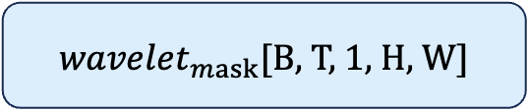
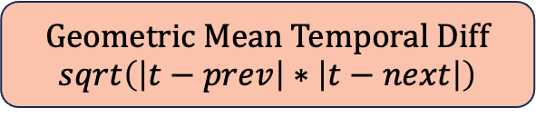


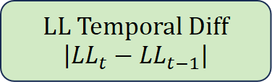

$L_{qs}$ [B, T, C, H, W]
HaarDWT2d
Haar Wavelet Decomposition
LL
LH
HL
HH
LL Temporal Diff
$$\left|LL_{t}−LL_{t−1}\right|$$
Geometric Mean Temporal Diff
$$sqrt\left(\left|t−prev\right|∗\left|t−next\right|\right)$$
Conv2d+Sigmoid
Conv2d+ReLU
$$m_{t}^{\text{flicker}}\left[B,T,1,H,W\right]$$
$m_{t}^{ \text{local}}$ $\left[B,T,1,H,W\right]$
max
$wavelet_{mask}$[B, T, 1, H, W]

