Slide 1
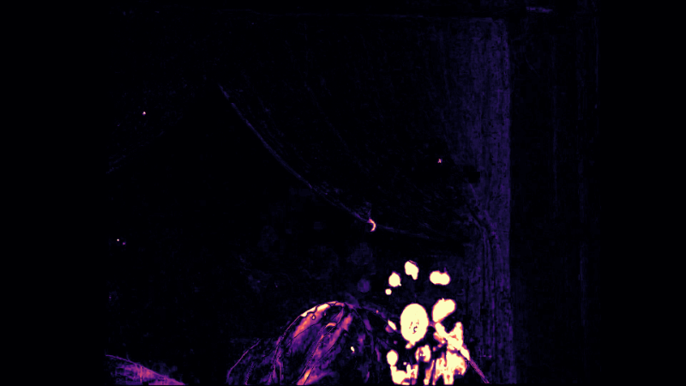
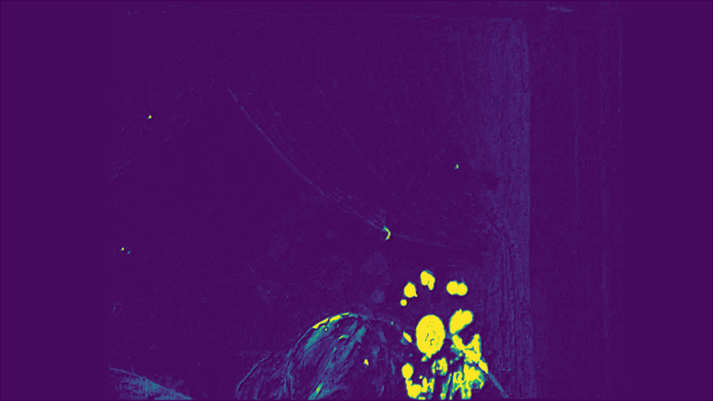
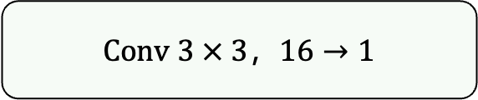

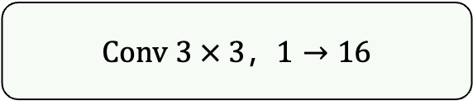



$$ΔLL_{t}^{min}$$
$$B×1×H/2×W/2$$
Conv 3 $×$ 3，$1→16$
LeakyReLU, slope=0.1
Conv 3 $×$ 3，$16→1$
Sigmoid
$${\tilde{m}}_{\text{t}}^{flicker}$$
$$B×1×H/2×W/2$$

