Slide 1
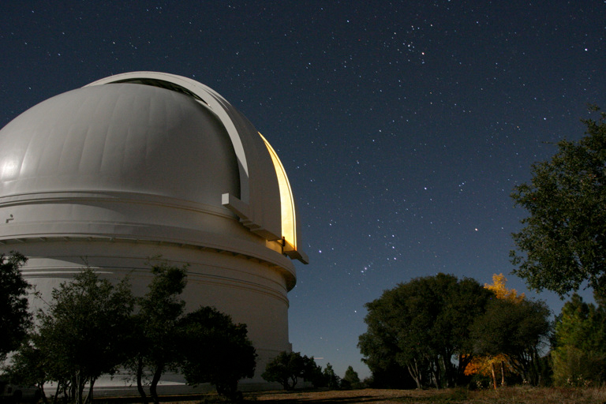
Chimera
Photometry
(Positioning)‏
By:
Scott Doherty
Jeremy Heiler
Jeremy Lombardo
Chintan Modha
Ray Pauldine

Slide 2
Chimera
“Chimera is a package to control astronomical observatories aiming the creation of remote and even autonomous observatories with just a few clicks. Using Chimera you can easily control telescopes, CCD cameras, focusers and domes in a very integrated way.”

Slide 3
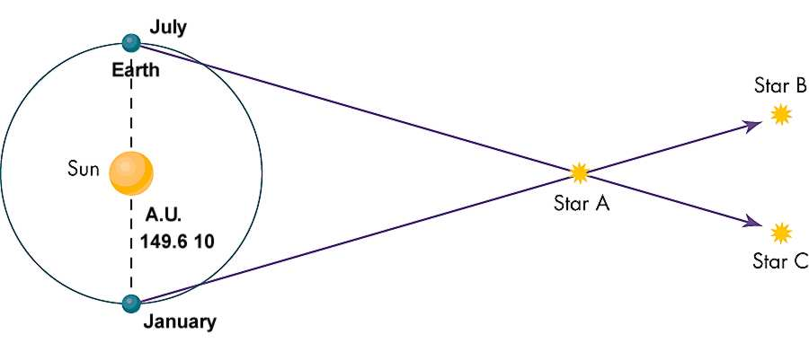
Astrometry
Astrometry is the precise measurements and explanations of the positions and movements of stars and other celestial bodies.
Stellar Parallax

Slide 4
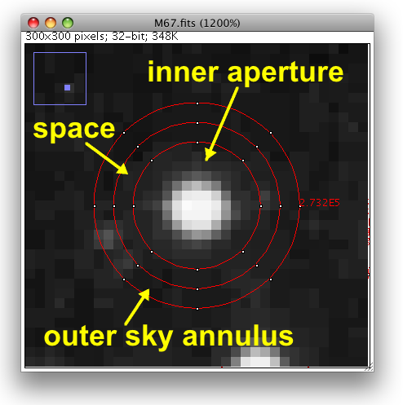
Aperture Photometry
Photometry is a technique of astronomy concerned with measuring a star's flux.
Flux is the intensity of an astronomical object's electromagnetic radiation. This is measured by counting the pixels within a circle centered on the object.

Slide 5
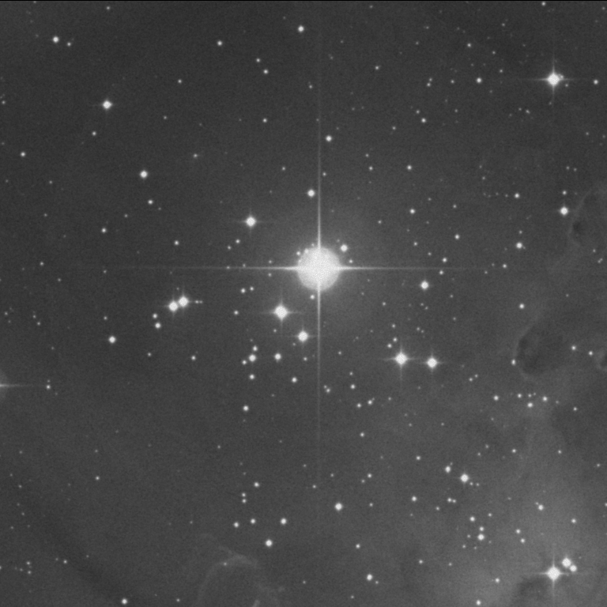
Setting the stage...
Imagine you're an astronomer taking pictures of the night sky.
What could be wrong with your photo?
  Camera is out of focus
  An astronomical seeing issue
  Your photo does not contain the stars you intended to photograph

Slide 6
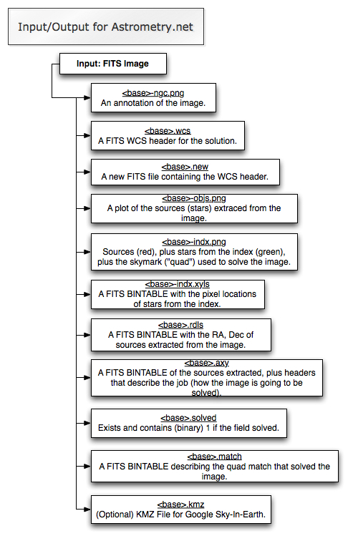
Astrometry.net
Used to determine what celestial bodies appear in photos of the sky.
The program examines the aperture photometry of the photo and produces the output files show on the right.
FITS file (Flexible Input Transport System) contains meta data inserted by astrometry.net as well as the image itself.

Slide 7
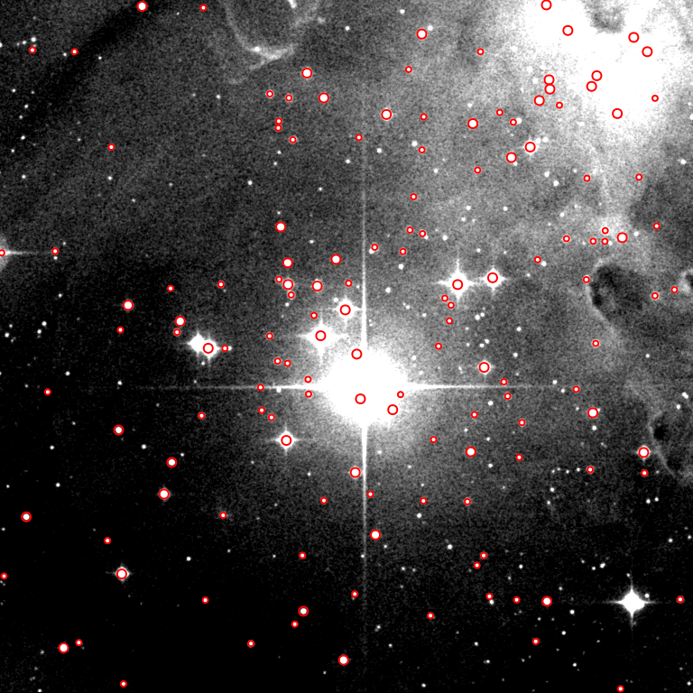
Astrometry.net
First, astrometry.net attempts to identify the objects in the image and circles them in red.

Slide 8
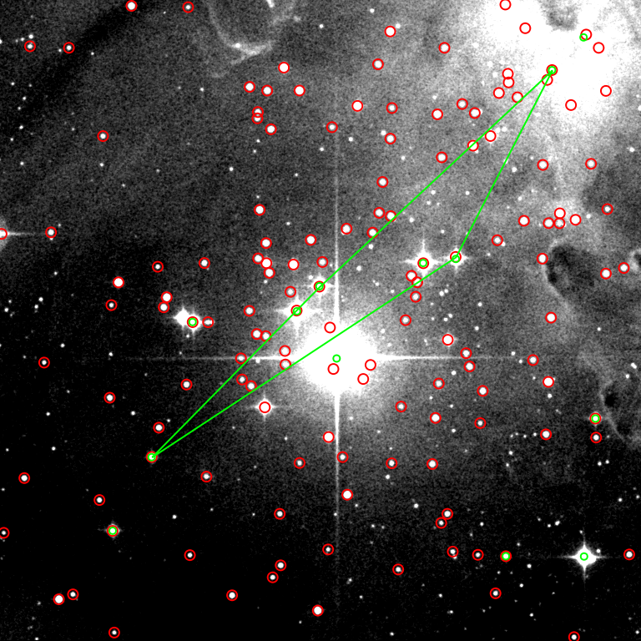
Astrometry.net
Next, it attempts to locate the brightest starts in the image and circles them in green.
From there, outlines a “quad” labeled ABCD. That is, with A and B being the two furthest separated from each other. The positions of stars C and D are used to compute the quad.
The quad is then compared with other known quads, searching for matches

Slide 9
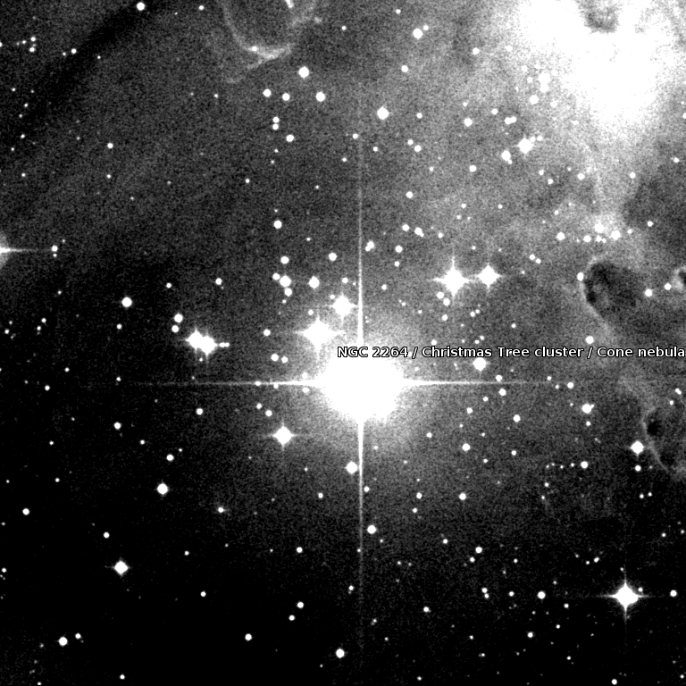
Astrometry.net
Field Center:
RA = 100.2 degrees (86:40:60)‏
Dec = 9.883 degrees (+9:52:59.1)‏
Field Size:
12.8772 x 12.847 arcminutes
Your Field Contains:
NGC 2264
Christmas Tree cluster
Cone nebula

Slide 10
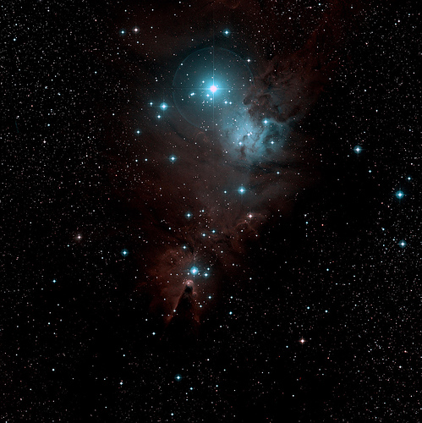
Astrometry.net
Field Center:
RA = 100.25 (06:41:00)‏
DEC = 9.6056 (+9:36:20)‏
Field Size:
59.73 x 59.85 arcminutes
Your Field Contains:
NGC 2264
Christmas Tree cluster
Cone nebula
Source:
http://www.flickr.com/photos/jimkster/832582282/

Slide 11
Astrometry.net & Flickr
http://www.flickr.com/photos/serac/3017131572/in/pool-astrometry

Slide 12
Sources
http://en.wikipedia.org/wiki/Photometry
http://en.wikipedia.org/wiki/Astrometry
http://astrometry.net/
http://www.astro.umd.edu/resources/introastro/parallax.html
http://www.uni-sw.gwdg.de/~hessman/ImageJ/Book/Measuring%20Brightness/index.html

